Slide 1

REA Member Forums Meeting
5th November 2019
A warm welcome to REA members working in the solar, energy storage, electric vehicles, large scale power markets and finance areas.
REA Restricted:
This contains information that is confidential to the REA and its members and should be not be shared without permission

Slide 2
Guest Speaker
Opportunities in Community Energy
Hannah Short, Community Energy London
REA Restricted:
This contains information that is confidential to the REA and its members and should be not be shared without permission

Slide 3

Community Energy & Solar
Hannah Short
Community Energy London Officer
hannah@communityenergy.london

Slide 4
What is community energy?
Notes:
Puts people at the heart of the energy system, we do this by working with local people to install solar panels on their community buildings, like schools, housing estates, etc . Or it could be running energy efficiency workshops, and targeting fuel poor households, to more innovative projects → supplying electricity to residents, battery storage etc..
Key principles:
Community ownershp
Community control
Community benefit
Community energy refers to the delivery of community led renewable energy, energy demand reduction and energy supply projects, whether wholly owned and/or controlled by communities or through partnership with commercial or public sector partners.

Slide 5
Key components:
Community group
Site
Project type
Funding
Notes:
All sorts of diff communities: Universities, place of worship, etc.
Many different sites
Project: produce renewable energy, perform energy efficiency, operate distribution networks, perform retrofit work, lead behaviour change, engage in energy sharing, and provide electric carsharing
Funding: - feasibility and capital costs, often through funds and community share offers

Slide 6
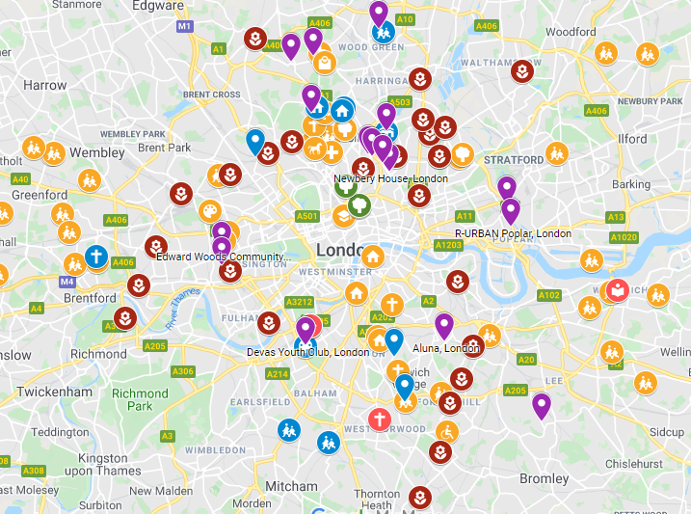
In London:
30 active groups setting up projects
Across England:
210+ active groups
Community Energy England & Hub

Slide 7
What is Community Energy London?
Network of around 30 community energy groups
Monthly open meetings with practitioners
Share knowledge, experiences, and skills
Advocate on behalf of community energy
Help secure funding for the sector

Slide 8
What are the benefits of community energy?
PEOPLE!
Notes:
Renewable decentralised energy system
Guided by the local community
Community funds
Democratic
Decentralised energy system
Engenders more agency and trust
Enables change
Encourages more participation
So we can take more of the community with us
We help drive behaviour change, and reaches out to people

Slide 9
What are the benefits of community energy?
Claire Perry: ‘From power stations to solar panels, the future is local’
An opinion piece from the Energy Minister, Jan 2019
‘But the UK’s success in deploying low carbon generation is just the start of the transformation of our energy system with community energy a key cornerstone of government’s ambition for transition to a low-carbon, smart energy system. I have been impressed with the community energy groups I have met across the UK who are working to ensure that communities take practical steps to take control of how they generate and use energy.’
Notes:
12-13x community benefit than a commercial installation
25% more effective at advocating and getting buy-in for the changes that we need to see e.g. energy audits, retrofitting, smart meters etc.
We can’t do this change without bringing everyone with us
Commercial solar installation → just having solar panels → just produces kilowatt hours, and benefits for shareholders
Community energy → Engagement with the community, networks with council, returns from investments going into the community, local training and engagement

Slide 10

What are the benefits of community energy?
-DECC report: Community Renewable Electricity Generation : Potential Sector Growth to 2020 Methodology, Detailed Assumptions and Summary of Results FINAL REPORT January 2014
Notes:
12-13x community benefit than a commercial installation
25% more effective at advocating and getting buy-in for the changes that we need to see e.g. energy audits, retrofitting, smart meters etc.
We can’t do this change without bringing everyone with us
Commercial solar installation → just having solar panels → just produces kilowatt hours, and benefits for shareholders
Community energy → Engagement with the community, networks with council, returns from investments going into the community, local training and engagement

Slide 11
What are the benefits to installers?
Reaches sites you can’t get to
Marketing from groups you partner with
Notes:
→ You’ve got the technology, we’ve got the people!
Accessing housing estates, universities, schools etc.
We’ll turn the Councils around better than you will
Community engagement → led by the locals
Can help identify sites
Can help secure funds
Customers in post-FIT market
We are part of the same story!
What do we want in return? Good partners!

Slide 12
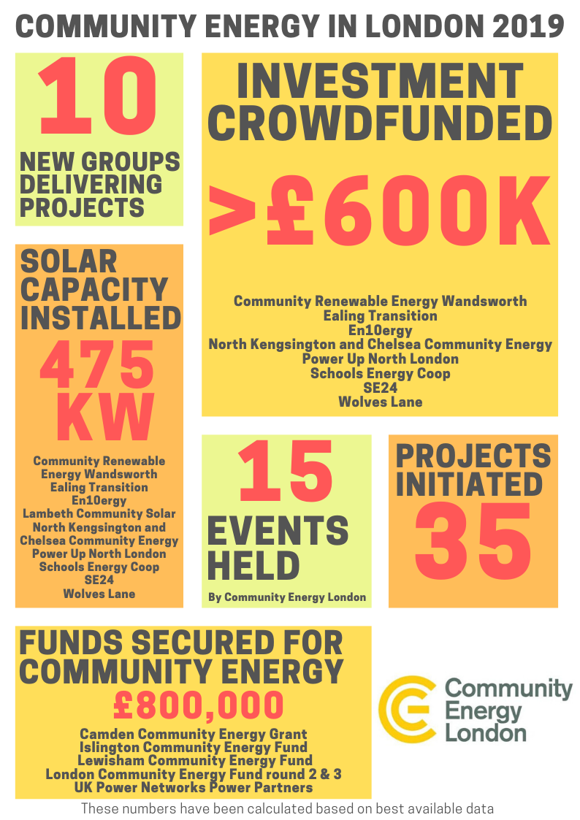

Slide 13
Notes:
Healthy sector!

Slide 14
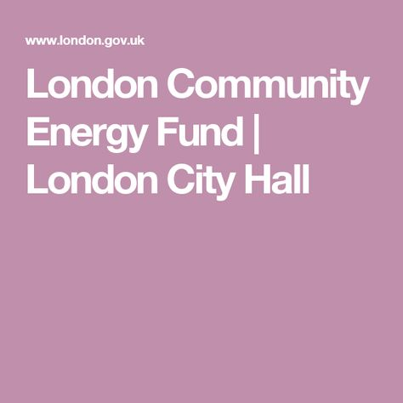



Funding for
community energy

Slide 15
What is the future of community energy
Post-FITs
Council community energy funds
…..Bright!
Notes:
Despite the cuts to FITs → CE still growing, and people are finding a way to make it happen
26/ 33 Councils have declared climate emergencies
We are hoping for more to be announced soon
We have active engagement with 10 Local Authorities by groups
We have big ambitions, it’s a growing sector

Slide 16
Please get in touch!
Hannah Short - Community Energy London Officer
hannah@communityenergy.london
www.communityenergy.london
FB: Community Energy London
Twitter: CommEnergyLDN
Community Energy London is currently seeking funding for its core activities. If you are interested in supporting CEL please get in touch.

