Slide 1
REA Bioenergy Members Forum
Wednesday 19th February 2019
Kindly hosted by MHA MacIntyre Hudson

Slide 2
Welcome from
MHA MacIntyre Hudson
Rachel Nutt,
Head of Renewable & Sustainable Energy

Slide 3
Bioenergy’s Role in Decarbonising Heat

Slide 4
Setting the Context
Policy Context
Heat Decarbonisation Roadmap Required to be published in 2020
Number of consultations expected to come out soon concerning reform to the RHI, what will come after the RHI and building Standards.
Initial announcements maybe included in upcoming Budget (confirmed 11th March)
New Secretary of State
COP 26 in November
REA Context
Trailing New Sector Day Format – theme focused
Want to be able to foster more unified messaging across sectors to ensure Bioenergy’s role in heat decarbonisation is recognised
Identifying positive messages about the whole industry to magnify its importance.
Encourage cross sector learning and discussion

Slide 5
REA’s Current Messages Around Heat
Time Limited Extension to the RHI
A new mechanism needed to support heat decarbonisation past 2021 (E.g. Heat-feed in premium scheme)
Take opportunity to reform Agricultural Support to promote bioenergy use and domestic bioenergy feedstock cultivation
Government Backed Low interest loans for heating
Effective Taxation system that slowly penalises dirtiest fossil heating fuels
Introduce Green Gas Obligation to meet a GHG reduction target
Amend Energy Saving Opportunity to focus on carbon emission reductions, not just power
Recognise all forms of renewable heating in Future Homes Standard
Variable Tax benefits for those with high energy efficiency standards (Council Tax, Business Rates, Stamp Duty)
Address Barriers to Heat network deployment

Slide 6
How the Session Will Run
Running Order
Update from BEIS - Tunde Ojetola, BEIS
Series of short presentations from different bioenergy heat technologies:
Biomass Heat - Alasdair Peppe, Dunster Energy
Biogas - William Mezzullo, Foresight Group
BioLPG - Andy Parker , Calor Gas
- Bioenergy Potential in Domestic Off Gas Grid Properties – Ian Waller, In Perpetuum
The above presentations are meant to foster debate and raise questions. They do not represent REA positions, but messages within the bioenergy heat sphere. This is therefore about informing the REA’s way forward.
Networking Break (15 min)
Discussions Forum around challenges and key messages

Slide 7
Questions for Consideration - Heat
How does the REA create a positive massage to ensure bioenergy’s role in heat decarbonisation is recognised?
How do we ensure the lessons learnt from the RHI are carried through to new heat policy?
What messaging does the sector need to focus on around feedstock availability and sustainability?
What other market barriers do we need to be focusing on – either sector specific or relevant across the whole Bioenergy Heat Sector?

Slide 8
Update from BEIS
Tunde Ojetola, BEIS

Slide 9
Biomass Heat
Alasdair Peppe, Dunster Energy

Slide 10


Solid Biomass Heat Potential
Alasdair Peppe, Dunster Energy
Notes:
Keep to under 10 mins!

Slide 11
Biomass Heat Deployment – Non Domestic RHI
Biomass Heat has been the largest recipient of the ND RHI to date and accounts for 66% of renewable heat so far generated by the scheme.
Source: BEIS
Notes:
Solid biomass heat is by far the largest beneficiary of the non-domestic RHI accounting for 66% of all heat generated under the scheme
Currently, it accounts for 4-5% of UK heat use – a poor comparison to the remainder of the EU where solid biomass delivers around 15% of all heat requirements.
Key take away from this – solid biomass heat generation is a technology available right now to help de-carbonise the UK and it is a technology that is under-represented in the UK.

Slide 12
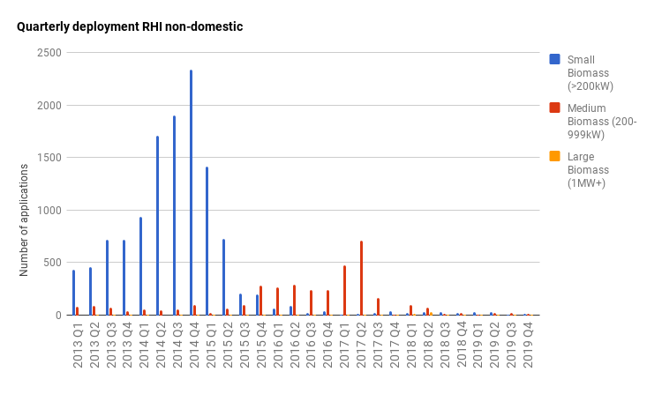
Deployment of Biomass has Stalled under the ND RHI
Biomass heat deployment slowed following RHI degression and policy uncertainty, reducing the levels of heat decarbonisation that could have been achieved to date.
Notes:
Anyone involved in the solid biomass industry will be more than aware of this – RHI support dropped away and a thriving industry is withering on the vine.
We are where we are but, this gives a very strong indication of the level of support required, in the absence of other changes, to drive solid biomass heat installations. In my view, if support is in the form of an RHI type mechanism, then at a rate of around 4-5p/kWh.

Slide 13
Potential Growth of Biomass Heat – REA Bioenergy Strategy
Sustainable level of deployment at around 700 MW/year would allow for market and supply chain development (as achieved during the RHI).
If installation rates grew to this level by 2025 and then continued at that level until 2032, the additional contribution to energy supply would grow from the current level of around 24 TWh (85 PJ/year) to over 42 TWh (150 PJ/year) by 2032.
Feedstock demand demonstrated to be met by increases in domestic feedstock availability, as modelled by BEIS to 2030, and continued feedstock import.
Notes:
The REA Bioenergy strategy published last year goes into the potential for expanding solid biomass heat generation in great detail.
It found that the installation and fuel supply industry could scale up fairly easily to a level where the UK was adding around 700MW of solid biomass heat generation capacity each year. Scaling up would take around 5 years and then this could easily be sustained to 2032 at which point it recommended that priorities be re-examined to determine if further solid biomass heat installations were the best use of the resource in the light of potential new technologies coming on line.
If this were to happen, solid biomass heat would account for around 11% of UK heat requirements

Slide 14
Key Benefits to Biomass Heat
Direct conversion to heat is most efficient use of biomass
Available now – including further reduced emissions
One of the lowest cost options for renewable heating
Suitable for existing, hard to heat, buildings
Reduces extra requirements on electricity infrastructure
Development of local supply chains, which are well adapted to the dispersed nature of UK forest resources, can help stimulate improved forest management and afforestation, including some new planting on unprofitable agricultural land
Key Technology for powering new Heat Networks and district heating systems.
Notes:
The bioenergy strategy identified a number of benefits of using solid biomass to generate heat:
It is by far the most efficient way to use the energy embodied within biomass – conversion efficiencies of around 90% are common compared to best case of 40% to turn it into electricity (before losses in the grid and conversion back to something actually useful!), or 50% to turn it into methane.
As already said – it is available right now, it is one of the lowest cost options available (as demonstrated in real world testing through the non-domestic RHI), it is suitable for existing, hard to heat, buildings and processes….. Most of which will still exist and still need to be heated in 2050 when we should have got to Net Zero
It takes load off the electricity grid by removing the need for electricity for heating. It is also easily stored until needed.
It has the potential to unlock major additional benefits for the UK environment and economy.
Linked to points above – it is a key technology for the proposed expansion of heat netwroks

Slide 15
What's Required?
Clear indication of post 2021 policy support in order to facilitate continued deployment
Time limited extension to the RHI in order to allow time for transition to new heat policy and given expected underspend under the RHI.
Longer term policy that creates a level playing field for renewable heat systems competing with fossil fuel alternatives
Supportive tax policies and building regulations that encourage installations of renewable heat systems
Recognition of the role that Biomass heat has to play in heat decarbonisation, especially in off gas grid areas and situations requiring high heat loads.

Slide 16

Case Study – Beaulieu National Motor Museum – Providing Efficient Heat across a Commercial Complex
National Beaulieu Motor Museum replaced their 600 kW oil boiler for a 400 kW woodchip biomass boiler in 2015.
The system provides water and space heating across the museum complex, including museum, the vehicle collection, restaurant, learning centre and main administrative offices.
Provides 90% of complexes heat demand throughout winter.
Design includes building management system combined with energy efficient distribution pumps – allowing for efficient heating that uses less heat and fuel.
The switch from oil to biomass provides savings on heating bills, while support through the ND RHI has helped improve the return on capital expenditure.
Estimated annual saving of 385 tonnes of CO2 equivalent per annum.

Slide 17
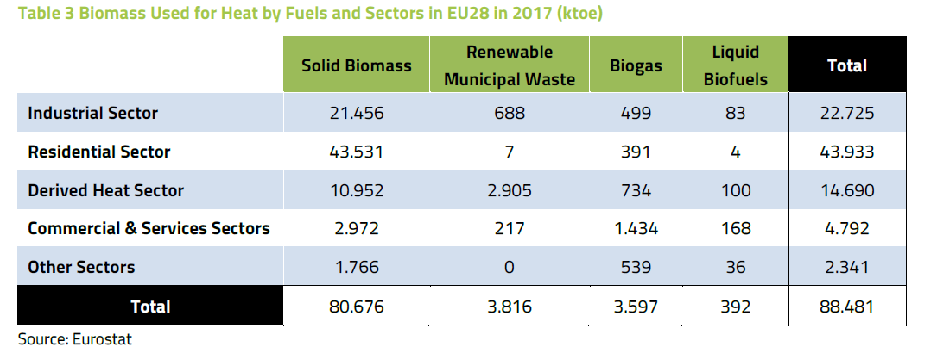
European example Demonstrates that Biomass Heat has a significant role to play in Heat decarbonisation
Bioenergy Europe 2019 Statistics indicate that Bioheat (including all bioenergy heat applications) accounts for 16.9% of all generated heating and cooling in 2017 across EU28.
Solid Biomass Accounted for 91% of bioheat production across Europe – making it the largest contributor to heat decarbonisation.
Especially effective within European markets with well established heat Network Sectors and accessibility to feedstocks.

Slide 18
Biogas
William Mezzullo, Foresight Group

Slide 19

William Mezzullo – Foresight Group REA Biogas Chair
Potential for Biogas to Decarbonise Heat

Slide 20
How much gas has the UK been using?
2011
2018
Final natural gas consumption over the past >20 years reduced by just under 30%

Slide 21
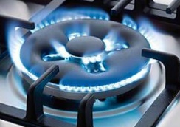

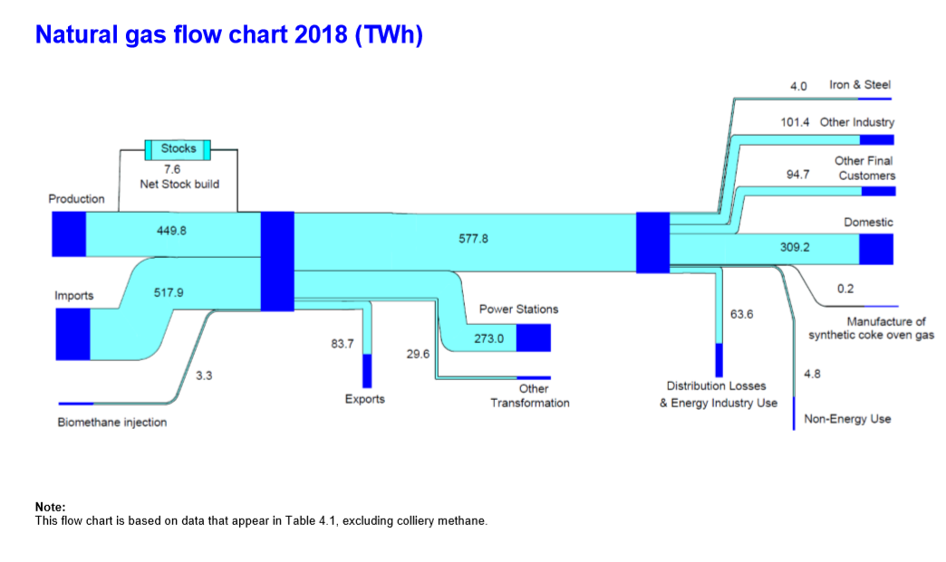
How much gas does the UK use for domestic purposes?
36% of gas used in the UK used for domestic heating and cooking

Slide 22
Biomethane development
 | No plants | Volumes of biomethane that are capable of injecting (m³/annum) | Volumes of biomethane capable of injecting (TWh/annum)
Biomethane projects commissioned under RHI by Dec 2019 (BEIS, Dec 2018, RHI deployment data) | 97 | 424,860,000* | 4.38*
Biomethane projects in the pipeline - applied for a TG (BEIS, Dec 2019, RHI deployment data) | 42 | 175,200,000* | 1.89*
Total | 139 | ~ 600,000,000 | 6.27
*Estimate based on average biomethane flow rate of 500 m³/hour (Tier 1 RHI). 1 m³ CH₄ = 10.3 KWh
Notes:
By end of RHI, around
By end of 2020 > 6 TWh/annum of biomethane injected into the grid

Slide 23
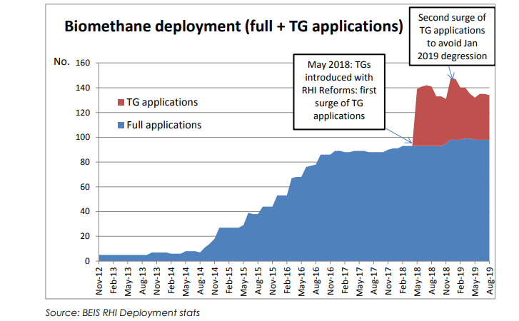
RHI deployment for biomethane

Slide 24
RHI tariffs and deployment for biogas heat

Slide 25
How to maximise the benefit of biogas for decarbonising UK heat demand?
Increased deployment of biogas for the decarbonising hard to reach sectors such as domestic heating and transport.
Continue to support the existing infrastructure to ensure long-term carbon savings.
Greater drive for energy efficiency to ensure renewables can offer the most significant benefit.
Recognising the actual carbon benefit of biogas for decarbonisation purposes.

Slide 26
Biomethane projections
Recent estimates on the potential for biomethane by 2026, 2032 and 2050
Source | By 2026 (TWh/annum) |  | By 2032 (TWh/annum) |  | By 2050 (TWh/annum)
 | Heat | Transport | Heat | Transport | Heat | Transport | Power
REA's Bioenergy Strategy, 2019* | 19 | 12 | 31 | 24 | - | - | -
ENA’s Decarbonisation Pathways (Balanced scenario), 2019 | NA | NA | NA | NA | 60 + 4 (Buildings + industry) | 109 | 20
Totals | 31 (all from AD) |  | 55 (2.8 TWh from gasification, the remainder from AD) |  | 193 (121 TWh from gasification, 57 TWh from AD and 15 TWh from Power-to-Gas)
Notes:
One plant = 500 m3/hour = ~ 0.045 TWh/annum.
~ 50 - 57 TWh/annum equivalent to between 1,100 and 1,300 AD plants

Slide 27
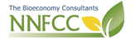
Current Feedstock demand (tpa)
 | Slurries/ manures | Food wastes | Crops | Crop waste | Other wastes*
Operational sites | 1,966,000 | 3,840,000 | 3,847,000 | 460,000 | 2,365,000
Sites in development** | 1,500,000 | 2,466,000 | 1,980,000 | 305,000 | 1,611,000
All sites | 3,466,000 | 6,306,000 | 5,827,000 | 765,000 | 3,976,000
 | Liquid and solid manures produced and applied annually to agricultural land (Defra/ADAS) | Food wastes generated every year (WRAP, 2020)***
 | 90,000,000 | 9,500,000
*E.g. industrial waste, processing residues
** Less than 50% expected to complete, so < 4 Mt total demand for food wastes from AD plants in operation and development
*** Excludes food waste from primary production and surplus
Notes:
Comments:
Because NNFCC anticipates < 50% of plants in developed will complete, total demand for food waste from AD plants in operation and in development is around 4 Mt.
WRAP data Jan 2020 estimates:
9.5 Mt food waste arising from households, retail, food and drink manufacture and hospitality (70% of which is edible, 30% inedible). Excluding pre farm gate wastes (ie food waste from primary production and food surplus). 6.6 Mt of these are from households.
A minimum of 1.9 Mt out of the 9.5 Mt (20%) is sent for composting /AD (only 0.78 Mt of which is separately collected from LAs, the rest is home composted)
A minimum of 3.2 Mt is landfilled (34%)
The rest is either sent for thermal recovery or landspreading (> 4.4 Mt)
From this data it looks like a very limited amount is going to AD at the moment (say 0.78 Mt) and there is a 3.2 Mt currently landfilled that should be diverted to AD/composting. Also, some of the tonnages that are currently going to incineration within a residual waste bins will probably be diverted to AD/composting once separate collections kick in. This is another > 4.4 Mt. In addition there are all the food waste from primary production that are not counted for here. However, waste prevention policies will also mean that food waste arising go down over time.
Current facilities in operation and under development have spare capacity and could absorb up to 4 Mt of food wastes, so I think there are still going to be a few million tonnes to be processed through AD once separate collections are mandated.

Slide 28
Decarbonisation target vs Energy Target?
Biogas has the ability to drive considerable carbon savings, further than any other non bioenergy technology.
Committee on Climate Change highlighted ‘Carbon Capture is a necessity, not an option’.
When Carbon Capture, Usage and Storage (CCUS) is paired to bioenergy technologies it can drive considerable carbon savings.
The REA is pushing for Government to support Bioenergy Carbon Capture and Storage (BECCS).

Slide 29
What is biogas’ decarbonisation potential?
RED II has published ‘typical’ GHG emissions from different types of AD. The Sustainability Criteria we use today is broadly formed around RED I.
Including GHG abatement savings of carbon capture storage and usage (REA data sourced from members, 2019):
Typical GHG emissions and savings – mid-case scenario for biomethane with CCUS (REA, 2019 and RED II Annex VI)
 | g CO₂/MJ | gCO₂/kWh | GHG saving (%)
100% manure biomethane | -134 | -482 | 267
100% maize biomethane | -5 | -17 | 106
100% biowaste biomethane | -21 | -75 | 126
Manure 80% - Maize 20% | -47 | -169 | 159
Manure 70% - Maize 30% | -33 | -118 | 141
Manure 60% - Maize 40% | -24 | -86 | 130

Slide 30
Thank You
William Mezzullo
REA Biogas Chair (The Foresight Group)
WMezzullo@ForesightGroup.eu
Kiara Zennaro
REA’s Head of Biogas
kiara@r-e-a.net

Slide 31
Andy Parker
Andy Parker, Calor Gas

Slide 32
Bioenergy Potential in Domestic Off Gas Grid Properties
Ian Waller, InPerpetuum

Slide 33
Break

Slide 34
Heat Discussion

Slide 35
Questions for Consideration - Heat
How does the REA create a positive massage to ensure bioenergy’s role in heat decarbonisation is recognised?
How do we ensure the lessons learnt from the RHI are carried through to new heat policy?
What messaging does the sector need to focus on around feedstock availability and sustainability?
What other market barriers do we need to be focusing on – either sector specific or relevant across the whole bioenergy heat sector?

Slide 36
Questions 1
How does the REA create a positive massage to ensure bioenergy’s role in heat decarbonisation is recognised?
Where are the areas of overlap and divergence between the bioenergy technologies? How do we in our sector groups reconcile differences?
Government remains primarily focused on electrification and potential of hydrogen. How do promote the importance of Bioenergy within this agenda?
What further sectors can we draw in to make this case?

Slide 37
Questions 2
How do we ensure the lessons learnt from the RHI are carried through to new heat policy?
What lessons need to be highlighted?
What role does industry play in highlighting these lessons
What practical steps could the REA consider to ensure these lessons are leant?

Slide 38
Questions 3
What messaging does the sector need to focus on around feedstock availability and sustainability?
How do we combat claims that there isn't enough feedstock to grow the sector
How to demonstrate the pathway argument – that growing today’s sector develops supply chains etc.

Slide 39
Questions 4
What other market barriers do we need to be focusing on – either sector specific or relevant across the whole Bioenergy Heat Sector?

Slide 40
Thank you
Mark Sommerfeld
msommerfeld@r-e-a.net

Slide 41



Further Political Context
New Secretary of State , BEIS - Rt. Hon Alok Sharma MP
Previously SoS for International Development (Jul 2019 – Feb 2020)
Minister of State for Housing, Communities and Local Government (Jun 2017 – Jan 2018)
Also appointed COP 26 President
Minister Kwasi Kwarteng remains in place
New Secretary of State, DEFRA - Rt. Hon George Eustice MP
Previously minister for DEFRA and farming background.
Written an opinion piece in the Guardian last year stating that the UK couldn't ignore environmental standards in favour of watered-down trade deals with the US
New Chancellor of the Exchequer, Rt. Hon Rishi Sunak MP
Promoted from Minister in HM Treasury
Has had roles in DEFRA Select Committee and PPS to BEIS in 2017.
Dr. Nina Skorupska recently met with him to highlight REA Messaging – especially around Heat!

