Slide 1
REA Bioenergy Members Forum
Wednesday 19th February 2019
Kindly hosted by MHA MacIntyre Hudson

Slide 2
Bioenergy and the Bioeconomy
Opportunities for the Agriculture and Forestry Sectors

Slide 3
Setting the Context
Policy Context
Forestry and agriculture has risen up the political agenda
New Agriculture Bill and Environment Bill provides opportunity to see support for cultivation of domestic bioenergy feedstocks
Opportunity to build on CCC land use report that identified bioenergy having role in land decarbonisation
Opportunity to focus last years Bioenergy Strategy at DEFRA – placing bioenergy firmly in the bioeconomy.
Reshuffle
REA Context
Trailing new sector day format – theme focused
Want to be able to foster more unified messaging across sectors to ensure Bioenergy’s role is recognised
REA Looking to develop report by the middle of the year to emphasis Bioeconomy messaging. This is our first opportunity to seek members input.

Slide 4
Running Order
Structuring the REA Report and Review of Relevant Reports - Alexa Holgate and Mark Sommerfeld (REA)
Focus On Agriculture - Jonathan Scurlock, NFU
Focus On Forestry - Ian Tubby, Forestry Commission
Break
Bioeconomy Discussion

Slide 5
Structuring the REA Report and Review of Relevant Reports - Alexa Holgate and Mark Sommerfeld (REA)

Slide 6
Overview of Report Structure
Section I: Bioenergy in UK forestry and agriculture sectors – a look at the different technologies and their potential for decarbonisation, job creation, and a healthier environment
Bioenergy and its role in decarbonisation
“Land-Use: Policies for Net Zero” & “Growing the Bioeconomy”: Both the CCC and HM make a clear case for bioenergy in reaching 2050 net-zero goals
Bioenergy and its role in the agriculture and forestry sectors
Summary tables of different biotechnologies (AD, biofuels, biomass heat/CHP, biomass power, biomass CHP, gasification/pyrolysis, bio LPG) and their: -feedstocks -UK generation figures -UK installation figures -policy contexts (incl. separate box on RHI)

Slide 7
Overview of Report Structure
Section II: The carbon case - how bioenergy and its feedstocks can help decarbonisation and meeting 2050 net-zero goals
The work ahead – Paris Agreement and UK Climate Change Act
Carbon budgets – progress so far and estimated shortcomings
The importance of a broad energy mix in achieving carbon targets
Bioenergy – a carbon neutral power source
Reductions are not enough – BECCS and the importance of removing carbon from the atmosphere
Carbon saving opportunities from bioenergy in the agriculture and forestry sectors

Slide 8
Overview of Report Structure
Section III: The economic case: how bioenergy is good for the UK economy
More carbon-neutral energy means more economic growth without compromising on UK emissions goals
Bioenergy and “green jobs”
Economic figures and estimates relating to bioenergy in the forestry and agriculture sectors
Notes:
Subsections not yet completed, need input from members

Slide 9
Overview of Report Structure
Section IV: Policy recommendations and strategies needed to deliver
Barriers to growth in the industry
End of CAP and opportunities for the Agriculture Bill
Notes:
Subsections not yet completed, need input from members

Slide 10
Relevant Reports: Committee on Climate Change Land use: Policies for a Net Zero UK
Released in January 2020
CCC sets out an opportunity for British farmers to use bioenergy to increase their incomes and UK tree cover while cutting carbon emissions
States the importance of changes to land use in the UK in order to meet net-zero targets, including additional usage of bioenergy crops
“Our Further Ambition” scenario: planting 0.7 million hectares of miscanthus, SRC, and SRF by 2050 (approx. 23000 hectares per year).
“Speculative” scenario sees that rise to 1.2 million hectares by 2050
Current emissions in agriculture, land use and peatlands were 58 MtCo2e in 2017. With ambitious steps, emissions could be reduced 64% by 2050, delivering a net lifetime benefit of £80 billion to the UK
Steps required include increasing UK forestry cover 4% to both store carbon and use harvested wood for bioenergy feedstocks and CCS
Bioenergy crops: expanding the growth of bioenergy crops by 23,000 hectares each year to deliver an additional 2 MtCO2e emissions savings in the land sector and 11 MtCO2e emissions savings from harvested biomass

Slide 11
Relevant Reports: HM Government Growing the Bioeconomy: a National Strategy to 2030
The government wishes to become a bioeconomy world leader, recognising that this would result in more high-value and high-skilled jobs, a more productive agricultural system, healthier and more sustainable foods, and an overall cleaner environment.
Important factor for the bioeconomy is bioenergy.: the report makes frequent reference to bioenergy and the increased need of sustainable feedstocks including those from waste and effective biorefineries
Bioeconomy in 2014 contributed £220 billion and 5.2 million jobs to the wider UK economy
The provision of bio-based feedstocks as well as other required inputs such as machinery, power and financial services represent what the ‘transformative bioeconomy’ demands as inputs from other industries, and are estimated to be worth almost £36bn in value added to the UK economy
By 2030 the UK waste processing and materials recovery market is forecast to grow to £67 billion
Annual turnover of the UK industrial biotechnology and bioenergy sectors was £2.9 billion in 2014 and is forecasted to grow to £8.6 billion by 2035

Slide 12
Questions for Consideration - Bioeconomy
Do we have a good understanding of the current state of the domestic feedstocks sector?
What is the potential value of bioenergy to farming and forestry sectors?
How do we address the policy and other barriers to promoting bioenergy within the bioeconomy?
How do we fit this report in with the current policy trajectory?

Slide 13
Focus on Agriculture
Jonathan Scurlock, NFU

Slide 14
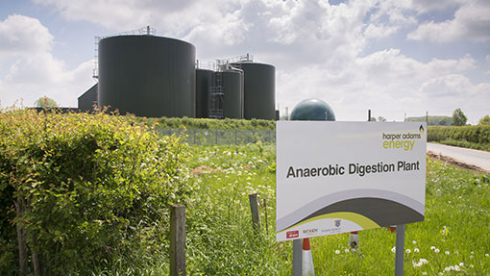
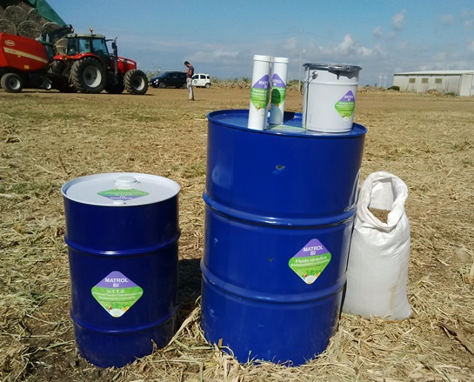
Achieving Net Zero: farming and the bioeconomy
Dr Jonathan Scurlock
Chief Adviser, Renewable Energy
and Climate Change
National Farmers’ Union of England and Wales
Novamont Matrol-Bi products

Slide 15

NFU ‘White Paper’
September 2019
The global challenge
Current UK inventory
Why agriculture is part of the solution
Our approach
Partnership working
Measurement and reporting
3
2
1

Slide 16


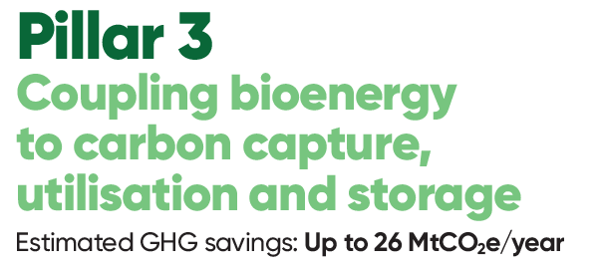
Wide variety of measures, from controlled release fertilisers and inhibitors to feed additives, advanced breeding, energy efficiency, on-farm AD
Enhanced hedgerows, increased tree planting, measures to boost soil organic matter
BECCS/BECCUS – notably farm-scale technologies and supply chains, plus bio-based materials, further displacement of fossil fuel emissions by renewables, and novel soil amendments

Slide 17
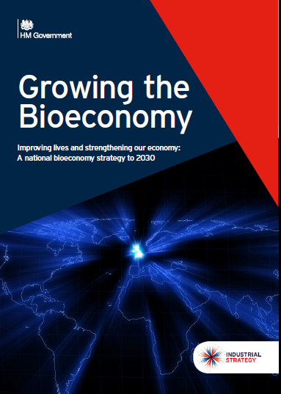
GHG removal through bio-based materials
Not a new subject – NFU has worked previously on EU Bioeconomy Strategy, Bioeconomy Manifesto, etc. – other initiatives include International BioFuture Platform, announced at COP23 in Bonn 2017
Bioeconomy includes all renewable biological resources (crops, forests, fish, animals, micro-organisms), i.e. primary agricultural biomass and energy crops (ABEC) plus forest and woodland resources, AND secondary co-products, residues and wastes from both food and non-food production
Key stakeholders:
paper+pulp/timber industry - timber/fibre based biorefinery, added value from CLT, gluelam, acetylated wood, potentially net energy positive and C negative
petrochemicals sector - carbohydrate biorefinery replacing fossil-fuel inputs (paint, lubricants, fine chemicals, carbon fibre, resins)

Slide 18
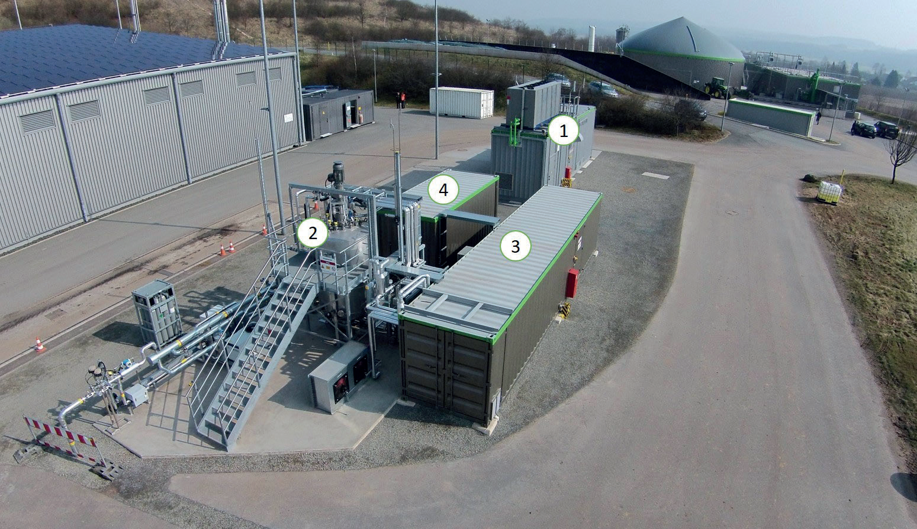
Synthetic fuels and materials: Power-to-Gas
Allendorf, Germany - Schmack + MicrobEnergy case study from IEA Task 37 (since 2016)
small 5m3 high-temp, pressurised bioreactor processing 30 m3/hour raw biogas, equivalent to about 72 kWe CHP
Audi – P2G plant at Werlte since 2014
Both German and UK aviation sector keen on synthetic fuels from CO2
adding value to CO₂
Solar PV power (or wind) → H₂ + CO₂ = CH₄
In coming years, bio-CO2 will be a feedstock for BECCUS, too valuable to vent to atmosphere
e.g. Econic CO2-based polyols for PU

Slide 19
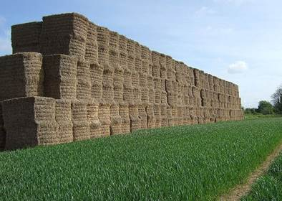
Take-home messages
A strong domestic bioenergy supply chain is needed to realise GHG removals through the bioeconomy, avoiding venting bio-CO2, etc.
Bio-based methane, ethanol/ethylene, isobutene, acrylonitrile (C-fibre); all likely to be important platform chemicals
Important distinction between environmental credentials of (1) short-life biodegradeable products, replacing single-use plastics; (2) long-lived bio-based products, creating GHG removal for decades
Dr Jonathan Scurlock
Chief Policy Adviser, Renewable Energy and Climate Change
National Farmers’ Union
Stoneleigh Park
Warwicks CV8 2TZ
jonathan.scurlock@nfu.org.uk

Slide 20
Focus on Forestry
Ian Tubby, Forestry Commission

Slide 21
Forestry and bioenergy
Ian Tubby
Forest Services

Slide 22

Forestry Health Check
Hardwood deliveries up?
Softwood deliveries up?
Employment up?
GVA steady?
Timber prices up?

Slide 23
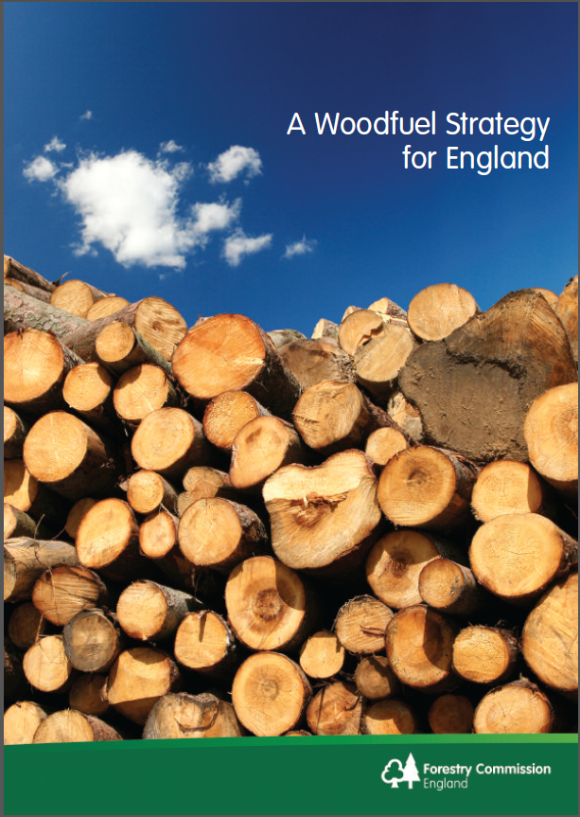
Remember this?
…bring an additional 2 million tonnes (Mt) to market, annually, by 2020…supported by other sources such as arboricultural arisings and recovered wood.

Slide 24
Timber deliveries in England

Slide 25
UK softwood deliveries (thousands of green tonnes)
Year | Sawmills | Woodbased panels | Woodfuel
2008 | 4,933 | 1,219 | 300
2009 | 5,133 | 1,135 | 650
2010 | 5,616 | 1,375 | 900
2011 | 5,859 | 1,417 | 900
2012 | 6,073 | 1,269 | 1,000
2013 | 6,407 | 1,263 | 1,250
2014 | 6,725 | 1,283 | 1,500
2015 | 6,168 | 1,334 | 1,600
2016 | 6,511 | 1,248 | 1,550
2017 | 6,581 | 1,059 | 1,600
2018 | 6,424 | 1,210 | 1,900

Slide 26
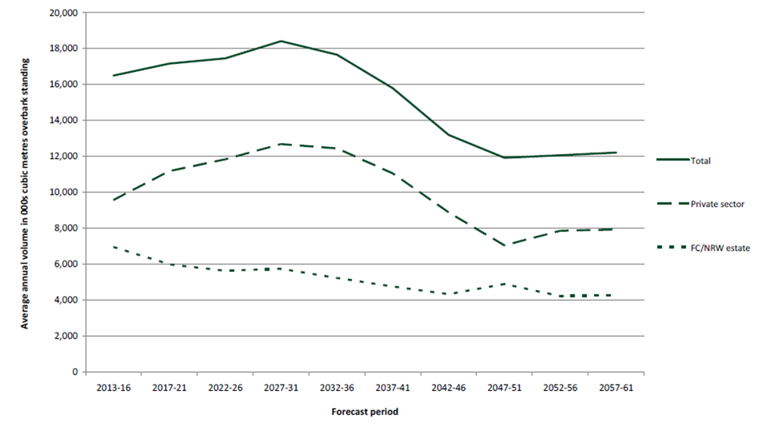
‘forecast available’ v ‘observed production’
2014 record harvest -13.6 million m³

Slide 27
Our challenge and opportunity
thousand cubic metres over bark standing
Annual average in the period | England
Total softwood
2013 - 2016 | 4,577
2017 - 2021 | 4,555
2022 - 2026 | 4,113
2027 - 2031 | 4,145
2017 softwood production in England 2,499 m³

Slide 28
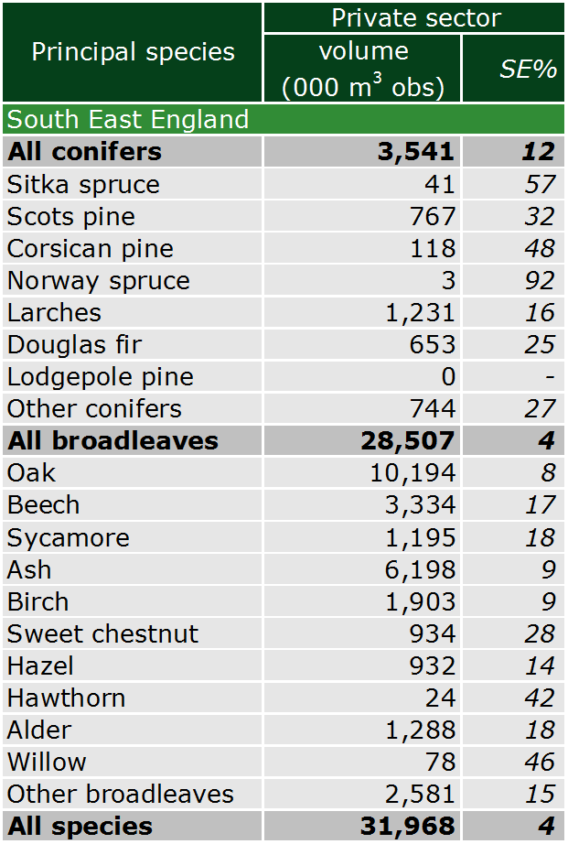
Timber beyond MMAI

Slide 29
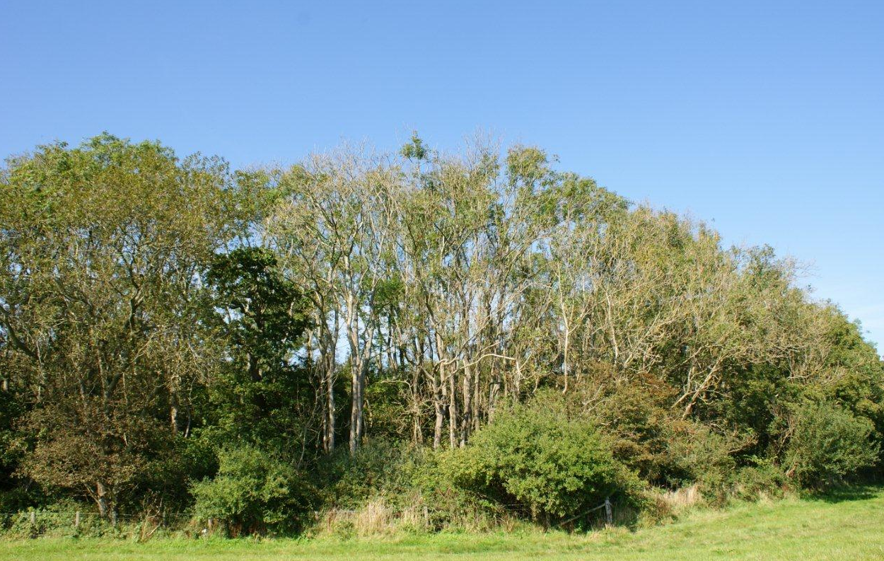
Threats to carbon stocks
Active management required to accommodate disease, protect and maintain ecosystem services (including carbon) and build resilience to climate change

Slide 30
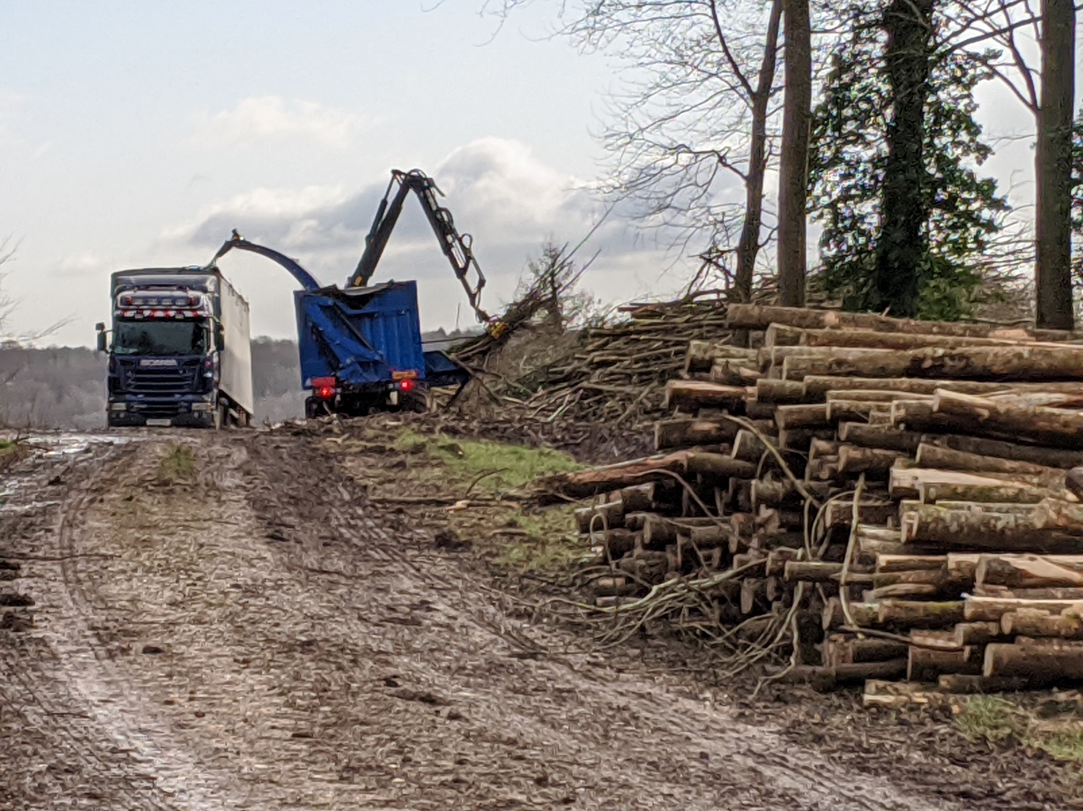
Tree diseases

Slide 31
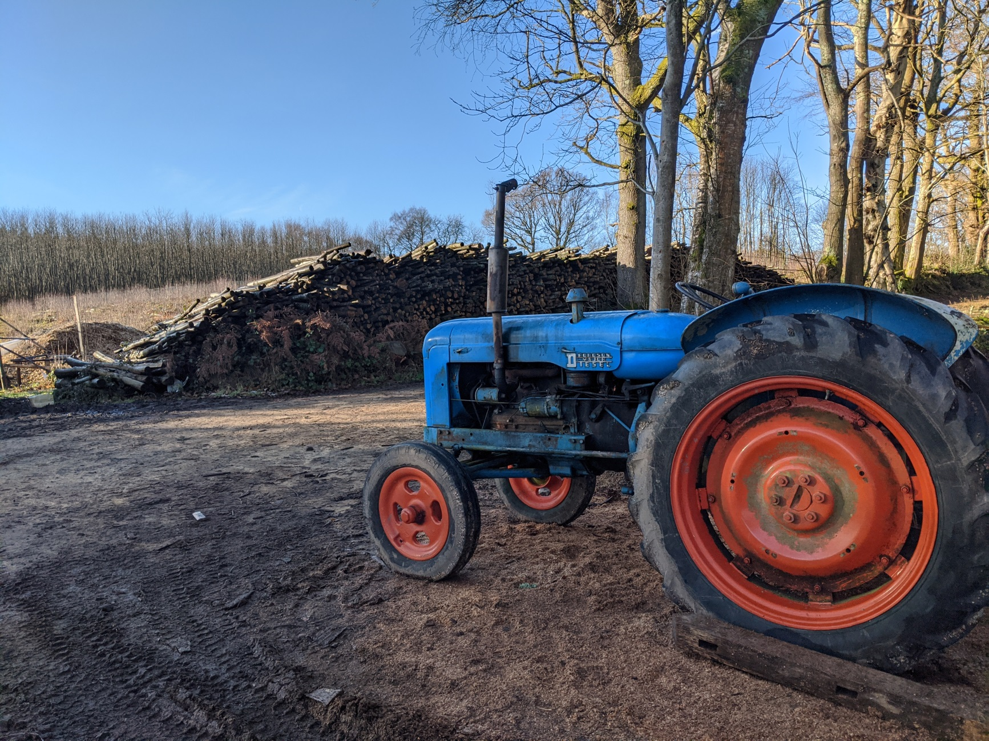
Productivity
70% of people think that ‘trees should not be felled in any circumstances, even if they are replaced’…..

Slide 32
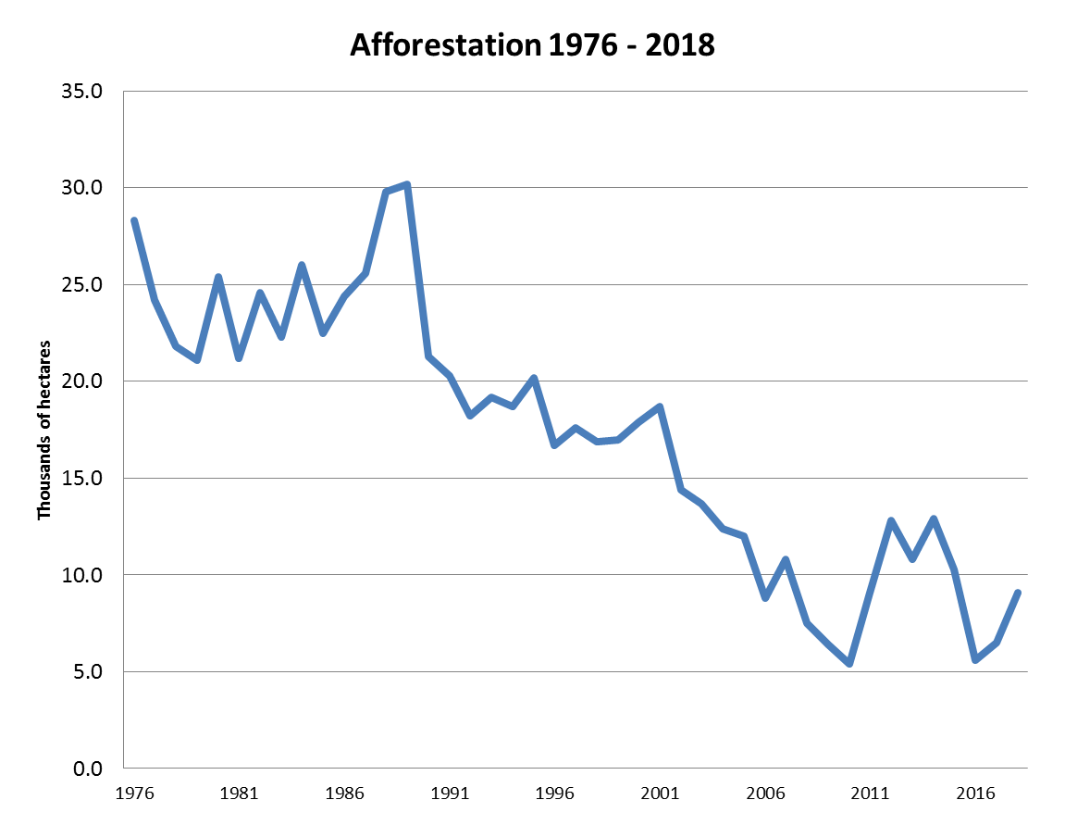

Slide 33
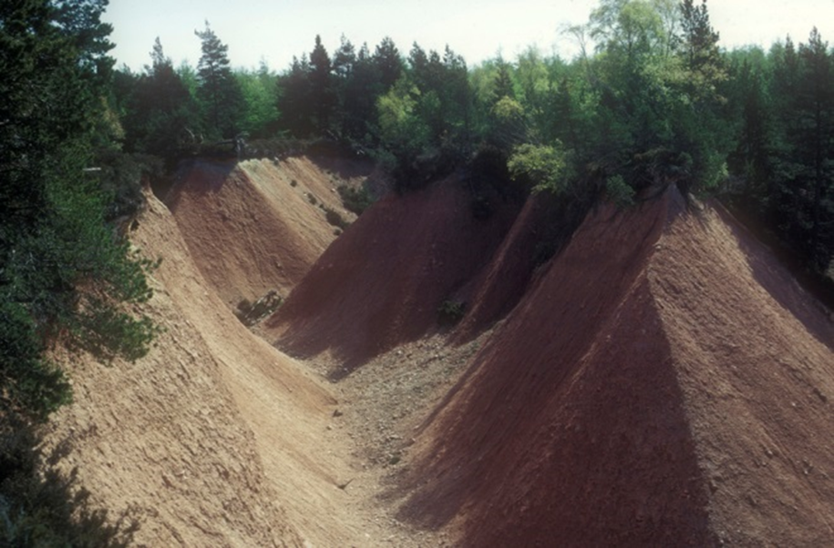
Pre UKFS woodland creation..

Slide 34
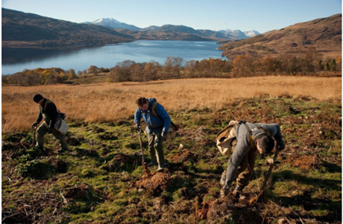
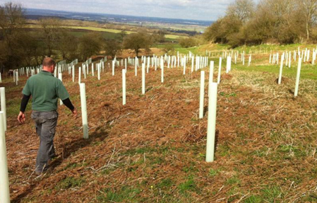
UKFS compliance
Breeding birds
Historic environment
Deep peat
Social impact
Water quality
Landscape/visual impact
Designated sites
Roading
Economic – high proportion of broadleaf and open space

Slide 35
ELM Goals
ELM Goals | Outcomes that might be bought by government
Clear Air | Reduced concentrations of particulates
Clean and plentiful water | Reduced concentrations of sediment Reduced concentrations of N+P Reduced concentrations of harmful chemicals
Thriving plants and wildlife | Enhanced status of native species Enhance quality, size and connectivity of habitats
Protection from and mitigation of environmental hazards | Enhanced resilience to flooding Enhanced resilience to wildfire Enhanced resilience to drought
Mitigation and adaptation to climate change | Increased sequestration of carbon Enhanced resilience of environment to climate change
Beauty heritage & engagement with the environment | Preserved and enhanced landscape character Preserved cultural heritage assets Enhanced access to the natural environment

Slide 36

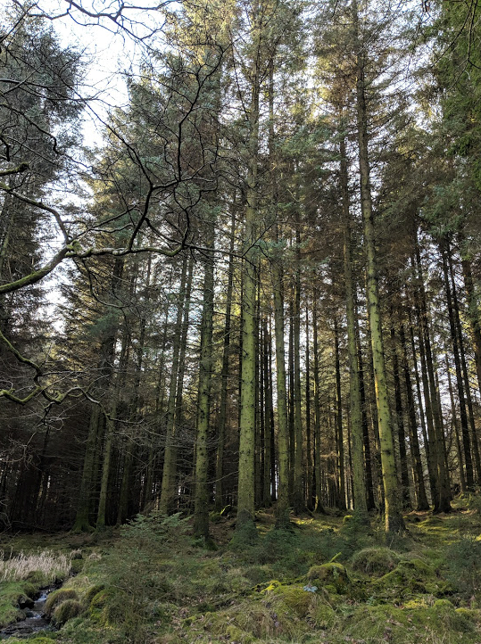
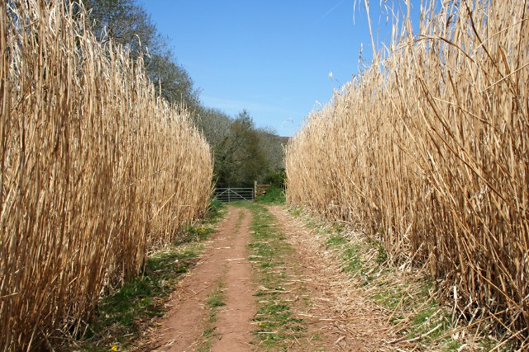
Perennial energy crops to forestry
Cash flow
Investment

Slide 37
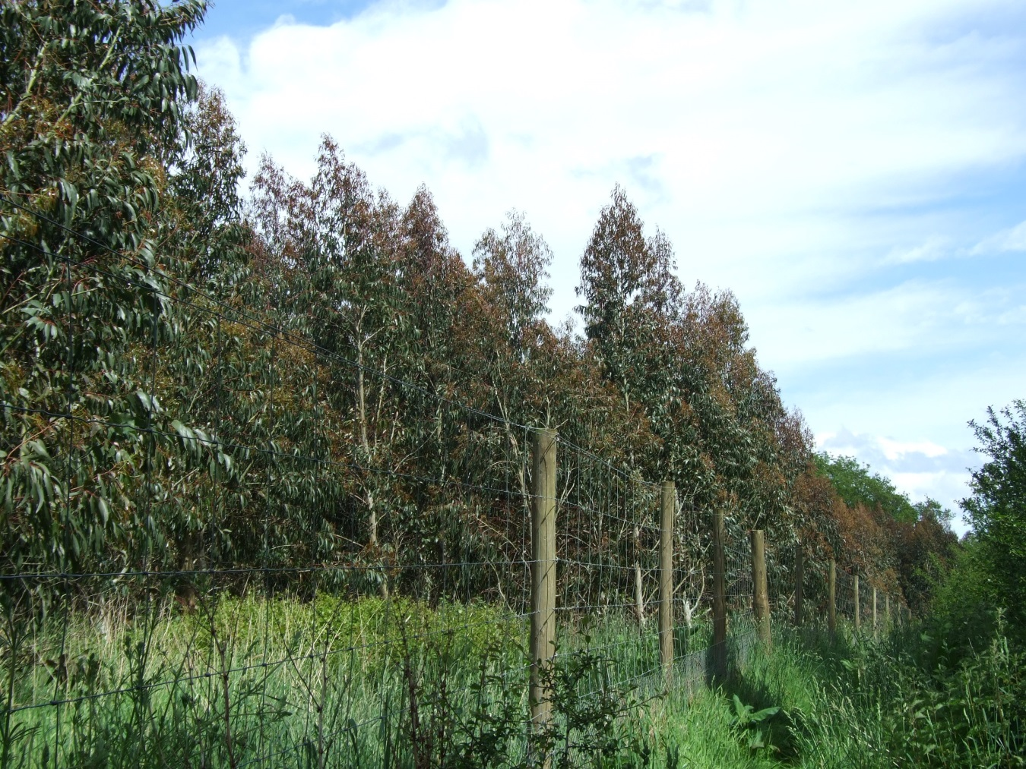
Eucalyptus 5 years old
Match silviculture to market – does everyone need to grow sawlogs?
Improved cash flow and return on investment
Regulations ready? How about permanence?

Slide 38
Break

Slide 39
Questions for Consideration - Bioeconomy
Do we have a good understanding of the current state of the domestic feedstocks sector?
What is the potential value of bioenergy to farming and forestry sectors?
How do we address the policy and other barriers to promoting bioenergy within the bioeconomy?
How do we fit this report in with the current policy trajectory?

Slide 40
Question 1
Do we have a good understanding of the current state of the domestic feedstocks sector?

Slide 41
Question 2
What is the potential Value of bioenergy to farming and forestry sectors?
What is the scope for more domestic supply? How is this divided between the forestry (present and future) and farming sectors?
Could domestic feedstocks supply the biomass power sector at industrial scale, or is it limited to heat and transport?
Do land managers recognise and understand this opportunity?

Slide 42
Question 3
How do we address the policy and other barriers to promoting bioenergy within the bioeconomy?
How is current public policy limiting the sector?
How might the CAP-to-ELMS shift release the sector’s potential?
What is needed to develop the infrastructure and skills base to enable domestic bioenergy at scale?
How should air quality issues be considered within this context?
How should feedstock sustainability be considered within this context?
Are the market signals strong enough to ensure landowners interest in bioenergy?

Slide 43
Question 4
How do we fit this report in with the current policy trajectory?
Is DEFRA considering bioenergy as part of its ELMS development? If not, how best should it approach this?
Is BEIS progressing the RHI sufficiently?
How should DEFRA best structure a bioenergy strategy focused on domestic feedstocks? What should be its desired outcomes?

Slide 44
Thank you
Mark Sommerfeld
msommerfeld@r-e-a.net

Slide 45

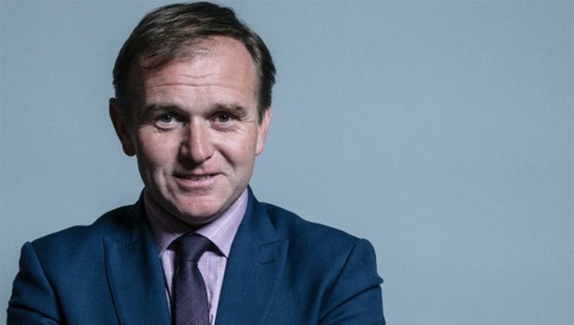

Further Political Context
New Secretary of State , BEIS - Rt. Hon Alok Sharma MP
Previously SoS for International Development (Jul 2019 – Feb 2020)
Minister of State for Housing, Communities and Local Government (Jun 2017 – Jan 2018)
Also appointed COP 26 President
Minister Kwasi Kwarteng remains in place
New Secretary of State, DEFRA - Rt. Hon George Eustice MP
Previously minister for DEFRA and farming background.
Written an opinion piece in the Guardian last year stating that the UK couldn't ignore environmental standards in favour of watered-down trade deals with the US
New Chancellor of the Exchequer, Rt. Hon Rishi Sunak MP
Promoted from Minister in HM Treasury
Has had roles in DEFRA Select Committee and PPS to BEIS in 2017.
Dr. Nina Skorupska recently met with him to highlight REA Messaging – especially around Heat!

