Slide 1


CCS & BCS TAC
12th June 2019

Slide 2
MINUTES & ACTIONS

Slide 3
SCHEME UPDATES

Slide 4
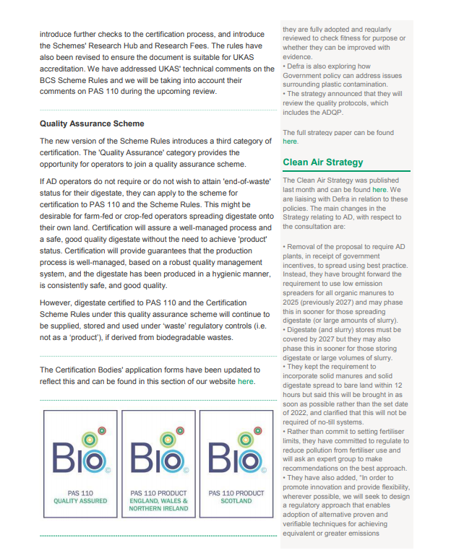
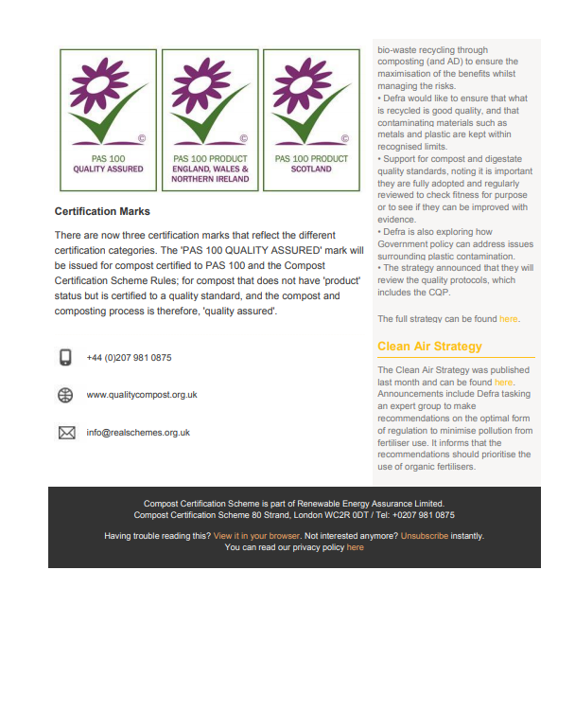
Winter newsletters issued

Slide 5
SCHEME NUMBERS

Slide 6
Numbers in June
CCS
174 certified processes
1815932/yr (input)
3627603/yr (output)
BCS
85 certified plants
61 in England
10 in Scotland
8 in Wales
4 in Northern Ireland
4.5 MT per annum of throughput
61 WD, 30 SL, 16 SF

Slide 7
2019 applicants, suspended, withdrawn
CCS
3 applicants
1 suspended
0 withdrawn
BCS
2 applicants
0 suspended
0 withdrawn

Slide 8
SCHEME RULES

Slide 9
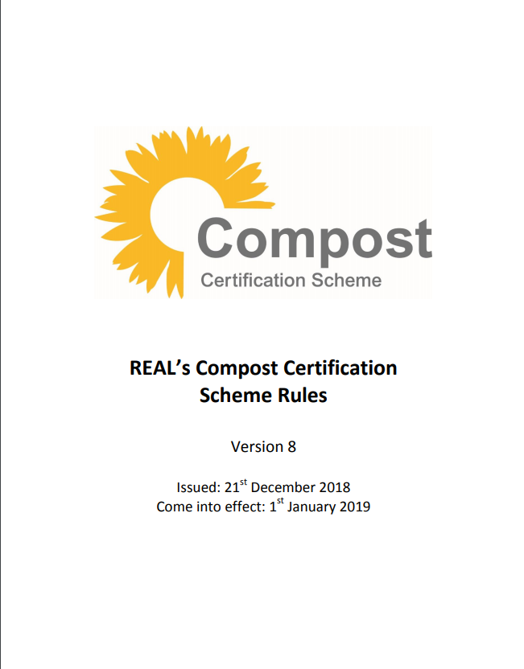
CCS Scheme Rules
The previous version revised with respect to UKAS’ comments, previous comments collated on the rules, the Research Hub development, the introduction of a quality assurance scheme, the BCS Scheme Rules, and the updates to PAS 100
Version 8 came into effect on 1st January 2019
Accompanied by the CCS Position on Technical Requirements (formerly Technical Guidance)
Transitional period for producers using bags printed with the old conformity marks – deadline of 1st July
The consultation responses document, updated audit checklist, and instructions for use of the CCS marks documents are available on our website

Slide 10
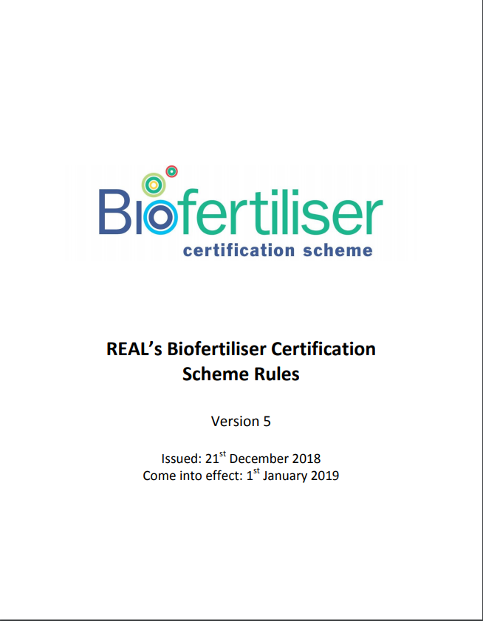
BCS Scheme Rules
The previous version revised with respect to UKAS’ comments, previous comments collated on the rules, the Research Hub development, the introduction of a quality assurance scheme, and CCS Scheme Rules
Version 5 issued in December and came into effect on 1st January 2019
Accompanied by the BCS Position on Technical Requirements
The consultation responses document and updated audit checklist are available on the Biofertiliser Certification Scheme website

Slide 11
Key changes to the rules
Key changes to the rules:
Introduction of the 'Quality Assurance' category of certification
Introduction of the Research Hub and Research Fees
Introduction of risk-based spot checks
New CCS conformity marks and introduction of BCS conformity marks
Other changes to the rules:
Removal of requirements for independent sampling
Introduction of the option for an inspector to request sampling
Addition of timeframes for certification renewal
Addition of clauses for data reporting by REAL

Slide 12
PAPERS/GUIDANCE/WORKSHOPS

Slide 13
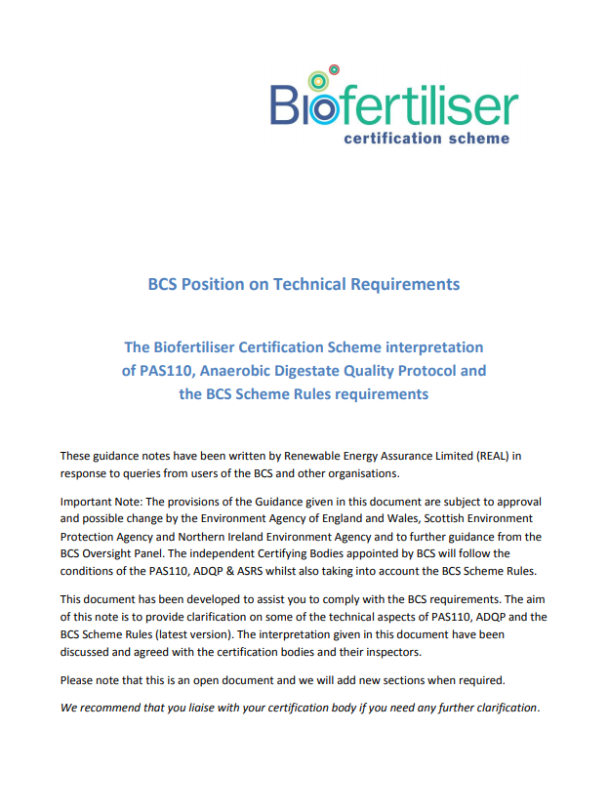
BCS Position on Technical Requirements
All the clauses on the Scheme’s interpretation of the requirements in the previous version of the Scheme Rules have been moved to this document with the former BCS detailed guidance for operators and FAQs
The updates discussed and agreed with the Certification Bodies
Advice and final comments sought from the Technical Advisory Committee

Slide 14
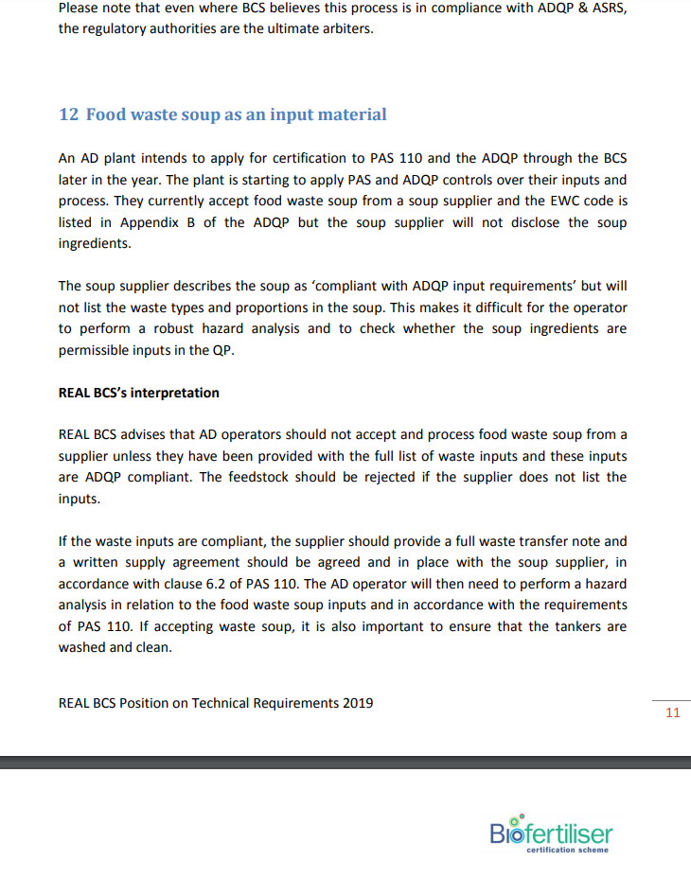
BCS Position: food waste soup as an input
If a food waste soup supplier does not disclose the ingredients of the soup, it is not possible to perform a robust hazard analysis or check whether the waste ingredients are ADQP compliant
Food waste soup should not be accepted unless the full list of waste inputs have been supplied
The tankers should be washed and clean to avoid contamination

Slide 15
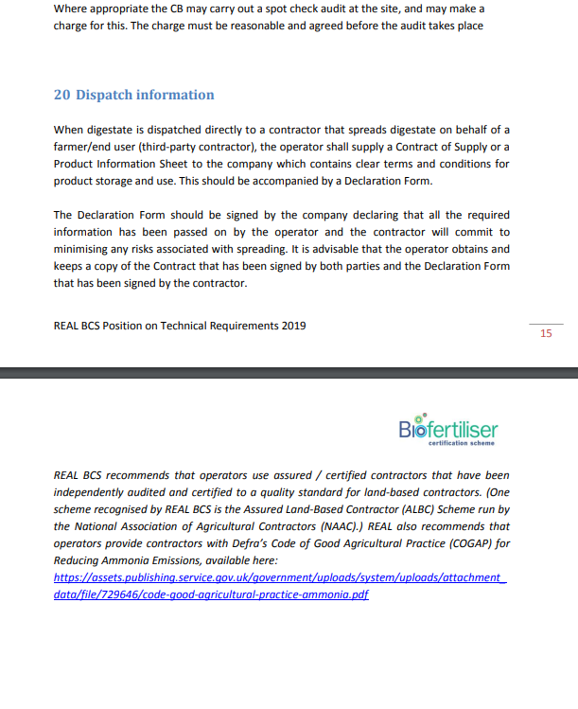
BCS Position: dispatch information
When digestate is dispatched directly to a third-party contractor for spreading, a Declaration Form should be provided and signed, declaring that all the required information has been passed on and the contractor will commit to minimising any associated risks.
We recommend that operators use assured / certified third-party contractors and provide them with Defra’s Code of Good Agricultural Practice for Reducing Ammonia Emissions.

Slide 16
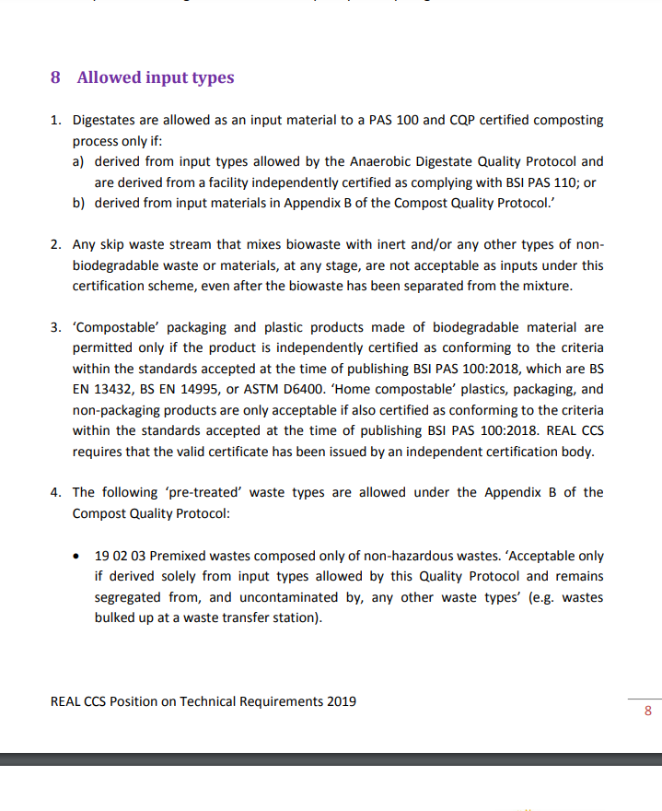
CCS Position: home compostable packaging
‘Home compostable’ standards for packaging are not specified in PAS 100
‘Home compostable’ plastics, packaging, and non-packaging products are only acceptable if also certified as conforming to the criteria within EN 13432, EN 14995, or ASTM D 6400 (standards for industrial compostability)
A valid certificate must have been issued by an independent certification body for industrial compostability

Slide 17
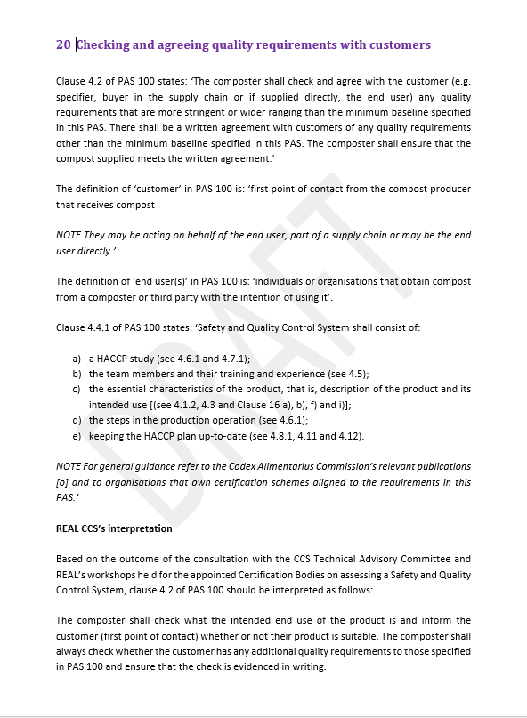
CCS Position: checking and agreeing quality requirements
The composter shall check the intended use of the product and inform the customer whether their product is suitable for the application
The composter shall always check whether the customer has any additional quality requirements
If the customer does not have any additional quality requirements and is supplied with compost that only meets the PAS 100 (minimum) quality criteria (certified compost), the composter shall retain written evidence that the customer is satisfied to take the compost – the paperwork/record must be retained to demonstrate the check has been carried out

Slide 18
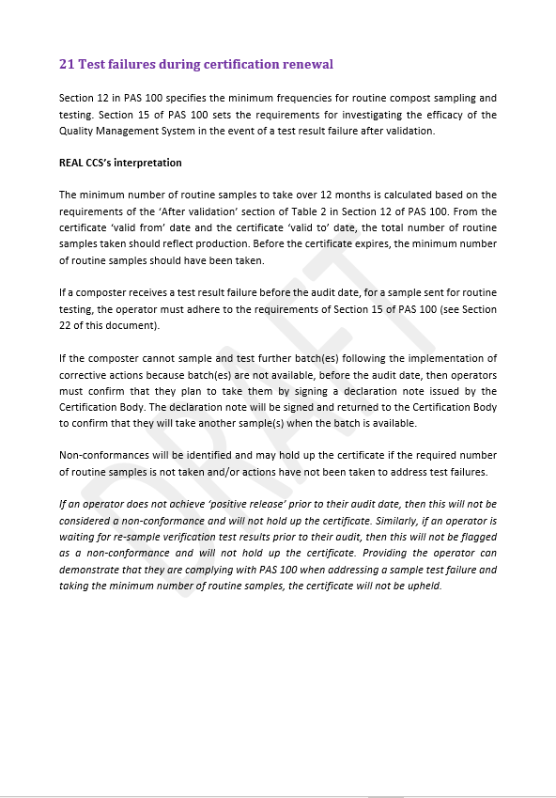
CCS Position: test failures during certification renewal
A routine sample test failure received before an audit must be dealt with according to the requirements of PAS 100 for non-conforming material and investigating the efficacy of the QMS in the event of a test result failure
If the composter cannot sample and test further batch(es) because batch(es) are not available, before the audit date, then operators must confirm that they plan to take them by signing a declaration note issued by the Certification Body.
Non-conformances will be identified and may hold up the certificate if the required number of routine samples is not taken and/or actions have not been taken to address test failures.

Slide 19
CCS sampling guidance and training
Guidance document
Draft sampling guidance prepared based on BS EN 12579:2013
Input from approved laboratories, CBs and producers
Publication pending further discussion on subsampling
Training workshop
Half day at a composting site
Overview
Relevant documentation
Relevant research
Guidance document
Demonstration of sampling approach(es)
Writing and maintaining SOPs
Recommended by CBs for producers with sampling issues

Slide 20
BCS sampling guidance and training
Guidance document
Current guidance based on BGK methods book
Reformatting and updating to match CCS guidance format
Input from approved laboratories
Finalising draft
Training
Workshop - half day at site?
Webinar?

Slide 21
Interpretation of test failures
CCS guidance document
Case studies from position on technical requirements
Expand to all minimum quality parameters
Basic level interpretation
Webinar
Open dialogue
Bring in relevant research

Slide 22
TECHNICAL/LABORATORY UPDATES

Slide 23
CCS and BCS databases
CCS database
By the end of this month, all laboratories will be uploading PAS 100 results in csv format
We can now download test results data in bulk for potential analysis
Will soon be issuing revised analysis request form so operators can specify sample type
BCS database
Programming complete and will soon be linked to our website
Input type categories for reporting; ‘waste’, ‘farm’, ‘other’
BCS certification codes issued to CBs and will soon be issued to all operators
PAS 110 Analysis Request Form will be revised for cert codes and sample type data
Both laboratories have been provided with PAS 110 csv reporting template
BCS database set up to receive PAS 110 test results
New categories of certification have been introduced for both databases

Slide 24
Approved Laboratories and PT programme
Approved laboratories
3 on CCS, 2 on BCS
New T&Cs issued January 2019
First combined scheme audits
Document request
Scheduling of audits
PT programme
Draft proposal PT programme for scheme specific methods developed in Q1 2019
Discussion held with the laboratory representatives in March
Draft TID in July for PT programme provision
Notes:
Three laboratories reappointed
New T&Cs issued
Combined audits

Slide 25
UKAS ACCREDITATION

Slide 26
Update on accreditation
UKAS carried out a technical review of the Compost Quality Protocol in 2016 and flagged up potential ‘showstoppers’
Following the publication of PAS 100 and the new version of the CCS Scheme Rules, UKAS has reviewed the CQP again and raised a number of comments or questions around how certain clauses would be audited
UKAS has also reviewed SEPA’s regulatory position for compost, as we would like the CBs to gain accreditation to ISO 17065 for all three categories of certification (including End of Waste Scotland)
Meetings will be set up with UKAS, SEPA, and the EA this summer
Liaising with UKAS about timescale for accreditation process

Slide 27
POLICY/REGULATORY UPDATES

Slide 28
Review of the CQP and ADQP
The ADQP and CQP will be reviewed within the next 2 years
A review might not result in an update (or revision)
If it is decided that the Quality Protocols require updating then industry will be required to bring forward the evidence to support changes to the Protocols
Industry will be engaged with depending on the outcome of the reviews
An Agency Briefing Note on the reviews will become publicly available soon

Slide 29
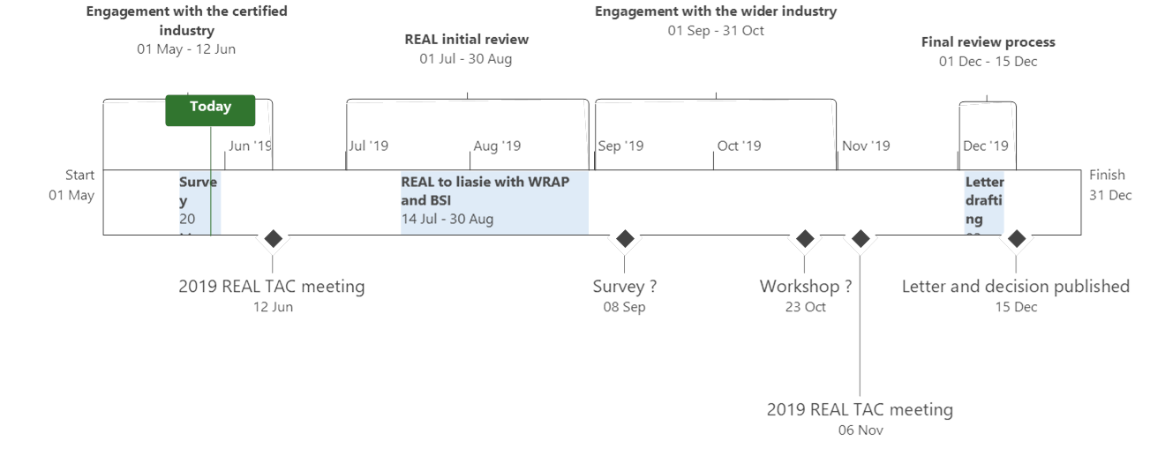
PAS 110 review process

Slide 30
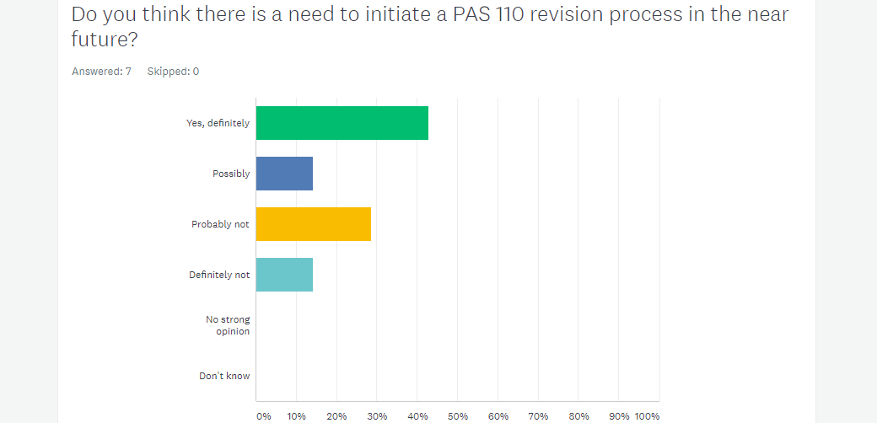
PAS 110 survey results
2 more survey responses came in: 1 probably not + 1 don’t know
44 % Yes, definitely 11% Possibly 33% Probably not 11% Definitely not 11% Don’t know

Slide 31
PAS 110 survey responses
Yes, definitely:
Compostable packaging: AD operators need assurance that starch-based compostable contamination in digestate is acceptable
Industry developments: SQCS should be introduced, PC testing for liquor should be included/clarified, product preparation section should be added (e.g. for drying digestate), storage of digestate – what happens to the settle solids in lagoons and tanks etc.
On-farm AD: Pasteurisation is required if on-farm AD plants want to bring feedstocks from agriculture, while waste transport companies are spreading the same material onto land
Possibly:
Industry developments: if changes are made to the ADQP then PAS 110 should be revised to
accommodate any changes, data from the MDWG or Research Hub may also inform this revision, not sure whether to wait for more data and evidence
Probably not:
Robust: works well, let sleeping dogs lie
No comment
Compliant: meet current requirements and not aware of any immediate need for revision
Definitely not:
Robust: the current scheme is fit-for-purpose, the current criteria to meet PAS 110 standards are achievable through strict process, policy and analysis, any adaptation would be a waste of time, energy, and resource
Don’t know:
Industry developments: if ADQP is reviewed/revised, it would make sense to wait to review rather than pre-empt

Slide 32
ROLE OF THE TAC

Slide 33
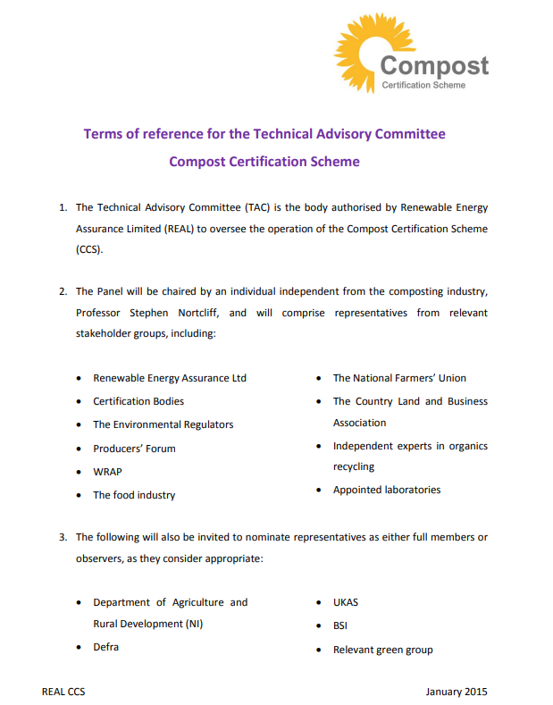
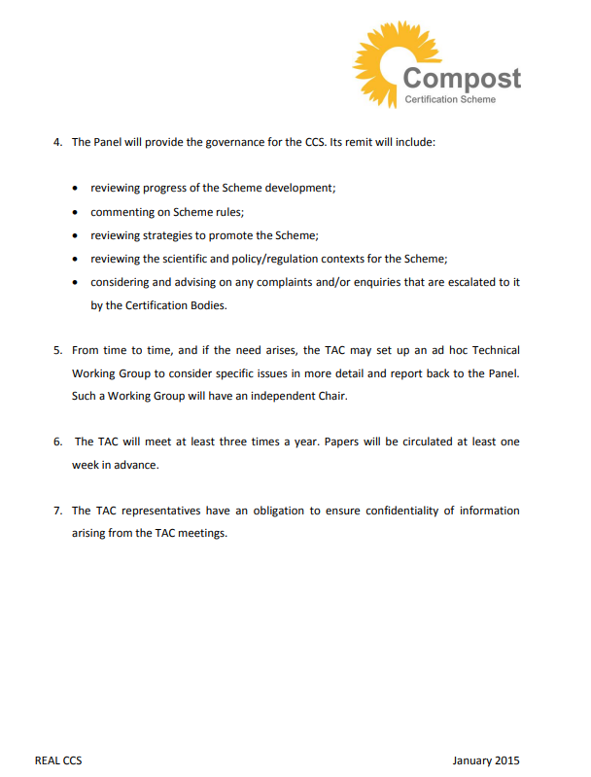
TAC Terms of Reference

Slide 34
UPDATE ON THE RESEARCH HUB

Slide 35
Research Hub - Inaugural Meeting of the Research Panel
Wednesday 10th April 2019
Meeting provided the opportunity to consider and discuss the research project proposals submitted to REAL
35 proposals submitted in total
Those projects determined by the Panel as realistic were shortlisted
13 projects shortlisted
Members of the Research Panel
Stephen Nortcliff (chair) | Chair of CCS/BCS Technical Advisory Committee
Justyna Staff | REAL
Jo Chapman | BCS Producers Representative
Gregor Keenan | CCS Producers Representative
Fiona Donaldson | Scottish Environment Protection Agency
Alison McKinnie | Zero Waste Scotland
Mat Davis | Environment Agency
Peter Noyce | Defra
Emily Nichols | REA Organics Recycling Group

Slide 36
Research Hub – Proposals shortlisted by the Research Panel
 | General
1 | Reducing plastic and other contaminants in compost feedstock
2 | Sanitation criteria for composting processes (green waste only)
3 | Impact of storage on the quality of compost and digestate
4 | What does a PAS 100 compost product look like?
5 | Development of a research library for the organics recycling industry
6 | Digestate value in agriculture
 | Test Methods
7 | PAS 100 plant response testing: options for change
8 | PAS 100 compost stability: options for the future
9 | Recommending potential changes to PAS 100's requirements relevant to E. coli
10 | Review of physical contaminant test methods specified in PAS 100 and PAS 110 and appraisal of alternatives
11 | Production of proficiency test materials to meet the analytical requirements of laboratories operating to PAS 100 and PAS 110 standards
12 | Research into the history of each test parameter as specified in PAS100/PAS110
13 | Review of the residual biogas potential (RBP) test method

Slide 37
Research Hub - Survey Monkey
Survey Monkey launched on 9th May 2019
Separate surveys for CCS/BCS Operators
Surveys asked operators to rate (1-5) each project proposal
Survey ended on 30th May 2019
Results analysed ahead of the second meeting of the Panel
Results to be discussed at the second meeting and research projects to be prioritised

Slide 38
UPDATE FROM THE CBs

Slide 39
UPDATE FROM THE LABs

Slide 40
UPDATE FROM THE CCS REP

Slide 41
UPDATE FROM THE BCS REP

Slide 42
TECHNICAL ISSUES

Slide 43
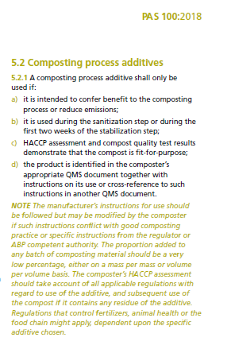
Use of additives under BCS
Enquires on the use of additives under BCS
No clause in PAS110 on additives
Different purposes
Enhancing performance within the digester
Improve separation of liquid and solid fractions post digestion
Regulate N in digestates

Slide 44
Enhancing digester performance additives
Synthetic polymers (with nutrients)
Reference to fertiliser regulations
Limit on application rate to land for synthetic polymers
Powdered activated carbon
SA to enhance microbial interaction, reduce retention time
Activated carbon non-toxic
Enzymes
Enzyme complex from SSF with Trichoderma longibrachiatum

Slide 45
Post digestion processing and digestate properties
Improve liquid and solid separation post digestion
Polymers (flocculants)
Cationic polyacrylamide copolymers
Regulate N in digestates
Urease inhibitors
Limit ammonia emissions / loss of N
Nitrification inhibitors
Slow release of available N

Slide 46
Coarse composted material and oversize
Issues
Variability is certification of compost grades
No PAS100 limit on additional grade size
Can/should we specify grade size limits? Is oversize still considered waste?
i.e. is 0-80 mm grade a compost but 20-80 or 40-80 mm oversize

Slide 47
Compost grades by frequency of testing
Wide range of grades in use
10+ grades all additional
All 0-80 mm are additional grade
Some additional grades from 0-10 and upwards
i.e. there is more than one way to produce an additional grade under PAS100

Slide 48
V. coarse grade products and PSD
No samples with material >31.5 mm
A 20-80 mm graded compost could be composed of 100% <20 mm material
Does the sample tested represent the compost produced?
Grades are based on fresh material and PSD on ‘air dried’ material
Grade (mm) | Sieve fraction (mm)
 | >31.5 | >16.0 | >12.5 | >8.0 | >4.0 | >2.0 | >1.0 | <1.0
20-80 | n/d | 10.18 | 10.18 | 41.56 | 62.91 | 75.05 | 83.39 | 16.61
n/d – not detected
100%

Slide 49
Comparison of compost grades based on PSD
Large variability between samples within grades
Should some compost products be reclassified based on PSD? Is there consistency in results to justify reclassification?

Slide 50
What do we do next
Engagement with producers
Why do producers want 0-80 mm or 20-80 mm compost products?
Do large grade size materials match samples sent for testing?
Guidance for CBs
Could PSD results be used to support CBs in respect of compost grade assigning?
Should more attention be paid on how additional grades are being produced – is the additional grade there just to get rid of oversize? What is the market(s) for these grades? – a product should have value (£)

Slide 51
CCS onsite subsampling
REAL position is that onsite subsampling is not allowed
Several queries received in respect of this
Proposal for onsite subsampling
Current CCS sampling guidance already mentions method for onsite subsampling – coning and quartering
Set minimum sample size for individual parameters (e.g. pathogens) and retesting

Slide 52
Plastic in compost windrows
Additional requirements were not added into the new version of the CCS Scheme Rules for annual witnessing of sampling or sample taking (independent sampling)/sampling every batch for physical contaminants or plastics/independent visits for final product sampling/annual unannounced spot checks
PAS 100:2018 does not introduce more stringent limits for PCs or plastics
Further controls or checks in the Scheme Rules would undermine the quality standard
When do we stop signing off complaints with compost that is allegedly contaminated with plastic but passes the PAS 100 limit? When do we look at the limits in the standard?
What more can we do to introduce checks in the auditing process based on the current requirements of the standard and scheme rules?

Slide 53
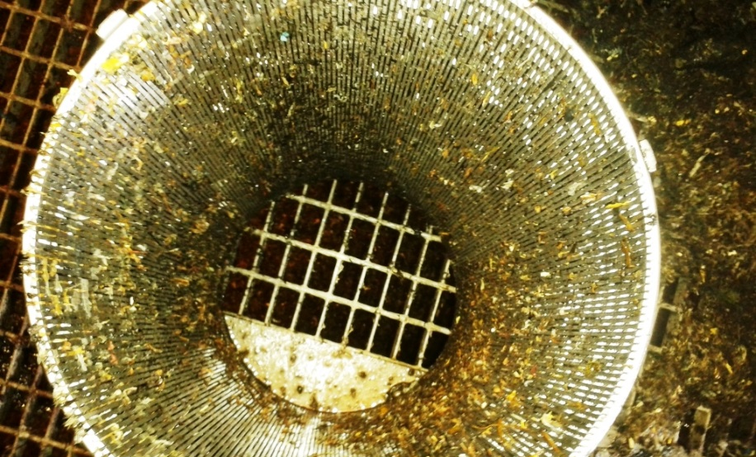
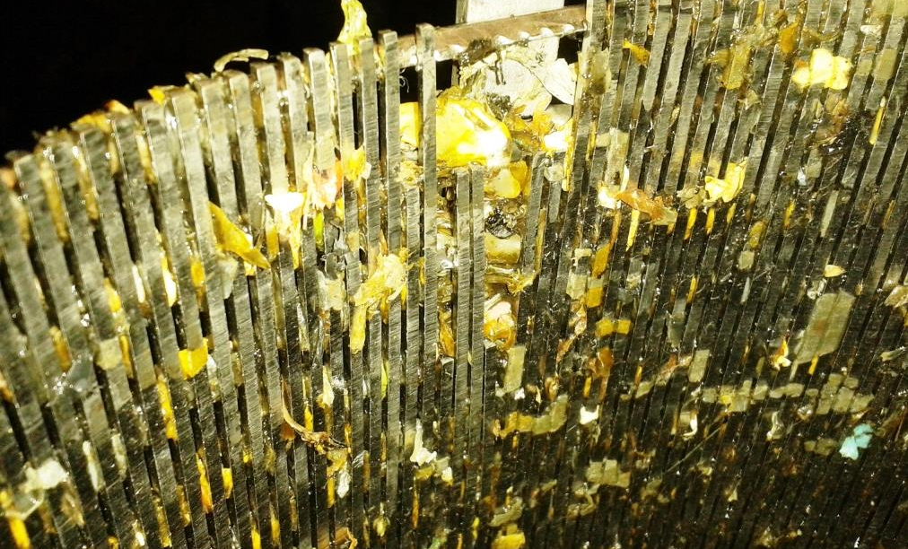
Separation/screening of digestate
BSI PAS 110 2014 (notes in clauses): ‘Separated liquor is exempt from physical contaminants tests only if the separation technology used by the producer results in all particles being < 2 mm in the separated liquor fraction.’
Operators are producing certified separated liquor with screens <2mm and not testing for PCs
WRAP PC report showed that separated liquor (screened to 2 mm on site) contained PCs >2mm
Could evidence be used to show that the screen results in all particles being < 2 mm but what would be sufficient and would this undermine the standard as an additional scheme requirement?
Notes:
Validation and after validation
PAS 110 review
What if not revised
Some sites interviewed screen digestate samples in their own laboratory using a sieve to assess physical contaminant levels, to check their screening equipment is working correctly.
Discussed with the CBs and clause is open to interpretation but this is not flagged as a non-conformance
Should the digestate be tested for PCs to verify the screen is working properly as a Critical Control Point and is not damaged

Slide 54
AOB

Slide 55
Thank you
JUSTYNA STAFF
Head of certification schemes
GEORGIA PHETMANH
SCHEMES MANAGER
Olivia FurssedonN
Technical support assistant
Thomas aspray
TECHNICAL advisor

