Slide 1

is your business sustainable?

Slide 2
who we are
In Perpetuum is the newly created entity to deliver a Bio Energy Cluster investment portfolio around the Bio Power, Heat, Fuels and Chemicals markets globally.
Biomass and Biofuels are highly regulated global B2B commodity markets that have suﬀered from market disturbances.
Many have been constrained by market / country regulatory regimes, leaving them distressed or with any growth limited to short periods of proﬁtability followed by turmoil.
what we do
In Perpetuum provides both a development engine and a marketplace for the Bio Mass, Fuel or Chemical outputs. All products and projects will deliver measurable sustainable benefits, meaning they have a positive and provable local and/or global effect on society and the environment.
The Biochemical market is an emerging sector driven by B2C demand and expectation that brands will “do the right thing” when it comes to looking after the planet.
This creates an opportunity for commercially competitive biogenic chemicals from established and novel feedstocks or technology routes.
Our analysis shows some of these opportunities will work eﬃciently when clustered around existing BioEnergy assets.

Slide 3
how we do it
Immediate opportunities exist around BioEnergy assets from field to fuel for heat, power and transport markets, where assets have become distressed in some way.
The precise investment / development solutions can only be deﬁned following detailed investigation, analysis, “optioneering” and critical decision making to identify the most appropriate returns and societal beneﬁts.
Optioneering will lead into consideration of a broad range of opportunities, including Bio chemicals as well as Biomass for heat and power and Biofuels for transport and power.
our experience
50 years of combined experience in this market sector
Bio Mass / Fuels and Chemical markets
New team / Market development
Project evaluation & delivery
Sustainability systems
Price / value discovery and Trading
Government and Public Aﬀairs

Slide 4
development activities
Project Evaluation
Identification, development, technology, due dilligence, partnering and funding.
Government and Public Aflairs
Sustainability Systems
Local, regional, global sustainability standards and system development.
Corporate standards, project standards, governance, certification for impact.
Financial Reporting
Price / Value Discovery and Trading
Project valuation and ongoing position management.
Delegation of authority, forecast returns, project costs, funding and into operating P&L.
Project Delivery
Project deployment, partnership execution, certification and commissioning.

Slide 5
OFTEC
roadmap to a sustainable future
In light of BEIS intention to eliminate liquid fossil fuels, OFTEC recognises the potential demise of the oil heating sector unless an alternate feedstock is found. OFTEC and its members face potential loss of market and subsequent loss of income and business uncertainty without an alternate. Liquid biofuels may be an alternate. However, some work is needed to convince BEIS that they offer a sustainable and available solution given the policy uncertainty and flip flop around use of liquid biofuels in the transport energy sector.
OFTEC intends to present to BEIS a roadmap of how to get to sustainable liquid biofuels in the off-gas heating network. This will be, by adopting In Perpetuum’s approach to a robust analysis of the sector to underpin policy options. The approach will consider in full the following seven factors: Sustainability / Feedstocks / Technology / Logistics / Markets / Policy & Economics.

Slide 6
OFTEC
methodology

Slide 8
Overview of the technical methodology:

Slide 9
Current housing stock (England):

Slide 10
Current housing stock (England):

Slide 11
Existing heating system installed in pre 1919 detached property
Boiler size = 40kW non-condensing Boiler efficiency = circa 70% System efficiency = circa 55% Oil Tank = 2000l unbunded, steel
Fuel = Kerosene No loft insulation
Single glazing in wood frame No wall insulation
4 x open chimneys – no throat restrictors
Total heat loss = 40kW/h
Annual Space Heat requirement = 49447kWh/Year

Slide 12
Energy Efficiency and Optimisation (England):

Slide 13
Carbon saving costs (average) per technology (England): SAP10.1 basis

Slide 14
OFTEC
roadmap to a sustainable future
Questions raised:
Pricing sensitivity
Biomass availability
Roadmap to truly low carbon power (cold, still, winters night scenario)

Slide 15
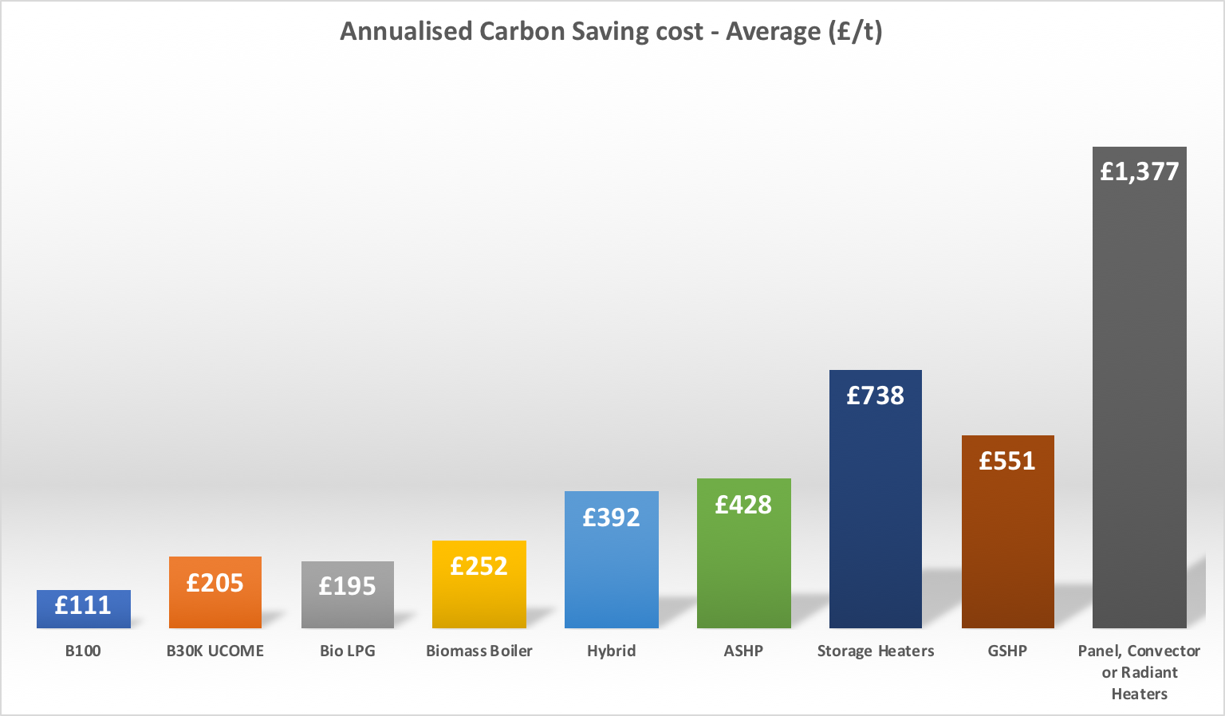
Carbon saving costs (average) per technology (England): Current market prices and emission factors

Slide 16
Carbon saving costs (average) per technology (England): BEIS Green Book basis

Slide 17

Biomass availabilities

Slide 18
Roadmap to truly low carbon power

Slide 19
REA thought leadership
build on bioenergy strategy
Forward projection for grid emissions factors
  Engaging with National Grid Future Energy Scenarios
  Applying REA/ member competence
Push for further work on biomass availability
  CCC position seems to be conservative
  CCC themselves now promoting greater adoption of energy crops
  Danger of a view that biomass is scarce seems to be misdirecting policy
Develop integrated REA position on Bioenergy for heat
  Sustainable low carbon liquids
  Sustainable low carbon gases
  Sustainable low carbon solid biomass

Slide 20

is your business sustainable?
Ian Waller
+44(0)7720 411779
ian@inperpetuum.global
Jason Woods
+44(0)7880 356767
jason@inperpetuum.global
thank you
www.inperpetuum.global

Slide 21
Reasonable improvements to fabric and heating system installed in pre 1919 detached property
Boiler size = 22kW condensing Boiler efficiency = circa 93%
System efficiency = circa 70% 270mm loft insulation
Double glazing in uPVC 4 x open chimneys – capped & trickle vented
Total heat loss = 22kW/h
Annual Space Heat requirement = 24285kWh/Year

Slide 22
Reasonable improvements to fabric and heating system installed in pre 1919 detached property – B30K
Oil Tank = 2000l bunded, plastic
Fuel = B30Kerosene

Slide 23
Reasonable improvements to fabric and heating system installed in pre 1919 detached property – B100
Oil Tank = 2000l bunded, plastic
Fuel = B100

Slide 24
Reasonable improvements to fabric and heating system installed in pre 1919 detached property – ASHP
Heat pump size = 17kW HP SCOP @55°C = circa 373% System efficiency = circa 75% Tank = None Fuel = Electricity
Note: Largest single phase heat pump currently available
cannot satisfy the heat loss at the design conditions –
supplementary heat source is required. DNO issues need to be addressed.

Slide 25
Reasonable improvements to fabric and heating system installed in pre 1919 detached property – GSHP
Ground source heat pump
Tank = None Fuel = Electricity
Note: DNO issues need to be addressed.

Slide 26
Reasonable improvements to fabric and heating system installed in pre 1919 detached property – Biomass
Boiler size = 22kW condensing / Modulating Boiler efficiency = circa 91% Bulk Pellet Store
Fuel = Pellets

Slide 27
Reasonable improvements to fabric and heating system installed in pre 1919 detached property – Hybrid
Boiler size = 12kW condensing Oil Tank = 2000l bunded, plastic
Fuel = B100 & Electricity
Note: DNO issues need to be addressed.

Slide 28
Reasonable improvements to fabric and heating system installed in pre 1919 detached property – LPG
Boiler efficiency = circa 90% System efficiency = circa 67% LPG Tank = 2000l Fuel = LPG

