Slide 1
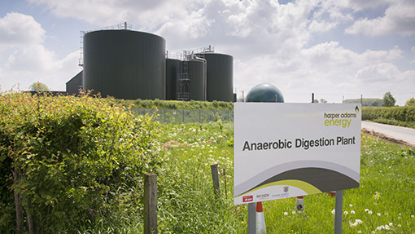
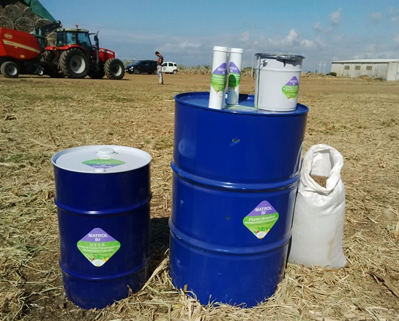
Achieving Net Zero: farming and the bioeconomy
Dr Jonathan Scurlock
Chief Adviser, Renewable Energy
and Climate Change
National Farmers’ Union of England and Wales
Novamont Matrol-Bi products

Slide 2

NFU ‘White Paper’
September 2019
The global challenge
Current UK inventory
Why agriculture is part of the solution
Our approach
Partnership working
Measurement and reporting
3
2
1

Slide 3



Wide variety of measures, from controlled release fertilisers and inhibitors to feed additives, advanced breeding, energy efficiency, on-farm AD
Enhanced hedgerows, increased tree planting, measures to boost soil organic matter
BECCS/BECCUS – notably farm-scale technologies and supply chains, plus bio-based materials, further displacement of fossil fuel emissions by renewables, and novel soil amendments

Slide 4
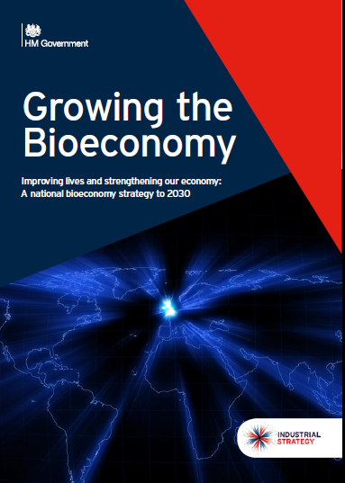
GHG removal through bio-based materials
Not a new subject – NFU has worked previously on EU Bioeconomy Strategy, Bioeconomy Manifesto, etc. – other initiatives include International BioFuture Platform, announced at COP23 in Bonn 2017
Bioeconomy includes all renewable biological resources (crops, forests, fish, animals, micro-organisms), i.e. primary agricultural biomass and energy crops (ABEC) plus forest and woodland resources, AND secondary co-products, residues and wastes from both food and non-food production
Key stakeholders:
paper+pulp/timber industry - timber/fibre based biorefinery, added value from CLT, gluelam, acetylated wood, potentially net energy positive and C negative
petrochemicals sector - carbohydrate biorefinery replacing fossil-fuel inputs (paint, lubricants, fine chemicals, carbon fibre, resins)

Slide 5
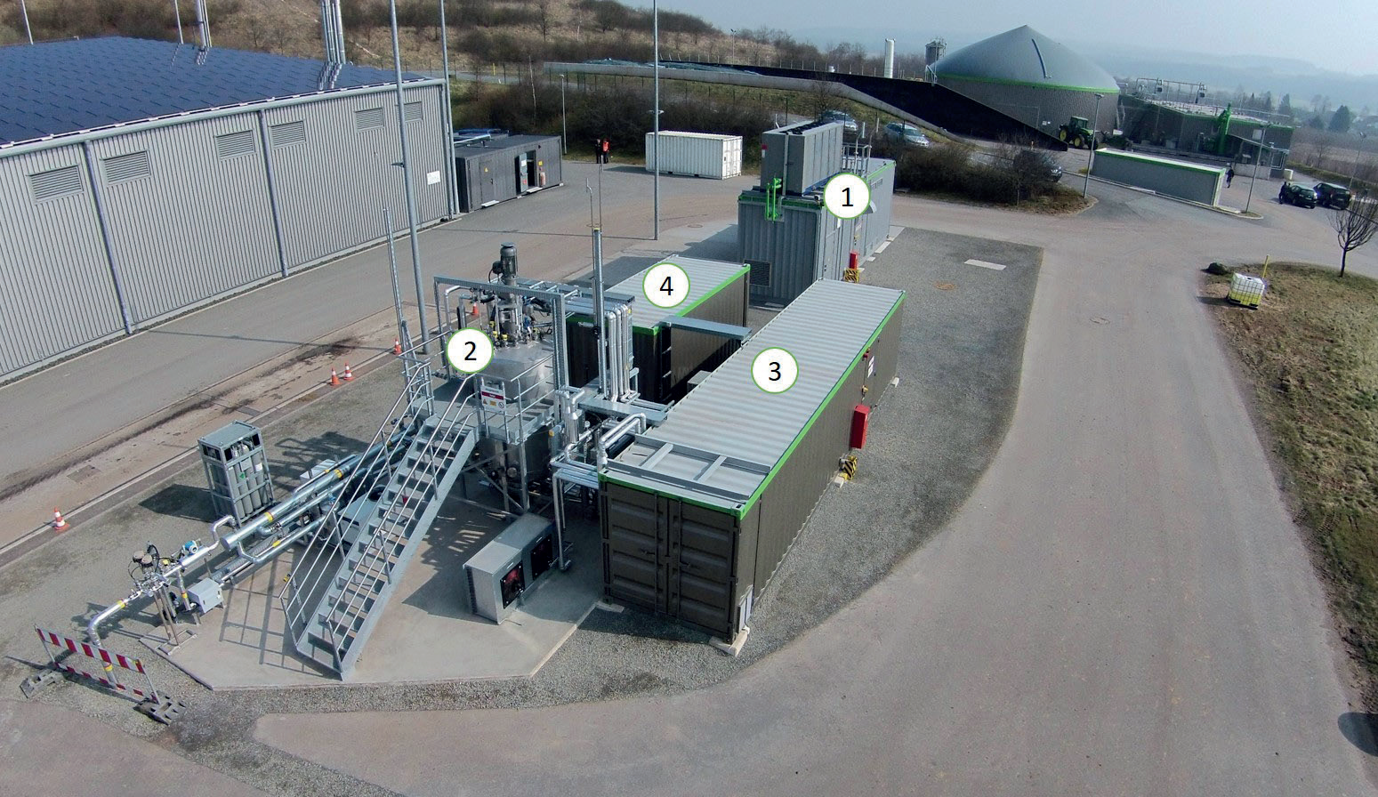
Synthetic fuels and materials: Power-to-Gas
Allendorf, Germany - Schmack + MicrobEnergy case study from IEA Task 37 (since 2016)
small 5m3 high-temp, pressurised bioreactor processing 30 m3/hour raw biogas, equivalent to about 72 kWe CHP
Audi – P2G plant at Werlte since 2014
Both German and UK aviation sector keen on synthetic fuels from CO2
adding value to CO₂
Solar PV power (or wind) → H₂ + CO₂ = CH₄
In coming years, bio-CO2 will be a feedstock for BECCUS, too valuable to vent to atmosphere
e.g. Econic CO2-based polyols for PU

Slide 6
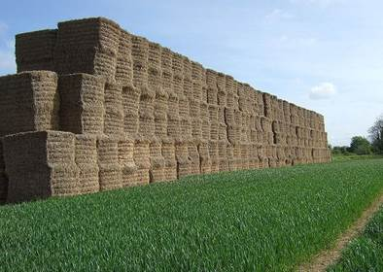
Take-home messages
A strong domestic bioenergy supply chain is needed to realise GHG removals through the bioeconomy, avoiding venting bio-CO2, etc.
Bio-based methane, ethanol/ethylene, isobutene, acrylonitrile (C-fibre); all likely to be important platform chemicals
Important distinction between environmental credentials of (1) short-life biodegradeable products, replacing single-use plastics; (2) long-lived bio-based products, creating GHG removal for decades
Dr Jonathan Scurlock
Chief Policy Adviser, Renewable Energy and Climate Change
National Farmers’ Union
Stoneleigh Park
Warwicks CV8 2TZ
jonathan.scurlock@nfu.org.uk

