Slide 1
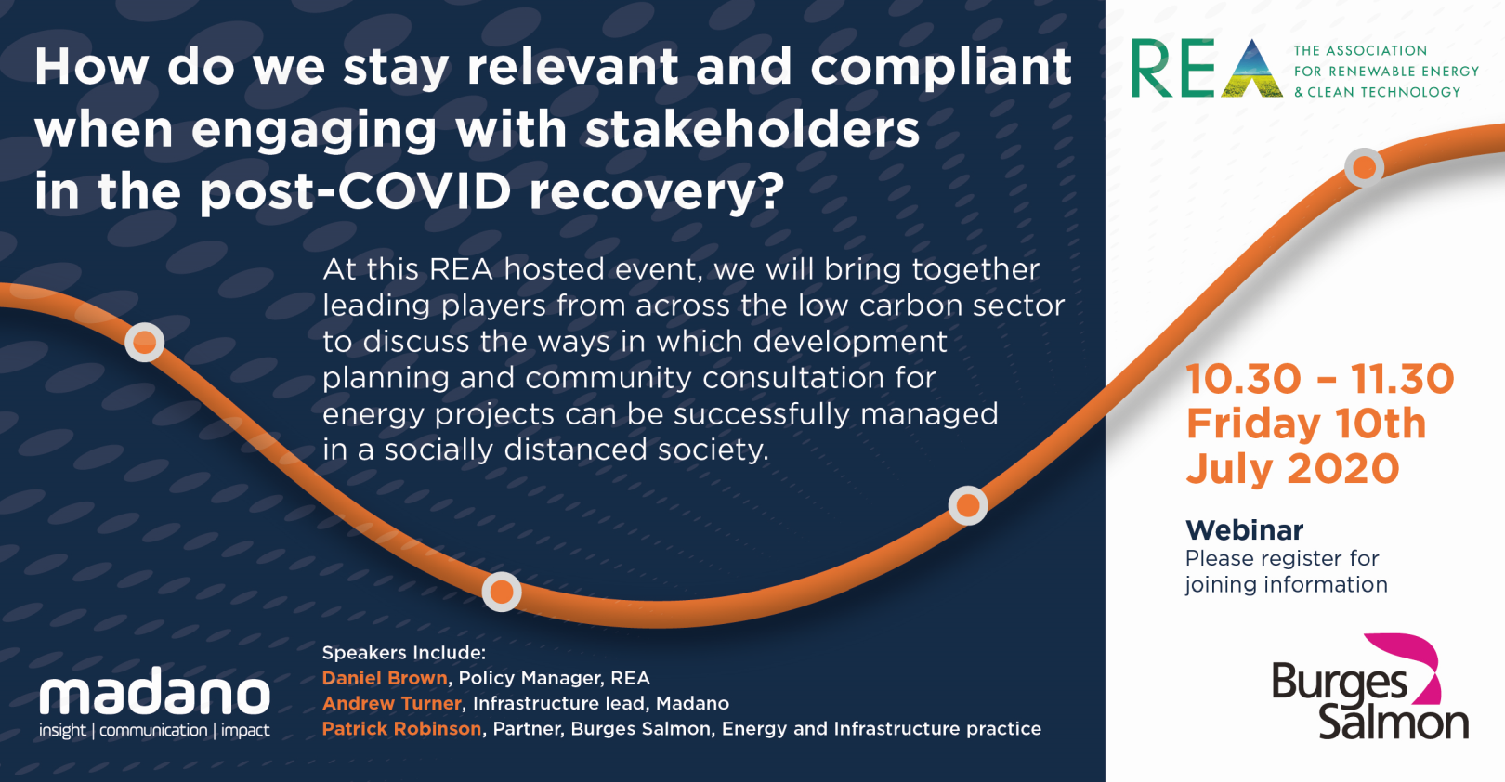
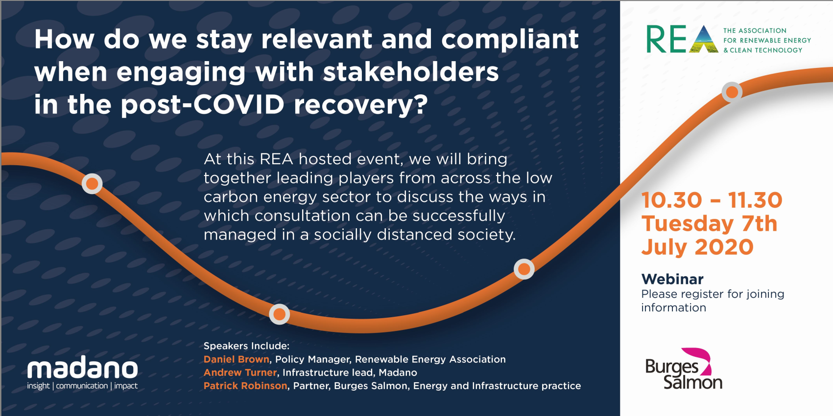

Slide 2

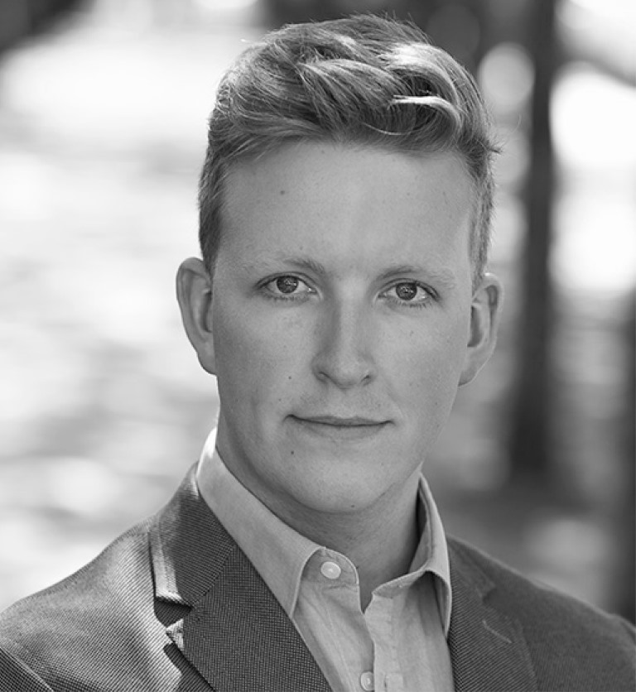
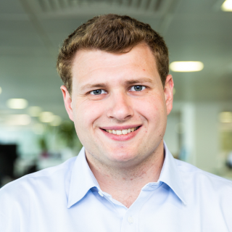
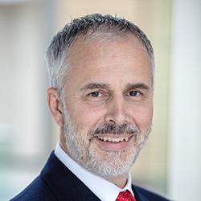


In the virtual room today
DANIEL BROWN
Policy Manager,
REA
ANDREW TURNER
Infrastructure lead, Madano
PATRICK ROBINSON
Partner,
Burges Salmon

Slide 3
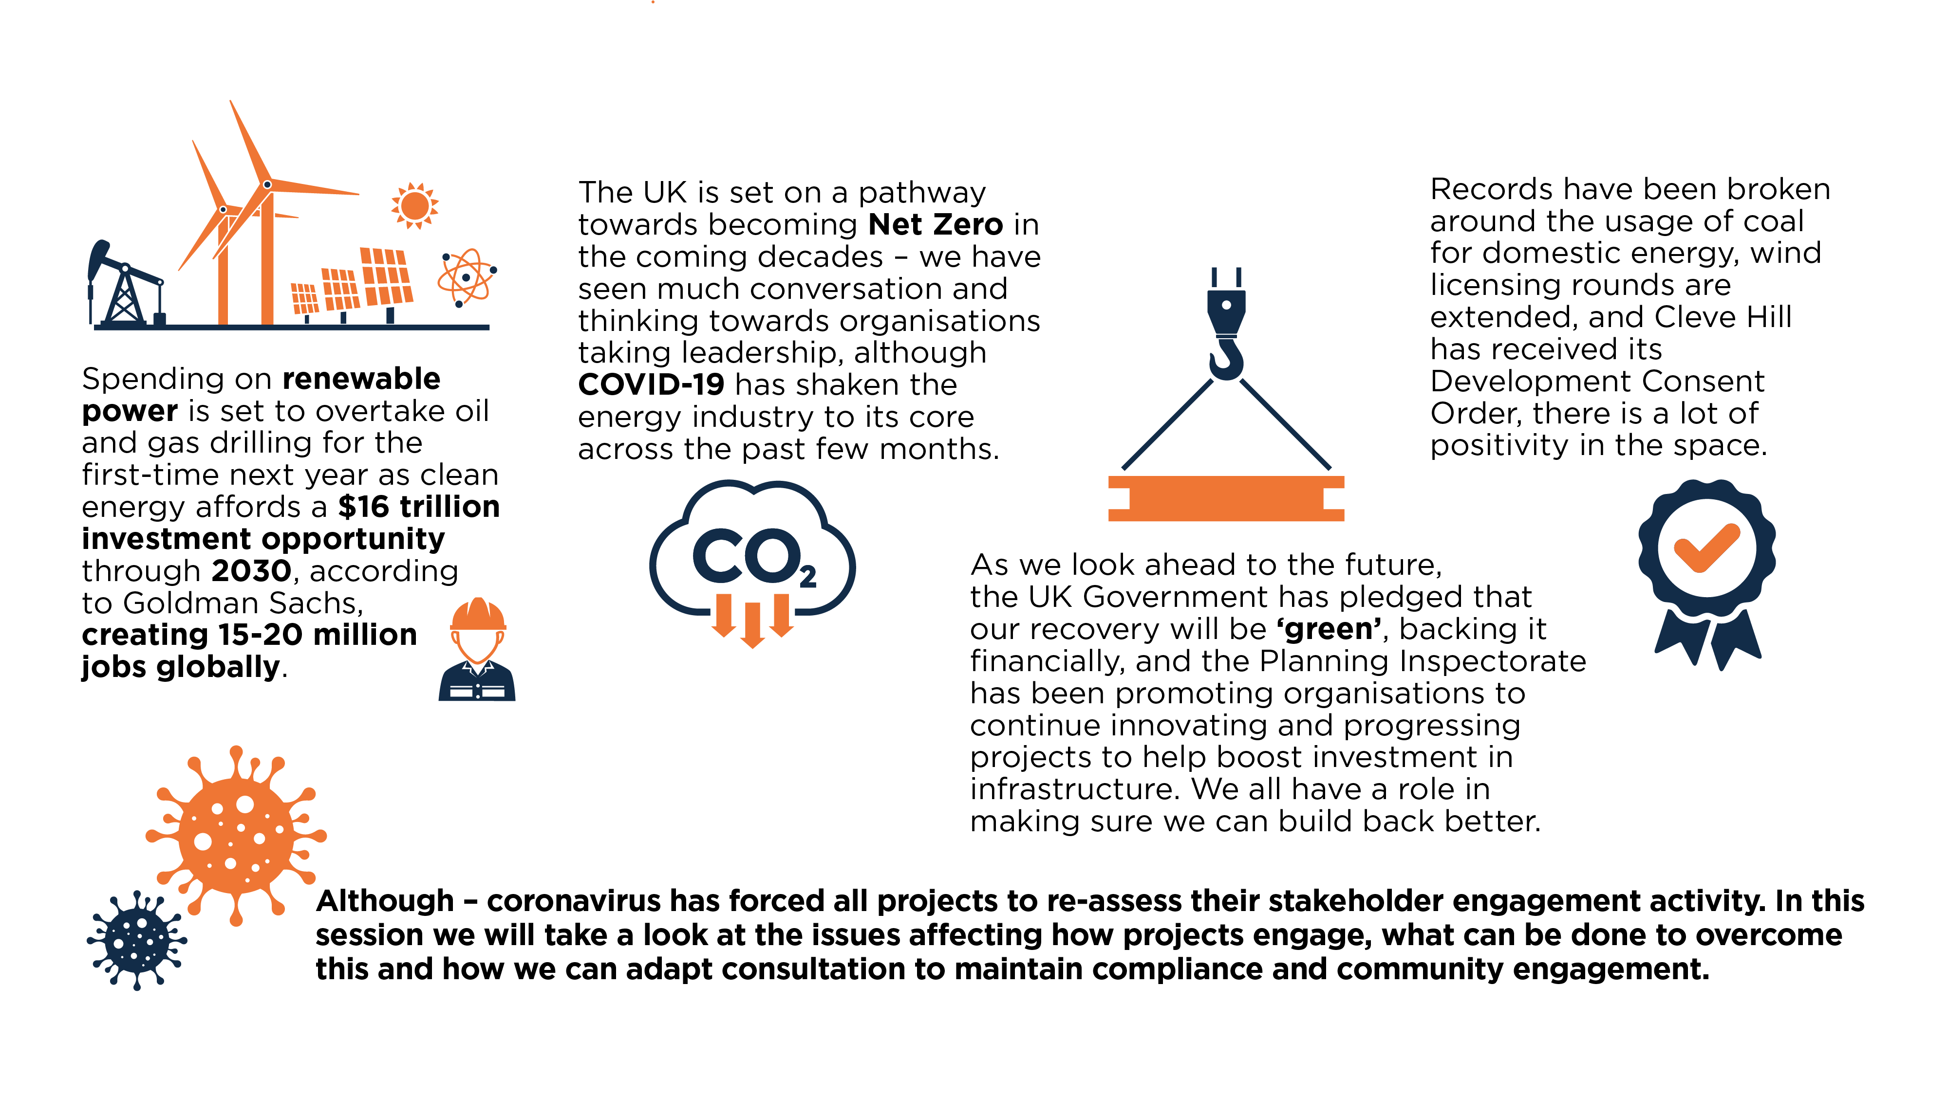
The start of the green recovery

Slide 4
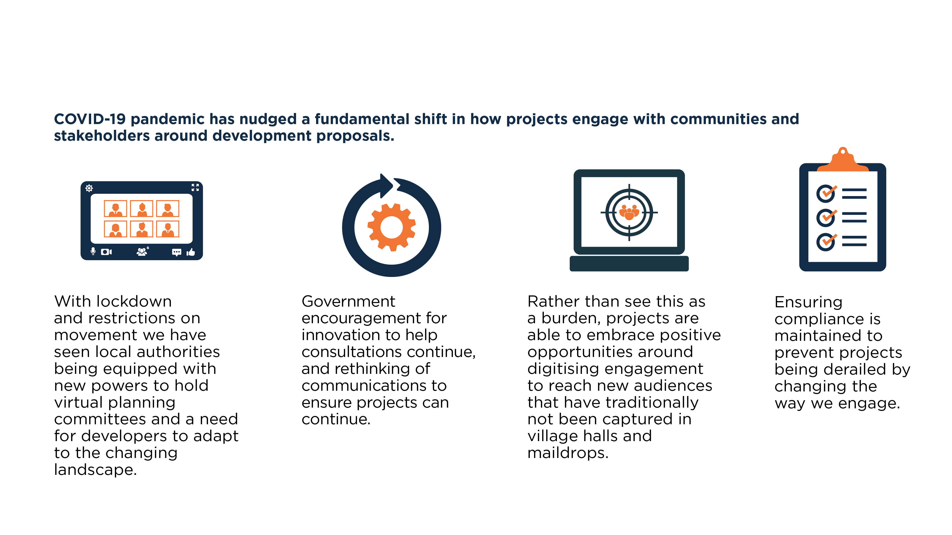
Setting up the situation – what we will cover in the next 30 minutes

Slide 5
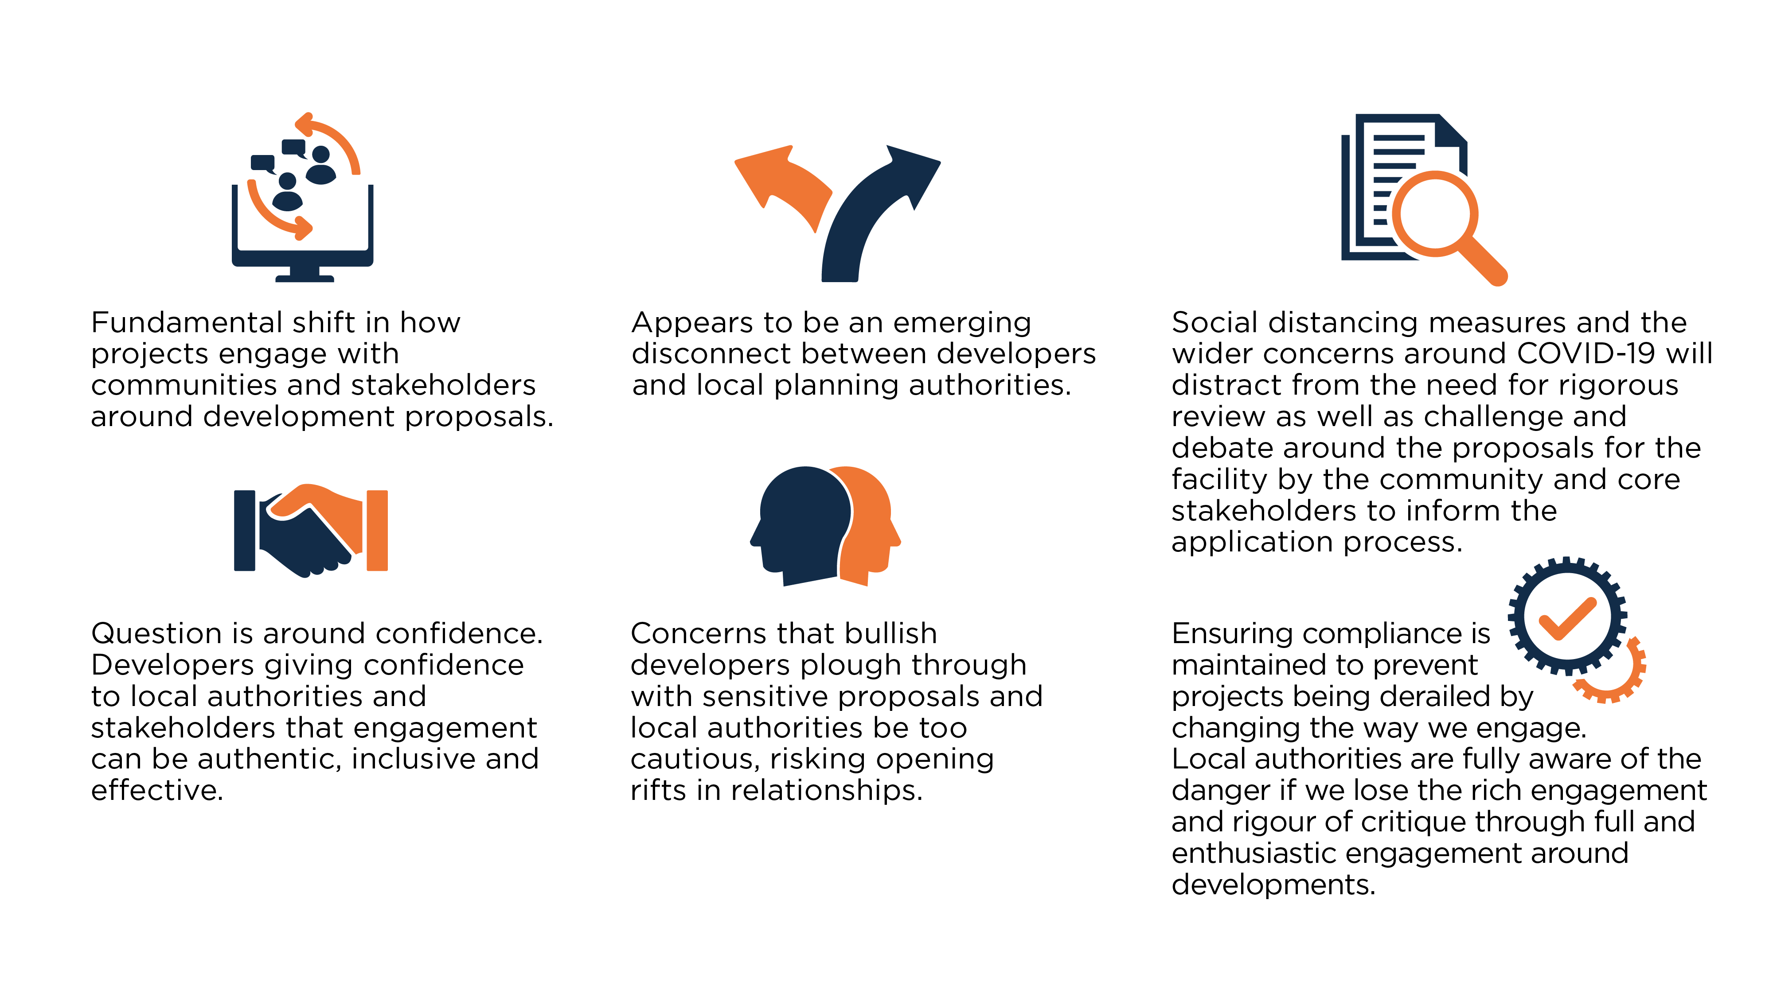
An interruption to society – changes that have been driven out of need

Slide 6
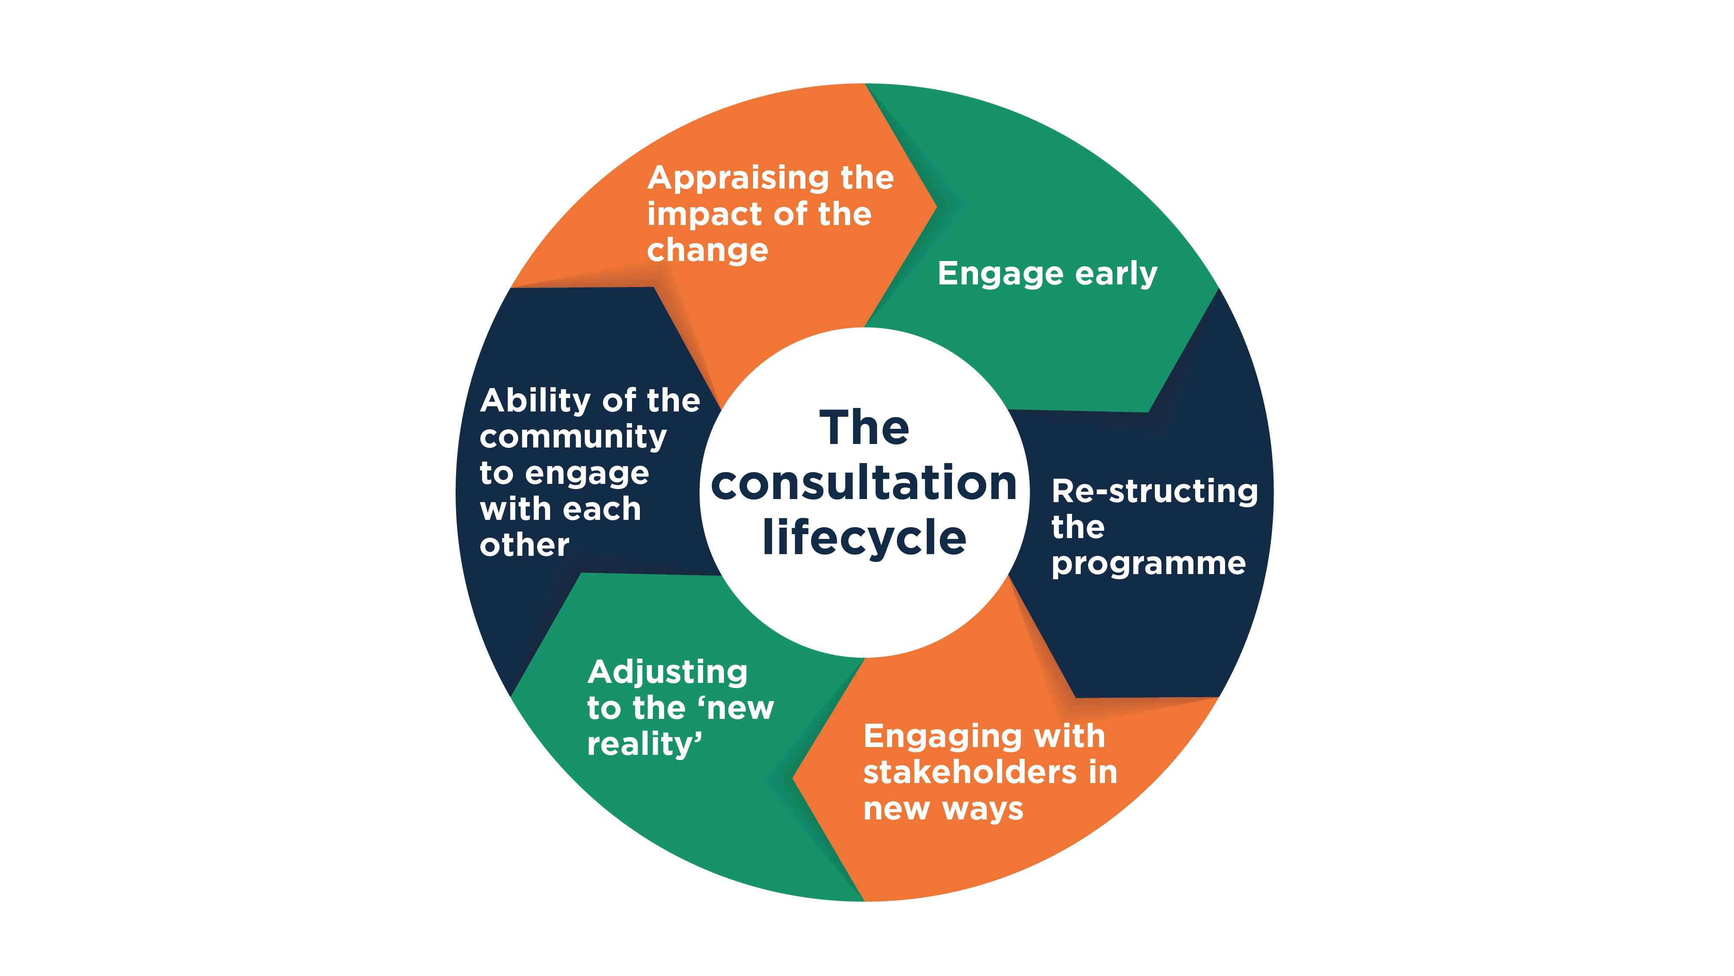
The consultation lifecycle

Slide 7
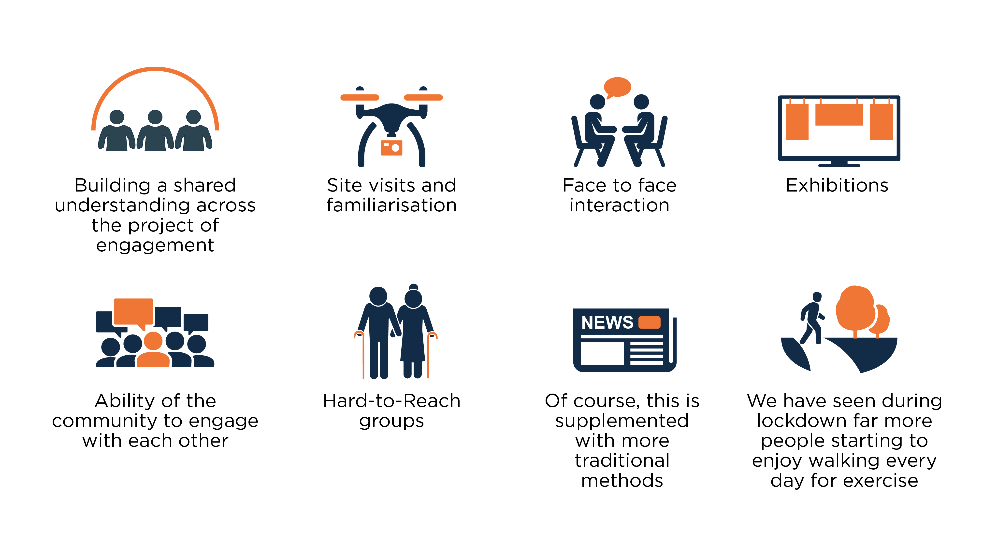
Core elements of engagement that have been affected

Slide 8
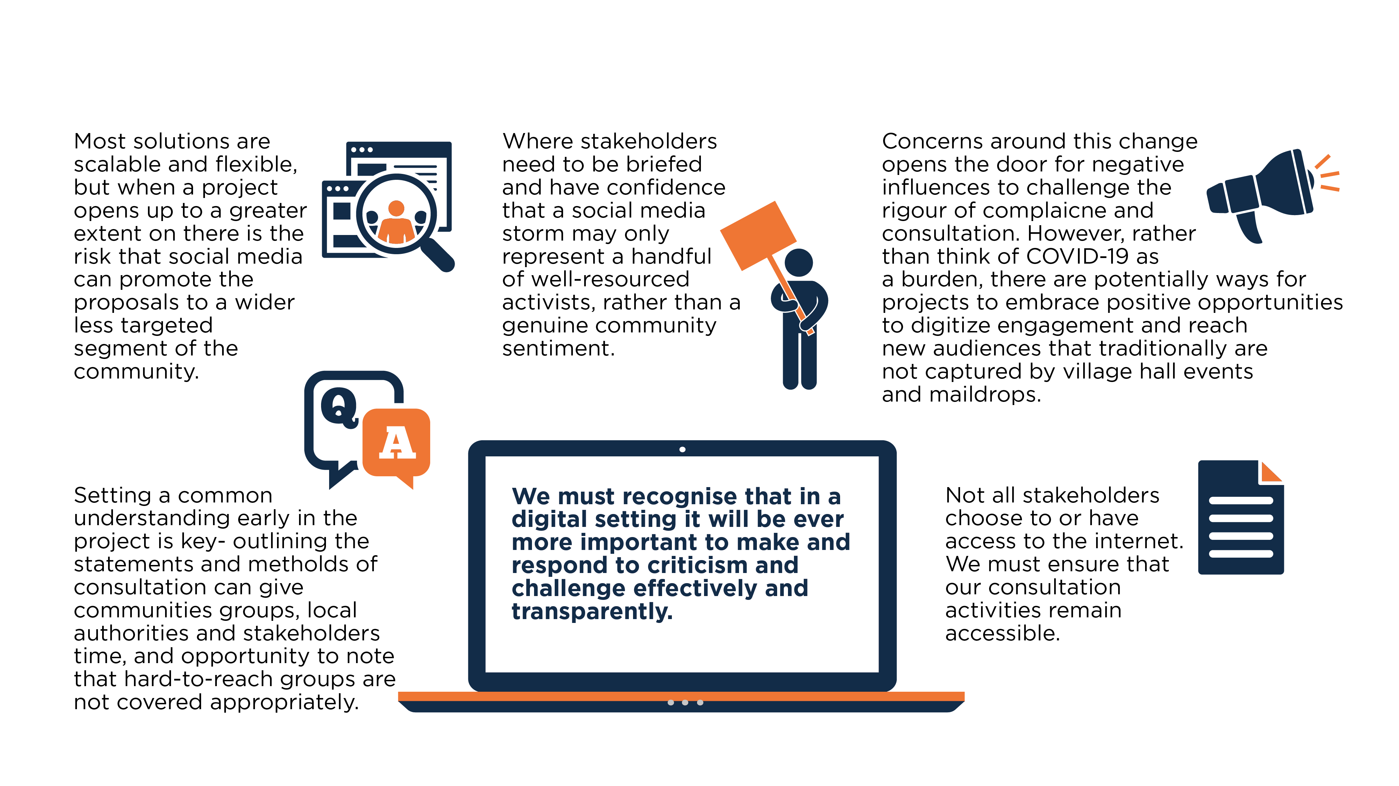
Ensuring we stay compliant and relevant

Slide 9
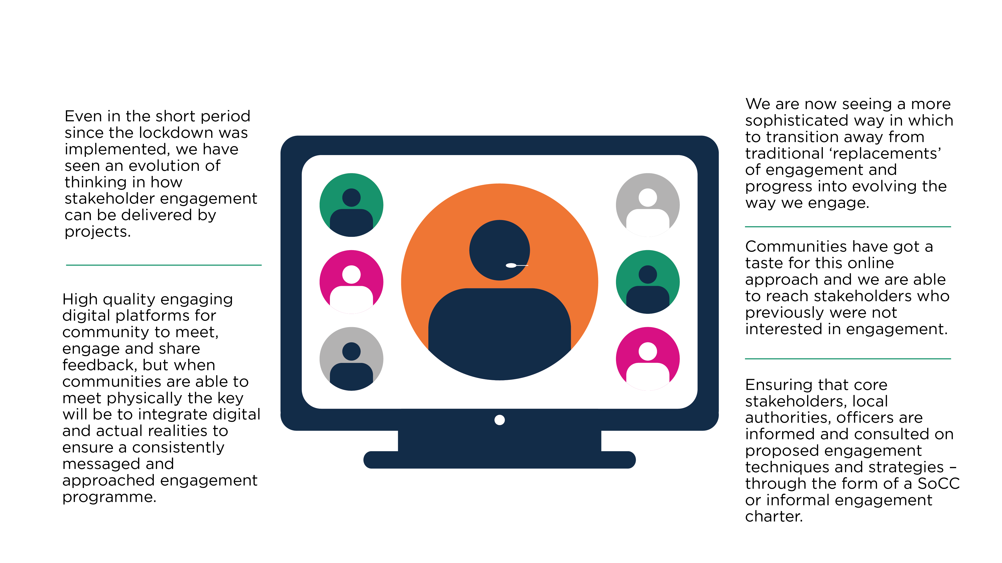
Delivering consultation in the green recovery

Slide 10
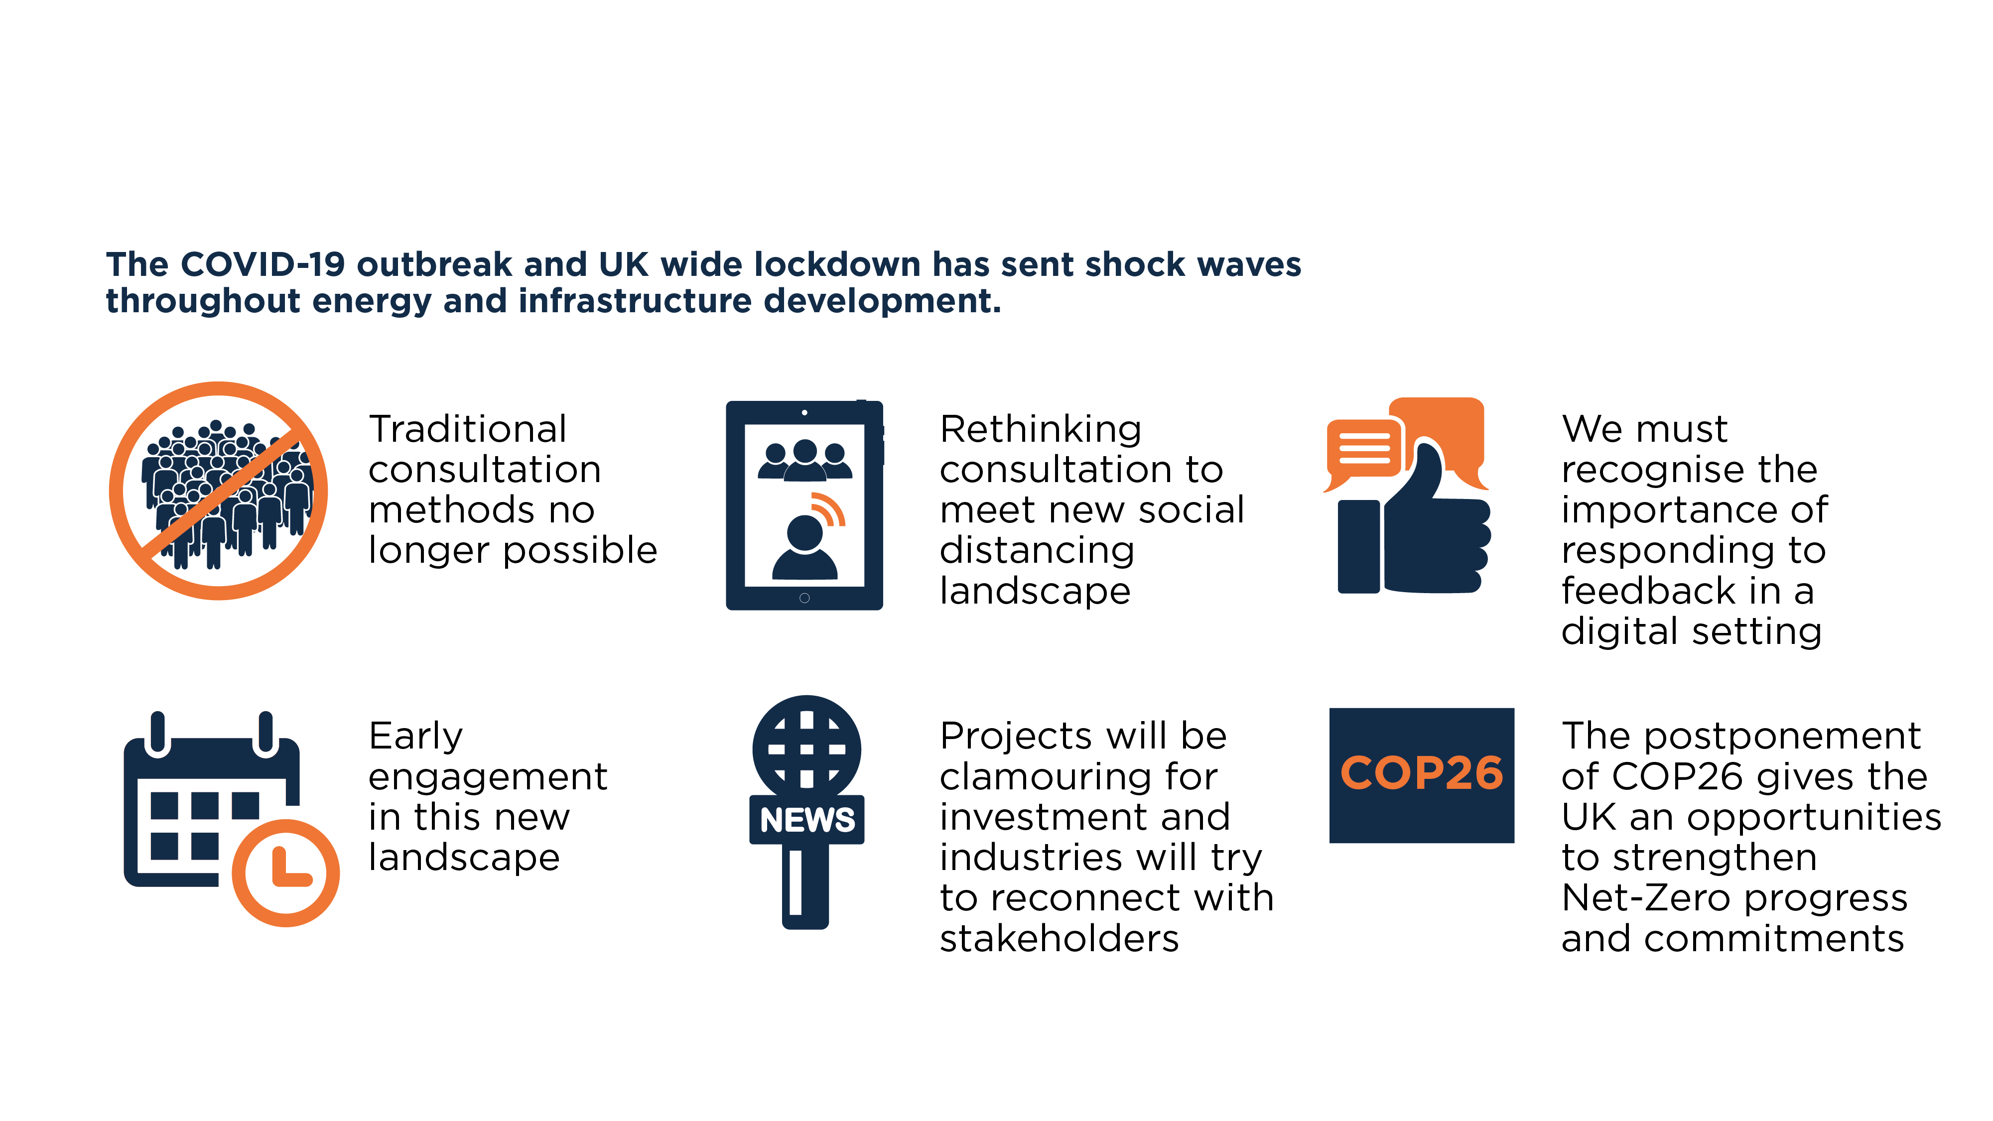
Summary – looking to build back better

Slide 11
Your questions and feedback
DANIEL BROWN
Policy Manager,
REA
ANDREW TURNER
Infrastructure lead, Madano
PATRICK ROBINSON
Partner,
Burges Salmon

