Slide 1
Long Duration Storage WG
Kick-off meeting
26 Aug 2020

Slide 2
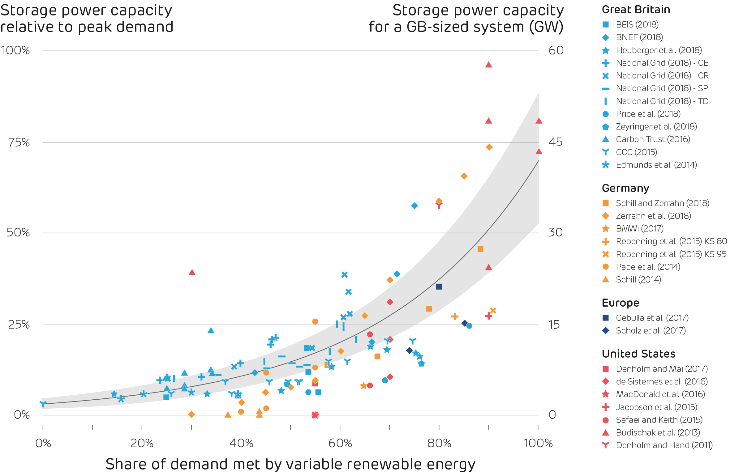
Storage at Scale
Imperial College and Carbon Trust
“An annual cost saving of £2 billion can be achieved in 2030 from the deployment of storage in GB”
3
3. Source: Data from multiple sources, in part compiled by Zerrahn et al., 2018. On the economics of electrical storage for variable renewable energy sources. Lead author: Oliver Schmidt
4. Imperial College and Carbon Trust (2016)

Slide 3
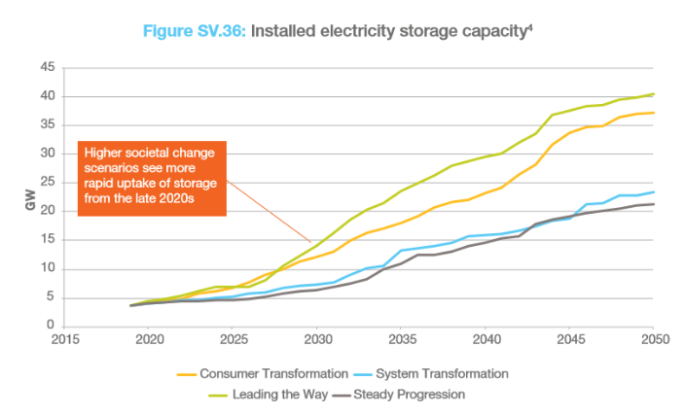
Latest ESO FES highlights need for storage
National Grid ESO
“It will be necessary to develop large-scale storage with longer durations to support the decarbonisation of the power system”

Slide 4
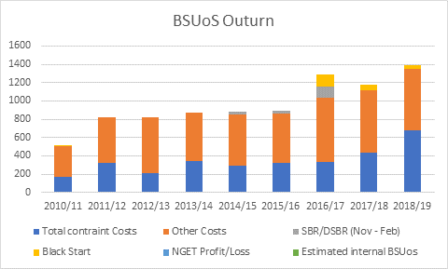
System Balancing is getting more costly
BSUoS are growing faster than anticipated, reaching £1.6bn in 2019/20
COVID-19 increased system operability challenges further in 2020/21, but high and volatile BSUoS charges are expected to be a feature in the future
Nominal Growth Rate: 6.2%

Slide 5
Problem Statement – Case Study: Pumped Storage Hydro
Large infrastructure project with high capex investment
Long lead time before revenues start (5-7 years)
Revenues are variable and uncertain driving up cost of capital
The current market design fails to deliver an efficient, bankable revenue stream
Internationally, less than 5% of existing PSH capacity has been built under liberalised market conditions⁵.
5. DNV GL (2016) The Benefits of Pumped Storage Hydro to the UK

Slide 6
Potential Solutions: Support mechanisms to enable investment in capital-intensive long-duration energy storage projects
Assessment Criteria | Cap & Floor | CfD | RAB | CM+
Technical Applicability | 4 | 1 | 3 | 1
Political Acceptability | 3 | 3 | 2 | 2
Investor Attractiveness | 3 | 1 | 4 | 2
 | Subject to positive CBA. If the project is expected to be ‘missing money’, scores for technical applicability & political acceptability fall | Appears incompatible with the operational profile of storage, as it incentivises maximum output of power rather than flexibility | Political acceptability likely to be the main barrier to overcome, given impact on wider flexibility market / competition | Unlikely to see the level of change required to realise transition to ‘CM+’ in the next 3-4 years
Overall Score | 10 | 5 | 9 | 5
12-10
Increasing suitability
9-7
6-4
3-1

Slide 7
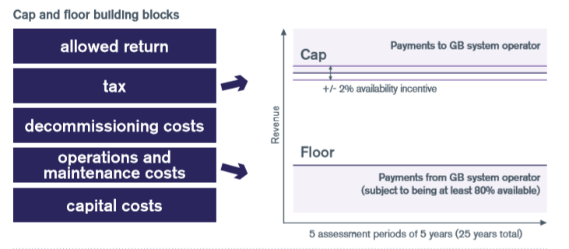
How does the Cap & Floor for interconnectors work?

Slide 8
What barriers are other members facing and what alternative solutions have they identified?

Slide 9
An effective financial support mechanism is contingent upon diverse external stakeholder buy-in and compelling value proposition
Ofgem
HMT
CCC
NIC
BEIS
UK Government & opposition
Scottish Government
Media
ESO

Slide 10
Next Steps

