Slide 1
CMA Electric vehicle charging market study
Sabrina Basran
10 December 2020

Slide 2
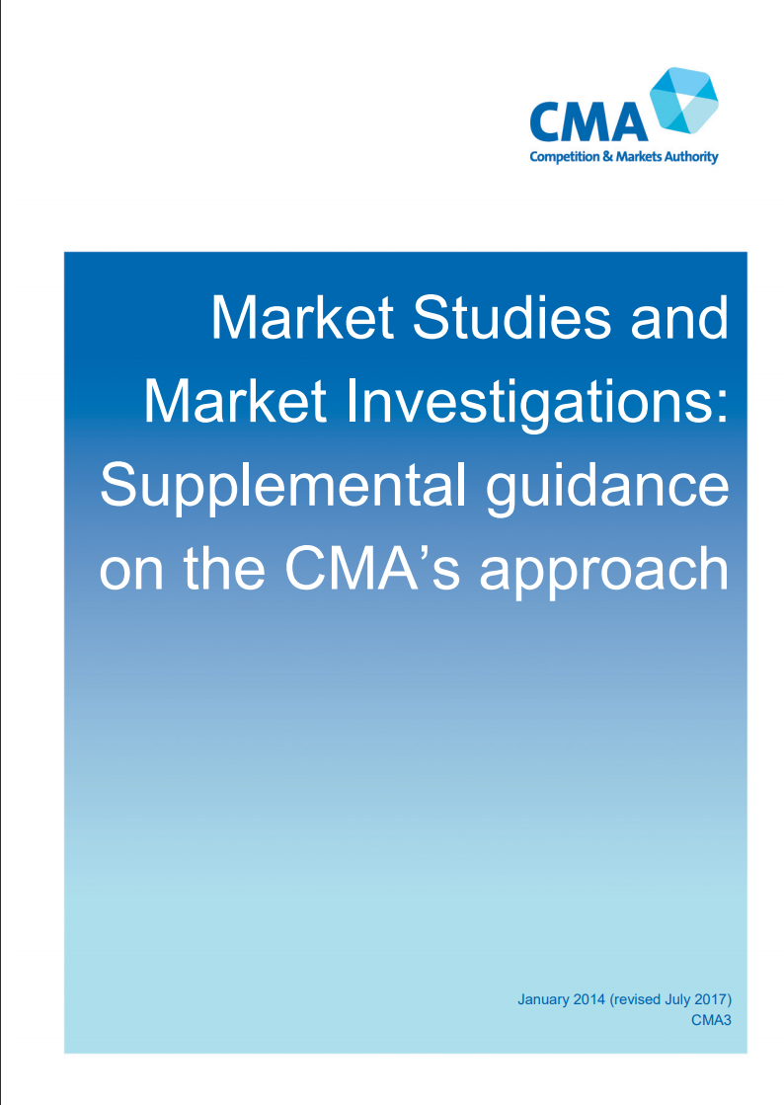
Introduction and Overview
Who is the CMA?
UK competition body
Non-ministerial Gov body; independent
Consumer and competition remit – multiple tools
What are market studies?
Flexible and wide-ranging tool
Info-gathering powers
Statutory timeframe
Range of potential outcomes including recommendations
“We work to promote competition for the benefit of consumers, both within and outside the UK.”

Slide 3
EV Charging Market Study
Approach
Forward looking and broad – identify & address any emerging competition issues
Scope
UK wide; passenger vehicle charging at home, work, on-street, destination, strategic road network
Two key themes – recognise links to other work; some areas out of scope
Explore ways to address any emerging issues
1. Developing competition while incentivising investment:
Role of comp and how comp is developing in sector
Investment incentives & costs
Barriers to entry & expansion
How competition manifests – risks of concentration?
LAs and policy approaches
Data-sharing to open up comp
2. Effective consumer interaction:
Building consumer trust; consumer understanding and journey
Challenges/barriers to interaction
Pricing and payment
Access – including information + reliability
Consider experience of sub-groups – eg vulnerable consumers

Slide 4


Next steps and questions
Evidence gathering and seeking views
Invitation to Comment – deadline 5 Jan
Stakeholder calls and questionnaires
Aiming for report in summer
Do get in touch!
EVCharging@cma.gov.uk

