Slide 1


Types of Certification
Holly Rossington
Electrical Certification Team Leader
December 2020
Copyright © 2020 BSI. All rights reserved

Slide 2
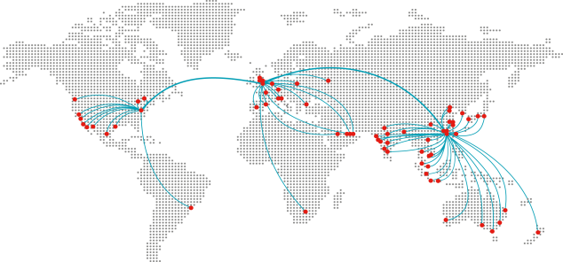
BSI – A trusted global brand
Trusted: An independent Royal Charter company
Experienced; World’s first National Standards Body and founding member of ISO and CEN (Europe)
Thought Leader: Shape the world’s most adopted standards
Founded in 1901
193 countries,
73 offices
86,000 clients
5,000 colleagues and 12,000 experts
150,000 delegates trained
59,000 standards published

Slide 3
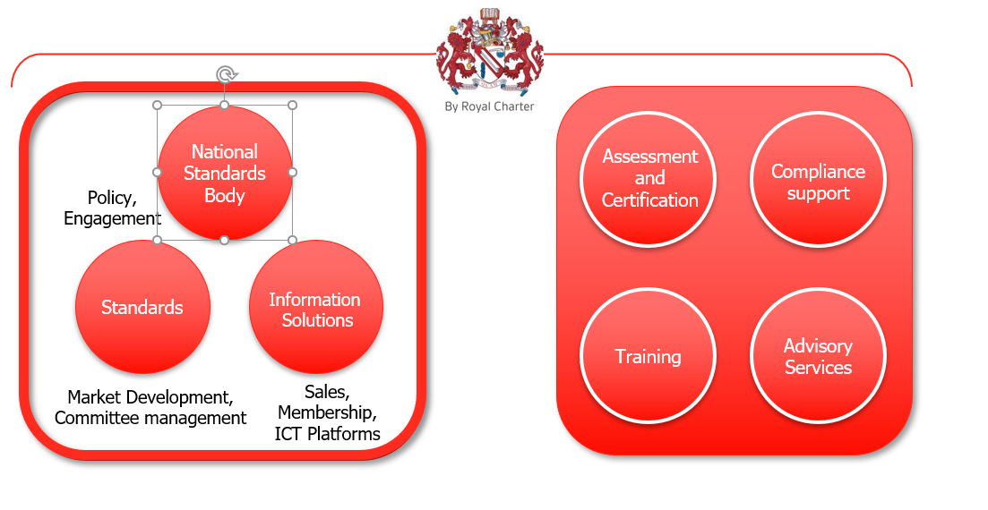
BSI Group Structure

Slide 4
Types of Certification
Covered in BS EN ISO/IEC 17067:2013 Conformity assessment — Fundamentals of product certification and guidelines for product certification schemes
Considered as Product Certification schemes
Operated by Certification Bodies such as BSI
Functions of a certification scheme:
Selection, Determination, Review, Decision, Attestation and Surveillance

Slide 5
Level | Description | Process
1a | One off type test to the standard No surveillance required | Test product is representative of typical production Gives no assurance that future production are as per the product sent for test No ongoing activity to ensure compliance
2 | Samples taken from the market periodically and to check items produced after initial attestation still meet requirements | Non compliant product could already be in the market Resource requirements are higher It does look at distribution channels and conformity
3 | Surveillance involves taking product periodically from production to check items produced after initial attestation still meet requirements Includes periodic assessment of production | Non confirming product can be found before it enters the market Products already in the market could be non complaint
4 | Surveillance allows for choice of taking samples from production, market or both to check items produced after initial attestation still meet requirements Includes periodic assessment of production | Allows for a choice so if both aren’t selected one remains unchecked which creates an unfairness in the market.
5 | Initial type testing + surveillance Certificate issue Ongoing surveillance includes periodic assessment of the QMS and limited safety testing of a product | Can cover a range of products Looks at production, QMS and product as part of initial and ongoing requirements CB’s ensure products carrying their mark are compliant with current standards
Assurance

Slide 6
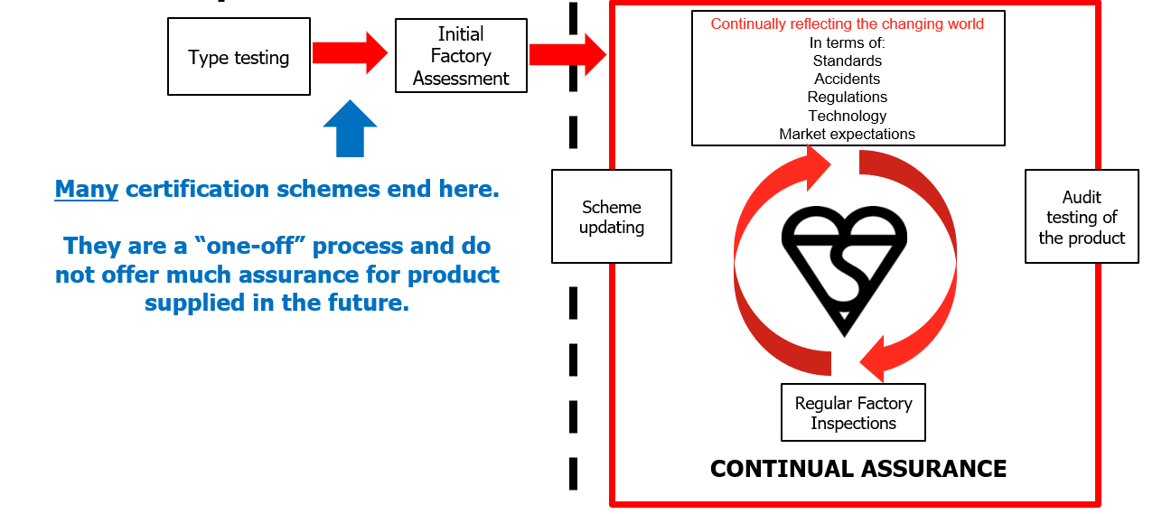
Kitemark Testing Process – Level 5 Certification

