Slide 1
Grid Securities Working Group
18 December 2020
Decarbonising the economy

Slide 2
Agenda
Welcome and introductions
Outline of the issues and questions
Possible solutions
Proposed plan of action

Slide 3
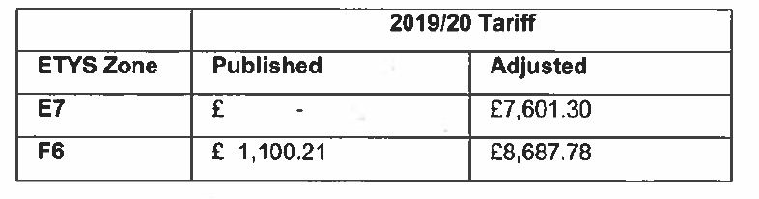
Introduction to the issue
CMP 192 & CMP 223 allowed DNOs to pass on their liabilities via securities and clarified the process.
Grid Securities (a proportion of the Wider Cancellation Charge Tariffs) are required to be paid after the developer of a proposed distributed generation site has accepted a grid offer.
An error discovered earlier this year saw liabilities increased as per the below – zones cover most of the South West
This brought to light a number of issues:
  Stark regional differences in how the securitisation process is handled by DNOs.
  DNOs requesting Triple A credit rating or cash upfront down payments as security.
  Lack of information provided at the grid offer stage, that developers are required to provide these securities, why, and how they are calculated.
  Lack of clarity about how the statuses of projects are communicated by DNOs to the ESO.

Slide 4
Possible solutions
To be discussed – reduce 26% cancellation charge from the date of key consents in place, for embedded connection, to a reasonable figure
A standardised securitisation process and clarity on associated cost calculations
A ban on requesting Triple A credit ratings as part of securitisation
Greater transparency on why securities are applied, how they are calculated, and how they should be paid
For a factsheet on securities and the securitisation process to be provided to would-be generators at the grid offer stage.
  This should include information about how securities are calculated and how to estimate securities, what they could be in the relevant zone, why and how they are applied, how and when they should be paid, when they are applicable, and the process for returning the money.
An established process on how DNOs should inform National Grid of key project dates.

Slide 5
Actions
Establish dialogue with ENA and DNOs, National Grid ESO and Ofgem on this issue
Discuss the liaison done so far by members with different DNOs and summarise which DNOs pass securities on and which don’t (so far we are aware of SSEPD, ENW)
Discuss and understand the inconsistencies among various DNOs on passing the cost to embedded generators. If there are DNOs who do not pass this cost how they manage this process?
DNOs pass the securities to embedded generators (and not demand/ import customers)
Research the drivers for this recent increased cost
Identify means of reducing the 26% rate when key consents dates are in place
Develop materials to support any case to change costs, including case studies and surveys of affected parties
Discuss whether a grid code modification proposal would be appropriate and collaborate to draft any required grid code modifications
See any modifications through the process

