Slide 1
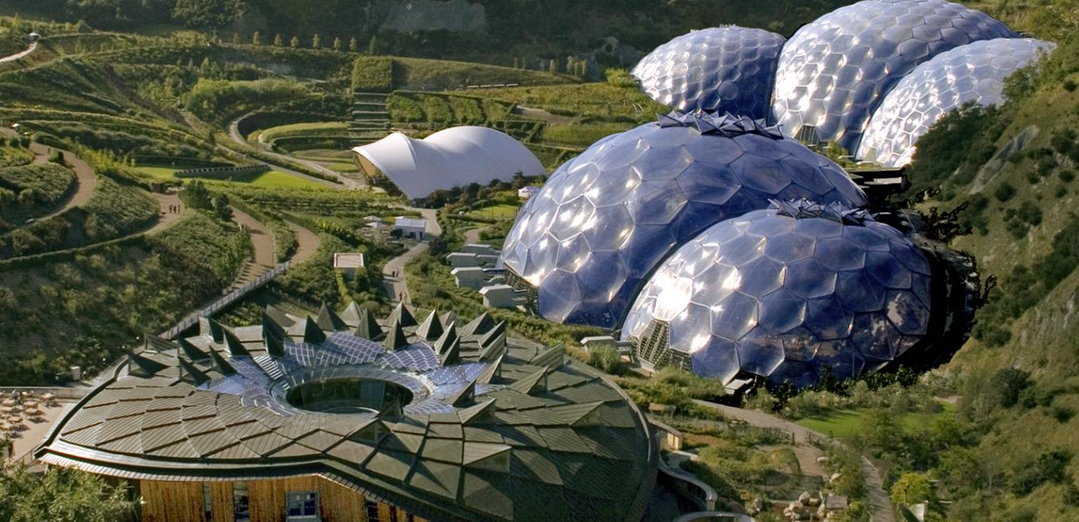

Deep geothermal heat workshop 7th February 2022
Dr Melanie Jans-Singh
Shivali Mathur

Slide 2






Outline
1 – Context
2 – Potential and barriers
3 – Outlook
1 – Context: why now?
2 – Potential and barriers of deep geothermal heat
3 – Outlook for the working group

Slide 3
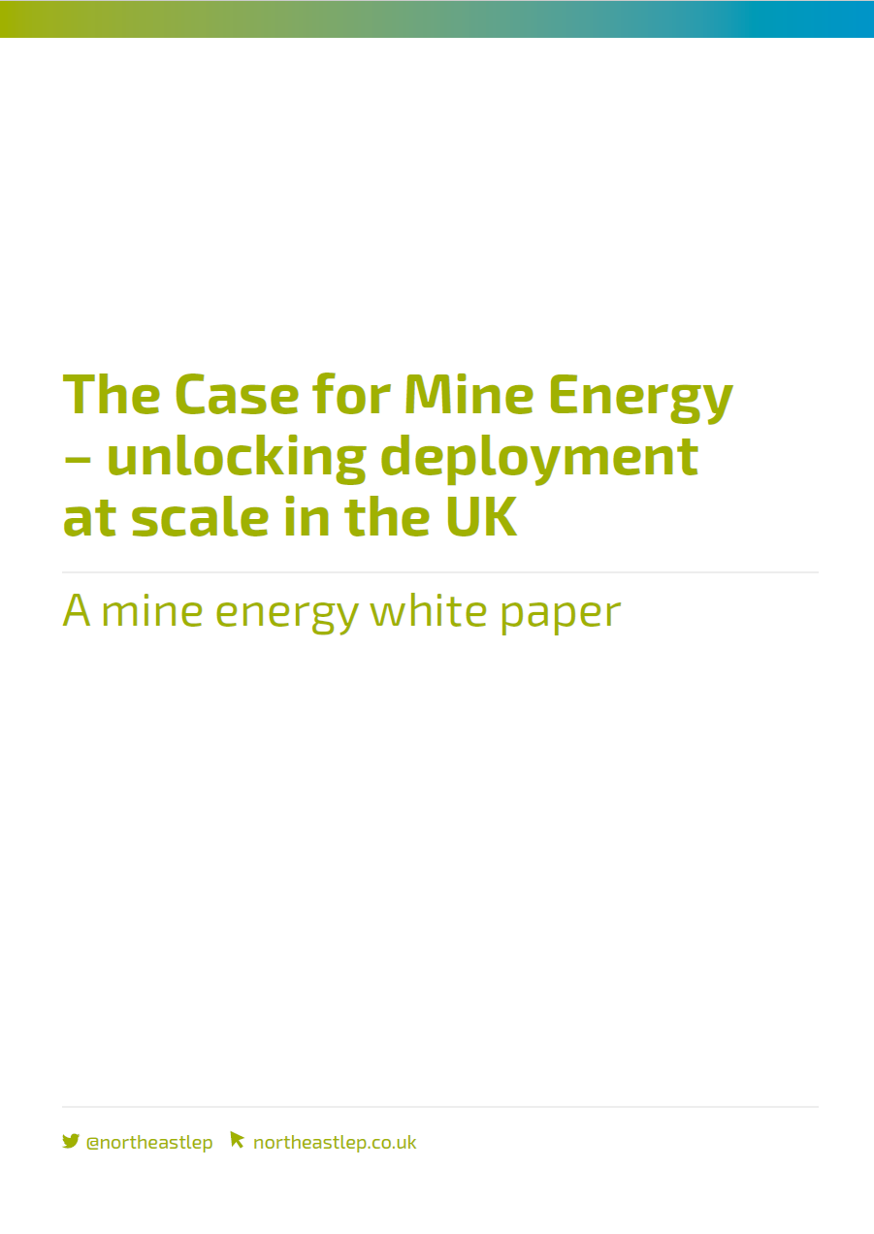



1 – Context for deep geothermal heat workshop
1 – Context
2 – Potential and barriers
3 – Outlook
25th May 2021
Mine energy white paper
March 2021
End of the RHI
July 2021
Geothermal Advisory Committee
for Northern Ireland
14th September 2021
Parliamentary debate
Opportunities for geothermal energy extraction in the UK
Feb 2022
Deep geothermal heat workshop
19th October 2021
Heat and Buildings Strategy
Notes:
In this presentation, we would like to highlight what we, as policy makers, know of the potential for geothermal and present what we see as the unaddressed barriers to further deployment.
Position:
HBS – Heating 13 mn homes, all pathways of decarbonisation
“To transform the national heating system, we need to replace many of the existing sources of heat with a variety of energy efficient, low-carbon technologies. We see heat pumps, heat networks and hydrogen as potentially playing a pivotal role in decarbonising heat. But we recognise that other technologies such as bioenergy, geothermal heat, and storage heaters may be a more viable alternative in some cases.”
Parliamentary debate – working on developing workshop with industry
High levels of activity in geothermal this year
Government in NI – Energy Strategy – advisory group initiated by Dpt of Economy – inform dpt and advise on geothermal opportunities – with aim to prepare a geothermal roadmap- chaired by Geological Survey of NI (subs of BGS) – industry + policy makers + academics

Slide 4
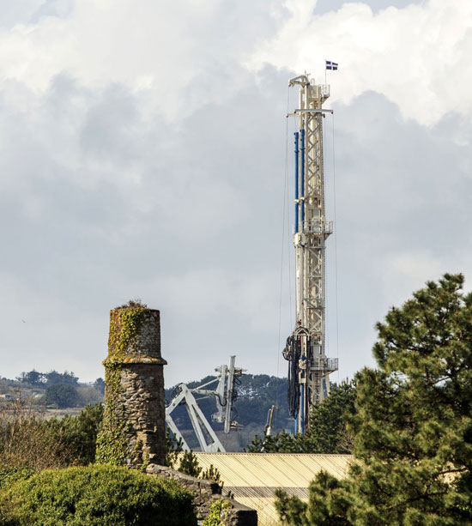
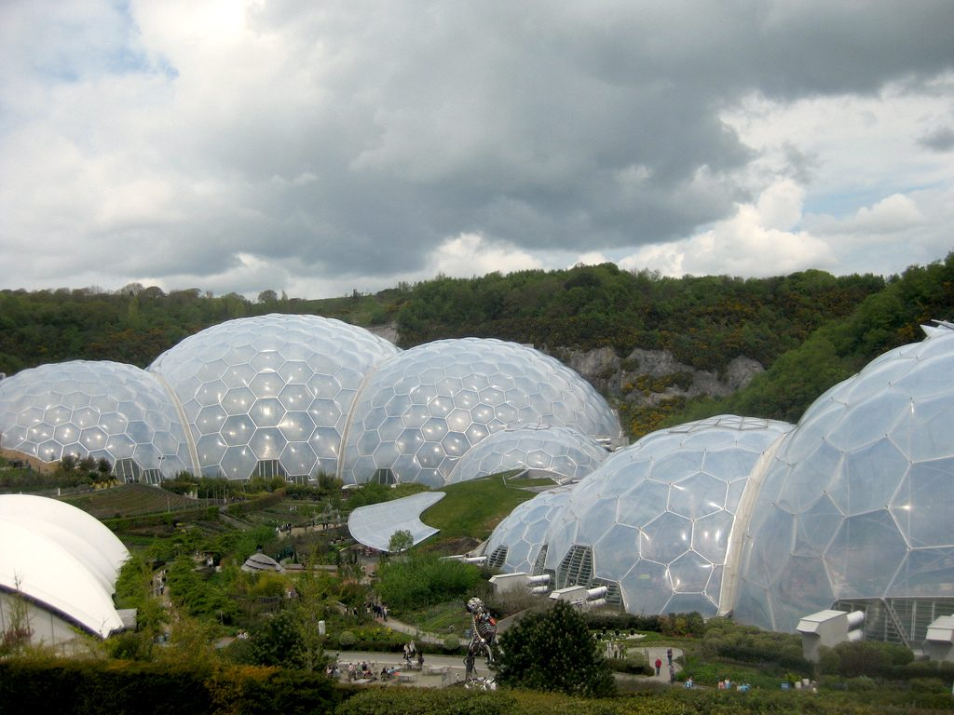
1 – Deep geothermal sites in the UK
1 – Context
2 – Potential and barriers
3 – Outlook
United Downs (GEL)
Status: Testing went well, expected to be complete 2022
Capacity: 12 MW_{th} and 3 MW_{e}
Funding: £10m (ERDF)
Depth: 2.5km and 5.3km
North Tyneside
Stoke on Trent (GT Energy/iGAs)
Status: Received planning permission 2021 []
Capacity: 12 MW_{th}
Funding: £20m (City Deal)
Manchester
Southampton (Engie)
Status: Built in 1986, been under repair since 2000s, likely operational again soon
Capacity: 1.7 MW_{th}
Funding: £12m?
Eden Project (Eden Geothermal)
Status: Received planning permission 2019
Capacity: 3.45 MW_{th}
Cost: £11.5m (ERDF and Council)
Depth: ~5km
Notes:
We have four promising sites in the UK- the purpose of this taskforce is to find out
Arup says we could have 25 operational sites by 2025 – how? What would be the timeline required, how does everything align to achieve this?

Slide 5






2 – Potential of deep geothermal for heat
1 – Context
2 – Potential and barriers
3 – Outlook
Opportunities and barriers
Platform
Academia
Businesses
Local and national government
NGOs
Interest groups
Low carbon heat source
Regulatory
Market
Geological
Financial
Technical

Slide 6

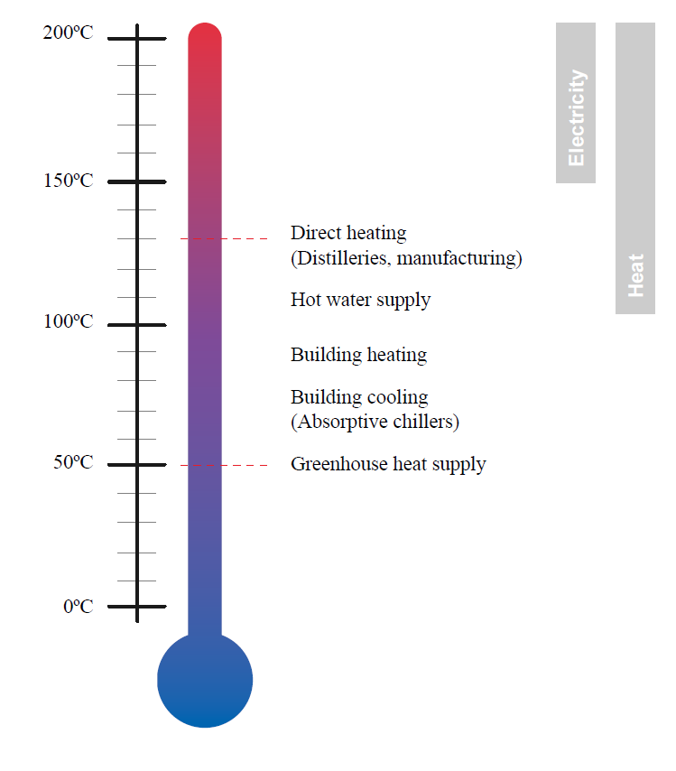
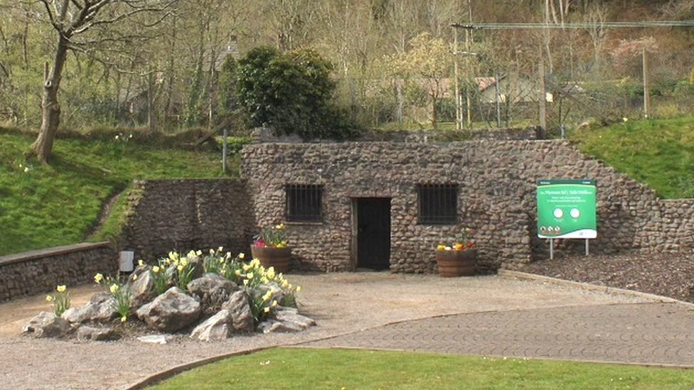
2 – Theoretical potential for deep geothermal
1 – Context
2 – Potential and barriers
3 – Outlook
Low carbon heat source
Electricity
Potential for 2 GW electricity (2.6% of UK electricity capacity) [1]
Heat
Theoretically recoverable 328 EJ, or 125 times annual UK heat demand [2]
Integration to district heating systems
Repurposing oil and gas infrastructure and skills
Unquantified evidence Uses same specialist equipment and skills
Potential to reuse shale boreholes
Heating and cooling storage
£14.6m in research from EPSRC and NERC to investigate potential [3]
Saving of 10 kt CO2e/year for a typical plant [6]
On-demand heat source
Low land use
Potential for deep geothermal heat [5]
Academic scrutiny of potential
Taff’s Well Thermal Spring heat network [4]
Notes:
Position
[1] Keeping warm: a review of deep geothermal potential of the UK. Gluyas, J G, et al. 1, s.l. : Proceedings of the Institution of Mechanical Engineers, Part A: Journal of Power and Energy, 2018, Vol. 232.
[2] Unlocking the potential of geothermal energy in the UK. Keyworth, Nottingham : UKRI, 2020.
[3] https://www.ukri.org/news/eleven-projects-launched-to-decarbonise-heating-and-cooling/
[4] Taff’s geothermal spring
Picture from: https://www.bbc.co.uk/news/uk-wales-54965889
[5]
[6]

Slide 7

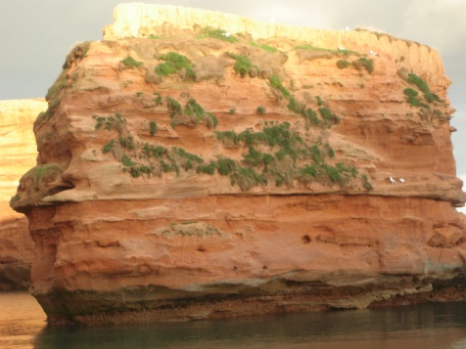
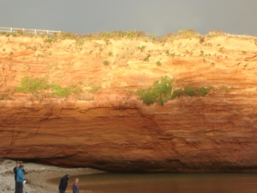
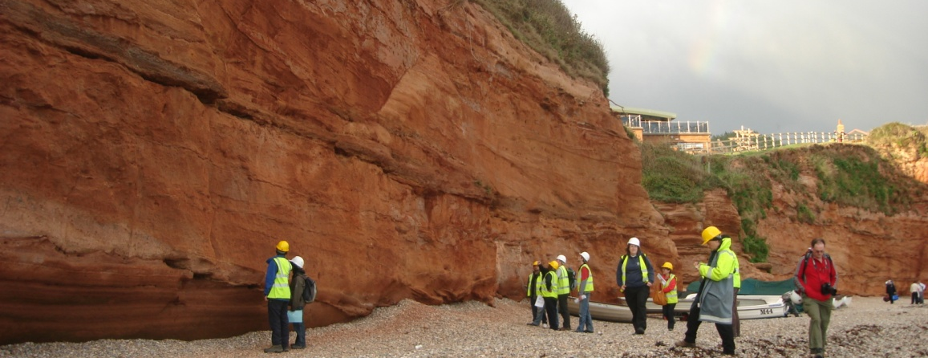
2 – Geological barriers and opportunities
1 – Context
2 – Potential and barriers
3 – Outlook
Barriers
Heat depletion
Uncertainty of deep geology
Unidentified/ unquantified potential (e.g. lithium)
Induced seismicity
Potential without reservoir or groundwater flow
Data access and availability
Geological potential
Suitable geology in some parts of UK (high porosity, permeability, reservoir)
Ways to overcome geological uncertainty, increasing transmissivity of subsurface reservoirs
Notes:
Photos from Jon Gluyas: Sherwood Sandstone Ladram Bay, Devon, October 2011

Slide 8

2 – Market opportunities and barriers
1 – Context
2 – Potential and barriers
3 – Outlook
Heat and power
Barriers
Different heat gradients to Europe and lack of case studies in UK
High capital cost (£1.6-£1.8M/km) [Arup]
Uncertain long-term revenues
New business models
Market penetration & supply chain
Promotion of technology
Market potential
No installed capacity
3 MW_{e} in pipeline
Potential protection against volatile gas prices
Economic stimulus (~£30m projects)
Job creation and transition
Alternative to electric heat
Heat only
2 MW_{th} installed capacity
15 MW_{th} in pipeline
Commercial pipeline of opportunities
Linking heat source to heat network

Slide 9

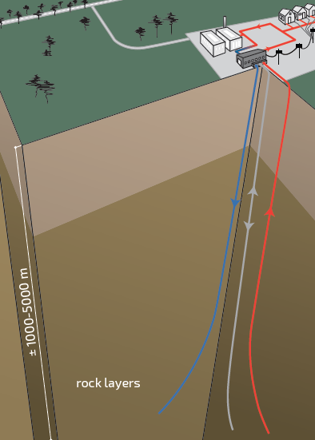
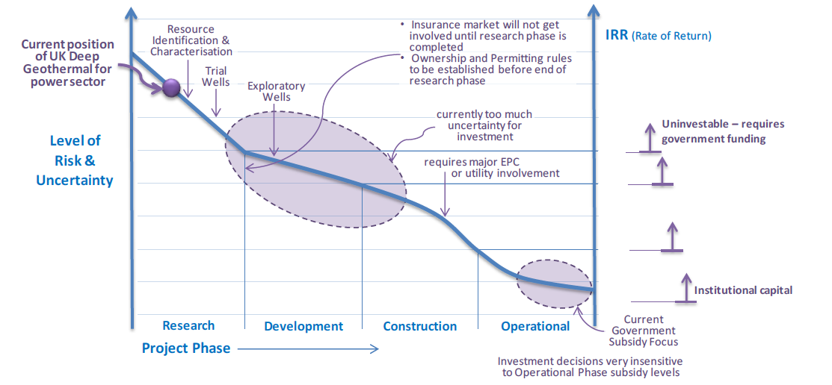
2 – Technical potential and barriers
1 – Context
2 – Potential and barriers
3 – Outlook
Barriers
Efficiency of system with low grade heat
Reuse of oil and gas boreholes
Geothermal as energy storage
Data access and availability
Training of technicians and decision-makers of regional and local authorities
Enhanced/engineered geothermal systems
Technical potential
Higher temperature district heating systems
Doublets well established
Enhanced systems successful in Cornwall
How does innovation change the risk profile?
Notes:
Figure is from 2013 Atkins report on deep geothermal for heat and power

Slide 10

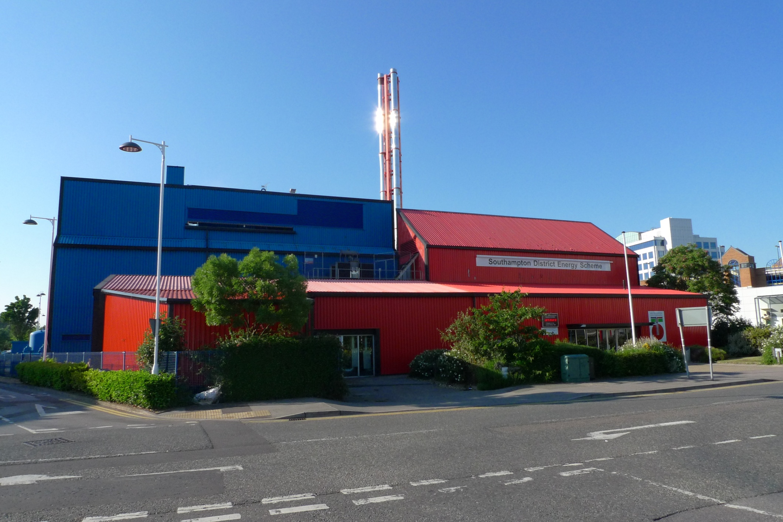
2 - Regulatory potential and barriers
1 – Context
2 – Potential and barriers
3 – Outlook
Barriers
Legislating heat as a resource
End-of-life and repairs
Integration into heat networks
Multi-stakeholder acceptance and awareness
Management of risk profile
Regulatory
Potential to integrate with heat networks
Licensing system with Environment Agency
How would regulatory change affect the business model?
Photo: Southampton plant by Jon Gluyas
Notes:
Photo – Southampton scheme by Jon Gluayas
Geothermal energy can be connected to heat networks: a distribution system of insulated pipes that carry hot water to homes or businesses.
National and local rules must include a definition of geothermal energy resources and related terms, in line with Directive 2009/28/EC.
Ownership rights should be guaranteed.
Administrative procedures for geothermal licensing have to be fit to purpose.
The rules concerning the authorisation and licensing procedures must be proportionate and simplified, and transferred to regional or administration level. The administrative process must be reduced.
Rules for district heating (DH) should be as decentralised as possible in order to be adaptable to the local context, and stipulate a mandatory minimum level of energy from renewable sources, in line with Article 13 §3 of Directive 2009/28/EC.
A unique geothermal licensing authority should be set up.
Information on geothermal resources suitable for GeoDH systems should be available and easily accessible.
GeoDH should be included in national, regional and local energy planning and strategies.
Policy-makers and civil servants should be well informed about geothermal.
Technicians and Energy Service Companies should be trained in geothermal technologies.
The public should be informed and consulted about Geothermal DH project development in order to support public acceptance.
Geothermal energy should be given priority in legislation over other uses such as for unconventional fossil fuels, CCS, and nuclear waste deposits.

Slide 11





3 – Role of BEIS in working group
1 – Context
2 – Potential and barriers
3 – Outlook
Signposting
NERC/EPSRC research projects
Funding
Funding NELEP taskforce for facilitation work
Through Green Heat Networks Fund
Listen, learn and review
Deep geothermal white paper
Financially viable
Technically recoverable
Ground heat resource
Ask policy relevant questions
What is the scale of the opportunity?
Supporting evidence for the full set of benefits
How varied are project costs?
Notes:
Barriers to developing a pipeline
Key outcome should be understanding the supply chain, and how to make heat customers align with heat source, and develop positive business case for this Cost estimates are different for everyone –
Can we achieve a constant cost matrix – drilling methods, oil & gas industry standard, different frameworks - construction market – large range of prices - what is the minimum framework

Slide 12
References
1. Keeping warm: a review of deep geothermal potential of the UK. Gluyas, J G, et al. 1, s.l. : Proceedings of the Institution of Mechanical Engineers, Part A: Journal of Power and Energy, 2018, Vol. 232.
2. Abesser, Corinna, et al. Unlocking the potential of geothermal energy in the UK. Keyworth, Nottingham : UKRI, 2020.
3. Deep Geothermal Energy: Economic decarbonisation opportunities for the United Kingdom. Arup. s.l. : Renewable Energy Association, 2021.
4. Brownsort, P, G, Johnson and Storage, Scottish Carbon Capture &. A synthesis report covering four feasibility studies. Edinburgh : Edinburgh Centre for Carbon Innovation, 2017. SCCS0174.
5. DECC. Underground Access Rights clauses in 2014 Infrastructure Bill – Impact on deep geothermal activities. London : Department of Energy and Climate Change, 2014. DECC0179.
6. GeoDH. UK - An integrated Energy Scheme using Geothermal Energy in Southampton. s.l. : European Union, 2014.
7. Atkins. Deep Geothermal Review Study. London : Department of Energy and Climate Change (DECC), 2013.
8. AECOM. Study into the Potential for Deep Geothermal Energy in Scotland. s.l. : The Scottish Government, 2013.
9. “On The Rocks” – Exploring Business Models for Geothermal Heat in the Land of Scotch. Townsend, D H, et al. Reykavik, Iceland : Proceedings of World Geothermal Congress 2020, 2020.
10. Bojek, Piotr and Bahar, Heymi. Geothermal power. s.l. : International Energy Agency, 2021.
11. A Review of the Performance of Minewater Heating and Cooling Systems. Walls, B, et al. 6215, s.l. : Energies, 2021, Vol. 14

Slide 13
4 – Summary
1 – Context
2 – Benefits
3 – UK Sites
4 – Challenges
5 – Our role
6 – Outlook
underdeveloped supply chain causing delays and higher cost of maintenance
Learn from other industries and supply chains
Financially viable
Technically recoverable
Ground heat resource
Cost of technological and long-term (depletion) risk
Improved forecast modelling
Library of case studies and guidance documents
Uncertain & high drilling costs
Lack of deep geological data
Further exploratory boreholes
Linking geothermal source to heat network
Platform with drilling companies, Coal Authority, local government association
Accuracy challenge to model 3D subsurface (lack of data)
Cost of exploration risk
Availability of aquifer or ground water flow, type of bedrock
Challenges and innovations of increasing transmissivity of subsurface reservoirs
Notes:
What is really needed
Reviewing what technology is available from other countries which can be adapted for UK (learnings/ sharings/ transition path from other sectors)
Forecast – if you take heat out and rate created –will not run out, but uncertainty around rate & cost of needing a heat pump vs reservoir depletion –feasibility of abstraction at replenishment rate

