Slide 1


Wood Heat Forum Member Meeting September 2021

Slide 2

Welcome from the Chair
Julian-Morgan Jones
Wood Heat Forum Chair
.

Slide 3
Agenda
Welcome from the Chair, Julian Morgan Jones – South East Wood Fuels (13:00)
Campaigning, messaging and external affairs - REA Staff and Steering Group (13:05)
Overview of biomass strategy
Political meetings
WHF Messaging plan
Policy Update - REA Staff + Woodsure Guest Speakers (13:40)
Update on Heat and Building Strategy
Industrial Decarbonisation Funds
Fuel Quality Standard and MCS Maintenance Standard Presentation/Update by Woodsure staff (Andrew Hopton)
Member discussion on Fuel Quality & Maintenance Standard/Woodsure Q&A
Combined Heat and Power Call for Evidence
Wood Heat Forum Steering Group Election information - Mark Sommerfeld REA (14:20)
Closing comments from the Chair, Julian Morgan Jones – South East Wood Fuels (14:25)

Slide 4
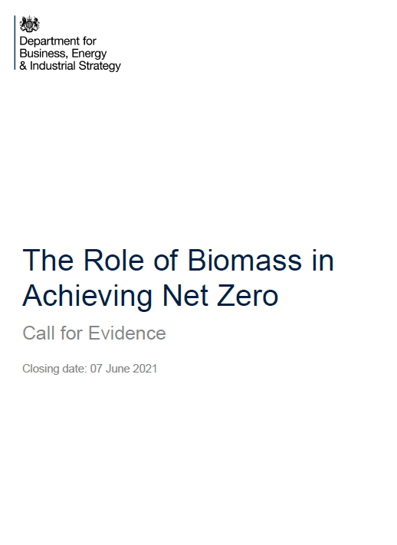
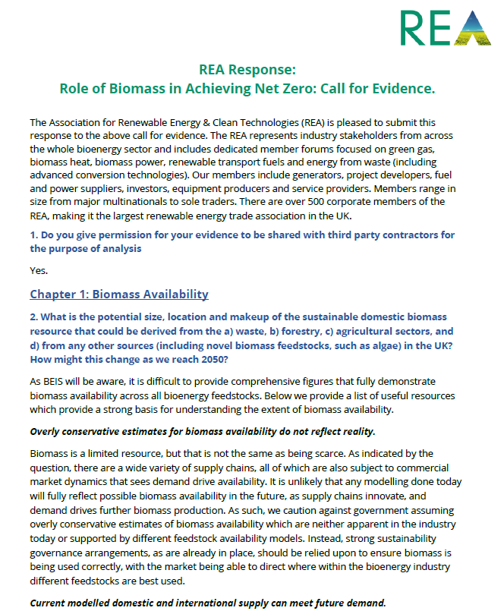
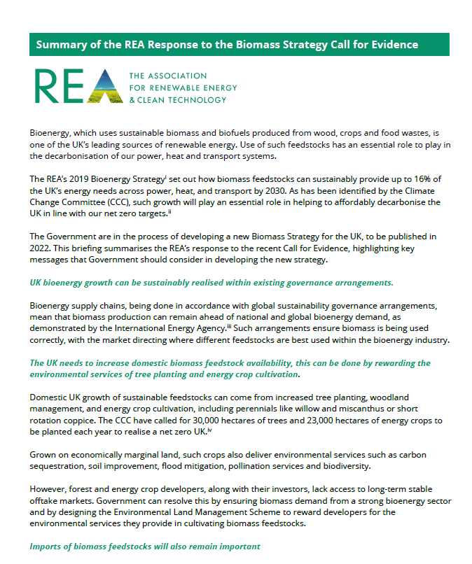
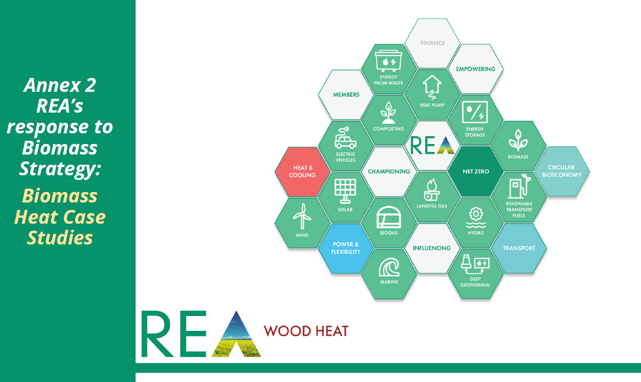
Campaigning Messaging and External Affairs – Biomass Strategy
The REA submitted a comprehensive response to the biomass strategy call for evidence in June.
Thank you to everyone who provided input into the response. This was a major workstream for the REA with five-member roundtables, a BEIS industry seminar and several meetings with MPs.
The REA are continuing to be engaged with the Biomass Strategy team in BEIS, Minister and MPs to continue to inform the development of Government policy.

Slide 5
Campaigning Messaging and External Affairs – Biomass Strategy
Key Biomass arguments the REA made included:
UK biomass growth can be sustainably realised within existing governance arrangements.
The UK needs to increase domestic biomass feedstock availability – Including use of innovative feedstocks like Perennial Energy Crops and SRC.
Biomass delivers a UK Bioeconomy that supports jobs over 54,000 jobs and contributes £9.2bn to the UK economy
Stringent governance arrangements are already in place and ensure a sustainable sector
Innovation in Biomass Carbon Capture and Storage (CCS) will be delivered by building on existing bioenergy sectors.
Additional Biomass Heat Messaging:
Policy has repeatedly underestimated the role of Biomass Heat, by labelling it ‘niche’ without defining the size of sector. This potential was further demonstrated through the case studies.
The Biomass Heat industry has an essential role in delivering carbon emissions savings today and in the future.
Failure to replace the Non-Domestic RHI is now a major policy Gap.
Stringent Installation, fuel and maintenance standards are the best way to address air quality concerns.
Reward conversion efficiencies when considering ideal use for biomass.

Slide 6

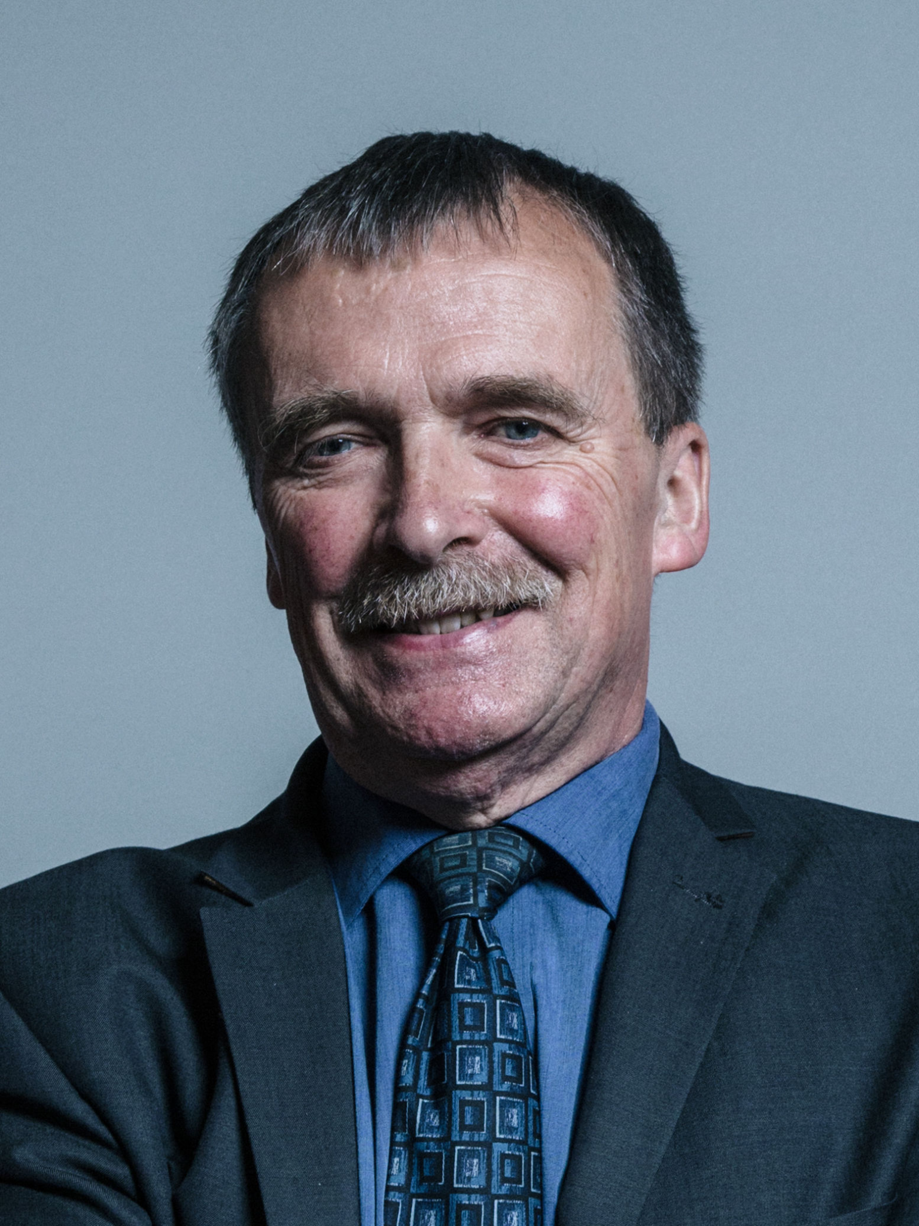
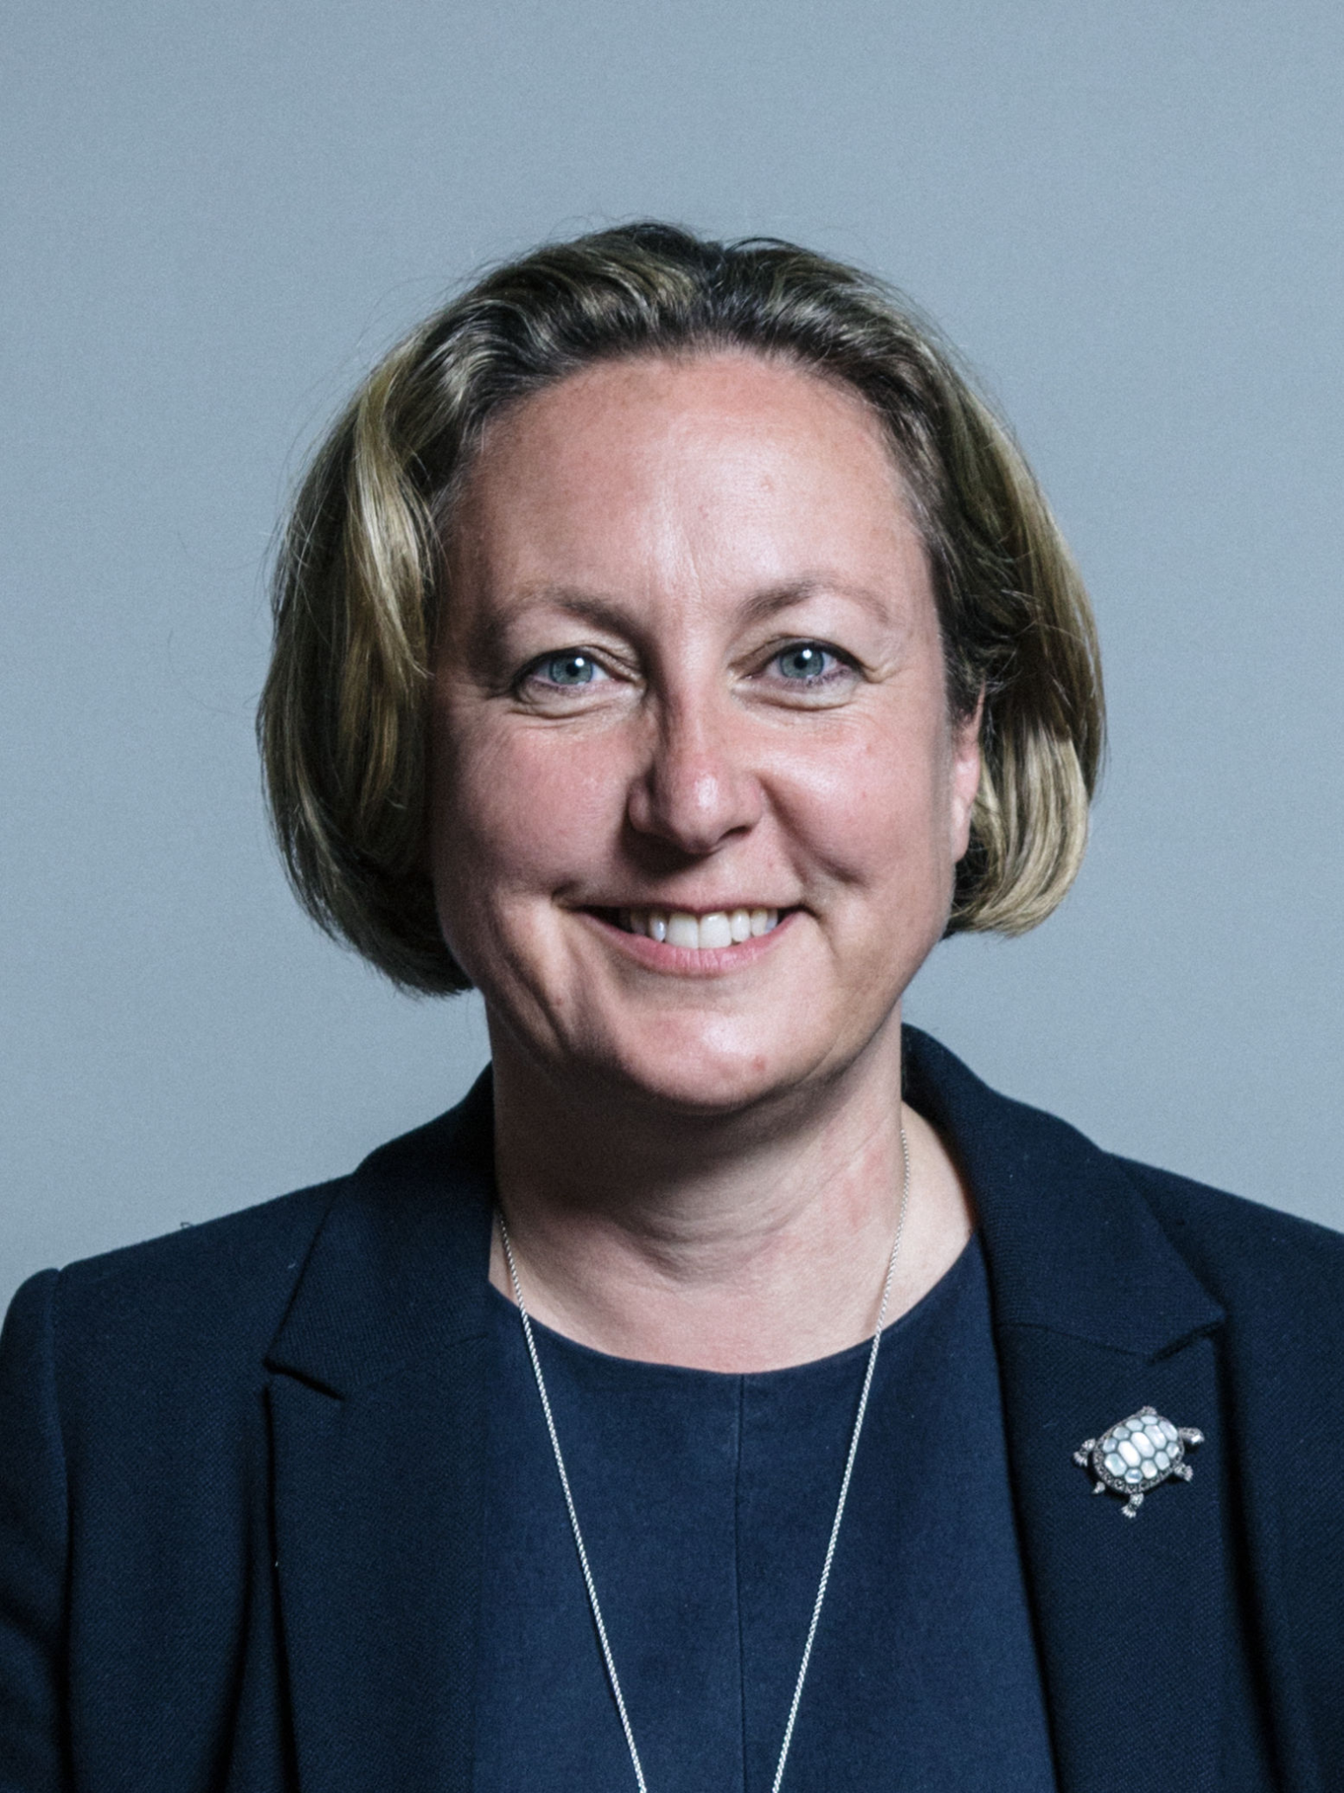

Meetings with Officials on Biomass Strategy
REA staff continue to engage with elected officials and other senior political stakeholders to represent the views of Wood Heat Forum Members. We recently recirculated our Biomass Strategy Briefing to MPs following their return to parliament. Some notable meetings include:
Kwasi Kwarteng
Secretary for State BEIS (further meeting on Biomass Strat. upcoming)
Alan Whitehead
Shadow Minister for Green New Deal and Energy
Other Notable MP Meetings who asked question relating to Biomass Heat :
Richard Fuller MP (Con)
Lisa Cameron (SNP)
Martyn Day (SNP)
Salaine Saxby (Con)
Luke Pollard (Lab)
Alex Cunningham (Lab)
16 MP meeting in total
Anne-Marie Trevelyan
Previous Minister for Energy
David Capper
Director of Clean Heat at BEIS

Slide 7

Political Update – New Minister Greg Hands
Chelsea MP Greg Hands has been appointed as a Minister at BEIS, with his policy brief covering heat.
Hands does not have a significant record of engaging with renewable or clean technologies in the House.
Although in his role leading the UK-Japan trade deal, he has defended the UK's commitment to the net-zero 2050 target when asked by ministers.
Hands' voting record in parliament indicates moderate support for green technologies.
However, Hands has voted to stop rises in road fuel duty and has a mixed record on Hydraulic Fracturing regulation.
We have already written to Greg Hands, congratulating him of his appointment and requesting a meeting.
Notes:
It is a shame that previous energy minister, Anne-Marie Trevelyan, has already been moved on, especially as she had previously owned a biomass boiler and was a supporter, as well as the REA having established a solid relationship following a number of meetings.

Slide 8
Wood Heat Forum Messaging Plan

Slide 9
Key Messages
Biomass Heat can provide 42 TWh of Heat by 2030
The REA Bioenergy Strategy demonstrated that Biomass heat could produce up to 42 TWh of heat across buildings and industry sector by 2032. Displacing about half of todays oil demand for heating in buildings, manufacture and constructions.
Biomass Heat could be needed to heat 260,000 domestic properties in the UK
The size of the ‘hard to treat’ domestic off gas grid sector is estimated to be 20% of all domestic properties by BEIS. This equates to 260,000 domestic properties where biomass may be an appropriate solution. That’s more then 20 times the current domestic biomass market.
Over 300 Biomass Heat Companies Stand Ready to Deliver Immediate Carbon Savings Today
REA Review 2021 suggest there are 324 companies involved in Biomass Boilers across the UK today, employing over 7000 people. This totals a contribution to the UK Economy of £1bn.
Biomass heat delivers immediate carbon reduction today, while further renewable heat markets develop
Biomass heat is one of a small number of established renewable heat sectors in the UK, with firm supply chains, expertise, and investors. Biomass heat is already delivering emission savings today, advancing decarbonisation
targets now.
Notes:
Biomass Heat can provide 42 TWh of Heat by 2030 The REA Bioenergy Strategy suggested that Biomass heat could produce up to 42 TWh of heat across buildings and industry sector by 2032. Equating to roughly half of todays oil demand for heating in buildings, manufacture and constructions.
Note CCC sixth Carbon Budget, figure 2.7) estimates energy demand for oil in buildings as 46 TWh and 45 TWh for Manufacturing and Construction in 2021. Total 91 TWh of demand. Hence 42 TWh of biomass is rougthly half this demand that could be replaced by biomass.
Biomass Heat could be needed to heat 260,000 domestic properties in the UK
The size of the ‘hard to treat’ domestic off gas grid sector is estimated to be 20% of all domestic properties by BEIS. This equates to 260,000 domestic properties where biomass may be an appropriate solution. That’s more then 20 times the current domestic biomass market.
Delta EE estimated about 80% of off gas grid domestic homes could be electrified at their current level of insulation. There are about 1.3 mn off gas grid properties in the UK. 20% of 1.3 million = 260000 homes.
Number of domestic biomass boilers on the Domestic RHI as of August 2021 = 12364
260000/12364 = 21.02
Biomass heat delivers immediate carbon reduction today, while further renewable heat markets develop
Biomass heat is one of a small number of established renewable heat sectors in the UK, with firm supply chains, expertise, and investors. Biomass heat is already delivering emission savings today, advancing decarbonisation targets now.

Slide 10
Messaging House: General Messages
Biomass Heat delivers immediate carbon reductions today, while further renewable heat markets develop
Biomass heat provides high heat loads particularly suited for use in public buildings and heat networks
Government consistently underestimates the size of the ‘hard-to treat’ sector, where biomass heat has a prominent role to play.
Biomass Heat is supplied in accordance with strong sustainability governance arrangements.
Biomass policy should reward efficiencies in energy conversion
Domestic biomass availability can also be increased by short rotation coppice and perennial energy crops which also deliver additional environmental services.
Biomass Heat helps drive the UK bioeconomy, delivering jobs and green growth
Energy policy must build on existing sectors, encouraging innovation and prioritising desirable environmental, social and economic outcomes
Biomass heat takes the strain off the electricity grid

Slide 11
Messaging House: what will we use this for?
Key messaging priority is to be able to inform the development of the Biomass Strategy and future heat policy, ensuring biomass heat is represented in final document.
Key stakeholders to influence:
Civil Servants – Heat and Biomass Strategy teams in BEIS, forestry civil servants in DEFRA, HM Treasury
Politicians – particularly MPs with rural constituencies or large industries where biomass could have a strong role to play
Ministers (particularly BEIS)
Key Outputs:
Industry blogs/ Articles – highlighting potential and strong case studies – aimed at trade press
Continuing Op-eds and public rebuttals
MP and Ministerial Briefings continuing political engagement.
Developing further materials for members to contact their MPs with
Further developing messaging once we have seen the
Heat and Building Strategy.

Slide 12
Policy Update

Slide 13
Heat and Building Strategy
The Heat and Building Strategy continues to be delayed but is still expected ahead of COP 26, and likely in the next few weeks.
The REA has put out several statement criticising the delays, highlighting the renewable sector cannot afford to continue to be held back.
Reshuffle likely responsible for latest delay, with new minister needing to be briefed.
REA have been calling on government to address the large policy gap for commercial and industrial heat decarbonisation following closure of the ND RHI in March.
Rumoured inclusions to look out for (but certainly not to be considered confirmed):
More generous Clean Heat Grant then originally consulted on for domestic properties
Possible domestic rebates for fuel poor to mitigate additional costs of low carbon heating
Maybe a consultation on some form of industrial heat decarbonisation mechanism (Fuel Switching Tariff? Heat CfD?)
Likely to focus on heat pumps, and maybe further deliberation around Hydrogen. Statements on Biomass expected to relate to be directed at Biomass Strategy, but also see a continuation of ‘niche’ messaging.

Slide 14
Industrial Decarbonisation Funds available
The REA heat policy team has put together an Industrial Decarbonisation Grid. This grid covers all financial schemes supporting Industrial decarbonisation as of 22nd September 2021.
The grid gives a quick breakdown of the how the financial scheme works and its goals.
Policies covered include:
The Energy Industrial Transformation Fund (IEFT)
Designed to help businesses with high energy use, such as energy intensive industries, to cut their energy bills
Industrial Fuel Switching Competition
Designed to Support innovative fuel switching and fuel switching enabling solutions.
Red diesel replacement competition
Aims to support low carbon fuel and system alternatives to red diesel
Industry of Future Programme
Designed to support industrial sites by awarding funding to develop decarbonisation pathways
Industrial Energy Efficiency Accelerator (IEEA)
Designed to provide funding for the development and demonstration of technologies that could reduce energy consumption
Green Heat Network Fund
Designed to support the development of low and zero carbon (LZC) heat networks

Slide 15

Policy Update – New Fuel Quality and Maintenance Standards, Starting April 2022
Presentation by Woodsure staff (Andrew Hopton)
Followed by member discussion/Q&A

Slide 16
Policy Update – CHP Call for Evidence
BEIS have announced a call for evidence examining incentives available for Combined Heat and Power (CHP) generation.
The call for evidence will also cover reforming CHP support policy to avoid subsidised gas CHP plants displacing lower carbon generation.
Under current policy CHP plants are dominated by natural gas (68.9%).
In comparison renewable fuels only account for 18.8% of plants, with biomass making up 37.9% of the renewable plants.
BEIS hopes to gather views on how this balance can be tilted more in favour of renewable fuels, with a particular focus on the following areas:
The need for change to decarbonise CHP to meet future carbon budgets.
Low carbon CHP options that may be adopted to help decarbonisation.
Potential options forming a pathway to CHP decarbonisation.
Call for Evidence builds on previous Call last year on general CHP policy.
REA policy team are currently working on a response, details on how members can feed into the response will be circulated soon.
Notes:
In terms of biomass - BEIS' current minded position is to promise biomass CHP development when combined with Carbon Capture Utilisation and Storage (CCUS). However they are considering restricting support for biomass CHP only to situations where there are no viable alternatives.

Slide 17
WHF Steering Group and Chair Elections – October 2021

Slide 18
Election Information
Members of the Current Steering Group are coming to the end of their term (3 years), although may stand again if they would like to. Our Forum Chair, Julian Morgan Jones, has indicated a wish to stand down.
These elections for the Wood Heat Forum Steering Group will take place in October. Those elected to the SG will then be able to nominate a Chair.
Commitments
Steering Group: 1 hour phone call a month, plus any small requests by email in-between calls.
Chair: Is also elected to the REA Policy Board, which meets 6 times a year.
Application
Please have a think about whether you would like to put yourself forward for the WHF Steering Group.
It is an excellent opportunity to represent your business and help steer the sector. Additional benefit of being the first to know about policy developments and discussions.
Official election notice will be sent out shortly, including requests for 300-word personal statements. Applications to be sent to pjohn@r-e-a.net

Slide 19

Chair’s Closing Remarks
Any Questions?
Email us:
heat@r-e-a.net

Slide 20
RHI Biomass Maintenance Standard
From 1st April 2022 all biomass participants under the ND RHI will be required to:
Have an annual maintenance survey completed.
Maintenance provider will need to demonstrate registration to MCS standard or equivalent.
Where an equivalent standard is used, BEIS are appointing a third party certification body to certify alternative standard.
Proof of compliance will be expected as part of the participant’s annual submission to Ofgem.
It was also confirmed that this will form part of ongoing obligations as of 1st April 2022.
The industry-led MCS standard was handed over to HETAS to operate. The Standard is now open for registration.
REA have fed back to HETAS, BEIS and Ofgem around concerns around the standard, but reiterate this should be viewed as a putting in place a minimum level that ensure all RHI sites do have at least one maintenance check a year.

Slide 21
RHI Biomass Fuel Quality Standard
From 1st April, all ‘woodfuel’ used on the RHI will need to meet a Fuel Quality Standard. The RHI regulations define “Woodfuel”, in the context of the woodfuel quality criteria, as “woodchip, logs, wood pellets and wood briquettes, regardless of whether the wood will undergo any other process before burning.” Note this does not include non-woody feedstocks or waste.
To satisfy the requirements, participants and their suppliers will need to meet the following (whichever applies):
All other woodfuel must meet fuel quality standard EN 15234-1:20118, EN15234/ISO 9001: 20159, EN ISO 17225-4:201410 or an equivalent standard
Compliance with this requirement can be demonstrated by using the Woodsure Certification Scheme or an equivalent scheme such as the UKPC ENPlus Certification scheme.
Government have amended the terms of the Biomass Suppliers List (BSL) to include these fuel quality requirements. This will allow participants to demonstrate to Ofgem that the fuel they are using in their biomass boilers meets the ND RHI.
Where participants self-report to Ofgem, the onus will be on the participant to show compliance with the new wood fuel quality criteria.
Requirements will not apply to waste wood, where fuel requirements are determined through environmental permits.

