Slide 1
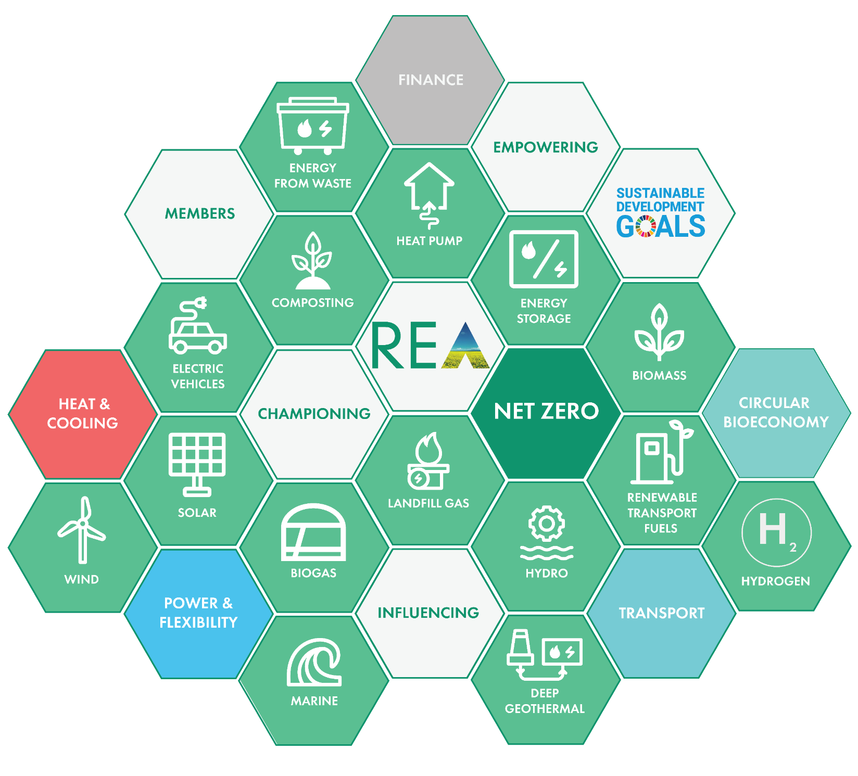
www.r-e-a.net
Welcome!
REA AGM
2021
REA Restricted:
This contains information that is confidential to the REA and its members and should be not be shared without permission

Slide 2
Agenda:
Chair’s welcome
Chief Executive’s Report – activities since the last AGM (September 2020)
Elections of Directors by Ordinary Resolution: Resolution 1 - Subject to the approval by the Members of the resolution, the election of 2 Member Non-Executive Directors. Candidates: Juliet Davenport OBE, David Williams Resolution 2 - Subject to the approval by the members of the resolution…
Any other business
REA AGM 23/9/2021
REA Restricted:
This contains information that is confidential to the REA and its members and should be not be shared without permission

Slide 3
Sept 2021
CEO Report
Dr Nina M Skorupska CBE FEI
What we do & benefits of membership
REA Governance
The REA team
Performance: 2020 Audited Accounts
Insight into REA Strategy 2020/21
REA Restricted:
This contains information that is confidential to the REA and its members and should be not be shared without permission

Slide 4
Our Vision
A future built on
renewable energy and
clean technology
A world that has surpassed unabated fossil fuels;
where clean technologies and renewable energy is accessible for all.
We, the REA, are a coalition built to promote
renewable energy and clean technologies.
REA Restricted:
This contains information that is confidential to the REA and its members and should be not be shared without permission

Slide 5
Our Mission
DECARBONISING THE ECONOMY
We are here to help our members build commercially and environmentally sustainable businesses
We do this by:
CHAMPIONING the role and benefits of renewable energy and clean technologies and the new disruptive decentralised business and market models supporting them
INFLUENCING governments, industry and individuals
EMPOWERING renewable energy and clean technology businesses to achieve sustainable growth

Slide 6
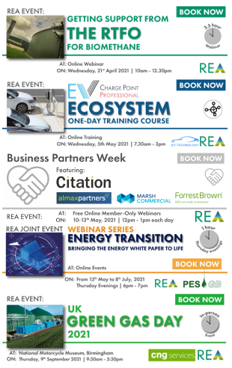



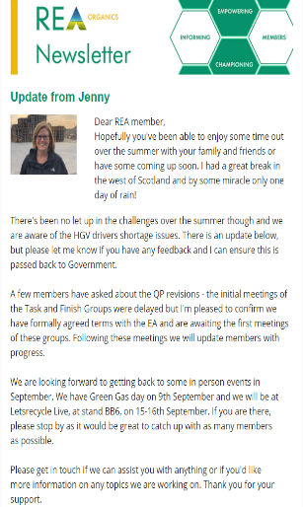
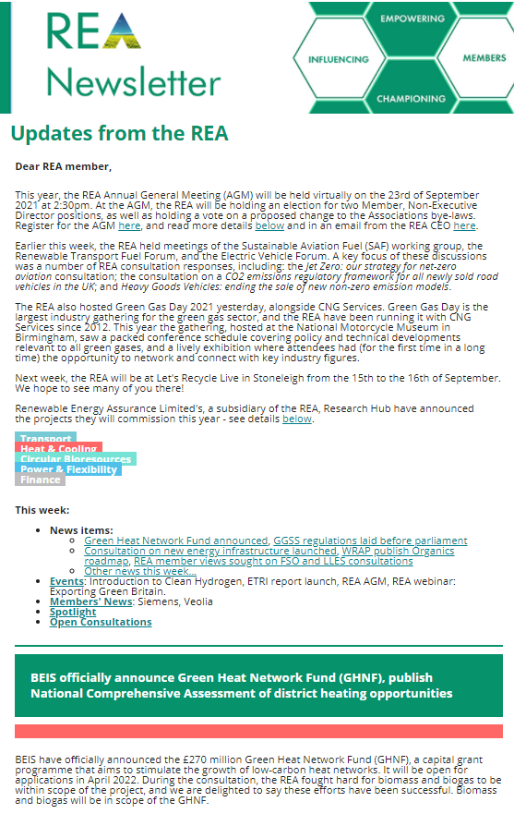


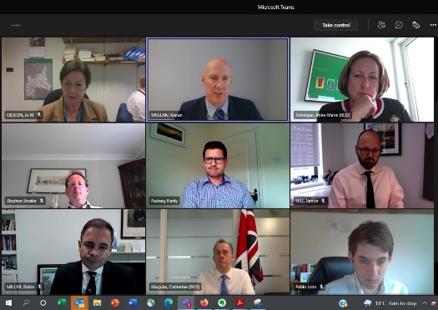




What we do
The REA continued to support its members in the new COVID-19 working environment!
For the remainder of 2020 & into 2021
Online Events, Seminars Training
Sept 2021….held its first in-person event
- UK Green Gas Day
For 2022 COVID-19 permitting:
Conferences, Seminars, Workshops & Training complimenting our Online platforms
Publications & Newsletters
Deep Geothermal 14.09.21
Minister & MP roundtable
Our Subsidiaries
Ministerial & Government Dept. meetings

Slide 7


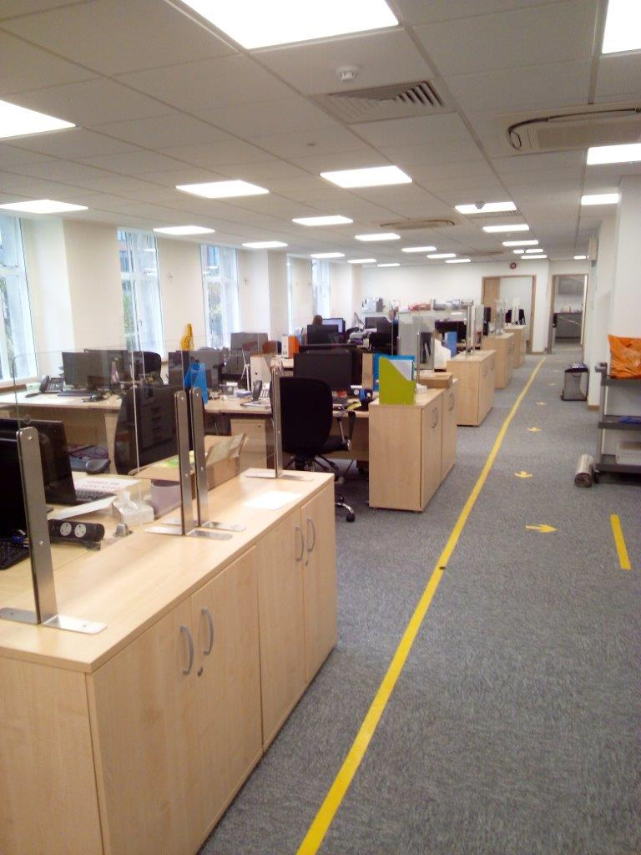
What we do Our office!
has become
After our staff’s wellbeing, our priority was our members’ business continuity
financially and for working safely, representing your interests in weekly Government Departments and Ministerial meetings
Over winter and across the first part of 2021
Released and communicated REA’s Net Zero Strategy
At the same time we stepped up our engagement and response to UK Government’s evolving Net Zero activities and consultations to represent our members interests in these extraordinary times

Slide 8




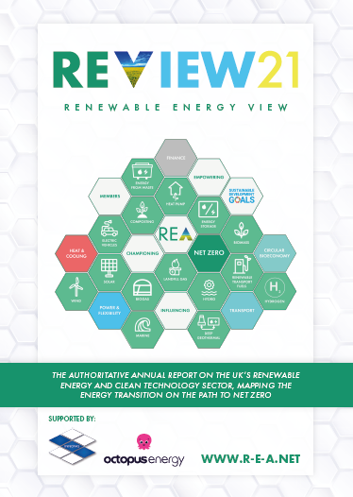

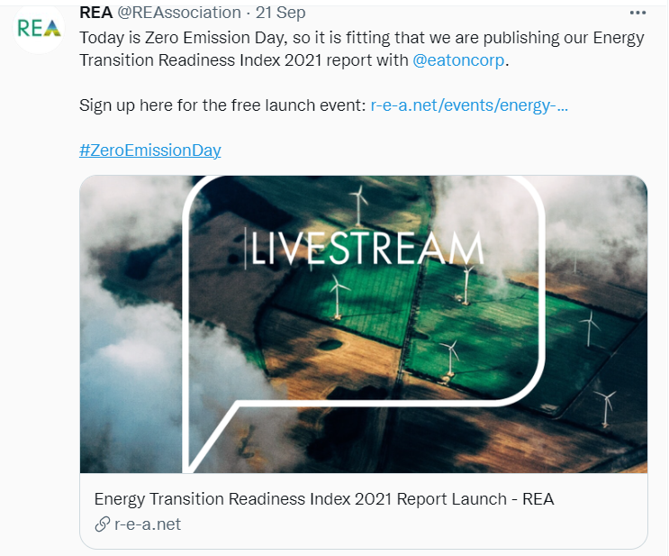

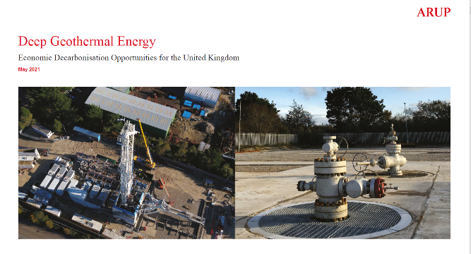

What we do
Reports & Events
Click on the reports to view them

Slide 9
Here’s what YOU, our members, say about us
“The REA is the leading trade association for the majority of the renewables technologies and as such has a broad understanding of the various different technologies and their needs. Their Policy team is excellent and produces much valuable output for members. All in all an excellent offering is provided by the REA.”
“The REA allows our company, and our sector, to engage with Government on strategic issues (and keep us informed about them) with an effectiveness that would not be possible for businesses on our scale.”
“REA is known as the premier organisation for renewable industry business. Extremely focused and hugely knowledgeable, I regularly recommend REA to new contacts in the industry.

Slide 10
REA Governance
REA Board
Comprised of Member Non-Executive Directors and
Independent Non-Executive Directors elected by the Board
The Board are representatives from member companies elected by the membership - one member, one vote
REA Policy Board
14 Board Members in total - comprised of Chairs of each
Member Forum
Representatives from member companies elected by the membership
Chairs are representatives from member companies elected by the membership - one member, one vote

Slide 11
REA Board (since 22nd Sept 2020)
Member Non-Executive Directors
Martin Wright (Aurora Ventures) Chair
Juliet Davenport OBE (Good Energy) Deputy Chair
Duncan Valentine (Almax Partners LLP)
Alexander Maddan, REA Policy Board Chair (Agrivert Ltd)
David Williams (Sero Homes)
Nina Skorupska CBE, Chief Executive, REA
Independent Non-Executive Director
Baroness Sandip Verma (House of Lords)
Vacancy
Rory Tait (Lux Nova Partners) Secretary

Slide 12
REA Policy Board
Members: (as of 1st August 2021)
Alexander Maddan (Agrivert) Chair & REA Board Member
Becky Wheeler (4R Group) Organics
John Mezzullo (Centrica) Green Gas
Steve Shaw (Veolia) Landfill Gas
Ian Waller (Inperpetuum) Renewable Transport Fuels
Julian Morgan-Jones (South East Wood Fuels) Wood Heat
Darren Williams (ECO2) Biomass Power
Hillary Stone (Imperial College) Waste to Energy
Max Carcas (CAELULUM) Innovative & Strategic Technologies
Vijay Shinde (Siemens Energy) Energy Storage & Renewable Power Markets & Grids
John Macdonald-Brown (Syzygy Consulting) Solar
Tanya Sinclair (Chargepoint) EV Charging Infrastructure
Michelle Davies (Eversheds Sutherland) Finance Forum
Harry Vickers (Green Investment Group) Decentralised Energy Forum, inc. built environment
REA Executive participation
Frank Gordon Director of Policy (Secretariat)
Amy MacConnachie* Director of External Affairs
Nina Skorupska Chief Executive
* now on Maternity Leave until Oct 2021
Represented by
Chairs elected from member forums

Slide 13
REA Organisation: 1st September 2021 (Subject to further change due to COVID 19 & REA strategy developments)
Nina Skorupska
Chief Executive
Executive & Operations support
Caroline Jones*
Stuart Pocock
Chief Operating Officer
(Dep. for Chief Executive)
Toyin Owadayo
Finance Director
Amy MacConnachie***
External Affairs Director
Frank Gordon
Policy Director
Lindsay Barnett
Membership, Marketing & Events Director
Accounts Manager
Malgorzata Kubik
PR & Coms
Manager
Jack Abbott
Head of
HEAT
Kiara Zennaro*
Head of POWER
Mark Sommerfeld
Head of TRANSPORT
Vacant
Head of Circular Bioresources
Jenny Grant*
Credit Control
Executive
Lali Nkhuwa
Membership & Events
Executive
Luana Minutella
Business Development
& Marketing Executive
Leo Marley
Marketing & Social Media
Executive:
Will Stevens*
Transp. Policy Manager: EV Lead
Jacob Roberts
Senior Policy Advisor
Biomass UK
Benedict McAleenan*
Technical Manager, Composting,
Circular Bioresources
Emily Nichols*
Notes:
Organogram represents lead role and reporting line/relationship in REA.
As we are a small organisation, we work as a team and to help clarify, further information is available of where people also play a key supporting role.
Additional support for key work and campaigns are sourced from time-to-time from supportive consultancies and agencies
Additional detail:
* Part time,
** Key individuals that support REA for strategic projects/events & receive appropriate compensation for time/travel ad hoc (agreed by CEO/Dep. CEO)
*** On maternity leave until Q4 2021
Business Development & International
George Li
Senior Policy Advisor
Transport Fuel
& LF Gas
Paul Thompson
Additional Support:
Senior Regulatory Expert & Int. Development**
Robert Hull, RiverSwan
Senior Regulatory Expert
Markets and Local authorities
Nigel Cornwall, New Anglia Energy
Policy
Analyst:
Bioenergy
Pablo John
Policy
Analyst:
Strategy &
Clean
technologies
Stan Fielding*
Policy
Analyst:
Grids and infrastructure
Vacancy
Policy
Analyst:
Smart energy
Freddie Kellet

Slide 14
REA Financial Status
2020
£
50,817
100
50,917
902,981
567,389
1,470,370
(1,078,576)
391,794
442,711
(45,000)
397,711
397,711
397,711
Balance Sheet
FIXED ASSETS
Tangible Assets
Investments
CURRENT ASSETS
Debtors
Cash at bank and in hand
Creditors < 1year
Net current assets
Total Assets less Liabilities
Creditors > 1year
Net Assets
Capital & Reserves
Profit & Loss
Total Equity
2019
£
1,434
100
1,534
1,112,222
480,161
1,592,383
(1,175,418)
416,965
418,499
0
418,499
418,499
418,499
2018
£
15,743
100
15,843
1,353,638
404,749
1,758,387
(1,347,733)
410,654
426,497
0
426,497
426,497
426,497
Audited Accounts

Slide 15
Whilst the REA Vision is….
A future built on
renewable energy and
clean technology
REA Restricted:
This contains information that is confidential to the REA and its members and should be not be shared without permission
Notes:
N.B. The vision is used for brand purposes, whereas impact is the change we want to see.

Slide 16
REA Impact
What is NEW
is defining
REA Impact
The UK transitions to 100% renewable energy and clean technology by 2050 delivering Net Zero CO₂ emissions, improving and valuing natural capital.
Notes:
Re-written impact statement:
Does the Board agree with this statement?
How do we measure our success?

Slide 17
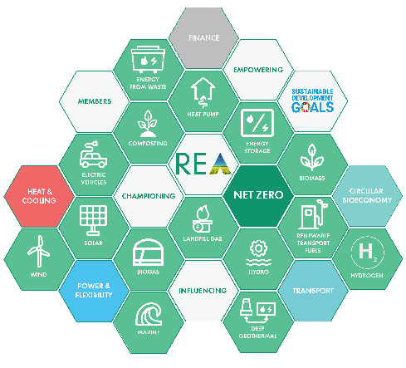
The REA Strategy
Heat & Cooling
Power & Flexibility
Transport
Circular Bioresources
Finance

Slide 18
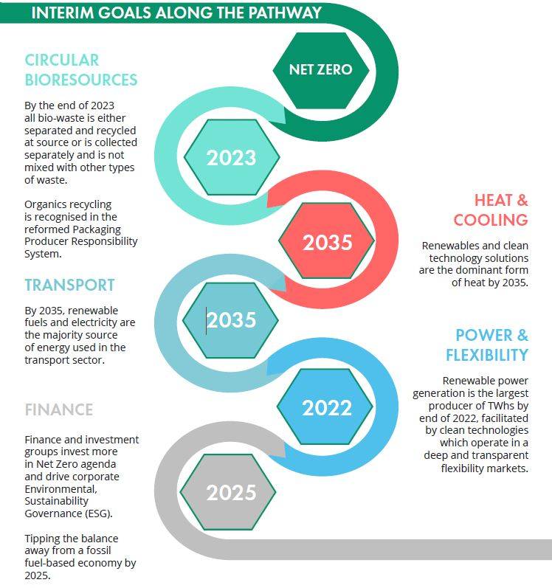
The REA Strategy:
Goals

Slide 19
REA Impact
REA Progress
REA Strategy – Time table
Main workstreams (Developed for full sign off by end Q4 2020)
Gather evidence /complete supporting work by Q4 2020
Arrange working meetings: Policy Board & Steering Groups
Engage wider members / Forums for individual pillars development -> BP 2021
Set up REA organisation for success in line with Strategy
Communication plan: Internal & External
Notes:
A full project plan will be developed by CEO/COO/HoEA in next weeks for sign off by REA Board.

Slide 20
REA Activities: The last six months
Heat & Cooling
Power & Flexibility
Transport
Circular Bioresources
Hydrogen working group
Biomass Strategy
Heat and Building Strategy
REA hosts BEIS event – Longer Duration Energy Storage competition
Grid connection and disconnection rules
Jet Zero Council
EV Consumer Experience consultation and smart charging rules
Increase in Renewable Transport Fuel Obligation (RTFO) targets secured
Waste & Recycling Strategy
Quality Protocol revision
Farming Rules for Water
CfD auction confirmed for Q4 2021

Slide 21
REA Activities: The last six months
Covid-19 response
Urgent member issues representation (>40) at Ministerial level (across key Government Departments: BEIS, DEFRA, Treasury, MHCLG, DfT)
Brexit
Provided clear access to preparatory guidance prior to the new year
Trade
JAMPRO webinar
Upcoming Austrian trade webinar
Sector-specific briefing : financial, regulatory and work safety
Member specific advice – on call resource
Since the end of the transition period, have compiled a list of issues facing members and helped members understand how the rules have changed

Slide 22
REA Activities: The next six months
- already planned
International Seminar
Sponsored by UKEF
Agenda will include:
1. An overview of Government support for export, presented by UKEF, BEIS, DIT, and possibly FCDO
2. A presentation of REA case studies (member successes)
3. A panel discussion with Q&A
4. A networking session
The event will aim:
1. To support domestic clean energy companies aiming to export.
2. To help the audience position themselves in a global market
2. To support an understanding of how they can best trade outside of the UK

Slide 23
REA has been granted by UNFCC ‘Observer Status’ at COP26 which means REA will be able to:
Send a formal delegation of 4 people to COP26
Gain access to the Blue Zone and be able to take part in all conferences and events in that zone
Meet other influential stakeholders and Government representatives
REA likely to be the only UK trade association from the energy sector to be invited into the Blue Zone
REA will also have access to the Green Zone where REA has been invited to take part in various activities including Climate Action’s Sustainable Innovation Forum
Looking Forward To
COP 26

Slide 24
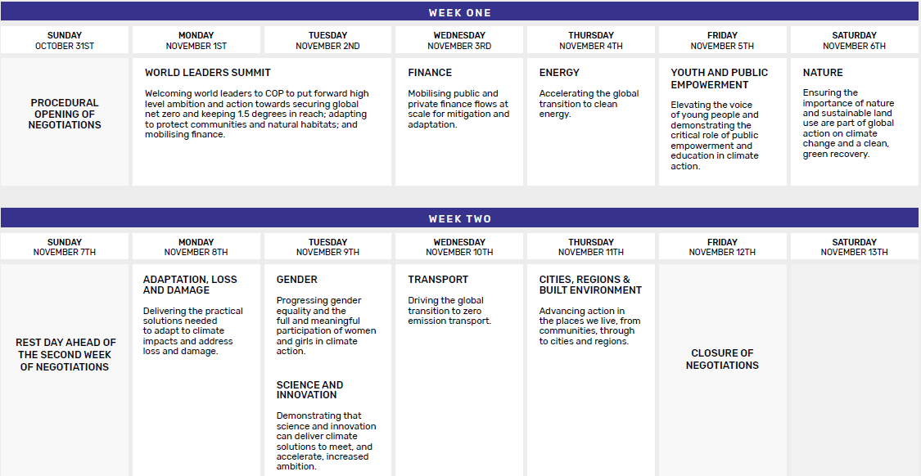
COP26 Programme

Slide 25
Race To Zero is a global campaign to rally leadership and support for a zero carbon recovery, creates jobs, and unlocks inclusive, sustainable growth.
REA is committed to:
Halve our greenhouse gas emissions before 2030
Achieve net zero emissions before 2050
Disclose our progress on a yearly basis
REA’s obligations include:
Measure and estimate our current greenhouse gas emissions
Set short and medium term targets for our emission reductions in line with the commitment
Develop a plan to achieve emission reduction targets
Take concrete action to reduce our key emission sources
Set a target date we have selected to reach net zero
Encourage our Members to sign up to the initiative!
Supporting Activities
-
Race To Zero

Slide 26
REA AGM 23/9/2021
Any questions?
Notes:
The REA currently functions with a bottom-up approach to planning and delivery, based on what the 14 Policy Forums consider a priority for their individual technology.
The benefits of this approach are;
REA are technical experts on multiple technologies
REA has a wide membership
REA members get to focus on niche areas of policy
REA members have a lot of control and autonomy over the REA’s work, which may be seen as good value for money by the members.
The challenges to this way of working are;
REA’s resources are spread very thinly over the 14 policy areas
It doesn’t facilitate joined up organizational planning and budgeting
REA struggles to resolve conflicting priorities/values/business models of members
REA is at the mercy of some members demands, while others feel under-represented.
REA cannot communicate clearly about the purpose of the organisation
REA comes across as ‘a jack of all trades, master of none’
REA cannot be seen as a ‘big hitter’ making it difficult to fundraise for Patron scheme and collect membership
REA struggles to horizon scan and bring in new technologies and income streams

Slide 27

REA AGM 23/9/2021
Rory Tait
-
Resolutions to be put to the Members
VOTING PROCEDURE
Each resolution will be read out by Rory Tait, Company Secretary
When directed to do so Members can vote by raising their virtual hand
After each resolution there will be a short pause before the result is announced while the votes are counted
Notes:
The REA currently functions with a bottom-up approach to planning and delivery, based on what the 14 Policy Forums consider a priority for their individual technology.
The benefits of this approach are;
REA are technical experts on multiple technologies
REA has a wide membership
REA members get to focus on niche areas of policy
REA members have a lot of control and autonomy over the REA’s work, which may be seen as good value for money by the members.
The challenges to this way of working are;
REA’s resources are spread very thinly over the 14 policy areas
It doesn’t facilitate joined up organizational planning and budgeting
REA struggles to resolve conflicting priorities/values/business models of members
REA is at the mercy of some members demands, while others feel under-represented.
REA cannot communicate clearly about the purpose of the organisation
REA comes across as ‘a jack of all trades, master of none’
REA cannot be seen as a ‘big hitter’ making it difficult to fundraise for Patron scheme and collect membership
REA struggles to horizon scan and bring in new technologies and income streams

Slide 28
REA AGM 23/9/2021
Resolution 1
The election of
2 Member Non-Executive Directors
To note that the following directors will retire under article 6.5 of the Company’s Bye Laws and to reappoint them by Ordinary Resolution as directors of the Company:
Candidates:
Juliet Davenport OBE
David Williams
Notes:
The REA currently functions with a bottom-up approach to planning and delivery, based on what the 14 Policy Forums consider a priority for their individual technology.
The benefits of this approach are;
REA are technical experts on multiple technologies
REA has a wide membership
REA members get to focus on niche areas of policy
REA members have a lot of control and autonomy over the REA’s work, which may be seen as good value for money by the members.
The challenges to this way of working are;
REA’s resources are spread very thinly over the 14 policy areas
It doesn’t facilitate joined up organizational planning and budgeting
REA struggles to resolve conflicting priorities/values/business models of members
REA is at the mercy of some members demands, while others feel under-represented.
REA cannot communicate clearly about the purpose of the organisation
REA comes across as ‘a jack of all trades, master of none’
REA cannot be seen as a ‘big hitter’ making it difficult to fundraise for Patron scheme and collect membership
REA struggles to horizon scan and bring in new technologies and income streams

Slide 29
REA AGM 23/9/2020
Resolution 2
Subject to the approval by the Members of the resolution, to allow the Policy Board Chair to resign their Forum Chair position should they wish
To amend by Special Resolution clause 7.11 from:
The members of the Policy Board shall elect the Policy Board Chairman from amongst the population of current Sector Group Chairmen, and such chairman must be a representative of a Member. The election process will be set at each election by the CEO.
To:
The members of the Policy Board shall elect the Policy Board Chair from amongst the population of current Member Forum Chairs, or any other Member who put themselves froward and such chairs must be a representative of a Member. The election process will be set at each election by the CEO. If the successful candidate is a current Member Forum Chair, they may elect to relinquish their position of Forum Chair, in which case the Forum will elect a new Chair.
Notes:
The REA currently functions with a bottom-up approach to planning and delivery, based on what the 14 Policy Forums consider a priority for their individual technology.
The benefits of this approach are;
REA are technical experts on multiple technologies
REA has a wide membership
REA members get to focus on niche areas of policy
REA members have a lot of control and autonomy over the REA’s work, which may be seen as good value for money by the members.
The challenges to this way of working are;
REA’s resources are spread very thinly over the 14 policy areas
It doesn’t facilitate joined up organizational planning and budgeting
REA struggles to resolve conflicting priorities/values/business models of members
REA is at the mercy of some members demands, while others feel under-represented.
REA cannot communicate clearly about the purpose of the organisation
REA comes across as ‘a jack of all trades, master of none’
REA cannot be seen as a ‘big hitter’ making it difficult to fundraise for Patron scheme and collect membership
REA struggles to horizon scan and bring in new technologies and income streams

Slide 30
REA AGM 23/9/2020
Resolution 3
Subject to the approval by the Members of the special resolution, to change the term of the Policy Board Chair from 1 to 3 years
To amend by Special Resolution clause 7.12 from:
The Policy Board Chairman is entitled to a vote at Policy Board meetings but shall not have a casting vote. The Policy Board Chairman will serve for a one-year term, which may be extended on an annual basis by the members of the Policy Board.
To:
The Policy Board Chair is entitled to a vote at Policy Board meetings but shall not have a casting vote. The Policy Board Chair will serve for a three-year term. The Policy Board Chair shall be eligible for re-election if they so choose.
Notes:
The REA currently functions with a bottom-up approach to planning and delivery, based on what the 14 Policy Forums consider a priority for their individual technology.
The benefits of this approach are;
REA are technical experts on multiple technologies
REA has a wide membership
REA members get to focus on niche areas of policy
REA members have a lot of control and autonomy over the REA’s work, which may be seen as good value for money by the members.
The challenges to this way of working are;
REA’s resources are spread very thinly over the 14 policy areas
It doesn’t facilitate joined up organizational planning and budgeting
REA struggles to resolve conflicting priorities/values/business models of members
REA is at the mercy of some members demands, while others feel under-represented.
REA cannot communicate clearly about the purpose of the organisation
REA comes across as ‘a jack of all trades, master of none’
REA cannot be seen as a ‘big hitter’ making it difficult to fundraise for Patron scheme and collect membership
REA struggles to horizon scan and bring in new technologies and income streams

Slide 31
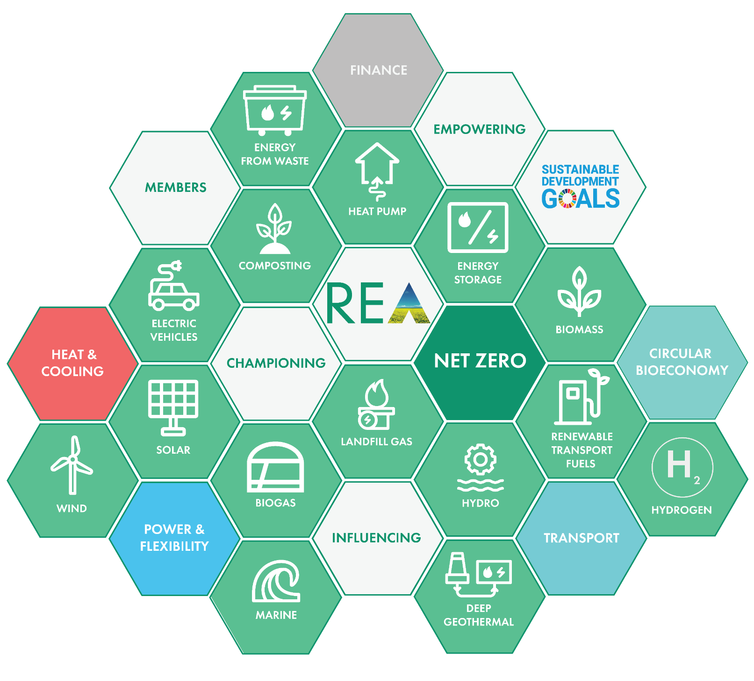
www.r-e-a.net
Thank you for your support!
REA AGM
2020
REA Restricted:
This contains information that is confidential to the REA and its members and should be not be shared without permission

Slide 32
REA Member Benefits
Be part of the industry’s voice
With around 550 member companies, with lots of individual contacts, our membership is far reaching. All our members have experiences to share and we actively encourage you to share your views and knowledge with us in consultations and at meetings. Being a part of a larger voice - the collective industry voice - enables us to engage with Government and regulators on your behalf, giving them an honest, unbiased and much valued view of the industry. Make your voice heard and make change happen - we’re working for you.
Solutions for your business
REA business partners deliver products and services to help you focus on your business - from H&S to legal advice, insurance to health and wellbeing - they’re united in delivering effective solutions and superior value to our members, saving you time and money. Offering you a competitive advantage.
Keeping you updated
Our newsletters, website, member briefings, webinars and events keep you fully updated on everything that’s happing in renewable energy and associated clean technologies. Whether it’s a consultation, a shift in policy or we’re campaigning for change, we’ll ensure you know what’s happening in our industry. We’ll keep in contact and keep you informed.
Championing
Influencing
Empowering
Grow your network
You can meet and engage with other members at any of our regular member Forum meetings - as a minimum these are held four times a year - or at our seminars and conferences. When they can’t be held in person and we’ve taken them online, you’ll still be able to connect with us and other members. Make new contacts and friends.

Slide 33
REA Member Benefits
Developing your skills and knowledge
You can upskill and develop your expertise by watching our on-demand webinars whenever it suits you. You can attend a training course and gain CPD points or get certified - we’ve got a range of training courses and seminars and REA members get free or discounted places, and preferential access. Grow your knowledge with us.
Our online community
Our new online meeting place brings members from all areas of renewable energy, clean tech and organics together. Here you can pose your questions and answer those of your peers, share knowledge, content and experiences as we discuss pressing issues, and the pace of change and direction of our sectors. Get online and get involved.
We listen to you and help find the answers
We’re not a stuffy hands-off organisation. We’re governed by you the members - you vote for our Policy Board and our Board - so you’re involved in the decision making. We’re always at the end of the phone or an email and we actively encourage you to engage with us - whatever the query, question or issue - we want to hear from you.
We’re a measured voice you can trust.
Championing
Influencing
Empowering
Proudly a not-for-profit
We’ve been a proudly not-for-profit member-led trade association since our inception in 2001. All of our income from membership subscriptions, events and sponsorship is ploughed straight back into the organisation to ensure we offer you the very best service, industry experts, specialist advisers with industry expertise in individual sectors, and the framework for you to make your business flourish. We are a coalition built to be the voice for renewable energy and clean technology in the UK - join us.

