Slide 1
Solar & Energy Storage Forum Joint Meeting
1pm – 3pm, Thursday 28th October 2021
Decarbonising the economy

Slide 2
Agenda
13:00 – 13:05 – Welcome
13:05 – 13:45 Policy announcements
Net Zero strategy and Net Zero review
Autumn Budget
Heat and building strategy
CfD Round
Net Zero Innovation Portfolio
13:45 – 14:15 Solar discussion topics
ENA (Queue management and grid securities update)
Member discussion: Supply chain issues and embodied carbon
REA VAT campaign update

Slide 3
Agenda
14:15 – 14:25 Break
14:25 - 14:35 Review of smart system and flexibility consultation responses
Open Consultation: Capacity Market and Flexibility Questionnaire
Design and delivery of energy code reform
Future system operator consultation
14:35 – 14:40 REA member briefing under development
Thermal energy storage briefing
14:40 – 15:00 Energy storage members discussion: recent policy developments
Smart systems flexibility plan and summer policy documents
ETRI report and REA COP plans

Slide 4
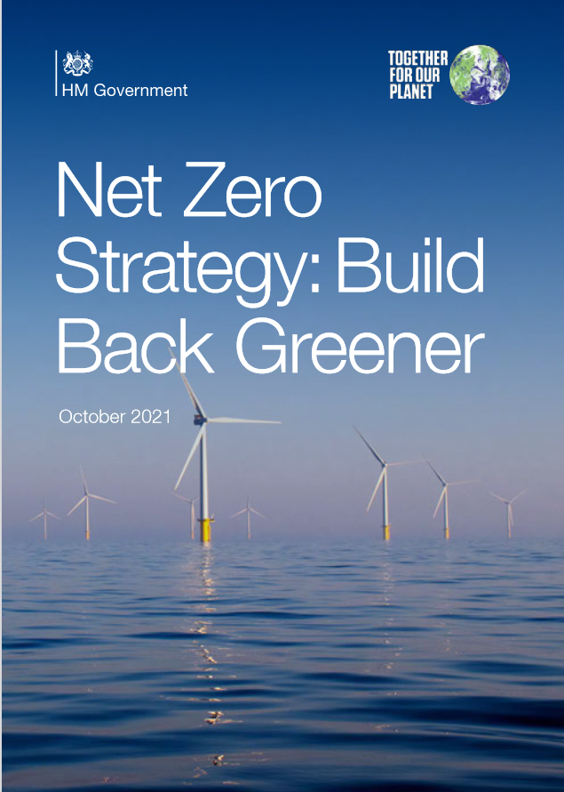
Policy announcements
Net Zero Strategy
Formal inclusion of the target for decarbonised electricity by 2035
£620m for zero emission vehicle grants and EV infrastructure
40GW of offshore wind by 2030
5GW of hydrogen capacity by 2030
£1.5b net zero innovation portfolio
REA response:
“There is much work to be done and this is therefore a vital strategy, which we look forward to seeing develop in the coming years.” “We need to see clear routes to market; a holistic Circular Economy approach; support for a range of clean tech and renewable technologies; best practice standards; tax reform to unlock investment, such as the removal of VAT on renewables and clean tech; and we need more flexibility and investment in the energy system and grid networks.

Slide 5
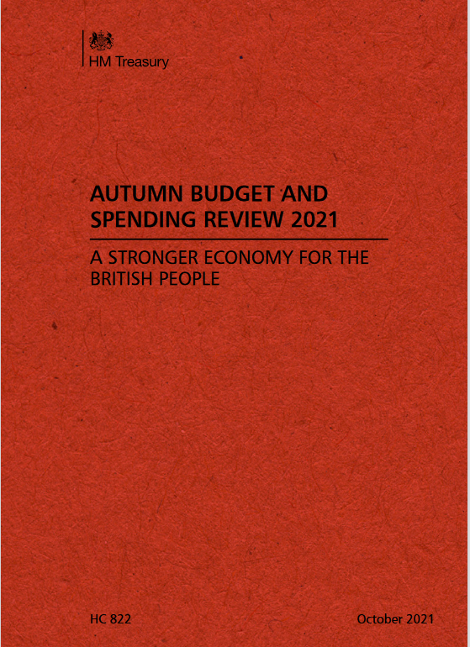
Policy announcements
Autumn budget 2021
Few new green measures announced, following Net Zero Strategy last week.
A win for the sector on business rates incentives for installing clean technology have been introduced - an REA campaign ask, Details on next slide
R&D Tax credit reform to focus on UK Innovation
No fuel duty rise for vehicles and a cut to domestic Air Passenger Duty (although increased for some long-haul flights);
The BEIS budget for core research will increase to £5.9bn by 2024/25 and overall direct investment in R&D will increase by 25% by 2024/25;
£1.7bn for new nuclear, through a Regulated Asset Base (RAB) model confirmed.
No cuts to VAT rates on energy bills or other support for
business from high energy costs.

Slide 6
Policy announcements
Business Rates
REA Win Following Consultation and Campaign Last Year
Yesterday Budget confirmed:
“Eligible plant and machinery used in onsite renewable energy generation and storage, such as rooftop solar panels, wind turbines, and battery storage, will be exempt from business rates from 1 April 2023 until 31 March 2035. Onsite storage used with electric vehicle charging points will also be exempt.”
Business Rate Relief will also support investment in property improvements – delaying increase in rateable value by 12 months.
Confirmed the freeze in the business rate multiplier
Budget committed to three yearly revaluations from 2023.
Unlikely that nil rates payable as there may be elements of the assets that remain rateable (battery housing, concrete pads, steelwork for solar panels etc) but this should resolve on site generation issues.

Slide 7
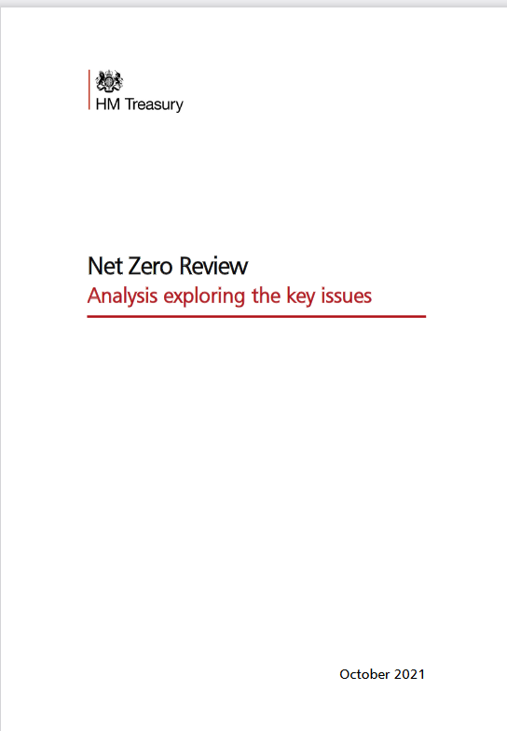
Policy announcements
Net Zero Review
Commitment to a Call for Evidence on Fairness and Affordability in the transition to Net Zero,
Decisions on moving policy support costs from electricity to gas in a phased way over a decade;
Revised Treasury Green Book modelling assumptions have been published alongside the report, in the Appendices;
Treasury sees a need for £40 to over 60 billion a year investment from 2026 to reach Net Zero;
They believe there will be a "combination of tax, regulation, spending and other facilitative levers" to deliver this.

Slide 8
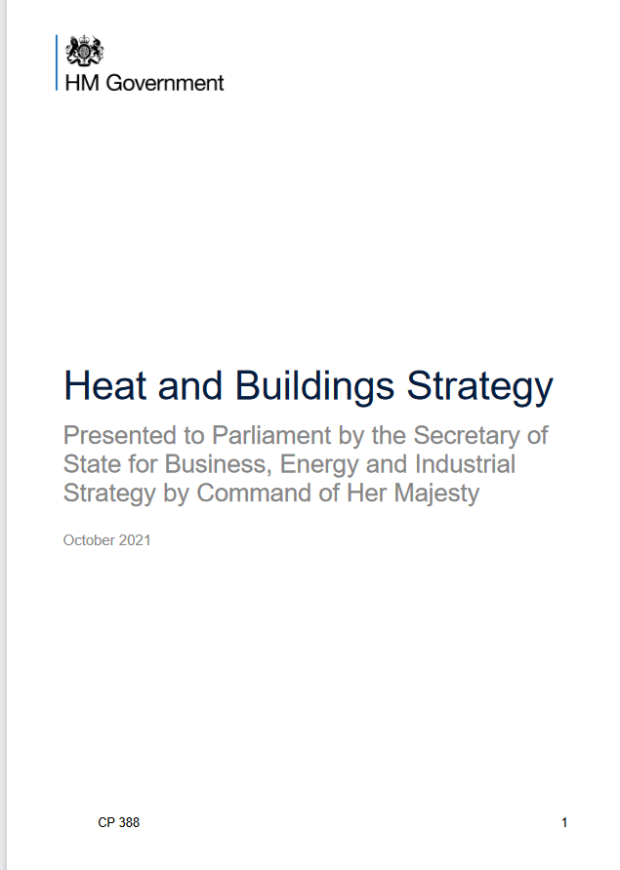
Policy announcements
Heat and Building strategy
No gas boilers to be sold by 2035
£450m three year boiler upgrade scheme (£5,000 grants)
£60m heat pump ready programme to support the target of 600,000 installations per year by 2028
Hydrogen village trail
Three consultations launched:
A market based mechanism for low carbon heat
Phasing out fossil fuels in off grid public buildings and domestic settings

Slide 9
Policy announcements
Contracts for Difference Allocation Round 4
Allocation round 4 confirmed for 13th December 2021.
Pot 1 (established technologies): Onshore wind (>5MW), Solar Photovoltaic (PV), (>5MW), Energy from Waste with CHP, Hydro (>5MW and <50MW), Landfill Gas and, Sewage Gas.
There will be a total of £265 million of funding available per delivery year as part of the auction, with £10m per year allocated for Pot 1.
The draft budget confirms there will be two separate maxima’s of 3,500 MW for Solar PV and Onshore Wind in Pot 1
Admin Strike Price on Solar: £47/MWh (2012 Prices).
Application Window now Open.

Slide 10
Policy announcements
Net Zero Innovation Portfolio Competitions
Flexibility Innovation Programme
Seeks to enable large-scale widespread electricity system flexibility through smart, flexible, secure, and accessible technologies and markets.
Up to £65 million will be made available.
Will Open in next few months.
Green home Finance Accelerator
Innovative green finance products and services, enabling homeowners to decarbonise their homes and improve thermal comfort.
Anticipated spring 2022
Heat pump ready programme
Demonstration of heat pump technologies and tools, and solutions for optimised deployment of heat pumps.
Anticipated late 2021
Longer Duration Energy Storage Competition – closed 17th Sept

Slide 11
Solar Discussion Topics
ENA Update
Queue management and Grid Securities
REA a meeting with Peter Turner and Hoy Brown at the ENA.
Que management thresholds have now come in.
ENA reiterated importance of letting them know any issues early, suggested they would be reasonably flexible.
I reiterated that there does need to be a process for review of the thresholds, if lots are failing them then they need to be changed.
Please keep REA informed of difficulties, we can collate and report to the ENA to seek changes.
No significant update on Grid Securities apart from the fact that issues continue to be raised with the ENA
New ENA Challenge Group Being Developed
To be opened in 2022, new stakeholder feedback group is currently open for applications. The REA will be applying.
“Group will shape the direction of the programme and its outcomes by providing a more formal challenge function on behalf of the wider industry.”
REA Responded to the ENA’s Annual Open Networks Competition
Suggested priorities:
Bringing more transparency in how DNOs facilitate local markets for flexibility
Standardising approaches across DNOs and between DNOs and the ESO
Addressing barriers to participation in flexibility markets.

Slide 12
Solar Discussion Topics
Member discussion: Supply chain issues and embodied carbon
Supply chain issues
In last meeting we had PACT International present on supply Chain monitoring
(See Sheffield Hallam University report). Increasing awareness in press & politics.
Engagement from REA on this issue must cover range of techs.
Since then we have had a number of meetings with several stakeholders, including:
Solar Energy UK
Solar Power Europe
Department for Business, Energy & Industrial Strategy
Faraday Institute
PACT
Embodied carbon in projects
Open source carbon calculator exist (EC3)
Where would Solar members like us to to take these issues next?

Slide 13
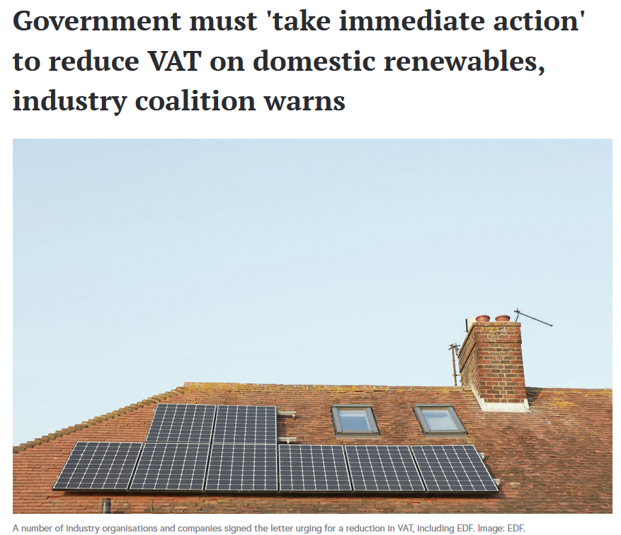
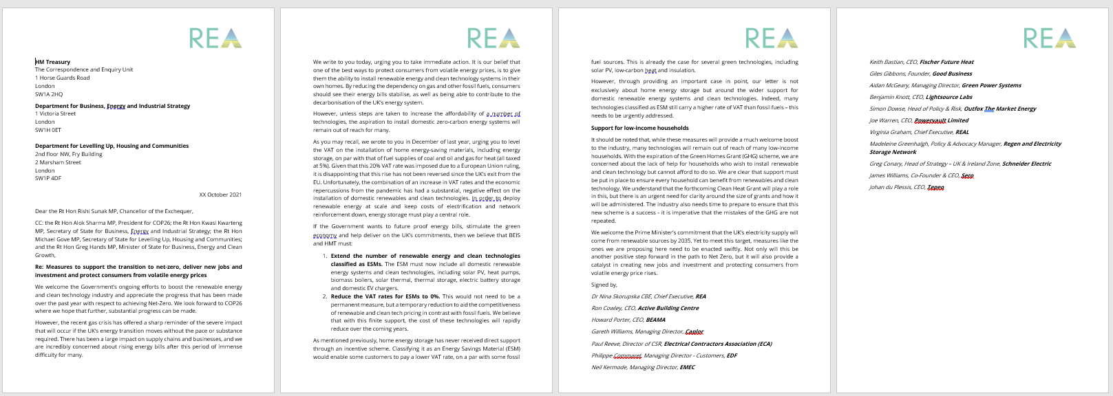
Solar Discussion Topics
REA VAT campaign update
We called for renewable technologies such as solar panels and battery storage to be included as an Energy Saving Material (ESM) so that VAT could be charged at 0%
30 signatories overall;
Key signatories included Eaton, EDF, Good Energy, Nissan Motors
Treasury remains reticent, saying they do not believe it to be the correct way to grow the sector. However, they are considering it.

Slide 14

BREAK
Future events:
COP 26 Fringe Panel Discussion in Glasgow – REA and NFU present: Delivering a Decarbonised Agriculture Sector Nov 10 2021, 13:30 - 15:00

Slide 15
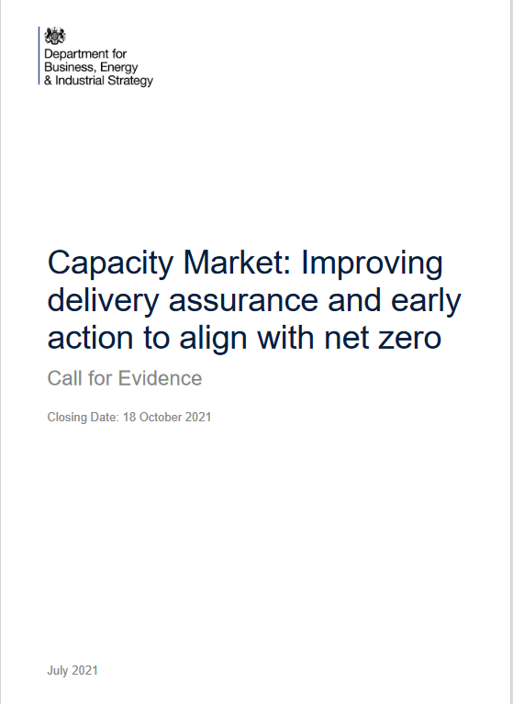
Storage Discussion Topics
Capacity Market: improving delivery assurance and early action to align with net zero
Consultation closes on 1st of November
A draft is available to view on our website and member views are welcome
Key REA Messages:
A linear relationship between contract length and carbon intensity to speed up the removal of fossil-based production
Highlighted the carbon intensity should reflect full life cycle assessment of the plant and embodied emissions. Assessments should align with international accepted methodologies.
Raised issues over grid connection times restricting bidding from yet to be built assets.
Suggested longer term contracts should be ringfenced for renewable and clean technology CMUs.
The CM does not incentivise flexibility or consider other system needs that longer-duration storage can address such as ancillary services.

Slide 16
Storage Discussion Topics
Flexibility Innovation: Market Engagement Questionnaire
Questionnaire will inform Flexibility Innovation Competition Coming up
Has over 150 short form questions – but very tight deadline for completion.
Key REA messages:
Have highlighted main barriers to flexibility:
Need for variety of contract lengths
Need to be able to properly reward all flexibility services
Grid design needs to be make it possible to stack revenue streams
Contracts need to recognise link between services
Existing mechanisms (CM, CfD) do not support flexibility
Innovation needed in smart tariff and their availability.
Have called for a income floor to support Long Duration Energy Storage.
There are also questions on standards PAS 1878 and 1879 for smart appliances, which we are currently not answering, but member views welcome.
Deadline 31st October

Slide 17

Storage Discussion Topics
Design and delivery of energy code reform
Consultation closed on 28th of September
The REA response largely supports the proposed option 1, for a separate strategic governmental body, in the form of Ofgem, who sets the direction for separate code managers.
However, ideally in order avoid conflicts of interest, the strategic body should itself be its own entity, allowing Ofgem to focus on being the industry regulator.
We recommend that the role of the strategic body be driven by decarbonisation objectives that are then implemented through the code manager.
Advisory board made up of industry representatives with there being financial support so no new entrants are not excluded.

Slide 18
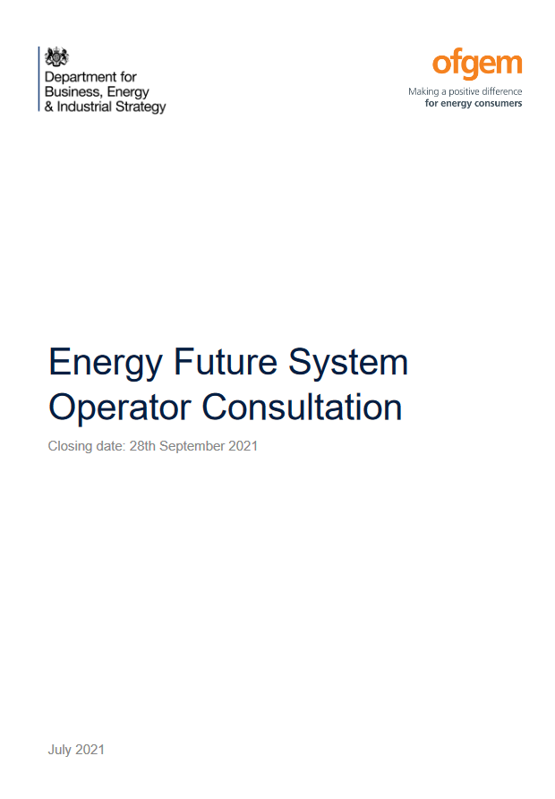
Storage Discussion Topics
Future System operator consultation
Consultation closed on 28th of September
The REA is supportive of the establishment of an FSO, as it is seen as a sensible means of developing an independent longer-term strategy at a national scale to decarbonise the energy system.
It was suggested that the new FSO should only be a strategic body, leaving day-to-day activities with the energy systems operator.
The REA called for a strategic role, separate from the national grids operational focus, with the aim of improving coordination and longer-term planning required for a net zero energy grid.

Slide 19
Storage Discussion Topics
Thermal energy storage
The REA is looking to refine its messaging on thermal energy storage
We are working in collaboration with our thermal members to develop a briefing document to present to stakeholders
Draft over-view

Slide 20

Energy storage members discussion
Discussion points:
Next steps following the smart systems flexibility plan and summer policy documents
ETRI report
REA COP plans
https://www.gov.uk/government/collections/longer-duration-energy-storage-demonstration-lodes-competition

Slide 21
Upcoming Policy Papers
Still to come:
Outcome of Fundamental Business Rate Review (Autumn 2021)
Future Home/Building Standards (Ongoing)
Biomass Strategy (Q2 2022, interim update in 2021)
Industrial Energy Transformation Fund (Round 2)
Carbon Capture Business Models (ongoing)
UK infrastructure bank

Slide 22
Meeting Close
Mark Sommerfeld – Head of Power & Flexibility - msommerfeld@r-e-a.net
Freddie Kellett– Policy Analyst - fkellett@r-e-a.net
Frank Gordon – Director of Policy – fgordon@r-e-a.net
Future events:
COP 26 Fringe Panel Discussion in Glasgow – REA and NFU present: Delivering a Decarbonised Agriculture Sector Nov 10 2021, 13:30 - 15:00

