Slide 1
March Wood Heat Forum Member Meeting
22nd June 2022
@REAssociation

Slide 2
Agenda
Welcome 10.30 (5 min)
WHF Steering Group
Presentation on Biomass Suppliers List Progress
10.35 (45 min)
Alastair Moore and Bruce Allen, HETAS
Policy Update 11.20 (15 min)
Boiler Upgrade Scheme
British Energy Security Strategy
Market Based Mechanism for Heat
Pablo John, REA
UK Emissions Trading Scheme 11.35 (5 min)
Mark Sommerfeld, REA
Closing Remarks
WHF Steering Group
END 12.00

Slide 3

BSL Progress Presentation
Bruce Allen,
HETAS and Woodsure CEO
Alastair Moore,
BSL Contract Manager

Slide 4
Launch of Boiler Upgrade Scheme
The Boiler Upgrade Scheme is now open for grant applications and payments.
The BUS is installer-led at both stages of the voucher process.
BEIS expect the discounted cost to be provided to the property owner at the quote stage, ahead of installation.
The legislation for the BUS does not dictate how installers pass on costs to their customers.
Installers are free to apply for BUS funding either before starting work, during the project or after the commissioning.
Each BUS voucher application and voucher redemption application is dealt with on a case-by-case basis, taking into account all relevant factors.

Slide 5
How to Apply
You can download your voucher application and submit it via email to BUS.application@ofgem.gov.uk.
When you are ready to redeem the voucher, you can download the redemption form and submit it via email to BUS.redemption@ofgem.gov.uk. Full details on the process can be found in Ofgem’s installer guidance.
Before installers are able to participate in the scheme, they must create an account with Ofgem. If you have not already done this, you can apply for an account via the installer account form. There is information available on how to do this in Ofgem’s account creation guidance.

Slide 6
When Vouchers Can’t be Redeemed
There may be incidents where approved vouchers can’t be redeemed, for example:
  The validity period has expired and the installation hasn’t commissioned.
  The installer hasn’t submitted a redemption application within the validity period.
  Insulation measures (where listed as a condition on the voucher) weren’t installed ahead of a redemption application being submitted.
In the above scenarios, installers can reapply to the scheme.
If an eligible technology not listed on the voucher was installed, the installer can submit a new application for a voucher related to the installed technology.
All redemptions will need to meet all relevant eligibility criteria before payment will be released.

Slide 7
Early BUS Statistics
Ofgem have released early statistics and an FAQ document from the Boiler Upgrade Scheme launch.
The headline stats as of the May 31 are as follows:
  466 installer accounts have been created
  745 voucher applications received
  288 property owner consents have been issued
  179 parallel applications have been received
  7 installers received payment
The REA are keen to understand members experience of applying for the scheme so that we can report back to Ofgem and BEIS. Please do let us know about any issues, or successes, related to the scheme to
heat@r-e-a.net.

Slide 8

Energy Security Strategy
The government published the British Energy Security Strategy on April 7 in response to the energy crisis and the Ukraine situation.
The Government billed the strategy as a “major acceleration” of cleaner and more affordable energy, but it has been widely criticised.
Most measures on nuclear, hydrogen and offshore wind, some positive moves on grids and networks.
Little in the way of support for biomass heat or energy efficiency.

Slide 9
ESS - Heat & Energy Efficiency
A lack of new funding or programmes for addressing poor levels of energy efficiency in the UK.
The BESS commits to:
  Double innovation funding to £20mn for the development and piloting of new green finance products for consumers
  Run a £30mn Heat Pump Investment Accelerator Competition in 2022
  Launch a government-backed energy advice service by Summer 2022
  Review practical planning barriers to the installation of energy efficiency measures by end of 2022.

Slide 10
ESS – Solar & Wind
For ground-mounted solar, Govt will consult on amending planning rules to strengthen policy in favour of sites on non-protected land
“Ambition to support” around 70 GW solar by 2035 (6 fold increase)
For rooftop solar, “radically simplifying planning processes with a consultation on relevant permitted development rights and will consider the best way to make use of public sector rooftops”
On onshore wind, no new deployment targets or commitments to reform planning regulation in England.
But commitment to work with ‘limited number of communities interested in a site’, in exchange for lower bills.
Ambitions to deliver up to 50 GW offshore wind by 2030, including 5 GW from floating offshore wind;

Slide 11
ESS - Nuclear & Oil
There is renewed government focus on nuclear with ambitions to deliver 24 GW by 2050. The government suggests this could equate to delivering a reactor a year, rather than a reactor a decade.
But this reactor a year won’t be delivered for another ten years.
Phase out of Russian oil and gas by end-2022.
The Strategy commits to:
  A £120mn Future Nuclear Enabling Fund;
  Setting up the ‘Great British Nuclear Vehicle’
  Initiate the selection process in 2023 for further UK projects.
  Collaborate internationally on technology for smaller nuclear sites (SMRs and AMRs).
  Autumn licensing round for North Sea Oil
and Gas exploration.

Slide 12
ESS - Network, Storage & Flexibility
Government recognised the need to address grid capacity constraints, both at the transmission and distribution levels, to facilitate greater flexibility and energy security.
A key REA ask for several years.
The BESS commits to a number of measures, including:
  Confirming the move to a publicly owned Future System Operator (FSO)
  Energy Intensive Industry (EII) Relief extended 3 years and at 100%
  Appointing an Electricity Networks Commissioner
  A comprehensive Review of Electricity
Market Arrangements (REMA).

Slide 13
Energy Security Strategy - REA View
The REA welcomes commitments regarding solar, hydrogen and offshore wind, but the Energy Security Strategy locks the country into more expensive, longer to build, non-renewable power sources.
The Government needed to turbocharge support for technologies which could tackle the cost of living crisis, and not just focus solely on developments which won’t come to fruition for another 5, 10, 15 years.
Refusal to expand Energy Company Obligation scheme will condemn people to continued financial hardship for the foreseeable future.

Slide 14
Engagement on the Strategy
Influenced Spring Statement to include removal of VAT
Meetings secured with Kwasi Kwarteng, Greg Hands and Trudy Harrison
Builds on our Energy Bills and Spring Statement work - Joint and REA letters sent to PM, SoS BEIS, Energy Minister on our objectives for the Strategy
Member survey conducted to feed into messaging
Nina met with 1922 Backbench committee and attended Labour party dinner
Several press statements and coverage on our Strategic asks

Slide 15
Market Based Mechanism
Government have published their response to their consultation on a market-based mechanism for low-carbon heat.
The Government now plans to take forward an obligation on manufacturers of fossil fuel heating appliances from 2024.
BEIS will focus the mechanism on heat pumps, as opposed to other low-carbon heating technologies.The mechanism will not support biomass or other low carbon fuels.
REA have written to Minister asking for a meeting on biomass inclusion in the mechanism.

Slide 16
Market Based Mechanism - REA View
We welcome the move to place decarbonisation obligations on the heating industry as it represents such large part of UK emissions but expressed our frustration in biomass not being included.
The REA has already written to Minister Greg Hands calling for them to consider Biomass’ inclusion and call for appropriate support for the sector.
The mechanism will need to be accompanied by a great deal of investment in energy efficiency to make UK buildings heat pump ready.
The scheme is overly focused on number of installations - rather than heat generated or emissions reduced.
In its current state this mechanism may lead to a great deal of the cheapest possible heat pumps being installed in properties without the energy efficiency measures to make them truly effective.

Slide 17
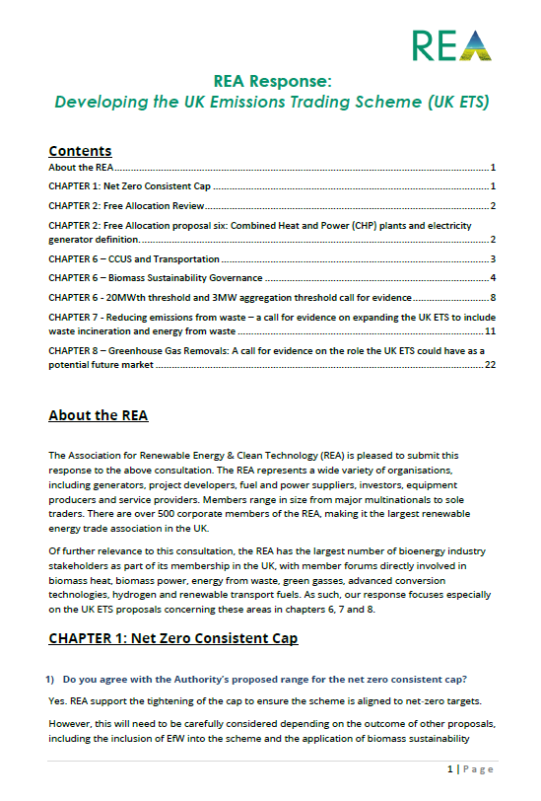
UK Emissions Trading Scheme
REA Responded to The Call for Evidence:
Proposals to introduce Biomass Sustainability Governance criteria into the UK ETS.
The REA support proposal but suggests the need for this to be carefully designed to both be appropriate to different bioenergy markets and recognise when existing obligations, tied to current support mechanisms, fall away.
Proposals to review the 20 MWth input threshold for involvement in the UK ETS.
The REA does not support the immediate review of this threshold for low carbon energy generation sites, in light of the number of other proposals for UK ETS expansion that should be prioritised. This may well help reduce burden on biomass heat and biomass CHP applications.
The Role of Greenhouse Gas Removals (GGRs) in the UK ETS.
The REA are supportive of seeing the development of a GGR unit within the UK ETS to reward negative emissions from both engineered and nature-based solutions.
Further consultations expected in the coming months

Slide 18

Upcoming REA Events
14th July - Trucks, Trains, Boats and Planes
29 September - Green Gas Day
  UK Green Gas Day is the largest industry gathering in the UK focused on green gases, including hydrogen – with over 300 people attending all previous years.
  The event's packed conference programme has now been published - confirmed speakers will be presenting from Centrica, European Biogas Association, Future Biogas, Grosvenor, Acorn Bioenergy and our sponsors Air Liquide.

Slide 19
Supergen Bioenergy Hub
The Supergen Bioenergy Hub, the UK’s leading biomass and bioenergy research consortium, will be facilitating a series of workshops across the UK to evaluate the potential, the changing role and the challenges of bioenergy deployment to 2050 and beyond. The workshops will seek to engage with bioenergy, energy system and climate change experts from academia, industry and policy and wider stakeholders.
Date and location of workshops
28 June, 10am-3pm, Manchester (all stakeholders)
7 July, 10-3pm, Birmingham (for industrialists)
20 July, 10am-3pm, Cardiff (all stakeholders)
27 July, 10am-3pm, Edinburgh (all stakeholders)
28 July, 10am-3pm, Belfast (all stakeholders)
Register online.
Upcoming Partner Events

Slide 20


Thank you
Email us:
pjohn@r-e-a.net

