Slide 1


REA Finance Forum
6th July 2022
REA Online : Teams
@REAssociation
Notes:
Peter - welcome

Slide 2
Agenda
Agenda
Welcome & Introduction (Peter Dickson, Chair of REA Finance Forum)
Policy Updates affecting Energy Markets (REA team) a. British Energy Security Strategy
- Launch of Energy Security Bill – TODAY
b. REMA - overview
c. UK Emissions Trading Scheme
d. UK Green Taxonomy proposals - update
e. Reminder of other changes since 1 April 2022
i. VAT reduction
ii. Business Rates changes
iii. Boiler Upgrade Scheme & Building Standards
3. REMA - REA’s Working Group (REA team)
Innovation and International support (REA team)
Upcoming REA reports: ETRI 2022 and REView 2022 (REA team)
Other REA Activities & General Discussion (REA team & ALL)
Closing remarks (Peter Dickson)
End at 16.00
Notes:
Peter/Nina

Slide 3
2. Policy Updates
British Energy Security Strategy – key areas
- Launch of Energy Security Bill – TODAY
REMA overview
UK Emissions Trading Scheme
UK Green Taxonomy proposals - update
Reminder of other changes since 1 April 2022
VAT reduction
Business Rates changes
Boiler Upgrade Scheme & Building Standards
Notes:
Frank

Slide 4

British Energy Security Strategy
The government published the British Energy Security Strategy on April 7 in response to the energy crisis and the Ukraine situation.
The Government billed the strategy as a “major acceleration” of cleaner and more affordable energy, but it has been widely criticised.
Most measures on nuclear, hydrogen and offshore wind, some positive moves on grids and networks
Commitment to ‘aggressively expand geothermal and marine technologies’ – but no details as yet
Included commitment to a Review of Electricity Market Arrangements
Notes:
Frank

Slide 5
British Energy Security Strategy (Cont.)
Nuclear and Oil
There is renewed government focus on nuclear with ambitions to deliver 24 GW by 2050. The government suggests this could equate to delivering a reactor a year, rather than a reactor a decade.
Collaborate internationally on technology for smaller nuclear sites (SMRs and AMRs).
Autumn licensing round for North Sea Oil and Gas exploration. Aim to be off Russian oil and gas by end-2022
Solar and Wind
“Ambition to support” around 70 GW solar by 2035 (6 fold increase)
Deliver up to 50 GW offshore wind by 2030, including 5 GW from floating offshore wind;
Strengthen Renewable National Policy Statements to support net-zero and energy security;
Proposals focus on reviews of planning permission process to expediate applications.
Notes:
Frank

Slide 6
British Energy Security Strategy (Cont.)
Other Renewables and Energy Efficiency
Ambition to ‘aggressively scale up geothermal and marine technologies, although lack of detail on commitments.
A lack of new funding or programmes for addressing poor levels of energy efficiency in the UK.
Double innovation funding to £20mn for the development and piloting of new green finance products for consumers;
Network, Storage and Flexibility
BESS did recognise the need to address grid capacity constraints, both at the transmission and distribution levels, to facilitate greater flexibility and energy security. A key REA ask for several years.
Confirming the move to a publicly owned Future System Operator (FSO);
Appointing an Electricity Networks Commissioner;
Setting out a blueprint for the system in the Holistic Network Design (HND) and Centralised Strategic Network Plan (CSNP);
A comprehensive Review of Electricity Market Arrangements (REMA).
Notes:
Frank

Slide 7
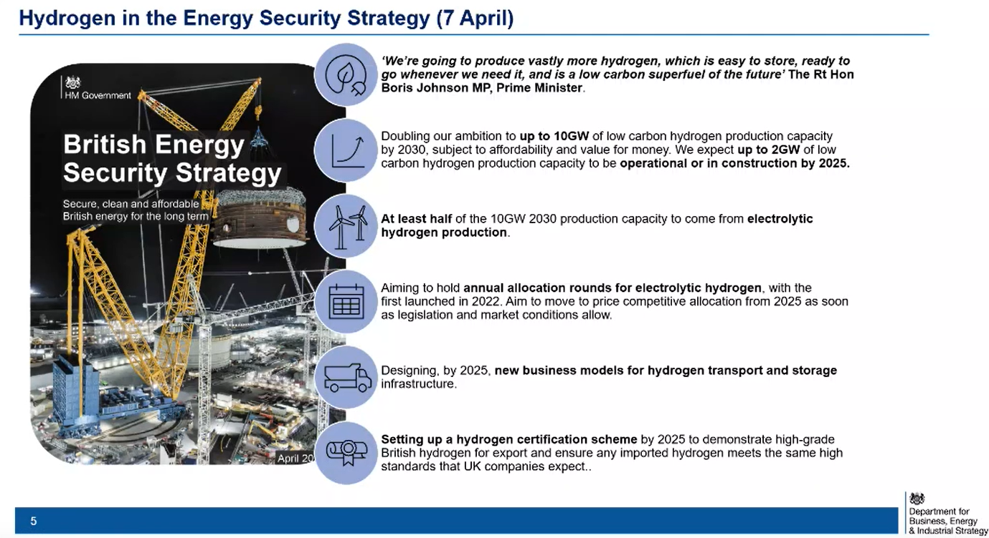
British Energy Security Strategy (Cont.)
Snapshot from BEIS presentation on 21/04/2022, British Energy Security Strategy
Notes:
Frank

Slide 8
Hydrogen Investment Package
Hydrogen Investment Package released by BEIS on 8th April, including three government consultation responses to:
Hydrogen Business Model and indicative Heads of Terms for the Business Model, with £100 million for electrolytic projects to cover the difference in cost between the cost of production (strike price) and the sale price for hydrogen (reference price);
£240 million Net Zero Hydrogen Fund - opening on 25th April; and
Low Carbon Hydrogen Standard (plus guidance, annexes, data annex and Hydrogen Emission Calculator setting out the GHG emission methodology and threshold)
Our press release welcoming the package here. Our member briefing here.
Joint allocation round for electrolytic projects for the Hydrogen Business Model and Net Zero Hydrogen Fund - Market Engagement opened for consultation (now closed 6th May) ahead of applications in the summer.
@REAssociation
Notes:
Frank

Slide 9
British Energy Security Strategy – REA View
The REA welcomed commitments regarding solar, hydrogen and offshore wind, but the Energy Security Strategy locks the country into more expensive, longer to build, non-renewable power sources.
The Government needed to turbocharge support for technologies which could tackle the cost of living crisis, and not just focus solely on developments which won’t come to fruition for another 5, 10, 15 years.
Refusal to expand Energy Company Obligation scheme will condemn people to continued financial hardship for the foreseeable future.
Notes:
Nina/Frank

Slide 10

Climate Change Committee (CCC) Progress Report
- published June 2022
“The UK Government now has a solid Net Zero strategy in place, but important policy gaps remain.” “Tangible progress is lagging the policy ambition.”
The headline figures from the report are:
The UK has world leading targets for emissions reduction, but our targets are at risk of being met due to lack of Government delivery
Insufficient plans are in place to deliver around one third of the required reductions
The UK’s 2021 emissions are up 4% compared to 2020 but still down 10% on pre-pandemic (2019) levels
UK emissions in 2021 are down 47% since 1990
They highlight good progress in power decarbonisation and EV growth, but say much more needs to be done on heat and transport
There are 300 recommendations for policy actions in the 619-page report
https://www.theccc.org.uk/publication/2022-progress-report-to-parliament/
Notes:
Nina

Slide 11
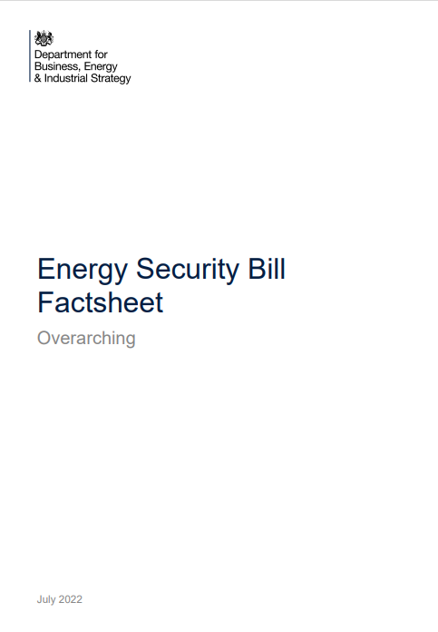
Energy Security Bill - 6th July 20
From a quick review for areas particular relevance to REA and it’s members – in addition to BESS statements
Flexibility/ Smart Systems/ Storage:
Defining Electricity Storage – as a subset of generation
Competition in Onshore Electricity Networks
Establishment of the Future System Operator
Regulation of Load control and energy smart appliances
Smart Metering
Hydrogen
Enabling the Hydrogen Village Trial – “Bill will enable the effective and safe delivery of a hydrogen heat grid conversion trial and support protection of consumers in the trial area.”
Hydrogen and Industrial Carbon Capture Business Models
Heat
Heat networks Regulation and Zoning
Low Carbon heat Scheme – provides the powers for introduction of a heat obligation
Retail
Default Tariff Price Cap – extending the price cap beyond 2023.
Announcement of Energy Networks Commissioner : Nick Winser
Energy Security Bill: factsheet - overarching (publishing.service.gov.uk)
Notes:
Frank/Mark

Slide 12
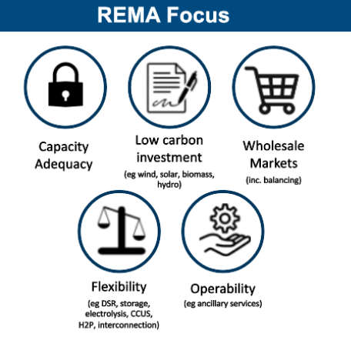
Review of Electricity Market Arrangements
Announced as part of the British Energy Security Strategy.
Overall Objective:
“To identify and implement the reforms needed to GB electricity market arrangements, in order to drive the necessary investment in, and efficient operation of a secure, low carbon electricity system by 2035”
The consultation on REMA is expected in the next few weeks.
The REA have formed a REMA task and finish group to lead on our response to government proposals – later agenda item.
Notes:
Frank/Mark

Slide 13

Review of Electricity Market Arrangements (REMA)
Timeline
Consultations and further stakeholder engagement sessions expected in the summer 2022.
Existing market mechanisms such as the CfD and capacity market auctions will continue to operate as usual.
Intial REA Views
The review is welcome but BEIS yet to show how REMA’s specific remit fits with other grid focused workstreams across Ofgem, BEIS, ENA and Ofgem.
Unclear how review also fits with establishment of Futuer Systems Operator
Review will have to be conscious of existing commitments in the market (such as capacity market or CfD contracts)
Notes:
Frank

Slide 14
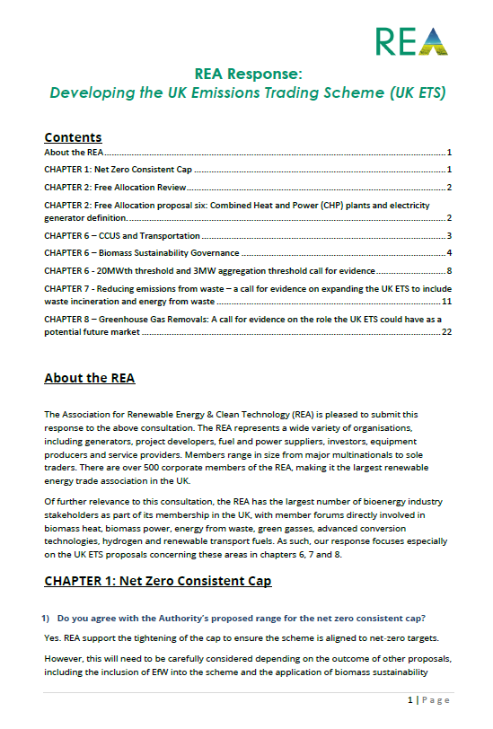
UK Emissions Trading Scheme
REA Responded to The Call for Evidence:
Proposals to introduce Biomass Sustainability Governance criteria into the UK ETS.
The REA support proposal but suggests the need for this to be carefully designed to both be appropriate to different bioenergy markets and recognise when existing obligations, tied to current support mechanisms, fall away.
Proposals to review the 20 MWth input threshold for involvement in the UK ETS.
The REA does not support the immediate review of this threshold for low carbon energy generation sites, in light of the number of other proposals for UK ETS expansion that should be prioritised. This may well help reduce burden on biomass heat and biomass CHP applications.
The Role of Greenhouse Gas Removals (GGRs) in the UK ETS.
The REA are supportive of seeing the development of a GGR unit within the UK ETS to reward negative emissions from both engineered and nature-based solutions.
Further consultations expected in the coming months
Notes:
Mark

Slide 15
UK Green Taxonomy Proposals
Update by Frank Gordon, Director of Policy, REA
Notes:
Frank

Slide 16
Other changes since 1st April: VAT Decision on Energy Saving Materials
Spring Statement 2022 introduced 0% VAT on installation of energy saving materials within homes from 1st April 2022 to 31st March 2027.
Application now set out in VAT Notice 708/6 .
Applies to both labour and materials.
Does not yet apply in Northern Ireland
Major win for the REA following an extended campaign over the last two years calling for Treasury to implement this change.
List of Energy Saving Materials:
controls for central heating and hot water systems
draught stripping
insulation
solar panels
ground source heat pumps
air source heat pumps
micro combined heat and power units
wood-fuelled boilers
wind turbines
water turbines
Notes:
Mark

Slide 17

Other changes since 1st April: VAT Decision on Energy Saving Materials (cont.)
REA disappointed that home energy storage systems not included in the current list of materials that will receive 0% VAT treatment.
However, storage can be zero rated if installed as part of a larger energy efficiency project, where it is providing ‘ancillary services’. I.e. in conjunction with a zero-rated solar system.
The REA has met with both BEIS and Treasury in the last two weeks to call for storage to be added to the Energy Savings Materials list and have developed an additional briefing for circulation. REA currently pushing for an industry roundtable to discuss the issue.

Slide 18

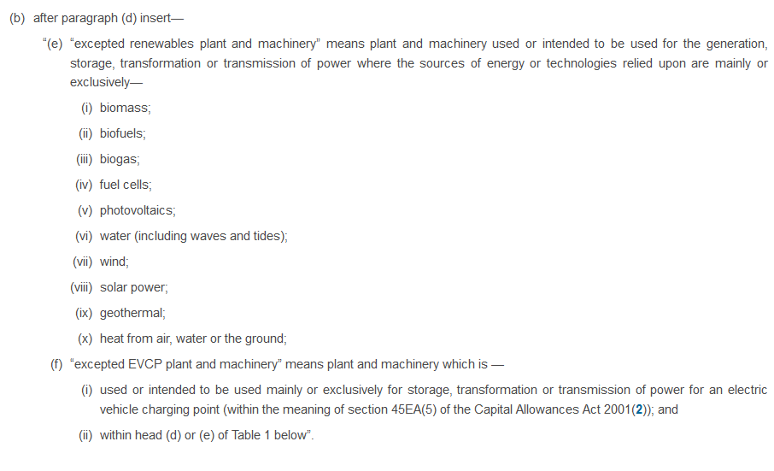
Other changes since 1st April: Business Rates
Autumn Statement 2021
“From 2023, the government will introduce exemptions for eligible plant and machinery used in onsite renewable energy generation and storage, and a new 100% relief for eligible heat networks, to support the decarbonisation of building.”
Spring Statement 2022 – Government announced they would bring this measure forward to be implemented as of April 2022.
Legislation has been laid to bring this into effect.
Largest impact will be seen by those who are using generation onsite.
Note that measure does not mean that Business Rates will be nil, just that rating bill will be reduced.
Measure intended to stay in place until 31st March 2035
Notes:
Mark

Slide 19
Boiler Upgrade Scheme & Buildings Standards
Other changes since 1st April:
Boiler Upgrade Scheme (BUS) launched and other areas
The Boiler Upgrade Scheme – applications live from 1 April 2022, payments available from 21 May 2022
Provides a grant of up to £5,000 on the cost of installing a low carbon heating source in domestic properties
Provides support for Heat Pumps and also Biomass boilers in non-urban locations
Budget will cover around 30,000 installations per year
Building Regulations, Part L Update – update to Part L of the Building Regulations to ensure c.30% lower emissions from new homes - Precursor to the Future Buildings Standard and Future Homes Standard that will mean only zero emission new homes and buildings can be built from 2025, with no new gas boilers in build houses from 2025 New Flexibility Markets for energy storage and DSR – National Grid ESO Dynamic Moderation and Dynamic Regulation markets launched on the EPEX trading platform. First auction results here.
Home Upgrade Grant – first phase of finding (£67m) has gone to Local Authorities for local projects to reduce energy use and install renewables – link here.
Notes:
Mark/Frank

Slide 20
3. REA’s REMA “Task and Finish” Working Group
Held its first meeting 5th July 2022 (yesterday)
Representatives from across REA’s Strategic Pillars/Forums
Purpose of the Task and Finish Group
The primary group through which the REA establishes its policy position on the Review of Electricity Market Arrangements (REMA) to inform consultation response and advocacy activities.
All positions will also be shared with wider REA membership for further input.
REA Overall REMA Aim:
To influence the outcomes of the review to see delivery of a reformed energy market that prioritises renewable energy generation and flexibility, in order to create a viable energy market able to deliver a fully decarbonised power system.
Notes:
Frank/Mark

Slide 21

REMA – Possible Market Designs
Primary aim of a new market design would be to decouple the cost of electricity from the cost of gas, which currently sets the marginal price.
A ‘Green Power Pool’ and ‘Fossil Wholesale Market’
A prioritised ‘Must Run’ market and a ‘Firm Power’ market
An ‘As Available’ market and a ‘On Demand’ Market
In all cases the intial market would be prioritised, with the cost of low carbon generation set by long run costs of existing contracts, such as CfDs. The second market would then be available to meet further demand.
Government also to consider how markets could be applied locally and whether a hands-on Distributed Service Operators (DSO’s), coordinating local systems and markets, could see regional benefits.
Models also need to provide benefits to consumers through the retail market – “Energy as a service”.
REA currently does not have a preferred market model and will be working this through with the REMA Working Group and members.
Notes:
Mark

Slide 22
REMA – Other Key “Talking” Points in System Design
Capacity Adequacy
Need for strong strategic guidance to deal with capacity constraints
Que Management Systems
Capacity Market Reforms to prioritise low carbon and flexible generation.
Low Carbon Investment
Public sector commitments to only contract low carbon power
Government support for strategically important technologies
Six monthly rolling CfD Schedule
LDES Cap and Floor Mechanism
Wholesale Markets
Decoupling renewable and fossil Generation
Energy as a service
Flexibility
Need for greater Data sharing at DNO and TNO Levels
Centralised transparent bidding market with established products
Establishing a range of flexibility contracts and lengths.
Operability
Role of Futuer System Operator
DNOs to DSOs
Ongoing Code Reviews
Notes:
Mark

Slide 23
REA and Task and Finish Group Approach
Opportunities to influence REMA
Consultation
Ministerial Roundtable
Civil Servant Engagement
Published Policy Paper
REA Industry event
Notes:
Frank/Mark/Nina

Slide 24
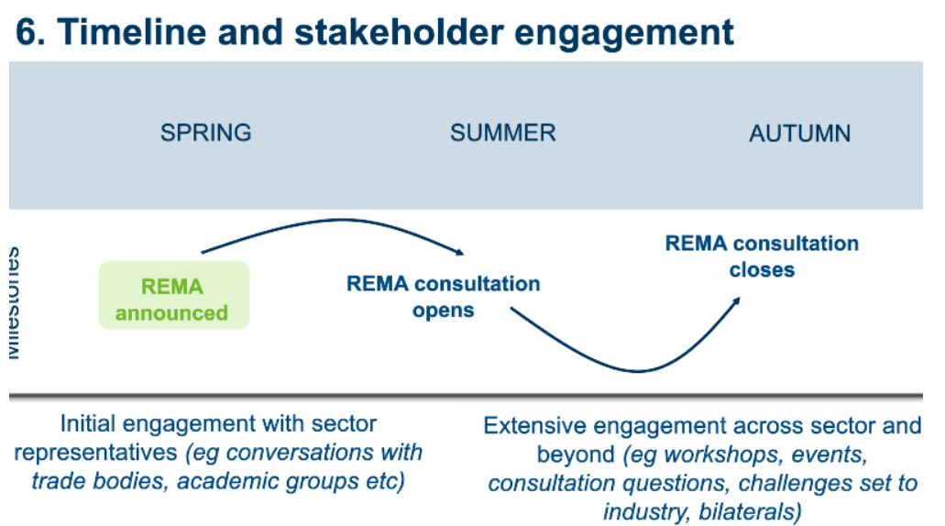
REMA - Timeline
Government Expected Timeline:
Notes:
Frank/Mark/Nina

Slide 25
4. REA International Support
REA enters year 2 of its programme to create an International offer focused on supporting trade
Successes in 2021 include
Delivering an event setting out the benefits to companies of engaging in international trade and the support available to them – UKEF sponsorship secured
Trade events delivered for Jamaica and Belarus
Project management and support of ETRI 2021 report
Developed new relationships during multiple international events
2022 activity will include:
Promotion of the REA’s consultancy offer to overseas and UK potential markets/ customers
Develop a portfolio of consultation projects that showcase REA’s ability and wide international connections – for the benefit of REA’s members
Strengthen the relationship with DIT and UKEF.
Bidding directly, or indirectly as a consortium member, for the British Support for infrastructure Projects. (BSIP)
Participate in COP 27 and possible becoming a leading/funding member for Commonwealth Sustainable Energy Council.
Notes:
Nina/George

Slide 26

REview 2022
REview 2022 REA’s State of the Industry Report REview is the definitive go to place for industry facts and figures, providing an important foundation for discussions with policy makers. It sets out the standing and progress of the UK renewable energy, energy storage and EV sectors and features interesting editorial on factors affecting the sector as well as highlighting opportunities within it.
Includes:
Deployment The data and broad analysis is presented by technology under the REA’s pillars - HEAT, POWER, TRANSPORT and CIRCULAR BIORESOURCES.
Jobs This will be a detailed breakdown of jobs by sector and by region, including the relevant supply chains and projected job growth. Regional sponsorship is available.
Investment A section taking an authoritative look at total investment into the renewable energy and clean tech sectors and the pipeline for future investment.
Editorial from sponsors Our sponsors contribute editorially with a two page introduction piece in terms of your general look at the UK’s renewable energy and clean tech market.
REview21 can be accessed here REview 2021 (nnebooks.co.uk)
REA’s Annual Authoratative Report
NOW in its eighth edition
Notes:
Nina/Frank

Slide 27

Energy Transition Readiness Index a key REA Report
The 2022 study aims to build on the first 2 versions of ETRI with an updated scoring of the studied 12 countries to measure progress in the last 12 months.
We are adding a few enhancements, namely:
Deeper analysis of market characteristics and a greater focus on quantifying distributed energy resources and flexibility markets
Expanding the numbers of survey participants
Deep dives - a greater focus on market, regulation, or policy characteristics in individual countries to highlight best practices. Focus on what's important to stakeholders and policymakers. This may include, for example, a deep dive into the Nordic flexibility markets.
More focused policy recommendations for each country, based on comparison of policy and market characteristics.
Compare the new finding with results from past ETRIs, show changes of policy and its effect in the past 4 years.
Address current energy crisis and the impact of UK energy security strategy on flexibility market, looking forward to likely future developments.
What’s planned for ETRI 2022
Notes:
Nina/George

Slide 28
Energy Transition Readiness Index
In case you missed thie report, here is the link : Energy Transition Readiness Index 2021 - REA (r-e-a.net)
Over 300 visits for our ETRI 2021 webpage. (Until April 2022)
Over 1400 Impressions among our 5 LinkedIn posts.
Various UK government briefing and COP 26
Abundant international coverage in trade media across Europe.
Advertiser.ie - Ireland’s Electric Vehicle charging infrastructure ranks low in EU
'UK risks missing decarbonisation goals' - reNews - Renewable Energy News
Urgent action required on grid flexibility to meet net zero, REA warns | Current News (current-news.co.uk)
Ireland lagging behind on EV charging infrastructure (irishexaminer.com)
UK second worst market in Europe for flexibility according to new report | Current News (current-news.co.uk)
Ireland lags behind Europe on EV charging infrastructure – report (siliconrepublic.com)
Urgent action required on grid flexibility to meet net zero, REA warns | Current News (current-news.co.uk)
Germen Netcongestie vertraagt Nederlandse energietransitie - Persberichten.com
Bei Energiewende nur Mittelmaß | SOLARIFY
Eaton: 2. Energy Transition Readiness Index – Deutschland bei Energiewende europaweit nur Mittelmaß – pv magazine Deutschland (pv-magazine.de)
Italian L’Italia rischia di non raggiungere gli obiettivi europei di decarbonizzazione (energiamercato.it)
Studio Eaton: Italia può non raggiungere obiettivi decarbonizzazione UE (rinnovabilierisparmio.it)
Obiettivi Esg: a che punto sono i Paesi del G20? (greenplanner.it)
Polish Europejskie gospodarki nie są gotowe na OZE (ceo.com.pl)
Performance of ETRI 2021
Notes:
Nina/George

Slide 29
REA Engagement & Next Steps
@REAssociation
Notes:
Nina/Amy/Frank

Slide 30



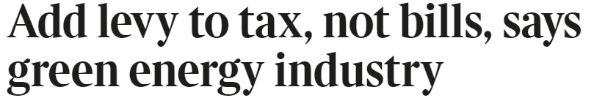

REA media campaigns (H1 2022)
Since the start of the year, the REA media campaigns have largely centred around energy security and the cost of living;
The REA’s ‘6-point plan’, culminating in an industry-wide letter, received wide-spread coverage, including in the Times;
Media coverage was also secured in the Guardian, the i and the Daily Mail, in addition to a variety of trade publications;
Further appearances on radio and podcasts, including Ed Miliband and Geoff Lloyd’s ‘Reasons to be Cheerful’.
Notes:
Nina

Slide 31
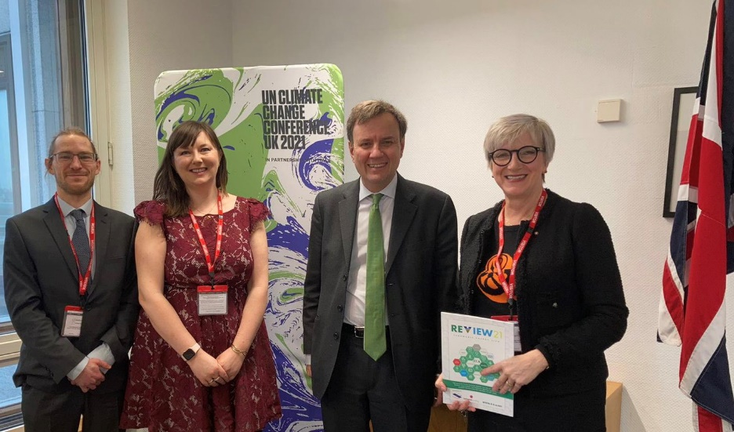
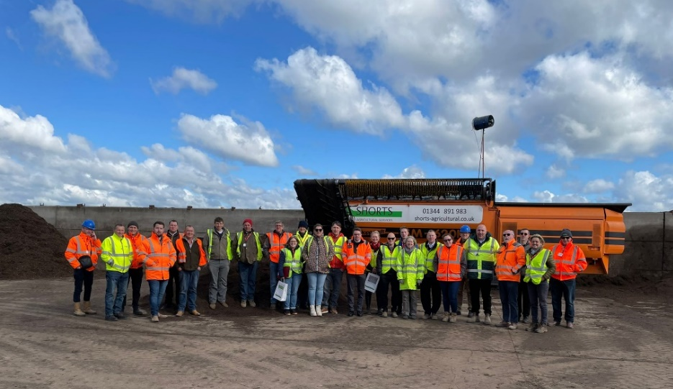
Engagement with Government ( H1 2022)
Meetings secured with Kwasi Kwarteng & Greg Hands (BEIS) and Trudy Harrison (DfT);
REA communicating directly with Ministers on a number of issues, including VAT., deep geothermal, red diesel, contactless payments for EV charging, and Biomass Fuel Quality Standards (Treasury, BEIS, DfT, DEFRA);
REA’s red diesel campaign also saw engagement with MPs across the country, with James Sunderland and Jerome Mayhew meeting with REA members;
Minister/BEIS/ REA REMA round table for October
REA preparing for Party Conferences 2022 – REview2022 REA’s Annual Report
Notes:
NINA
Influenced Spring Statement to include removal of VAT
Meetings secured with Kwasi Kwarteng, Greg Hands and Trudy Harrison;
Builds on our Energy Bills and Spring Statement work - Joint and REA letters sent to PM, SoS BEIS, Energy Minister on our objectives for the Strategy;
Member survey conducted to feed into messaging;
Nina met with 1922 Backbench committee
Labour party dinner attended
Several press statements and coverage on our Strategic asks;

Slide 32
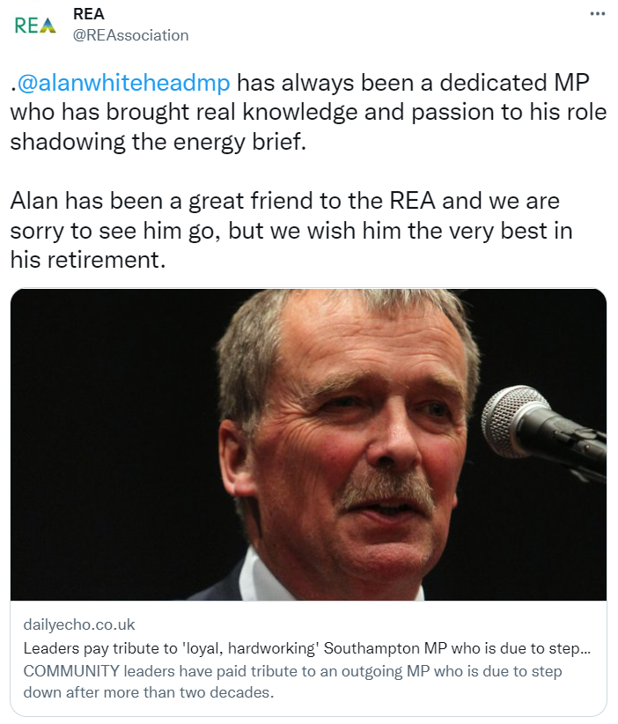
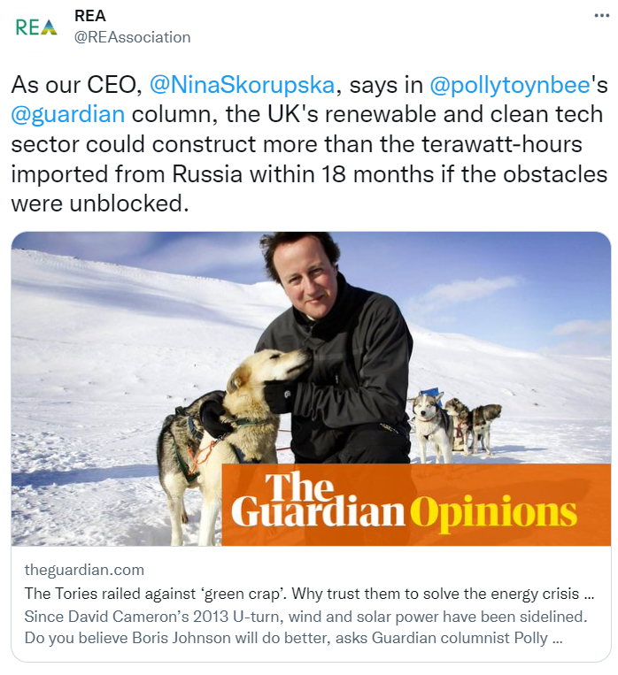
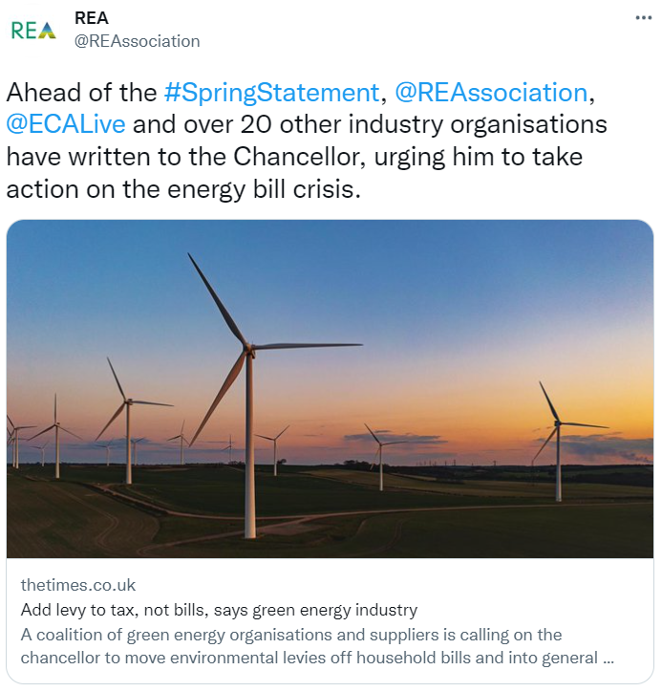
Growing REA’s social media presence (Q1 2022)
Twitter and LinkedIn continue to play an important and growing role in the REA’s communications strategies, with around 19k and 17k followers respectively;
REA’s Twitter channel had over 90k impressions over Q1, with the respective LinkedIn site receiving nearly 50k. Followers have also continued to increase – just under 100 have been added on Twitter and nearly 300 on LinkedIn;
Notes:
Nina/Amy

Slide 33
REA Actions – Policy / Internal
The REA will continue to work with civil servants
(eg recent Treasury meeting to secure the addition of energy storage devices to the VAT exemption, Hydrogen Expert Groups).
Member survey on current market conditions
Full range of complimentary events tying into policy objectives
Finance Forum members In-person meeting planned for October 2022
Other REA Forum planned “In-Person” events
Launch events planned for REA reports
Round tables for specific REA campaigns (REMA)
Topical Webinars
Notes:
Frank/NIna

Slide 34
REA Public Events 2022 – Examples
Notes:
Nina

Slide 35
Thank you for your attendance
@REAssociation
Notes:
Peter/Nina

