Slide 1
REA Members Townhall: Review of Electricity Market Arrangements (REMA)
25th August 2022
Kindly hosted by CMS,
Cannon Place, 78 Cannon Street, London, EC4N 6AF

Slide 2
REA Competition Law Policy
REA’s compliance with all aspects of UK Competition Law applies to all activities of REA including its subsidiaries Member Forums, committees, working groups, technical groups, and sub-groups and any other such meeting:
Members are not permitted to discuss competitively sensitive information, or to use REA as a conduit for such discussions
Competitively sensitive information covers any non-public strategic information about a business’s commercial policy. It includes, but is not limited to, future pricing and output plans
Please note this session is being recorded for note taking purposes.

Slide 3
Agenda
Welcome from CMS - Munir Hassan, Head of Energy & Climate Change Law, (CMS)
2) REMA Overview
• REA Approach to REMA – Mark Sommerfeld (REA)
• Overview of REMA – Daniel Tindsley and Brianna May Mills (BEIS)
• Locational Pricing Assessment – Heather Stewart (Ofgem)
3) Discussion 1: Wholesale Market Reforms and Options for Regional Pricing
Break 15 Min (Around 15.05)
4) Discussion 2: REMA Focus Areas
• Low Carbon Investment
• Flexibility and Capacity Adequacy
• Operability
5) REA Next Steps

Slide 4
Welcome from CMS
Munir Hassan,
Partner, Head of CMS Energy & Climate Change Group

Slide 5
REA Approach to REMA
The REA have welcomed the Review of Energy Market Arrangements, highlighting the need for market reform to:
Expediate deployment of renewable energy systems
Deliver flexibility to the energy market
Provide Energy Security
Realise cost benefits of renewable generation.
To respond to REMA The REA have:
Developed a chapter-by-chapter summary for members to break down proposals
Established a Task and Finish working group to develop intial positions and draft response.
Holding cross membership meetings to get further feedback.
Looking to develop thought leadership series
Engaged directly with relevant government teams.
Develop a first draft by early September to provide opportunities for further member feedback.
Exploring options for post-consultation engagement to continue to influence REMA process, including exploring possibility of an event.
“Reforms, once agreed, will be vital to the target of a Net Zero electricity system by 2035, and will emphasise the need to protect existing renewables investments alongside any wider changes. We will now work with our members to fully analyse the proposals and their possible impacts.”
Frank Gordon, Director of Policy at the Association for Renewable Energy and Clean Technology (REA)

Slide 6

Membership Engagement is Crucial
We are keen to hear directly from members on what they would like to see happen through REMA.
Today's session is just one of many ways to engage with the REA on REMA.
In today's sessions you will be able to feed in through:
Live discussion
Slido Polls
Chat box on the MS Teams call
After this session, please continue to feed in via:
Response to the initial draft
Feedback to power@r-e-a.net
The policy team are happy to set up bilateral discussions as appropriate.
Further membership discussions as required following 1st draft.
Sponsorship of thought leadership pieces

Slide 7
Overview of REMA
Daniel Tindsley and Brianna May Mills
REMA Team, BEIS

Slide 8
Locational Pricing Assessment
Heather Stewart
Ofgem, Head of Wholesale Market Reform
Energy Systems Management and Security

Slide 9
Overview
The UK Government is undertaking a Review of Electricity Market Arrangements. This will consider a wide range of options for updating GB electricity market arrangements to meet out 2035 target – decarbonisation of our power sector by 2035.
Alongside providing advice on the case for change and full suite of options, we are undertaking an assessment of zonal and nodal market design for GB.
Approach
Identify (i) simplified market designs to model and (ii) how these markets could operate in GB
Economic modelling to provide a quantitative benefits analysis of different market designs
Assess likely implementation requirements and costs
Distributional impact assessment and potential mitigations (and impact on benefits)
Outcomes
System modelling and analysis:
Supports BEIS decision-making on whether zonal and nodal market design should be short-listed for further consideration
Advances sector-wide market reform debate and capability in considering reform options
Internal Only

Slide 10
Discussion 1: Wholesale Market Reforms and Options for Regional Pricing

Slide 11
Wholesale Market Reform: Proposals
Split Market
Splitting generation into separate markets of variable, ‘as available’ and firm, ‘on demand’ power
Consumers able to participate in both but the greater their flexibility, the more they purchase from the variable market. Consumers in the firm market pay a premium
Status quo reform
With incremental reforms such as those to gate closure
Green Power Pool
The SO would run a renewable power pool alongside the existing market with voluntary participation
Locational pricing
Zonal pricing – clearly defined zones with boundaries drawn where transmission constraints occur. Suppliers pay the difference between the price where electricity was generated to where it was supplied, where there is a difference.
Nodal pricing – each location in the transmission network has a value. Could be applied to both demand and supply, or just generation, with consumer opt-in. Central dispatch.
Local markets options – 1) separate markets (pool, balancing, ancillary) at each connection between transmission and distribution networks. DNOs responsible for balancing local markets. 2) locational imbalance pricing, with suppliers facing regional based imbalance charges between demand and supply points
Pay as bid
Participants receive the prices of their bids/offers rather than the bid of the highest price supplier selected to provide supply (decoupling gas from electricity price)

Slide 12
Wholesale Market Reform: REA Initial Positions
We welcome further exploration of the split market option, with careful design to prevent an investment hiatus
The Green Power Pool’s voluntary nature may mean that generators are not sufficiently incentivised to participate
Shortening gate closure time could be help to provide effective price signals
We would like to see a proposed timetable for delivery of the chosen options to demonstrate how it will enable Net Zero 2035
We need to see more analysis on the proposed benefits of nodal and/or zonal pricing. There are significant concerns in industry about investment deterrence, increased complexity for smaller participants, access rights and interaction with other areas such as Queue Management reform. May not have the desired effect of incentivising generation at demand location.
Neither of the local markets options has ever been implemented before, we think this is likely to mean they would take longer to design and implement and may deter investors
We support the decoupling of the gas price from electricity price. Additional incentives to support flexibility may be necessary

Slide 13
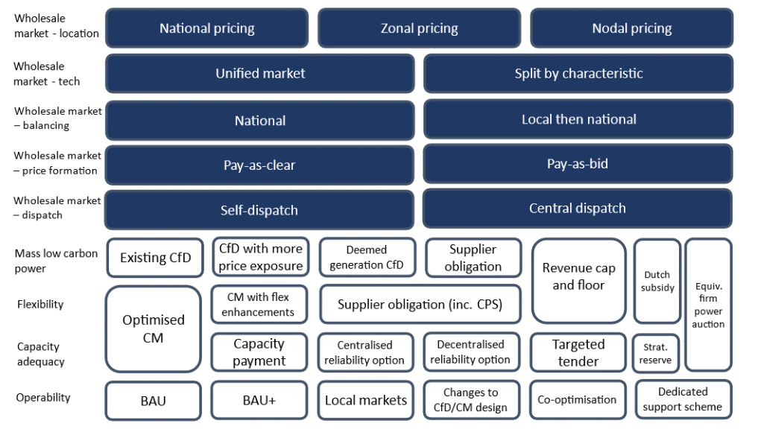
Wholesale Market Reform: Discussion
Should there be a split market for generation, with separate markets of variable and firm power?
Should locational price signals be introduced? How could the challenges of nodal pricing be mitigated? What is the balance between potential benefits and problems with locational pricing?
Could the Green Power Pool work?
Would a ‘pay as bid system’ be sufficient to lower prices and meet decarbonisation objectives?

Slide 14
Break

Slide 15
Discussion 2: REMA Focus Areas • Low Carbon Investment • Flexibility and Capacity Adequacy • Operability

Slide 16

Low Carbon Investment: Proposals
BEIS are considering the following options to increase low carbon power deployment:
Supplier obligation
Govt set an obligated trajectory of carbon intensity of electricity that suppliers can sell to customers.
CfD Variations
Develop the CfD so that generators are more exposed to price signals. Options:
A strike range.
Changes to the reference price methodology.
Plants paid on potential to generate rather then output.
Revenue Cap & Floor
Intended for all assets, possibly designed on £/MW basis.
Would support flexibility and provide investor confidence.

Slide 17

Low Carbon Investment: REA Initial Positions
Our initial positions have been formed from the REA strategy, previous work with members, and meetings with the REA REMA task & finish group.
We recognise the role of the CfD in maintaining investor and developer confidence, and support more frequent auctions. We note some variations have benefits, such as scaling CfD pricing to match demand.
We believe a supplier obligation may be useful but it is difficult to assess before the conclusion of retail market reforms. We also have concerns over how this may favour mature technologies.
In relation to the cap and floor, we would like to see detailed plans on how generation plants and storage facilities would be incentivised to offer maximum value to the system.
The risk with the Equivalent Firm Power Auction is its untested nature, and with the Dutch Subsidy Scheme that it would rely on CCCS.

Slide 18
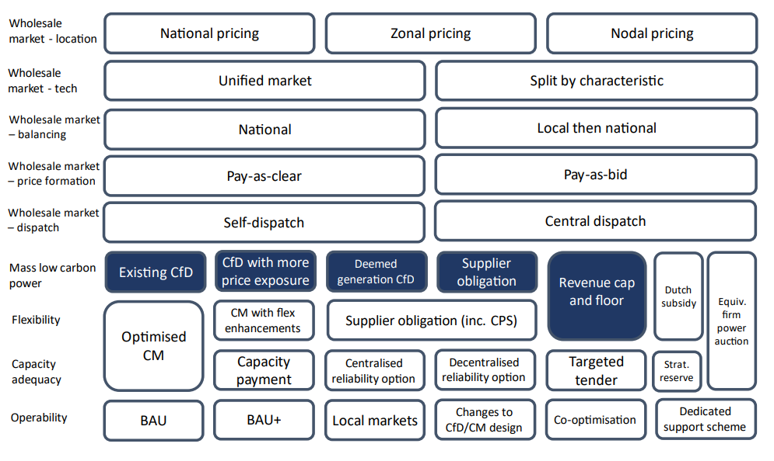
Low Carbon Investment: Discussion
Should the CfD be reformed as is set out in REMA?
Should a revenue cap & floor be introduced for all renewable generation assets?
Would a supplier obligation mechanism deliver sufficient investment in low carbon technologies?
How can investor confidence in renewables be maintained during a period of market reform?

Slide 19
Flexibility and Capacity Adequacy
Flexibility
BEIS outline the following options for increasing flexibility:
Supplier Obligation
Flexibility-focused supplier obligation could provide strong investment signal for flexibility.
Would likely not be standalone but could deliver smaller scale flexibility like demand side response.
Cap and Floor
Flexibility assets compete for guaranteed minimum revenue floor from the government each period.
A Cap could also be designed to maximise competition.
Capacity Market Reform
Flexible auctions – introduce auctions open to all carbon technologies which meet agreed set of flex criteria.
Introduce Multipliers to the clearing price to value flexibility characteristics.
Capacity Adequacy
Need to secure investment in sufficient capacity to enable system balancing at all times
Centralised Reliability Options
The TSO determines the amount of capacity to be auctioned (sufficient to meet peak demand) and, in return for a reliability premium (determined through
the auction process), secures the right to buy electricity from
the assets on the wholesale market at a ‘strike price’.
Strategic Reserve
Central authority auctions reserve capacity on top of what the market is expected to provide. Successful providers receive payment at their bid price which includes a payment for being available and a separate activation payment.
Capacity Market Optimisation:
Separate Auctions for low carbon generation
Introduce multipliers to clearing prices valuing flex characteristics – response time, duration, location.

Slide 20
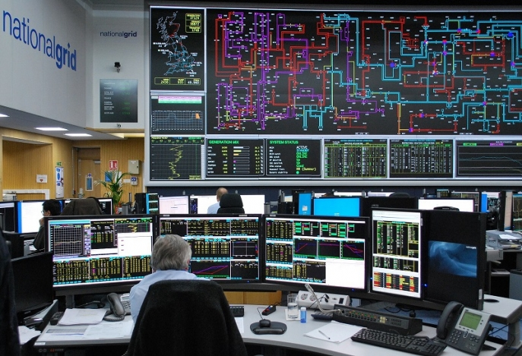
Flexibility and Capacity Adequacy: REA Initial Positions
Our initial positions have been formed from the REAs previous Long Duration Energy Storage Report, previous work with members, and meetings with the REA REMA task & finish group.
Flexibility
The REA continues to push for a cap and floor mechanism to support Long duration energy storage in particular, in order to get those sectors established.
Such a mechanism could possibly be expanded, but there could be concerns over unintended consequences to the rest of the market.
In the longer term, moving towards a more market-based mechanism, through competitive capacity market reforms likely preferable.
Capacity Adequacy
Reforms to the capacity market are likely to be the easiest for the market to respond to as well as the best for prioritising low carbon generation and rewarding ability to respond to smooth peaks and troughs.

Slide 21
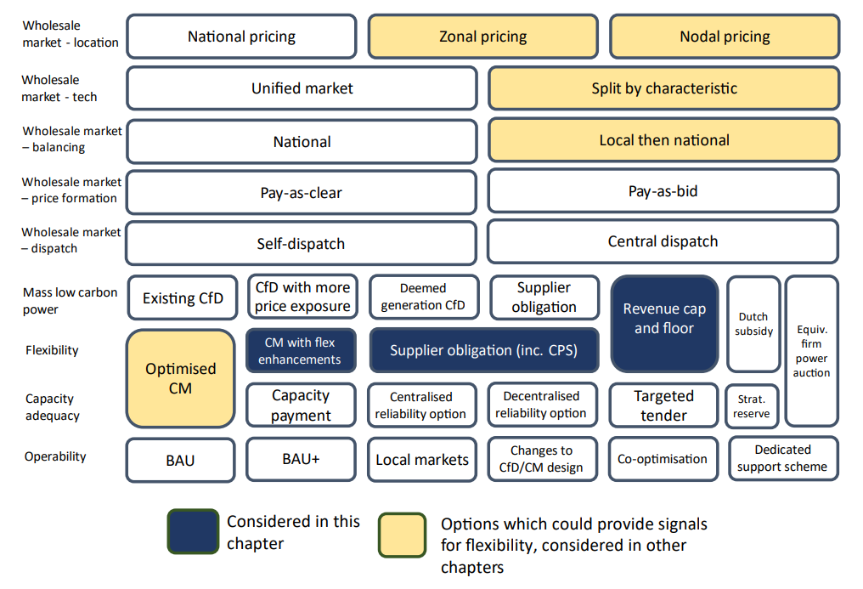
Flexibility and Capacity Adequacy: Discussion
Flexibility
Should a cap and floor be introduced to support all flexible assets, or just for Longer Duration Energy Storage?
Is there value to a supplier obligation?
Would flexible auctions in the Capacity Market provide sufficient support to flexible technologies?
Should the Capacity Market introduce multipliers to the clearing price to value flexible characteristics?
Capacity Adequacy
Will changes to the Capacity Market alone be enough to ensure capacity adequacy in the future, or will additional measures be needed?
Would any other major reforms to the Capacity Market be useful?
Should the government consider a strategic reserve?

Slide 22

Operability: Proposals
Options
Maintaining the status quo
Enhance the existing: Give the ESO (or FSO) an obligation to prioritise zero/low carbon procurement, ensure an optimal balance between long and short contracts, align CfD & CM tenders with ancillary services, introduce a matrix approach
Developing local ancillary services markets: DNOs take on greater role in managing operability
Co-optimisation of ancillary services: with broader wholesale market changes using central dispatch. Short timeframes; more whole systems approach
CfD: remove disincentives to ancillary service provision
CM: modify to include obligations or incentives to ancillary service provision
Summary
Status quo vs enhancing existing arrangements vs developing local ancillary services markets
Co-optimisation of ancillary services, changes to CfD, changes to CM also considered

Slide 23
Operability: REA Initial Positions
Distribution grid relies on transmission grid for back-up, so transmission grid needs to have sufficient in back-up
Local balancing at distribution level will become increasingly important, so greater coordination is needed between ESO/FSO and DNOs, but ESO/FSO needs to maintain central control and a coordination role
ESO/FSO should prioritise zero and low-carbon services because it’s harder for them to compete at the moment
FSO needs to be looking at both transmission and distribution due to the interaction

Slide 24
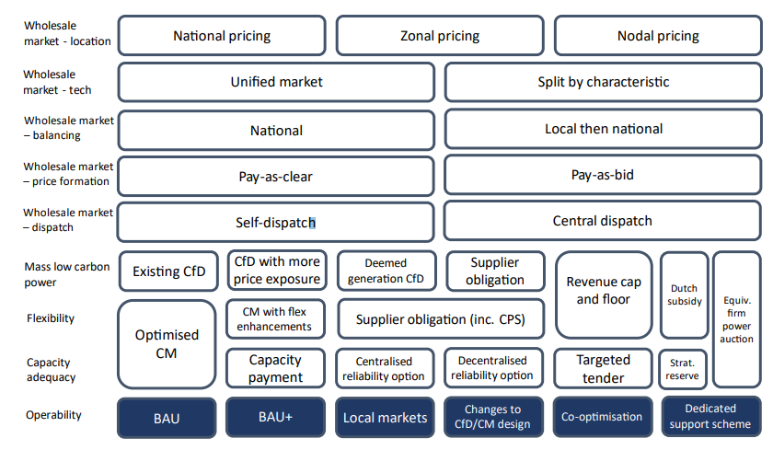
Operability: Discussion
Are existing arrangements sufficient to ensure operability?
Does the CfD discourage ancillary services’ provision in its current form? Would it be useful to modify the CM so that it facilitates ancillary services’ provision?
Should DNOs take on a greater role in managing operability and how?
How should low carbon procurement be prioritised? Does the FSO have an ability (or obligation) to prioritise zero/low carbon tech?

Slide 25
REA Next Steps
The REA will distribute a draft consultation response to all members for feedback in early September. This may be followed by further, more detailed online sessions open to the full membership.
We are actively engaging with the BEIS REMA team and will continue to do so throughout the consultation period and after the consultation closes.
The REA intend to develop a series of industry-leading policy papers to shape the debate on key areas of the REMA consultation, published in September. This may be followed by an industry conference on REMA in October (TBC). Sponsorship opportunities are available (contact gjoseph@r-e-a.net for details).
Further influencing opportunities also being explored.
Please contact power@r-e-a.net with any feedback concerning the consultation. The REA policy team are also happy to arrange bilateral calls for specific feedback where appropriate.

Slide 26
Frank Gordon
Director of Policy
fgordon@r-e-a.net
Amy MacConnachie
Director of External Affairs
amacconnachie@r-e-a.net
Mark Sommerfeld
Head of Power and Flexibility
msommerfeld@r-e-a.net
Callum Coleman
Solar and Storage, Policy Analyst
ccoleman@r-e-a.net
Isobel Morris
Senior Policy Analyst
imorris@r-e-a.net

