Slide 1


REA member meeting on Hydrogen Certification consultation
22nd March 2023
Consultation: UK low carbon hydrogen certification scheme
Vision and Objectives

Slide 2
Session rundown and objectives
Today, we are looking to hear your views on our proposals for a UK Low Carbon Hydrogen Certification Scheme.
We will start with a short presentation outlining the proposals in our consultation document.
We will then move on to a longer feedback and open discussion section. Please feel free to ask us questions, let us know what you think and tell us how these proposals will impact your organisation.
Consultation: UK low carbon hydrogen certification scheme
Vision and Objectives
Notes:
Lizzie

Slide 3
Consultation Overview
Seeks views on the design features for a UK low carbon hydrogen certification scheme
Closes at 11.45pm on Friday 28th April
Respond online or via email
Open to individuals and organisations
Contents
Introduction
1. Fundamental scheme design
2. Information disclosure
3. Chain of custody
4. Further design considerations
5. Delivery and administration
Annex: De Minimis Assessment
Consultation: UK low carbon hydrogen certification scheme
Vision and Objectives
Notes:
Lizzie

Slide 4
Secondary priority design feature
Introduction: Objectives
Connect producers and end users with a reliable method of tracing emissions
Facilitate cross-border trade
Stimulate market growth and incentivise production
Support decarbonisation of hydrogen economy by:
- providing a way of proving the low carbon credentials of hydrogen
- increasing transparency and traceability
Primary priority design feature
Consultation: UK low carbon hydrogen certification scheme
Vision and Objectives
Notes:
Lizzie

Slide 5






Chapter 1: Fundamental scheme design
Open to producers and end users of low carbon hydrogen
Initially voluntary
Certificates show embodied emissions from production (LCHS)
Evolves with the LCHS as sector develops
UK-wide, facilitating international trade
Issued in energy-based units (MWh)
Consultation: UK low carbon hydrogen certification scheme
Vision and Objectives
Notes:
Lizzie

Slide 6


Chapter 2: Information Disclosure
Factual disclosure
Detailed information about production process and emissions
Label
Quick assessment of if the hydrogen is “good enough”
Minimal mandatory disclosure fields
Additional voluntary disclosure fields
Options:
One simple label – e.g. LCHS compliant
Tiered label – e.g. by emissions intensity
Consultation: UK low carbon hydrogen certification scheme
Vision and Objectives
Notes:
Lizzie

Slide 7
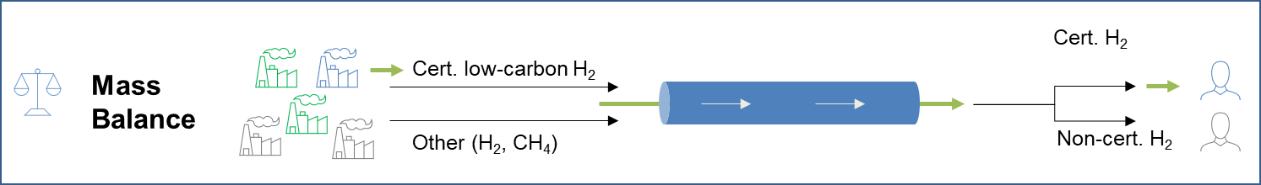
Chapter 3: Chain of Custody
Paper trail which tracks when and where something moves.
We propose a mass balance system where:
  Certificates stay with the physical gas
  The value of hydrogen plus the certificate is negotiated between producer and purchaser, and therefore the added value of the certificate is captured in the price of the hydrogen
Consultation: UK low carbon hydrogen certification scheme
Vision and Objectives
Notes:
Lizzie

Slide 8




Chapter 3: Chain of Custody
A mass balance system will provide:
Strong traceability of certificates
Protection against greenwashing claims
Alignment with other schemes
Easier harmonisation with international schemes
Consultation: UK low carbon hydrogen certification scheme
Vision and Objectives
Notes:
Lizzie

Slide 9




Chapter 4: Further design considerations
Consignment Approach
International Trade
Mid-Stream
How certification will work with regards to discrete consignments or averaged consignments
Considering how best to adapt the scheme to facilitate international trade of hydrogen
Considering emissions associated with transport (inc. carriers), storage and conversion of hydrogen
Consultation: UK low carbon hydrogen certification scheme
Vision and Objectives
Notes:
Lizzie

Slide 10
Chapter 5: Delivery and Administration
Proposal:
Government led scheme
Seeking to align with funding scheme reporting requirements
Collect and verify the data in a proportionate way
Self-reported data to demonstrate compliance with LCHS
Monthly light touch verification (IT Based)
Annual Audit – primary form of verification
Certificates issued via IT system to producer
Certificates are transferred to any inter-mediaries and then end user
Post-use, should certificates be retired?
Consultation: UK low carbon hydrogen certification scheme
Vision and Objectives
Notes:
Martha

Slide 11
Feedback and open discussion space
Consultation: UK low carbon hydrogen certification scheme
Vision and Objectives
Notes:
Beth

Slide 12
Next Steps
This consultation is open until 11.45pm Friday 28th April 2023
  Respond online (preferred) at https://beisgovuk.citizenspace.com/energy-security/low-carbon-hydrogen-certification-scheme/
  Or respond via email to HydrogenProduction@beis.gov.uk, stating whether you are responding as an individual or for an organisation
Please send any enquiries to HydrogenProduction@beis.gov.uk
After analysis, a Government response to the consultation will be published later this year. We will continue to work with industry and across Government to finalise the scheme design.
Consultation: UK low carbon hydrogen certification scheme
Vision and Objectives
Notes:
(Beth).

Slide 13
Annex – Extra Slides
Consultation: UK low carbon hydrogen certification scheme
Vision and Objectives
Notes:
Beth

Slide 14
Focus point: International Trade
Key objective:
Facilitate international trade of hydrogen, enabling imports and exports
We are currently working both bi-laterally and in multilateral forums to learn about existing and emerging schemes, and approaches to harmonisation
We are keen for views from industry on the role that certification should play and how certification could work when trading hydrogen
Consultation: UK low carbon hydrogen certification scheme
Vision and Objectives
Notes:
Katherine
What schemes do you already use / are you considering?
How do you think certification should help facilitate trade?
What would be useful for us to consider?

Slide 15
Additional Questions: De Minimis Assessment
Consultation Questions:
Are there any significant costs of participating which we haven’t captured?
Are the assumptions about time and cost for each activity reasonable?
Do you expect there to be a green premium associated with the certification of hydrogen?
Accompanying annex
Sets out estimated costs to business from participation
Interested in your thoughts on our assumptions and any alternative estimates you may have
Consultation: UK low carbon hydrogen certification scheme
Vision and Objectives
Notes:
Tom

Slide 16
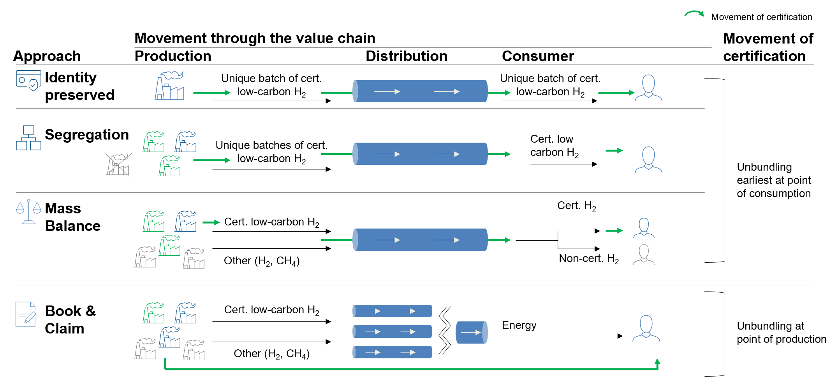
Chapter 3: Chain of Custody
Consultation: UK low carbon hydrogen certification scheme
Vision and Objectives
Notes:
Hatty

