Slide 1
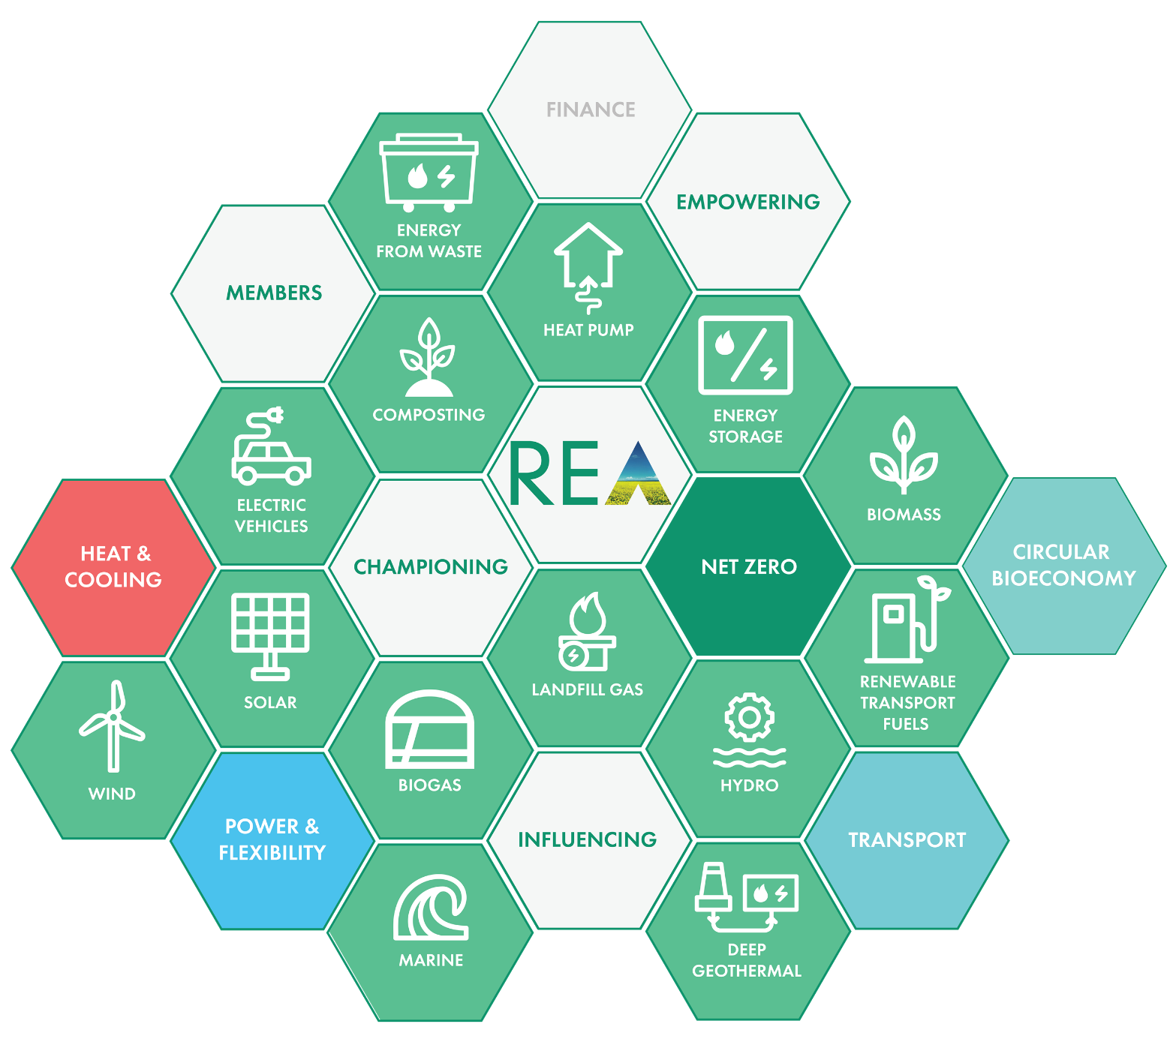

REA Solar & Energy Storage Forum:
Grid Connections

Slide 2
Solar & Energy Storage – Grid Connection Delays
This document has been designed to help the REA compile case studies from recent solar and energy storage development projects.
Delays in connecting to the grid are the one of the biggest barriers to the deployment of solar and energy storage across the country. In the April 2023 meeting of the Solar & Energy Storage Steering Group, it was agreed that the REA would produce a template to share examples of particularly bad cases of grid connection delays in a consistent format.
Ideally, the REA would like to present these case studies to DESNZ officials and/or Andrew Bowie MP, DESNZ Parliamentary Under Secretary of State (Minister for Nuclear and Networks). They will also prove helpful this summer as National Grid ESO and Energy Networks Association start to implement connection reform programmes for both the Transmission and Distribution grids.
Please provide a short description of the site including details of its size, the current stage of development of the project, and financial backing. Please also provide details of any steps taken to engage the distribution grid or transmission grid to accelerate the grid connection. A further slide is provided for any other relevant information we might take to DESNZ.
Many thanks,
REA

Slide 3
Details of the site
Please provide a short description of the site including details of its installed capacity (MW), its location, the current stage of the project’s development, and any other relevant information.

Slide 4
Questions 1 & 2
Please indicate your current engagement.
1. When did you apply for a grid connection? How long did it take for you to receive a response? Please indicate whether this application is to the transmission grid or distribution grid.
2. What date did the TNO or DNO give for your grid connection date?

Slide 5
Questions 3, 4 & 5
3. What engagement have you had with the distribution grid or transmission grid since being given the connection date? 4. Please give an estimate of the cost involved in securing the grid connection? How much of this cost relates to grid reinforcement requirements?
5. What steps, if any, have you taken to accelerate the grid connection?

Slide 6
Questions 6 & 7
6. If able to, please provide an estimate of the level of committed investment that is put at risk due to delayed connection dates. Our intention is not to link specific projects and amounts, but to come to an estimated number for how much investment, across the case studies, maybe lost. We understand that this information might be commercially sensitive. All information will be treated in the strictest confidence unless you give us permission to do otherwise. Individual responses will not be shared with other members, and we intend to anonymise all data before sending it to Government. If you cannot provide an exact figure, we would appreciate a ballpark figure.
7. If possible, please provide information on the site’s community and economic benefits that are being delayed due to the grid connection date. Information could include financial agreements to parish councils for community projects, apprenticeships, biodiversity projects, job creation etc.

Slide 7
Questions 8
8. Please provide any further relevant information.

Slide 8
Consent
By providing this information, you are consenting for the information to be used with the purposes of this report.
A reminder that all information will be treated in the strictest confidence unless you give us permission to do otherwise. Individual responses will not be shared with other members, and we intend to anonymise all data before sending it to Government.
If you have any questions, please contact the REA Policy Team at power@r-e-a.net. You can contact the following individual members by:
Mark Sommerfeld
Head of Power and Flexibility
msommerfeld@r-e-a.net
Frank Gordon
Director of Policy
fgordon@r-e-a.net
Jordan Dilworth
Policy Analyst, Power & Flexibility
jdilworth@r-e-a.net

