Slide 1
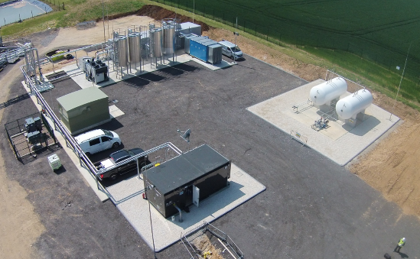
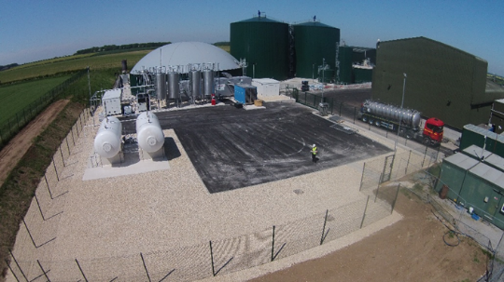
Improving Access to the Gas Grid
Alison Cartwright
Senior Project Manager
CNG Services Ltd alison.cartwright@cngservices.co.uk www.cngservices.co.uk
07746 812649

Slide 2







CNG Services Ltd
CNG Services Limited (CSL) provides consultancy, design and build services to the biomethane industry, all focused on reducing Greenhouse Gas (GHG) emissions
In the past 10 years our efforts have produced a material impact with an estimated 20 year project life reduction in CO2 emissions of 17,500,000 tonnes through:
  Biomethane injection into the gas grid
  Running trucks on Bio-CNG
  Acting as developer and design and build contractor for the Highlands CNG Project
Working on a number of Biomethane, H2 and CCUS innovation projects including:
  Biomethane from manure with CCS
  Biomethane direct into the NTS
  Green H2 into the NTS and Hydrogen Business Model Projects
  Reverse Compression to Create Capacity for Biomethane Injection
CSL is an ISO 9001, 14001 and 45001 approved company and has also achieved Achilles certification. CSL is GIRS accredited for design and project management and has been certified as a competent design organisation for high pressure UK onshore natural gas works by DNVGL

Slide 3
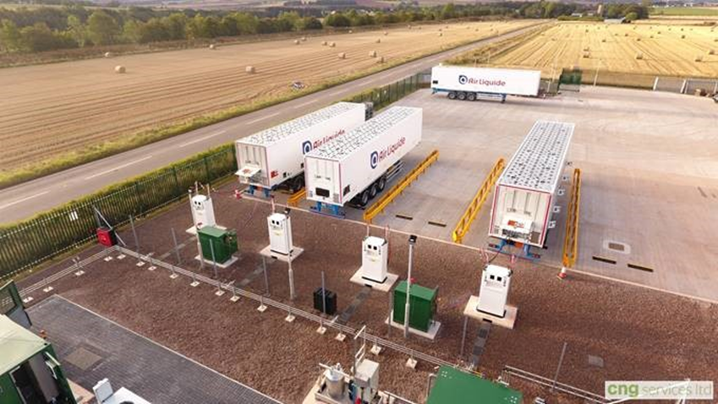
Summary
Issues – 4 C’s
Complexity
Cost of Connection
Capacity
Competition – the NTS
If you make it too difficult or do not provide the capacity then customers will move the gas by road instead

Slide 4
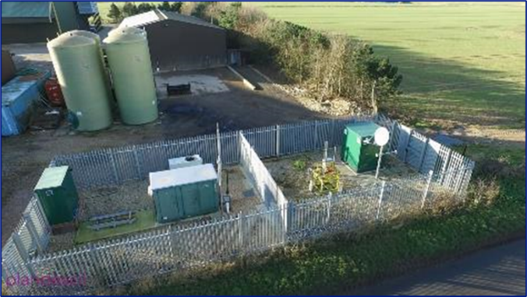
Complexity
Some GDNs adopt RTU & ROV
  Any changes to design, communication, flow rate requires full design approval and appraisal
    Every project treated like the first
    Lack of available Approvers and Appraisers to complete in a timely manner
  Do not have the process to be able to sign off anything outside of this
    Electrical light switch change – 6 months
    ROV welding to be designed to -20⁰C even though it is in a room
Above means longer lead times and more time in meetings for GDN and developer
  For no customer benefit

Slide 5
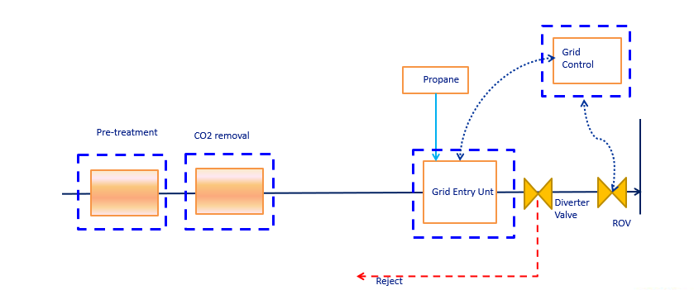
Cost of GDN auditing the Connection Works
Range of costs across the GDNs
  Cadent c. £100k
  WWU c. £15k
Adoption of assets leads to higher costs

Slide 6
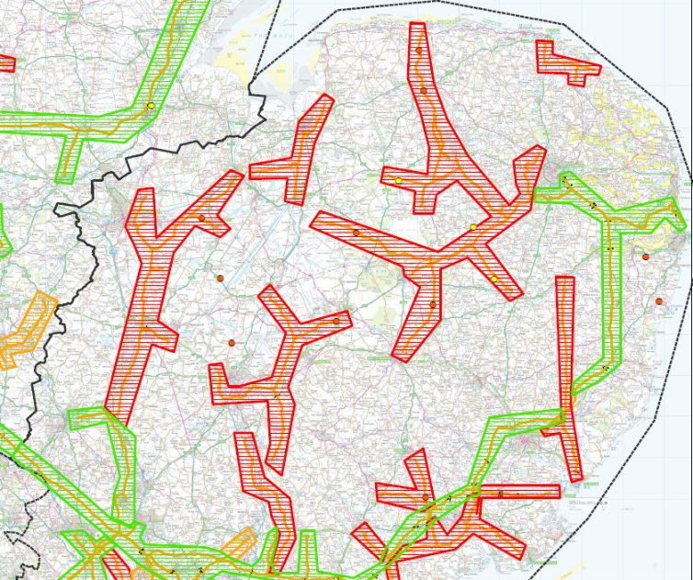
Capacity
Capacity issues in GDNs
  Grid in many areas can no longer offer capacity on summer nights or if local industry closed
Electrification of heat including district heating
H2 use by major gas users
  Reduction in fossil gas use to reduce ETS
  HBM incentive to help them switch

Slide 7
Competition from the NTS
NGT Response to Requests from the Industry
Can the NTS connection be made standard and simpler to reduce capex and delivery time. YES, good progress has been made with >75% reduction in number of valves and flexibility to have joint customer-NGT compound
Can a below ground NTS connection be designed to avoid planning in rural areas for the NTS connection assets? YES, whilst this is not our normal practice for large diameter assets, we can see the planning benefit for biomethane and we are working on modifying our standard design to provide this option to support developers
Can 1% Oxygen be allowed YES, subject to review of impact on salt cavern gas storage
Can a low cost gas quality monitoring scheme be used to give assurance to NGT over gas quality at lowest reasonable cost? YES, duplication of fast acting devices for Wobbe, H2S, O2 and H2O can be used subject to final NGT review taking into account overall design including the Diverter Valve and Compressors
Can the gas quality assurance scheme remove the need for an ROV? YES, subject to 4 above
Can the biomethane meter be at inlet of gas compressor to reduce costs for the biomethane producer Yes
Can there be a new simple process from Feasibility through to Delivery of the connection YES, we are developing this. At a high level, should always be feasible to inject biomethane into the NTS and capacity should always be available. A trial hole will be required to confirm the key elements of the connection and then standard design and cost
Can there be flexibility on installation window and notice period? YES, the aim of NGT is to install the connection within a 2 – 3 week period with NGT working with the customer to identify the window for the installation
Check if your project can inject into NTS
  No ROV
  No RTU
  No propane
  No odorant
  No chromatographs
  No Capacity issues
  No Letter of Direction
  Smaller new compound to reduce planning issues

Slide 8

Solutions
Work with GDNs, IGEM and Ofgem to change the regime
  Start with Netherlands model (<£200k GEU) and work up to assess if anything further is actually needed
  Reassess work completed in 2015 around Letter of Direction and ensure a compelling argument is communicated to enable change of the regime
CSL believes the industry should start this work in Feb 24 and give an update to Ofgem by June 24

Slide 9
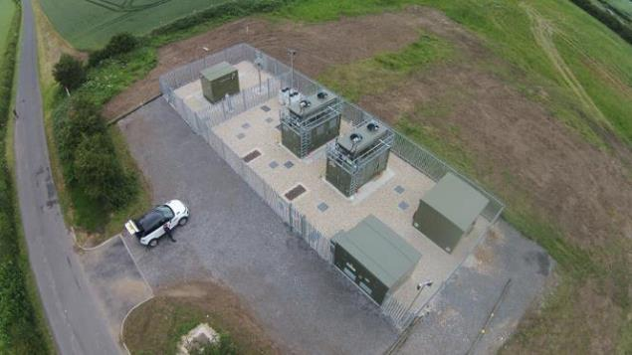
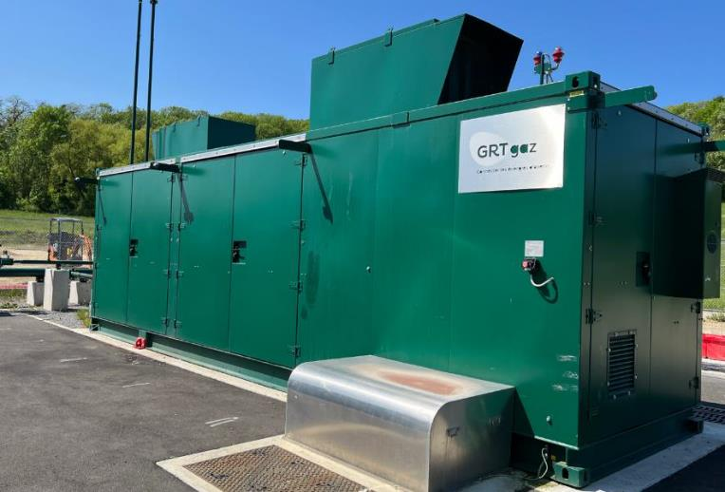
Solutions
Reverse compression
  Allows capacity and runs at reduced hours
  Widely installed across France by GRTF
    Off the shelf compressors
    Hoses allowed – helps with vibration
  UNC modification 0808 in place to allow iGT to implement reverse compression
    Discussions ongoing re the specification to allow adoption option
    First 0808 project in build (in WWU area)

