Slide 1
REA Green gas and Hydrogen Update
Including update provided by DESNZ
Sara Bartle
@REAssociation

Slide 2
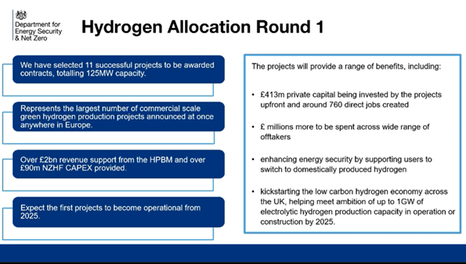
@REAssociation

Slide 3
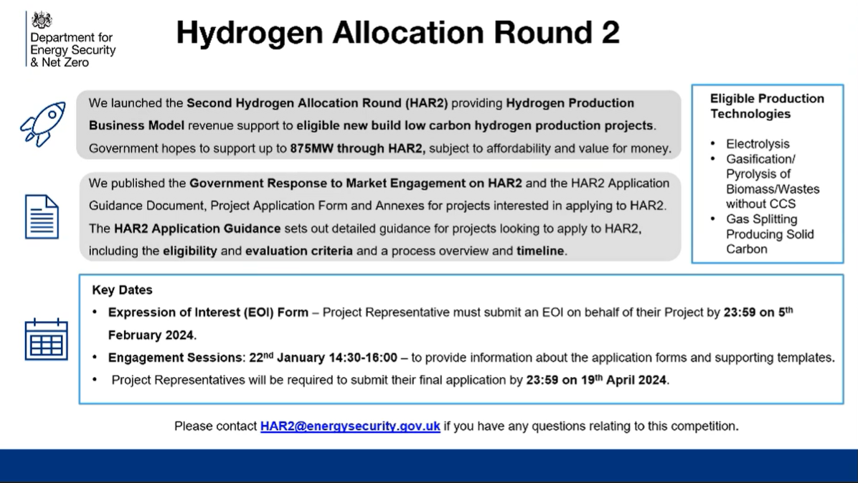
@REAssociation

Slide 4
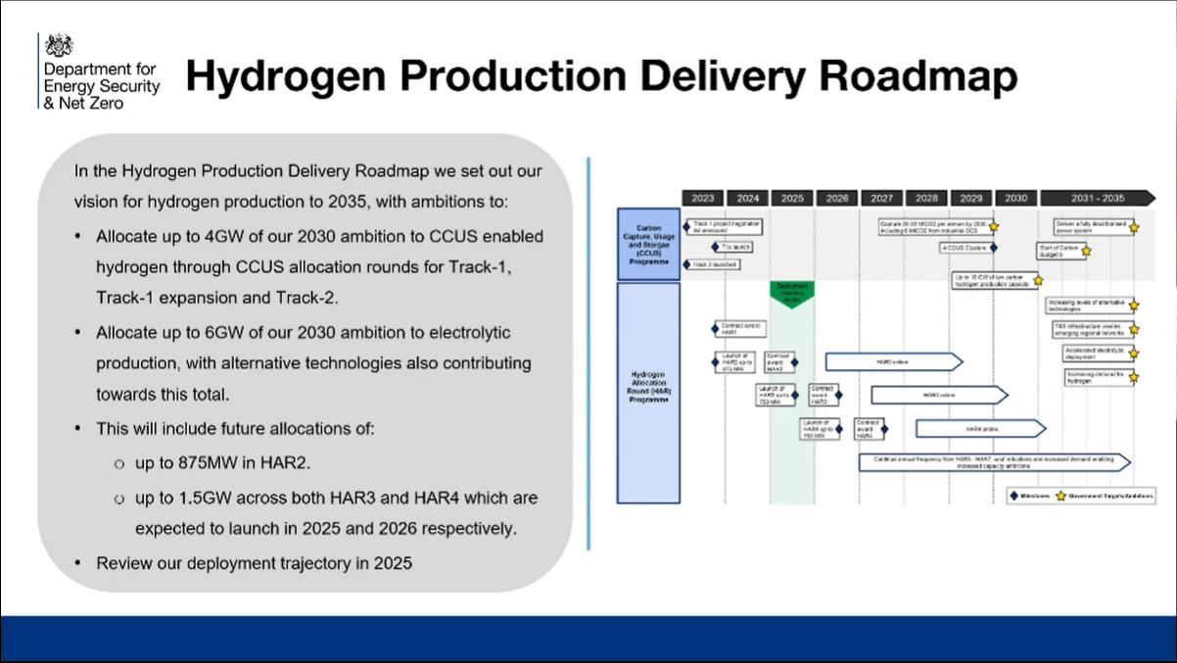
@REAssociation

Slide 5
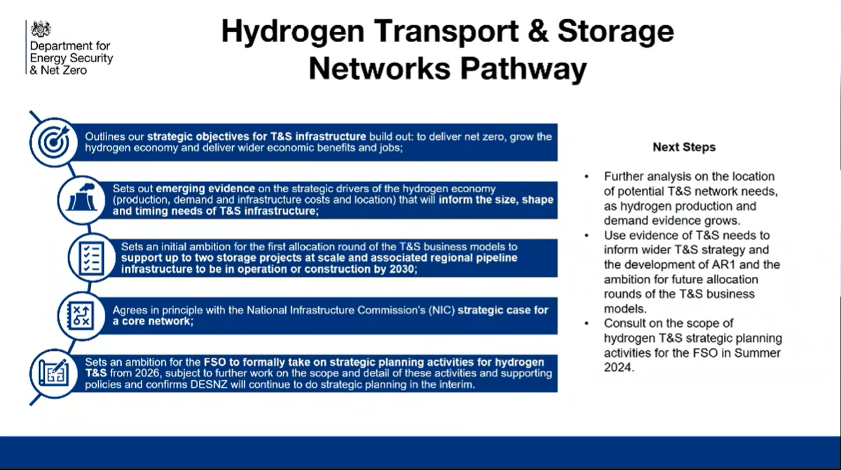
@REAssociation

Slide 6
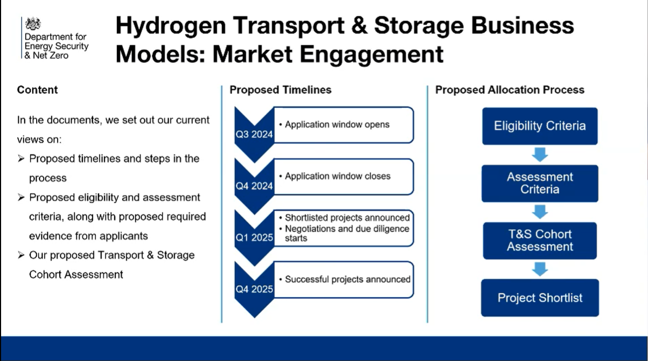
@REAssociation

Slide 7
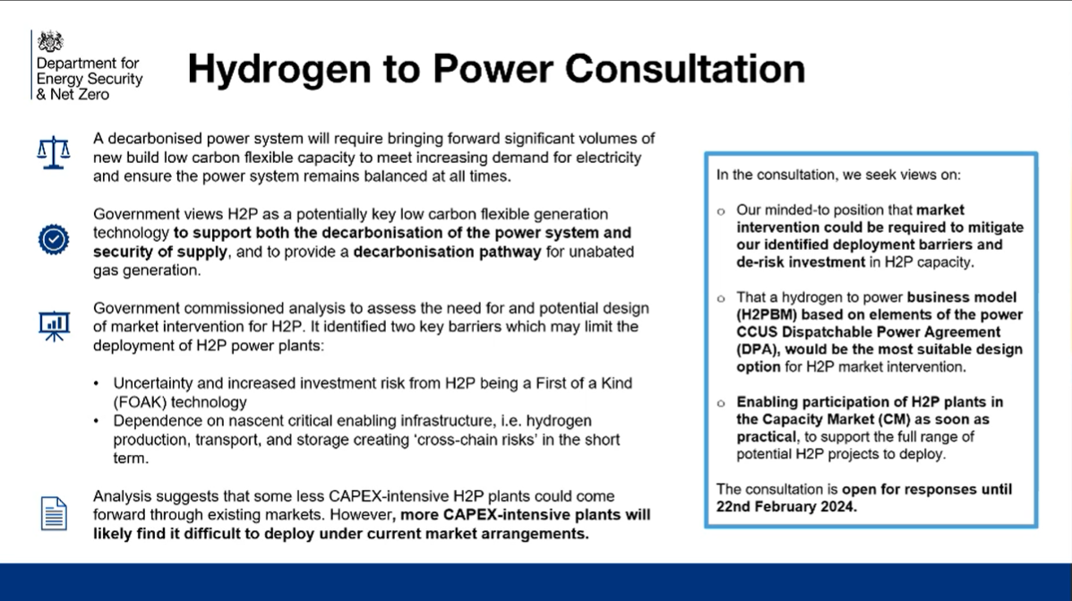
@REAssociation

Slide 8
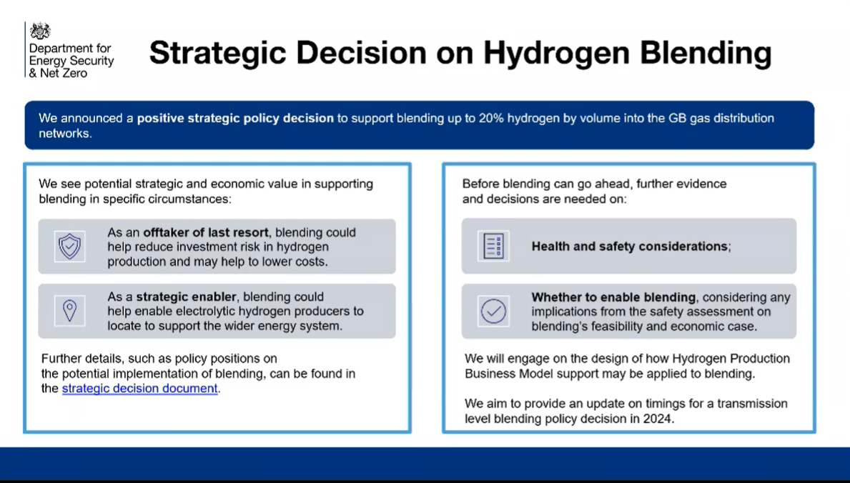
@REAssociation

Slide 9
Additional reports/info
HAR1 Process evaluation report
Research project on planning barriers for hydrogen projects
Hydrogen Transport and Storage Cost Report
Hydrogen to Power Market Intervention Need and Options Report
Green skills
Hydrogen Skills Alliance - Cogent Skills
Home - Green Skills for Hydrogen (Europe)
Green Jobs Delivery Group - GOV.UK (www.gov.uk)
@REAssociation

Slide 10
Biomethane Policy Update
22nd January 2024
REA Green Gas Forum Meeting

Slide 11
GGSS Mid Scheme Review
The GGSS consultation ran in March 2023 and reviewed several areas for potential amendments.
In October 2023, DESNZ announced plans to extend the GGSS closure date to 31 March 2028, providing more time for prospective applicants to register on the scheme.
The extension ensures continued alignment with the introduction of food waste collections across England as set out in Defra’s Simpler Recycling Government Response. It should also support a smooth transition into a future framework.
DESNZ expects to publish the Government Response imminently and this will set out further details on the extension and final policy positions across the remaining areas.
DESNZ will make the relevant regulatory changes to the GGSS in Spring 2024 and will share more details on dates as soon as possible.

Slide 12
Future Biomethane Framework
The Biomass Strategy published in August 2023 was clear on biomethane’s role in optimising the path to net zero cost-effectively by 2050 and increasing UK energy security.
In early 2024 DESNZ expects to publish a Call for Evidence to inform a future policy framework to follow the GGSS.
This will consider several key areas, including ambition for the sector, the potential for a broader range of production methods, how to overcome barriers to market growth, and the potential for a market- based mechanism to support the sector, including exploring the role of the ETS. It will also consider how to develop robust sustainability standards.
DESNZ will be working closely with industry and conducting workshops to ensure views and evidence from across the sector can inform policy development.
For any queries or to join the mailing list to receive information about future publications please contact greengassupport@energysecurity.gov.uk

Slide 13
Thank you
OFFICIAL : SENSITIVE

Slide 14
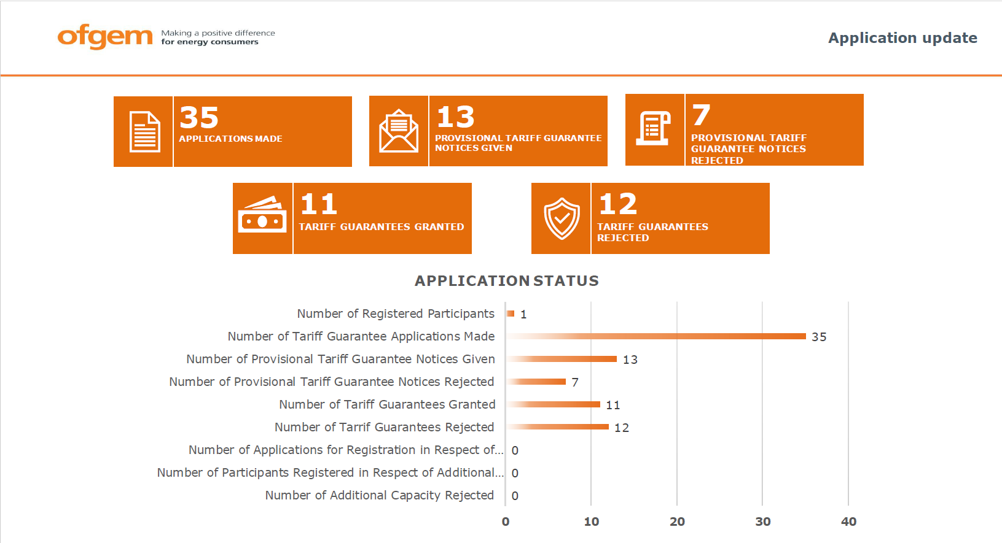
REA Transport and renewable fuels update
Paul Thompson
@REAssociation

Slide 15
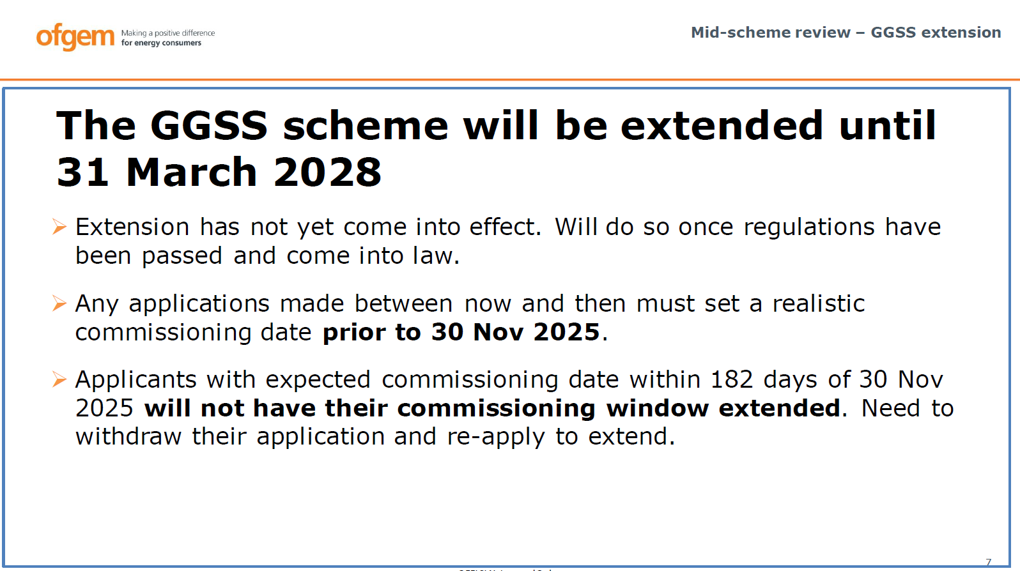
REA Transport and renewable fuels update
Paul Thompson
@REAssociation

