Slide 1
Green Gas Support Scheme GHG Calculator & Lifecycle Analysis
Lucy Montgomery
Senior Consultant

Slide 2


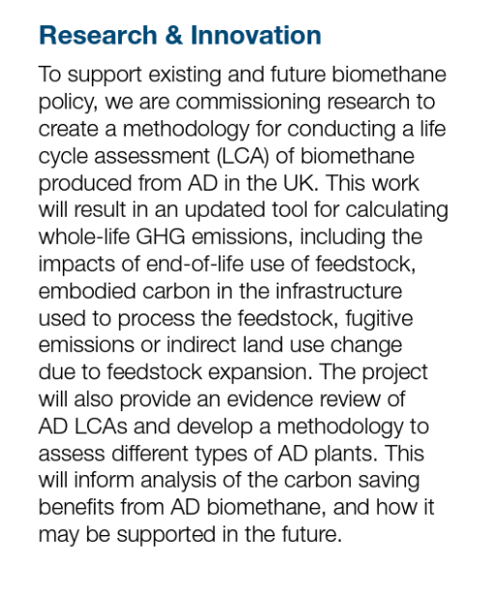
Task 1 & Task 2
PS23029 AD LCA commissioned by DESNZ (September 2023)
Task 3

Slide 3
GGSS GHG Reporting requirements
Ofgem (November 2022) Green Gas Support Scheme Guidance
https://www.ofgem.gov.uk/publications/green-gas-support-scheme-guidance
Maximum emissions threshold of 24 gCO₂eq/MJ biomethane

Slide 4
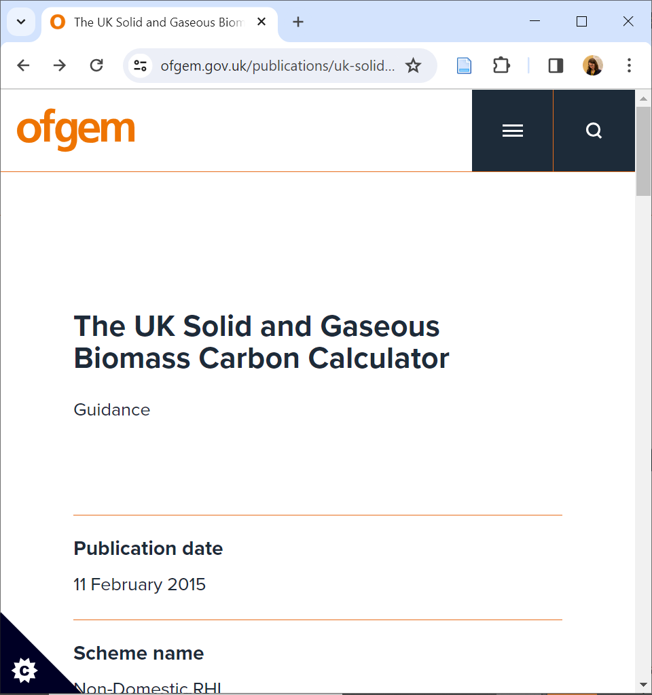
GGSS GHG Reporting requirements
Ofgem (November 2022) Green Gas Support Scheme Guidance
https://www.ofgem.gov.uk/publications/green-gas-support-scheme-guidance
Maximum emissions threshold of 24 gCO₂eq/MJ biomethane

Slide 5
GGSS GHG Reporting requirements
Ofgem (November 2022) Green Gas Support Scheme Guidance
https://www.ofgem.gov.uk/publications/green-gas-support-scheme-guidance
Maximum emissions threshold of 24 gCO₂eq/MJ biomethane

Slide 6
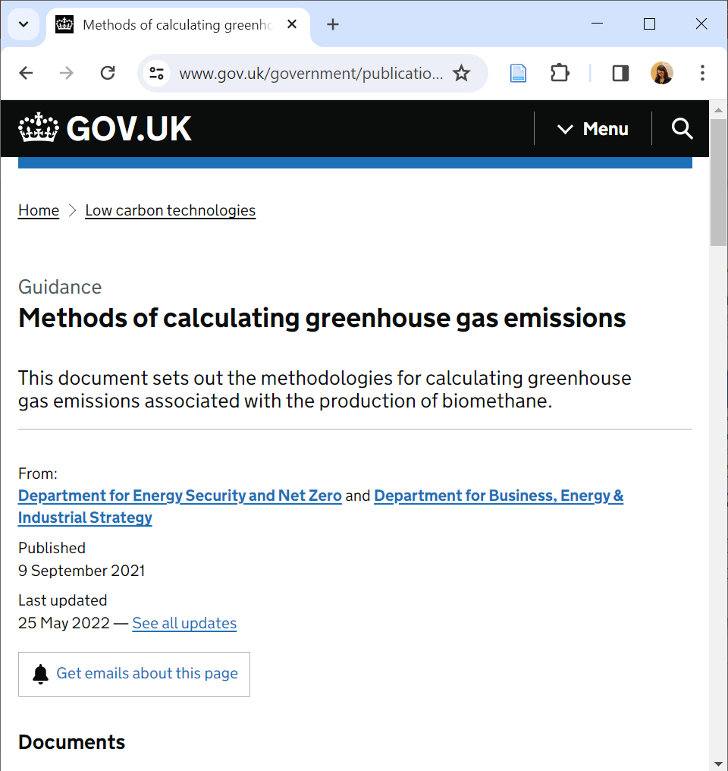
GGSS GHG Reporting requirements
BEIS (September 2021, updated May 2022) Methods of calculating greenhouse gas emissions: “actual value method” and “default value method”
https://www.gov.uk/government/publications/methods-of-calculating-greenhouse-gas-emissions
RHI was aligned with the EU Renewable Energy Directive RED (2009/28/EC)
GGSS is aligned with RED II (2018/2001)

Slide 7

Task 1 & Task 2 – GGSS GHG Calculator

Slide 8

Key Differences between RHI and GGSS
RHI - RED (2009)
“Fuel which is waste or wholly derived from waste is deemed to meet the sustainability requirements”
Individual emissions for each feedstock should be reported; any consignment over the threshold deemed ineligible.
Manure is treated as waste, and therefore deemed to meet the sustainability requirements [no other benefit].
Global warming potential of CH₄ = 23 * CO₂
Global warming potential of N₂O = 296 * CO₂
Methane slip from the process is fixed, regardless of, scale, type, system configuration.
GGSS - REDII (2018)
“Wastes and residues […] shall be considered to have zero emissions up to the process of collection of those materials…”
Every individual feedstock does not need to be under the threshold and only the average emissions count.
“For e_{sca} a manure bonus of 45 gCO2eq/MJ shall be attributed for improved agricultural and manure management...“
Global warming potential of CH₄ = 25 * CO₂
Global warming potential of N₂O = 298 * CO₂
Methane slip from the process has different defaults;
Methane slip is much higher if:
Digestate storage is open (i.e. not covered)
Offgas from biogas upgrading is directly vented
Methane slip is zero if:
Digestate storage is closed
Offgas from biogas upgrading is flared or oxidised.

Slide 9
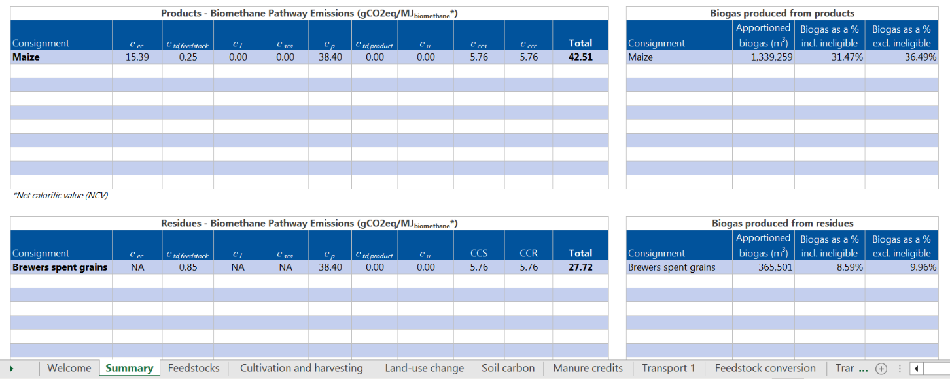
GGSS GHG Calculator
Scope: User-friendly Excel-based tool, compliant with REDII, that can be used by GGSS participants to calculate their GHG emissions for periodic reporting.
Team:
Lucy Hopwood, Project Manager
Lucy Montgomery, Technical Lead
Polly-Ann Hanson, Technical Support & Analysis
Zebra EM, Data Management support
Delivery:
Based on RHI GHG Calculator, used by industry since 2016
With added User Interface and Reporting functionality
Aligned with revised (RED II) methodology
Freely available to GGSS participants

Slide 10
Task 3 – LCA of AD
Brief was to look at LCA of AD “beyond REDII”
Both positives and negatives are implied
DESNZ expressed particular interest in:
Impact of infrastructure
Impact of fugitive methane emissions
Impact of ‘end of life of feedstocks’
Some commonly mentioned methodology limits of REDII are:
Manure credit can distort emissions (and RTFO have ditched it for 2024)
The handling of digestate as a co-product can distort emissions
CO₂ is not treated as a co-product, which will potentially put it out of sync of carbon certificate schemes.

Slide 11
3. Life Cycle Analysis for UK AD facilities
3.1 Literature review of LCA methods
3.2 LCA method development
3.3 LCA tool development
3.4 Data gathering & testing
3.5 Case studies
3.6 Sensitivity analysis
3.7 Emissions of UK AD fleet

Slide 12
3. Life Cycle Analysis for UK AD facilities
3.1 Literature review of LCA methods
3.2 LCA method development
3.3 LCA tool development
3.4 Data gathering & testing
3.5 Case studies
3.6 Sensitivity analysis
3.7 Emissions of UK AD fleet

Slide 13
Task 3 – Methodology
Some methodology changes can have a big impact on how big the ‘benefits’ of AD are.
An example of this is whether manure gets a credit.
In REDII/GGSS, your AD pathway emissions get a carbon credit for every unit of manure you use as a feedstock.
Because poorly stored manure would otherwise have emitted powerful greenhouse gases on farm.
However, the credit is a simplification.
The benefit really should be counted in agriculture, as it’s avoided on the farm not at the AD plant.
The credit can cause a distortion of emissions further down the line.
It can be used unscrupulously to compensate for poor practice.

Slide 14
Task 3 – Methodology
We are approaching these issues with a methodology ‘toggle’.
For certain big issues, you can choose in the tool to toggle them on and off.
‘include manure credit’ / ‘exclude manure credit’
For other issues, there is a high, medium and low range that you can toggle between.
E.g. How high are fugitive methane emissions really?
In this afternoon’s session, looking into some of these bigger issues.

Slide 15
Policy context

Slide 16








Thank you
Lucy Hopwood, Project Manager
l.hopwood@nnfcc.co.uk
Lucy Montgomery, Technical Lead
l.montgomery@nnfcc.co.uk
Polly-Ann Hanson, Technical Support & Analysis
p.hanson@nnfcc.co.uk
A specialist strategic business consultancy with 20 years of bioeconomy experience
Website: www.nnfcc.co.uk
Email: l.montgomery@nnfcc.co.uk

