Slide 1

REA Heat
Heat network zoning consultation
Members Discussion
1st February 2024
@REAssociation

Slide 2
REA Competition Law Policy
REA’s compliance with all aspects of UK Competition Law applies to all activities of REA including its subsidiaries Member Forums, committees, working groups, technical groups, and sub-groups and any other such meeting:
  Members are not permitted to discuss competitively sensitive information, or to use REA as a conduit for such discussions
  Competitively sensitive information covers any non-public strategic information about a business’s commercial policy. It includes, but is not limited to, future pricing and output plans
  Please note this session is being recorded for note taking purposes.

Slide 3
Agenda
Heat Network Zoning Members discussion
14:00- 15:30
Introductions
Background on Heat Networks
Brief overview of consultation
Key message for REA members/ technologies
Open discussion
Round up and next steps
Close
@REAssociation

Slide 4
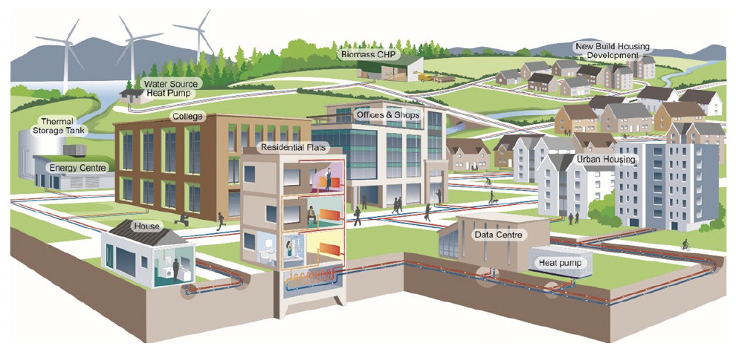
Background on Heat Networks
@REAssociation

Slide 5

Current Policy and Funding Available
Funding boost: Heat Network Transformation Programme (GHNF and HNES) - £485 million will go towards (1) the Green Heat Network Fund to help around 60,000 homes and buildings gain access to low carbon heat networks; and £45 million to (2) the Heat Network Efficiency Scheme to improve around 100 existing heat networks.
Four successful projects have recently been awarded £80.6 million under the Green Heat Network Fund (GHNF).
GHNF Applications for Round 7 are open and will close on 23 February 2024.
34 projects have been awarded £8.1 million under the the Heat Network Efficiency Scheme (HNES).
HNES Application deadlines for Round 6 have been extended to the 22nd March 2024.
Application seminar Weds 6th March 10am-11am.
Ofgem to regulate heat networks
Notes:
The Green Heat Network Fund (GHNF) is a multi-year, capital grant fund that opened to applicants in March 2022 and is anticipated to run to 2027. It will provide support to organisations in the public, private, and third sectors in England. It supports (a) the commercialisation and construction of new low and zero carbon (LZC) heat networks (including cooling) and (b) the retrofitting and expansion of existing heat networks. It replaced the Heat Networks Investment Project (HNIP) scheme which closed for applications in January 2022. In contrast to the HNIP scheme, the GHNF scheme will only fund heat network projects where there is a low-carbon heat source.
The Heat Network Efficiency Scheme (HNES) provides funding to public, private and third sector applicants in England and Wales to support improvements to existing district heating or communal heating projects that are operating sub-optimally and resulting in poor outcomes for customers and operators.
The Heat Networks Delivery Unit (HNDU), which supports local authorities in delivering heat networks.
HNDU grant funding can cover up to 67% of the eligible external costs of heat network development studies. Applicants must secure the remaining funding through match funding. Additionally, HNDU can provide up to 100% of the cost of externally procured project management support for public sector applicants and registered social landlords.

Slide 6
Background to Consultation
In 2019 the UK government set a legally binding target to achieve net-zero greenhouse gas emissions by 2050. In 2021, the government laid legislation for the UK’s sixth carbon budget, proposing a world-leading target which would reduce greenhouse gas emissions by 78% by 2035 compared to 1990 levels.
As heating is responsible for about 20% of the UK’s greenhouse gas emissions, meeting our net-zero target will require the decarbonisation of virtually all heat in buildings and decarbonising heat is a key part of the government’s strategy: it underpins the Net Zero Strategy, the Heat and Buildings Strategy and most recently, Powering Up Britain.
Heat networks are an essential part of our path towards decarbonising heat, enhancing energy security and achieving net zero by 2050. They currently provide about 3% of total UK heat. Our analysis shows that heat networks could provide up to 20% of total UK heat by 2050.
The Energy Act 2023 establishes the regulatory framework for heat networks in Great Britain and provides powers to introduce heat network zoning in England through secondary legislation.
On 18 December 2023 the government published a consultation on heat network zoning. This document provides an overview of the definitions, key concepts, and proposals in the consultation

Slide 7
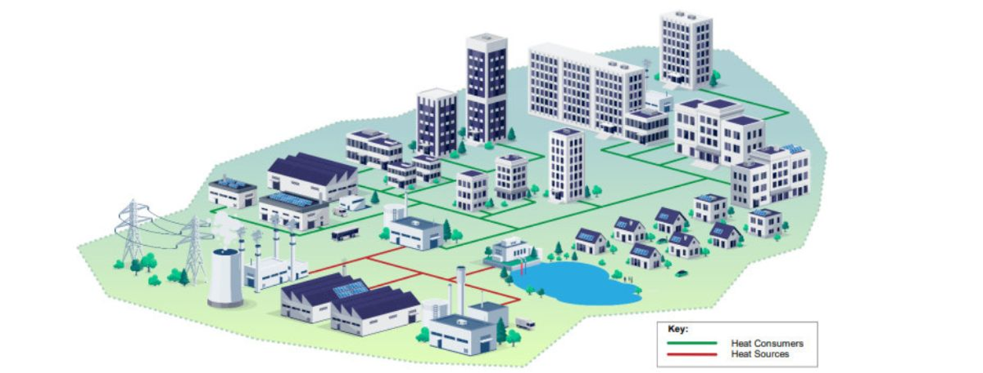
Brief overview of consultation
@REAssociation

Slide 8
Aims and objectives of heat network zoning
Under heat network zoning, central and local government will work with industry and local stakeholders to identify and designate areas of England where heat networks are expected to be the lowest-cost solution to decarbonising heat. Heat network zoning will be essential to speeding up the development of new heat networks. By indicating where heat networks are likely to be the lowest cost solution to decarbonising heat, we hope to catalyse growth where it’s most needed.
Heat network zoning will significantly increase private sector investment in the sector by removing the barriers which currently limit the pace of developing large scale heat networks. It will also give local communities the tools to accelerate the development of heat networks in their own areas and ensure that more homes and businesses can have access to greener, cheaper heat. It also has the potential to create tens of thousands of jobs across the country

Slide 9
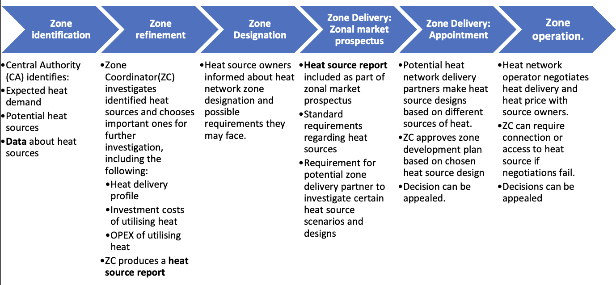
Heat Sources Questions 37 - 40
Notes:
Zone Coordinators will finance and enable the investigation of the potential for recovering heat from local sources to produce a heat source report for the Zonal Market Prospectus. The Zone Coordinator will publish the Zonal Market Prospectus to attract potential heat network zone developers.
The heat source report will include, at a minimum, expected delivery temperatures, delivery profiles (a reliability assessment), likely or confirmed investments costs, operation and maintenance costs, administration costs and the expected lifetime of delivery for each heat source investigated.
During the heat source investigation, the Zone Coordinator will inform heat sources that they may be required to connect or give access at a later stage
Heat network companies which then subsequently bid for the rights to develop a heat network zone based on the heat source report
Zone developers may start negotiations with heat source owners ahead of the Zone Coordinator assessing bids as part of the zone delivery process, and they can also set conditions when awarding zoning rights to a particular developer that will require them or incentivise them to develop connections with relevant heat sources.
The aim of the negotiations, supported by guidance and expertise from the Central Authority, will be for the heat network developer and the heat source owner to arrive at a mutually beneficial agreement for the sale of heat.
Zone Coordinators will have the powers to ultimately require heat sources to connect or give access if negotiations fail. The Zone Coordinator can do so if, in their view, there is a sufficient case for the heat source to provide heat to the heat network at a price beneficial to both sides and without significant risk to the business interests of the heat source.
Negotiations between heat source owners and a heat network developer should be based on whether there is a difference between the ‘marginal heat price’ and the ‘substitution price’.
The marginal heat price is the cost to a heat producer of producing the heat before profit. The substitution price (counterfactual price) is the price at which a district heat network operator can produce the same amount of heat by themselves with whatever technologies the heat network is using. Where the difference is positive this indicates that both the heat source owner and the heat network could financially gain from the sale of heat.
if this value is zero or negative heat delivery cannot be required.
Want to be provided an indicative list of heat sources that will be considered so we can make sure members are aware they could be included
Need to make sure ZC is aware of all the technologies.

Slide 10
Heat Sources Questions 37 - 40
Categories of heat sources
High temperature recoverable heat sources such as combined heat and power (CHP), Energy from Waste (EfW), combined heat and cooling as well as high temperature heat resulting from industrial processes.
Low temperature ‘near constant’ recoverable heat sources - for example, wastewater treatment, datacentres, electricity transformers, gas compressors, mines, cold stores, underground railways.
Low temperature ‘intermittent’ recoverable sources – for example, sugar mills, breweries, foundries, supermarkets.
Ambient location specific sources – for example, solar, river, sea, canals.
Ambient location agnostic sources such as air-to-water heat pumps.
‘Requirements to connect heat sources should apply to only high temperature heat sources, and requirements to give access (to land, for example) to low temperature infrastructure and some ambient heat sources.’
40. Do you agree that a) the requirement to connect should prioritise high temperature heat sources, and b) the requirement to give access should apply to low temperature infrastructure heat sources and the location specific ambient heat sources?
Notes:
The heat source design will often be a combination of the heat source categories above, perhaps including a heat storage system
Therefore, we propose that requirements to connect heat sources should apply to only high temperature heat sources, and requirements to give access (to land, for example) to low temperature infrastructure and some ambient heat sources – mainly where an agreement is
required with an owner of, for example, water or land.

Slide 11
Carbon emission requirements
The Central Authority will set maximum gCO2e/kWh limits for new heat networks in zones and new connections of existing heat networks in zones. These limits will apply from 2030.
• Option 1 - 44g CO2e/kWh: This option is equivalent to the low-carbon threshold required under the Green Heat Network Fund adjusted by the predicted change in the CO2e of electricity grid intensity by 2030 as per the Green Book projections.
• Option 2 - 147g CO2e/kWh: This option will represent a reduction in CO2e emissions for some heat networks predominantly using gas-generation.
• Option 3 – 83g CO2e/kWh: This option is a middle option between option 1 and 2. It is based on a fuel mixture that is less carbon intensive than option 2, that assumes the use of less gas and more renewable or waste heat.
Key questions
43. Which, if any, of the three proposed emissions limits should be set as the initial limit in 2030? If none, please provide an alternative proposal for the initial limit on emissions.
44. Do you agree that introducing the emissions limit from 2030 will give adequate time for heat networks to adapt? If you disagree, what would be an adequate alternative timeline?
45. What would be appropriate intervals for reviewing the national zoning emissions limit?
Notes:
The national emissions limit will not prevent Zone Coordinators from looking more favourably on lower carbon proposals when assessing bids for heat network development within zones.
Also references solid biomass combustion producing fine particulate matter as the pollutant of greatest harm to human health, saying that operators that are considering solid biomass combustion as a heat source should closely consider the potential effect of tightened environmental permitting requirements as these develop.
These impacts are controlled through environmental permitting regulations, which will continue to be tightened in the future to prevent health impacts
We will be asking for transparency about emissions reductions and bring up the role of biomass in biomass strategy and the assurances EfW biomass plants need approaching end of RO

Slide 12
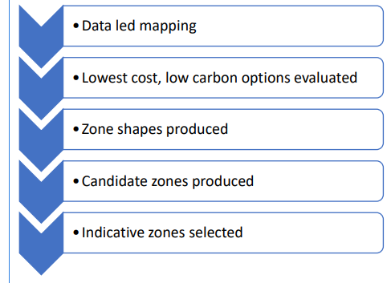
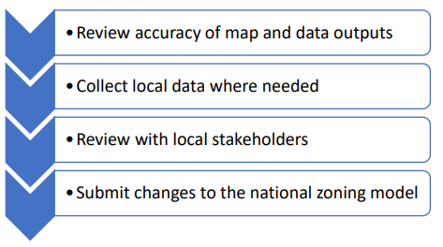
Stages 1-5
5 stages to the heat network zoning lifecycle:
  Zone identification and refinement
  Zone designation
  Zone delivery
  Zone Operation
  Zone Review
Stage 1: The Central Authority will lead a data-driven national mapping exercise, using the National Zoning Model, to identify indicative heat network zones – areas in which heat networks are expected to be the lowest cost technology for decarbonising heat.
The Zone Coordinator will use a standardised approach, with accompanying guidance, to refine the indicative heat network zones.
The zoning bodies will source data from national datasets, or other publicly available sources. However, when necessary the zoning bodies may request information directly from organisations.
The Central Authority will review the zoning methodology every five years. Changes will not retroactively apply to existing zones
Notes:
the zoning bodies may request that information directly from organisations.
For the purposes of zone identification, the following data may be requested by the Zone Coordinator or Central Authority. This list is not exhaustive. • Heat demand of buildings. • Information about heat sources. • Information about waste heat. • Carbon emissions associated with heat sources. • Planning data.

Slide 13
Stages 1-5
Stage 3: Zone delivery
Will be the process by which a Zone Coordinator, or the Central Authority acting as a Zone Coordinator, will be able to confer “zoning rights”, provided by heat network zoning legislation, to specific organisations.
Stage 4: Zone operation
During the operation stage, developers will construct new infrastructure, make new connections, and maintain and operate their heat networks. The Zone Coordinator will also collect data for monitoring and reporting purposes.
Stage 5: Zone review
Changes in local circumstances may require a reassessment of the designation. Zone review will only allow for the expansion of designated heat network zones.
Stage 2: Zone designation
There are 2 parts of designation: (a) agreeing the proposed shape in a formal consultation and (b) registering the areas with the Central Authority
There will be a two-tier approach to consultees in the consultation process.
Tier 1 will include bodies expected to have an interest in most heat network zones such as heat network operators and local planning authorities. The Zone Coordinator must provide these bodies with an opportunity to respond to the consultation. These are the statutory consultees.
Tier 2 bodies may have an interest depending on the location and/or nature of a specific zone. Zone Coordinators may wish to seek their views, but there will be no requirement to specifically consult these parties
Notes:
Triggers for changes include:
A new major development adjacent to an existing zone.
A new major development near an existing zone
An agreed connection of a new or newly identified heat source to a heat network in a zone. And where potential for a new heat source to be recorded.
Potential future sources

Slide 14
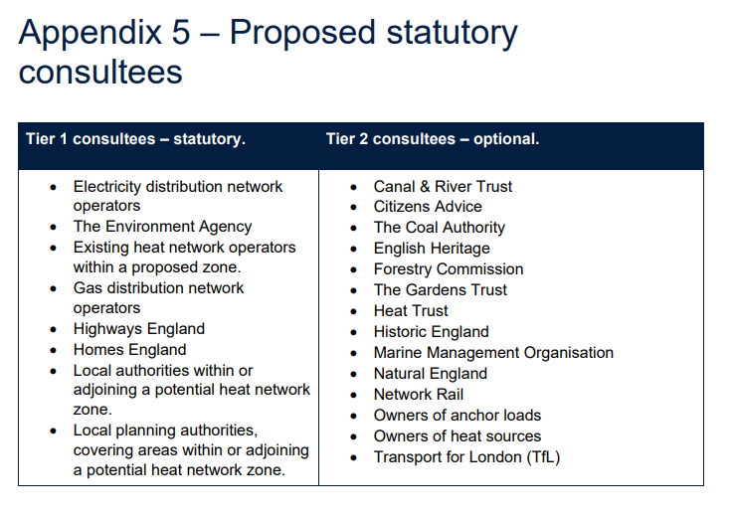
Stages 1-5 ~ Questions 48-80
48.Should the zone refinement stage allow more general refinements? Please provide any specific examples of other factors which could be considered.
52.Please provide any views on types of data which could be difficult or costly to provide. Specify the type of data and which organisation would supply it.
54.What factors should the Central Authority consider when reviewing the zoning methodology?
60.Do you agree with the proposed Tier 1 and Tier 2 consultees set out in Appendix 5? If not, please provide any suggested changes.
73. Do you agree with the process for zone review described in this section, including the list of relevant changes and the role of the zoning bodies? If not, please provide further detail.
Notes:
Trade bodies as tier 2 consultees
54. Are there specific attributes or factors they should be considering
Severn trent green power: When using chp statuatory regulatory duty to treat biomass and convert sludges to apply to land. We are using the heat in order to treat that material. These sites are providing material as well as producing heat. The heat isn’t actually available/waste. Where we have chp it is to provide heat.

Slide 15
Key message for REA members/ technologies
@REAssociation

Slide 16
High Level Messages
Encourage Technology Agnosticism – all potential low carbon heat sources should be considered. This includes biomass, green gases, wastewaters and raw sewage, thermal storage, geothermal, heat pumps, energy from waste and solar. Important to ensure the right technology for the right situation.
Reference UK’s Biomass Strategy, which emphasises bioenergy technologies have a role to play in decarbonising heat.
Interaction with other support schemes – ensuring sites can take part when in receipt of other government support.
Renewables obligation is coming to an end, impacting EfW and Biomass, we need assurances now – this needs to be taken into consideration in heat network planning.
Need for planning reform alongside this and not excluding full range of delivery partners.
It is important that the methodology is not too rigid and allows for flexibility so that decisions can be taken at the local level based on the local context, and updated when new technologies are developed or new heat sources identified.
Notes:
Regulations should be in accord with those set out by the Environment Agency and permissions acquired through Environmental Permits as already takes places.
Transparency about reductions
Business case for doing so, economically feasible
Innovative heat sources data might be more difficult to get access to.
Need to consider relationship between heat and power production – its possible that if a site becomes predomintaly heat production then power production might decrease and that current data on heat production might be based on numbers prioritising power production

Slide 17
High Level Messages
Regulations should be in accord with those set out by the Environment Agency and permissions acquired through Environmental Permits as already takes places.
Transparency about future plans to reductions in emissions limits.
Ensure sufficient business case when connections are being mandated.
Innovative heat sources data might be more difficult to get access to.
Need to consider relationship between heat and power production. It’s possible that if a site becomes predominately heat production then power production might decrease and that current data on heat production might be based on numbers prioritising power production.
Notes:
Regulations should be in accord with those set out by the Environment Agency and permissions acquired through Environmental Permits as already takes places.
Transparency about reductions
Business case for doing so, economically feasible
Innovative heat sources data might be more difficult to get access to.
Need to consider relationship between heat and power production – its possible that if a site becomes predomintaly heat production then power production might decrease and that current data on heat production might be based on numbers prioritising power production

Slide 18


Open discussion
@REAssociation
Notes:
General feeling on zoning – a threat or opportunity?

Slide 19
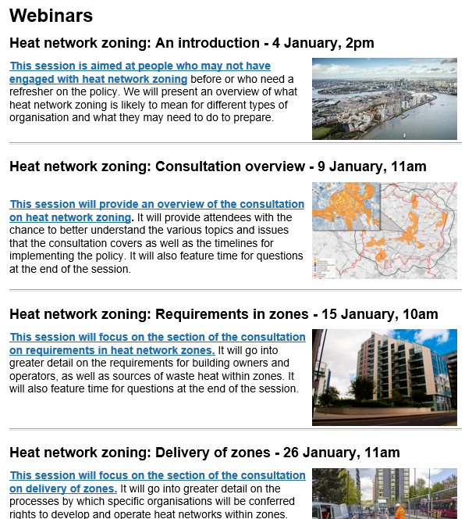


Next steps/ Timeline
Webinars and information sent around: Next week
Consultation Response REA Draft: W/C 12th February
Member Feedback: February
Consultation Deadline: 26th February 2024
enquiries@tp-heatnetworks.org
Notes:
The Green Heat Network Fund is delivered by Triple Point Heat Networks. They often host webinars on the GHNF and Heat Networks more broadly.
If you are applying to the GHNF we recommend getting in touch with them - they have a dedicated Relationship Management team to discuss individual projects and for application advice. Their website also has a range of information including guidance materials and case studies.

Slide 20
Thanks
As always if you have any questions please get in touch:
All heat enquiries:
heat@r-e-a.net
Sara Bartle
Green Gas and Hydrogen Policy Lead
sbartle@r-e-a.net
Kat McManus
Bioenergy Policy Analyst
kmcmanus@r-e-a.net
Poppy Airey
Heat Policy Analyst
pairey@r-e-a.net

Slide 21
Useful Links
Heat Network and Transformation programme Heat networks - GOV.UK (www.gov.uk)
Heat Network Zoning Consultation
Heat network zoning - GOV.UK (www.gov.uk)
Proposals for heat network zoning 2023 - GOV.UK (www.gov.uk)
Green Heat Network Fund (GHNF) PowerPoint Presentation (tp-heatnetworks.org)
Heat Network efficiency scheme – currently Rond 6
Apply for the Heat Network Efficiency Scheme (HNES) Round 6 - GOV.UK (www.gov.uk)
Energy Act 2023 Energy Act 2023 (legislation.gov.uk)

