Slide 1


21st March 2024
REA Organics – Chair Welcome
Graeme Kennett
Chair of REA Organics Forum
Principal Environmental Consultant, Mabbett & Associates
Organics Conference
www.r-e-a.net

Slide 2
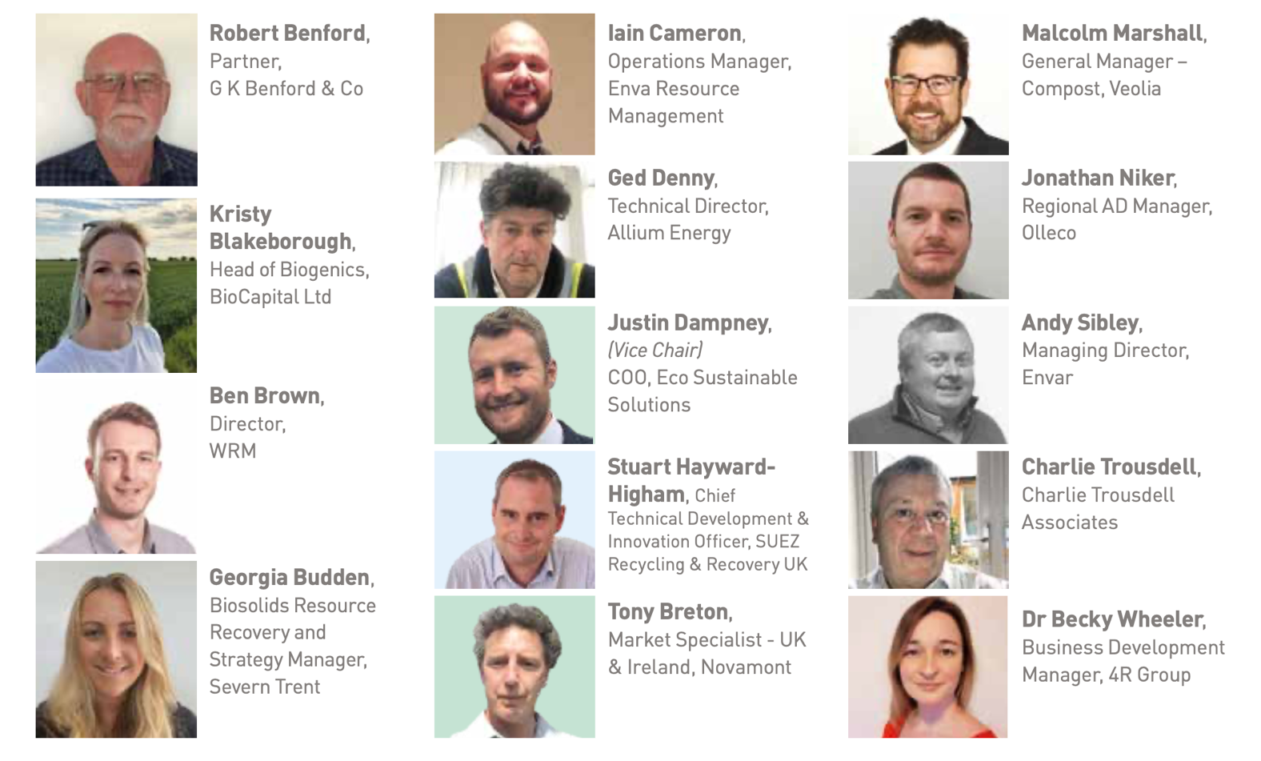
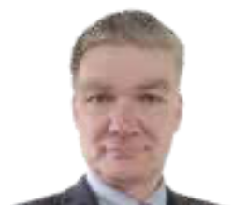
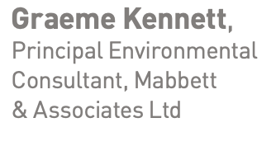
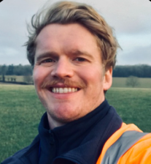
Organics Steering Group
Declan Barlow,
Biosolids and Trade Waste Lead, Severn Trent
@REAssociation
Notes:
Graeme taken over as chair as Becky now on REA board.
Ralph Lodge from Enva retired.
Janes Astor, Georgia Buddon, Rob Moody and Jon Niker have stood down.
New members: Kirsty Blakeborough, Declan Barlow, Iain Cameron, Ged Denny, Malcolm Marshall.

Slide 3
Government and Regulator Engagement
Quality Protocols revisions
Consultations
Events and training
Others:
UKRI funded project on Compostables
Revision of EN 13432 Standard
Sustainable peat replacements
REAL’s research hub
Bioresources Strategy
WRAP Organics roadmap
Key activities
@REAssociation
Notes:
Government and Regulatory engagement
The team have regular meetings with Defra, DES-NZ and DBT on a range of topics
Sit on some advisory groups to shape policy.
Regular dialogue with the EA where required.
Quality Protocols Revision. Finally making progress and likely there will be draft revised QPs in the next few months. The main changes being the revised input lists and tighter plastics limits. Talk to Jenny if you want more info.
Consultations – appreciate members feedback. Recent responses include:
Scottish Circular Economy and Routemap
Technical Competency
Various EPR consultations
Standard rules on gas capture from lagoons
To do – The Scottish Environmental Authorisation consultations.
Events and training :
Member meeting on the Scottish Consultation
PAS100 and PAS110 training – Run in February but will be doing them again in a few months.
Member meeting on Simpler Recycling
Upcoming events
HACCP training –25th April
British Renewable Energy Awards, 13th June 2024
The team also work on a range of other technical areas including:
UKRI funded project on Compostables – please talk to Emily if you want more info
Emily also sits on the committee who are revising the standard for compostable materials
Sit on the external advisory group of a project looking at sustainable peat replacements
Both Emily and Jenny involved in some of REAL’s research hub projects and we’ll hear more from Megan later about one of these.
Bioresources Strategy – Emily involved in a group looking at waste water and sludge treatment
Working on various aspects of WRAP’s organics roadmap to do with improving quality of feedstocks and outputs.

Slide 4
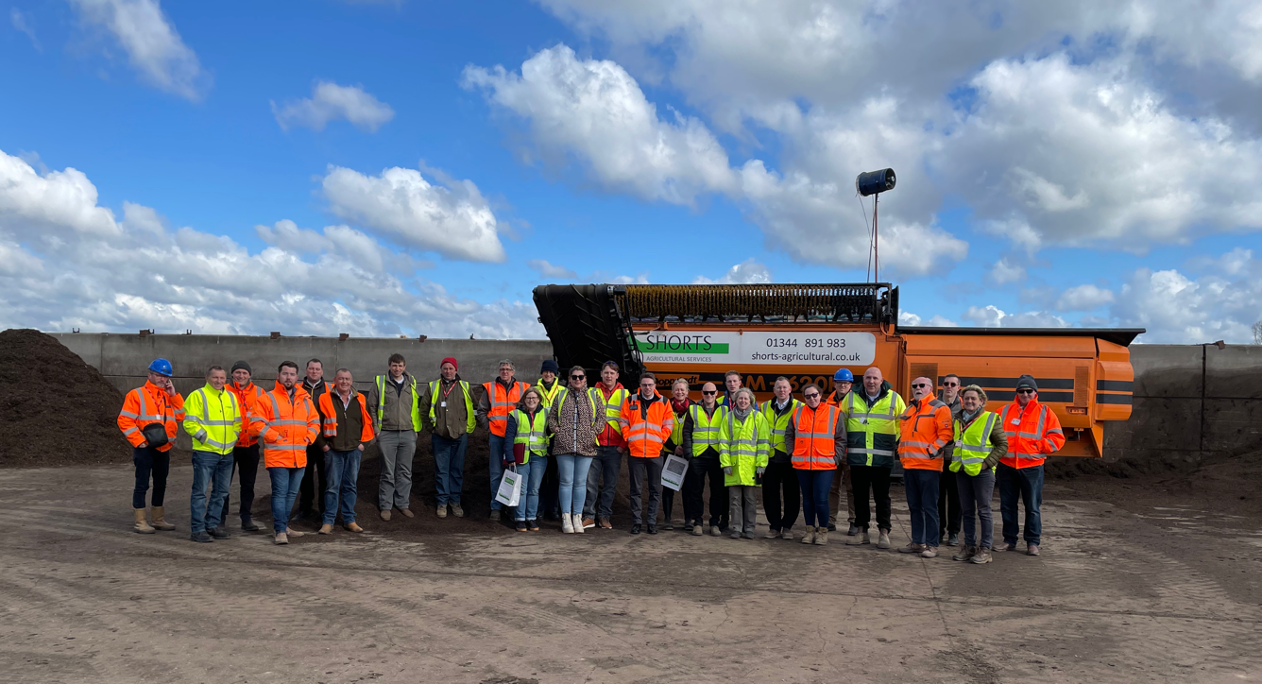
Questions:
Where would you like to go?
Any sites willing to host?
Member meetings
@REAssociation
Notes:
Keen to get back to in person member meetings and site visits.
Please tel us where you would like to go and if you would be willing to host a visit, please let us know.

