Slide 1
The future of kerbside organic collections in England Daniel Roberts FCIWM
21/03/24
Notes:
20 years experience, 16 years in LA, implemented and managed kerbside organic collections.
Legislation and targets apply to England only. Other information (e.g. composition, charges) broadly relevant across UK.
Focus on household collections: current LA status, forthcoming requirements, WRAP interventions.

Slide 2
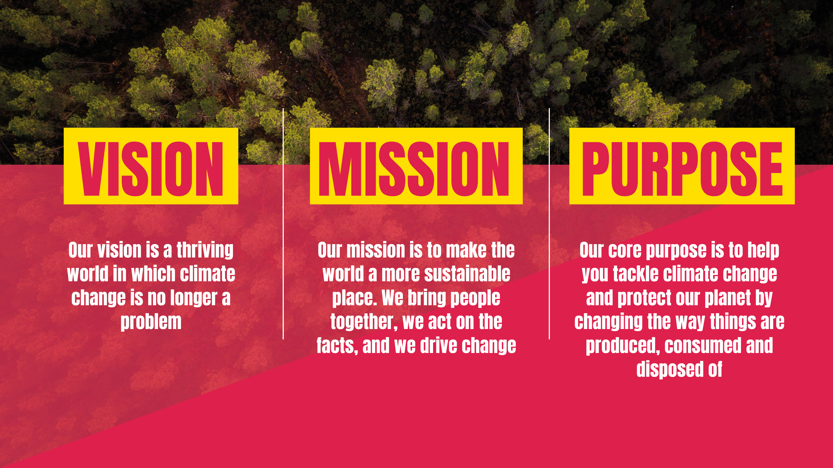





Notes:
WRAP is a climate action NGO working around the globe to tackle the causes of the climate crisis and give the planet a sustainable future.
Our vision is a thriving world in which climate change is no longer a problem
We bring people together, act on the facts and drive change
We were established in the UK in 2000; we now work in 40+ countries.
We work at the heart of the system and across the value chain, with governments, businesses, philanthropic funders and NGOs to make real and lasting change.

Slide 3
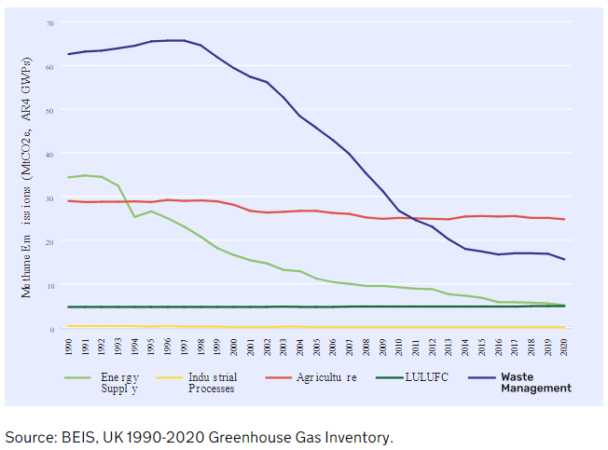
Environmental impact of organic waste in landfill
Over 20 years, methane is 80 times more potent than carbon dioxide as GHG (UNEP).
EU Landfill Directive: target to reduce by 2020 BMW to 35% of that produced in 1995.
75% reduction in methane emissions from waste sector between 1990 and 2020 (BEIS).
Notes:
Anaerobic degradation of organic material in landfill generates methane.
Complementary levers of legislation and fiscal measures (i.e. landfill tax).
LULUFC = land use, land-use change and forestry.

Slide 4
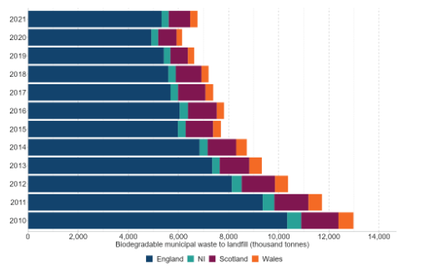
Environmental impact of organic waste in landfill
https://www.gov.uk/government/statistics/uk-waste-data/uk-statistics-on-waste#impact-of-coronavirus-covid-19
Notes:
2021/22: 111 LAs in England sent waste to non-hazardous landfill

Slide 5
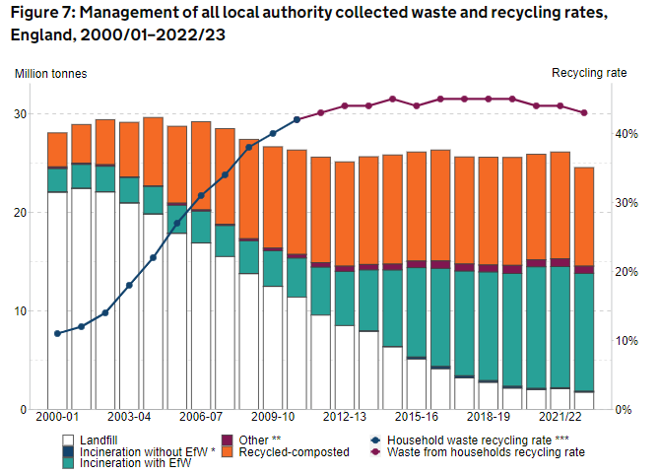
https://www.gov.uk/government/statistics/local-authority-collected-waste-management-annual-results/local-authority-collected-waste-management-annual-results-202223
Notes:
Recycling rates plateaued over 15 years. Step change expected from SFW collections.

Slide 6
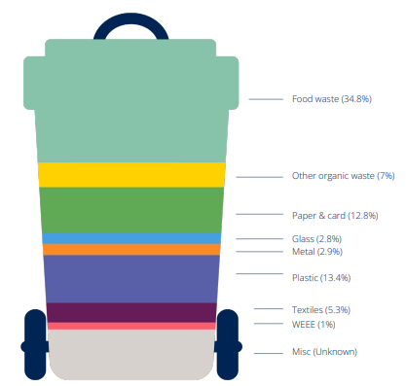
Waste composition (UK)
Average composition of household residual waste collected at the kerbside (2017).
https://wrap.org.uk/sites/default/files/2024-02/WRAP-Household-Food-Waste-Collections-Elected-Members-Summary-Guide-INTERACTIVE.pdf
Notes:
Figures based on WRAP 2017 UK waste composition studies. Variances across LAs depending on contextual and service factors (material collected, frequency, seasonality).

Slide 7
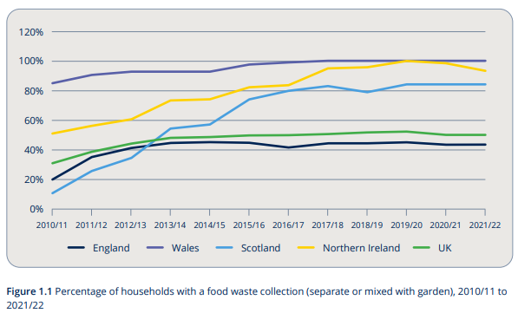
https://wrap.org.uk/sites/default/files/2024-02/WRAP-Household-Food-Waste-Collections-Guide-V17.pdf
Notes:
Not reflective of number of LAs that have implemented FW collections.
In 2022, over 15.1 m households in UK had access to a FW collection (2007 = 3.2 million).
2022/23: 128 LAs with SFW collections; 41 LAs with co-collected food and garden waste collections.
Food waste within co-collected food and garden waste stream is 1/3 to 1/2 that observed where SFW collected.

Slide 8

Requirement to collect garden waste (England)
Legal requirement to collect garden waste when requested by householder by 31st March 2026.
Statutory guidance to detail what should be included.
LAs can continue to charge for garden waste collection (EPA 1990, CWR 2012).
Notes:
95% of LAs already collect garden waste.

Slide 9

Requirement to collect food waste (England)
Collection from all households by 31 March 2026.
Food waste from households must be collected at least weekly.
Transitional arrangements will apply for LAs with long-term disposal contracts.
Collection from businesses and non-domestic premises by 31st March 2025 (micro firms by 31st March 2027).
Subject to consultation, co-collection of food and garden waste without need for written assessment may be permitted. Food waste must be collected free of charge, at least weekly.
Notes:
LAs subject to a TA will be named in regulations.
Targeted consultation (co-collection exemption) closed November 2023. Awaiting Defra response.
Affirmative and negative SIs and commencement regulations with enact requirements of Simpler Recycling and provisions set out in Environment Act 2021.

Slide 10
Defra new burdens funding
LAs notified of indicative capital funding January 2024. Based on modelled costs.
Section 31 grant letters will be issued to all LAs by 31/03/24.
Capital funding for containers and vehicles for LAs that need to partially or completely rollout food waste collection service after 1st April 2023. No retrospective funding.
Further funding: resource transition (from 2024/25) and resource ongoing (from April 2026). Subject to further confirmation.
Notes:
No new burdens funding for garden waste collections as LAs can continue to charge for this.

Slide 11
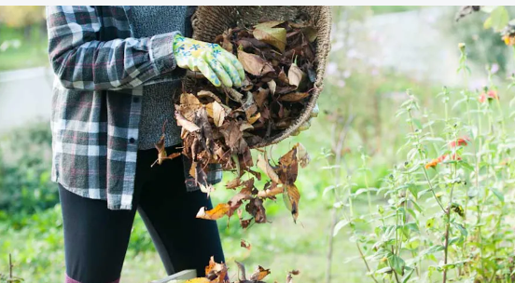
Garden waste collections
72% of LAs in England charge for garden waste collection.
Per wheeled bin:
Mean average subscription charge = £51
Cost range per subscription = £25 to £89
Mean average % hholds subscribed = 35%
Garden waste yields reduce by 25% when charge implemented*.
LAs that charge for garden waste see 5.9 percentage point reduction in overall recycling rate*.
*based on WRAP research in 2019.
Notes:
Information derived from LA Portal: currently undergoing annual review and update. Figures will change.
£51.13 recognises multiple LA schemes.
£ values include all collection frequencies. Some charges may be higher in Year 1 if additional charge levied for container/delivery.
Subscription rate excludes LAs with chargeable service selecting 0% or 100% subscription rate.
Further work planned to update garden waste yields, recognising nuances of data obtained from LA Portal and WDF.

Slide 12
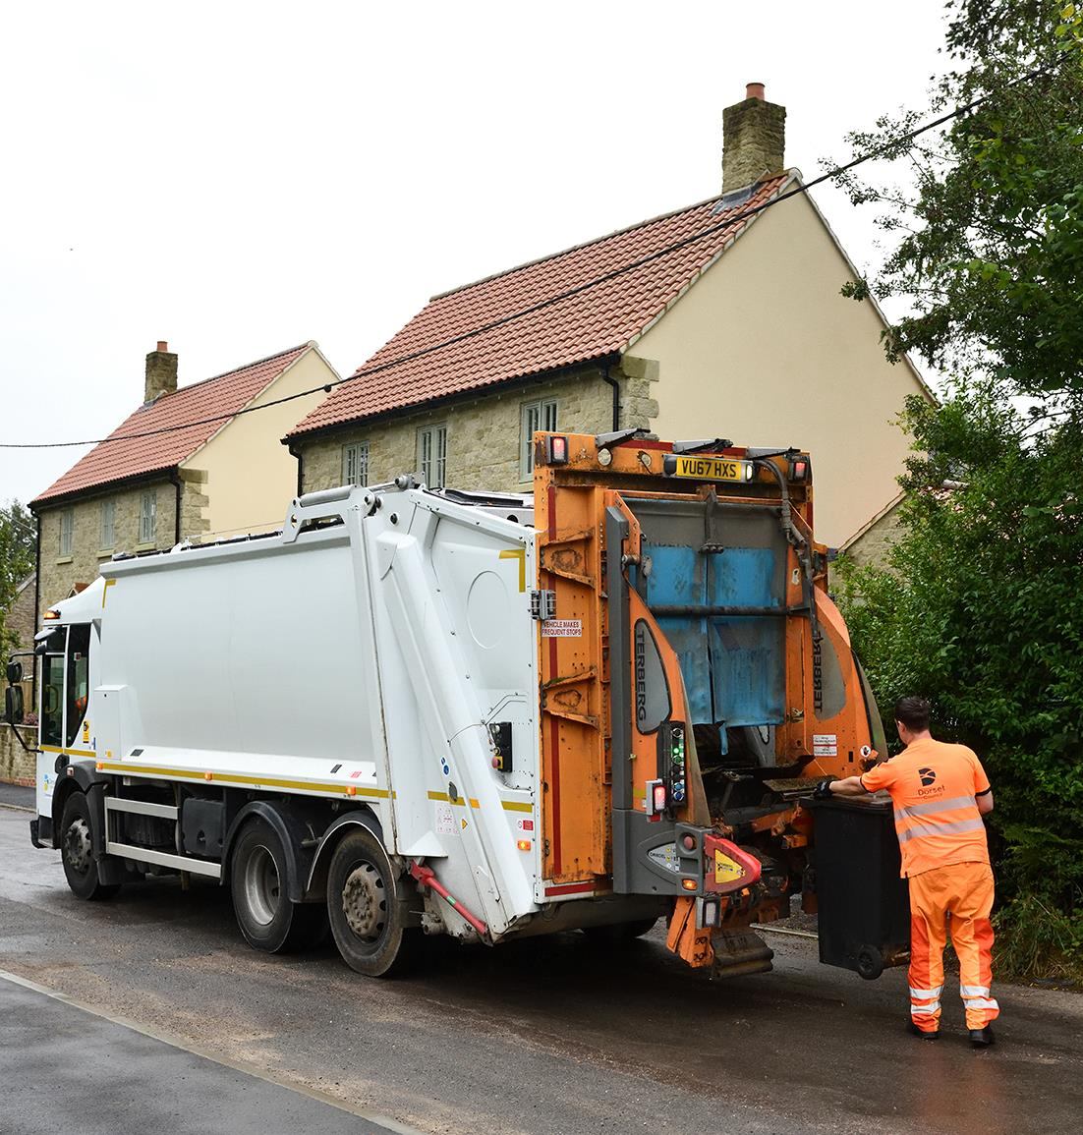
Future considerations (England)
Additional options for the recycling of garden waste
We will continue to monitor garden waste recycling rates. We will gather further evidence on the additional options we consulted on and how they can be used to minimise the amount of garden waste that ends up in the residual waste stream.
Government response to consultation on Simpler Recycling (21/11/23)
Notes:
Defra consulted on provision of limited free collection service with LAs able to charge beyond this (e.g. increased capacity/frequency).
Defra recommends GW collections over no less than 36 weeks in a year (March to October inclusive).
Key collective aim: maximise green waste yield, irrespective of charge or not.

Slide 13
How is WRAP supporting organic collections?

Slide 14
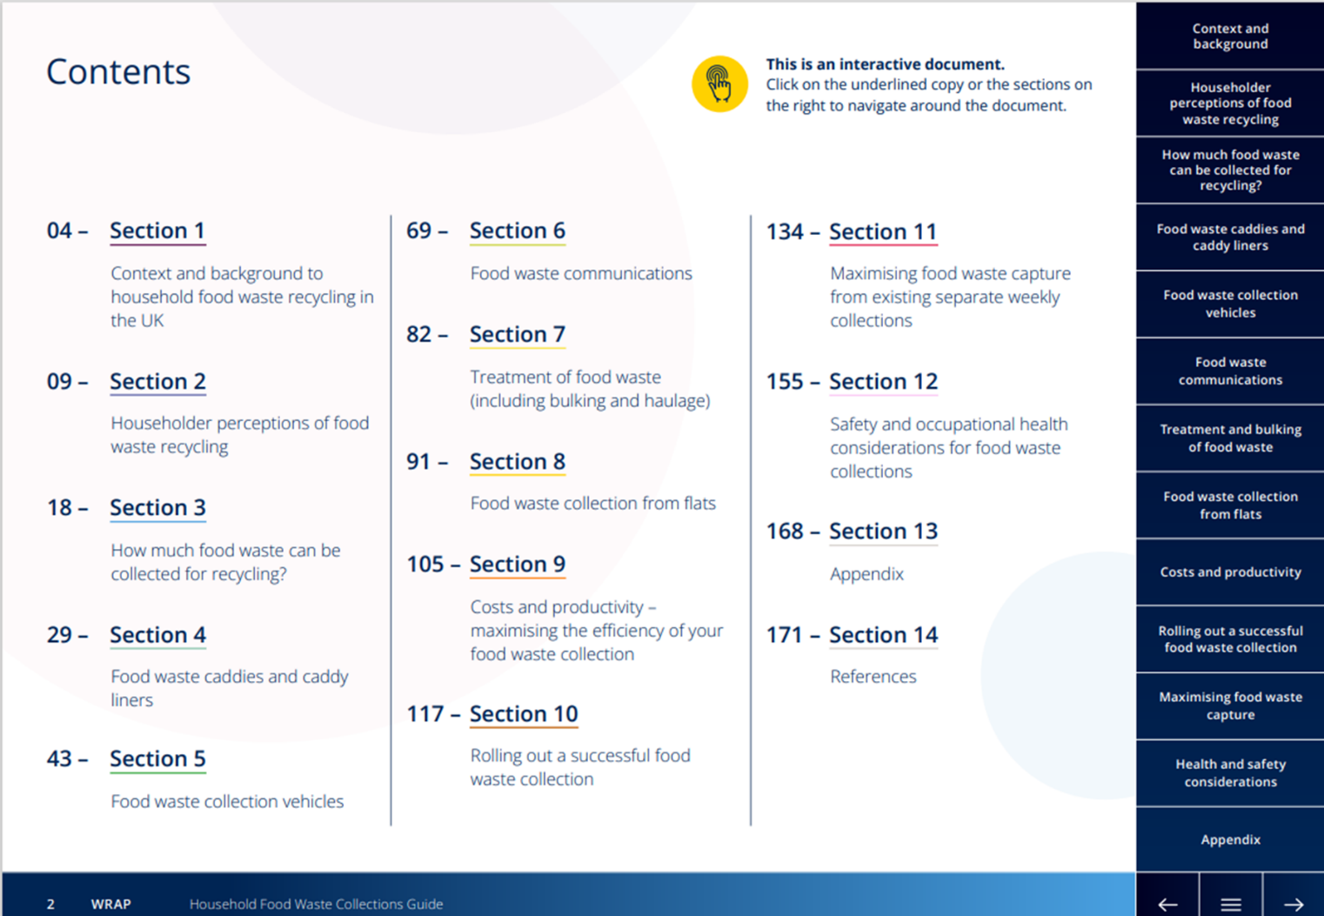
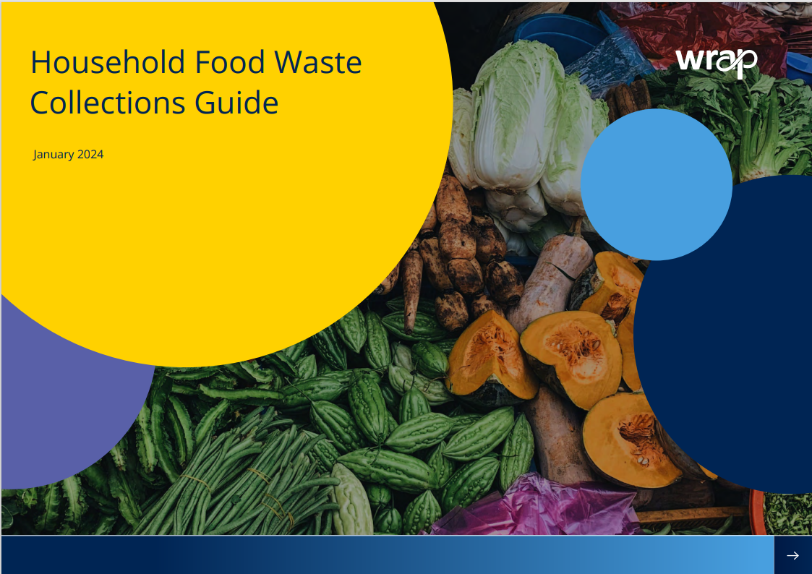
Household food waste collections guide
Notes:
Comprehensive, interactive guide to rolling out food waste collections.
Information on material quality, vehicles, containers, flats, bulking, treatment, communication, mobilisation.
Launched February 2024.
Elected Member guide also launched.

Slide 15
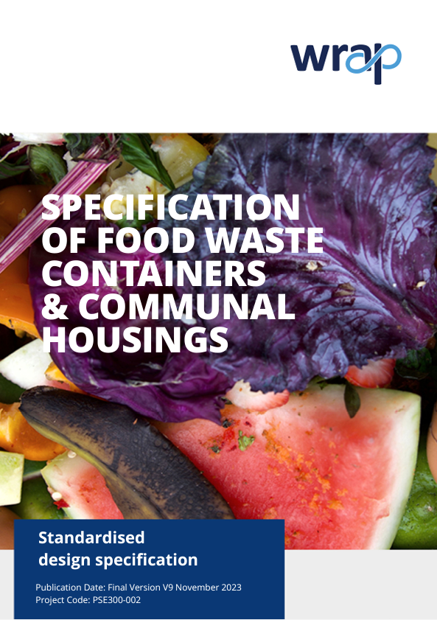

Standardised specifications
Notes:
WRAP engagement with container and vehicle manufacturers since 2020.
Challenges: manufacturer and LA procurement capacity.
Aim to remove bottlenecks and expedite orders/delivery.
Docs available free of charge to LAs and manufacturers, voluntary use.
Caddies: 5, 7, 23 litres; 2 wheeled bins: 120-240 litres; 4 wheeled bins: 440 litres.

Slide 16
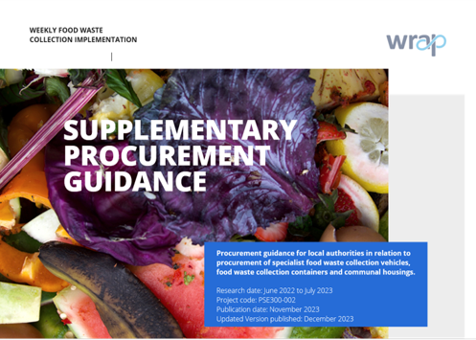

Supplementary Procurement Guidance
https://wrap.org.uk/resources/guide/weekly-food-waste-implementation-supplementary-procurement-guidance
Notes:
Information on collaboration, use of standard specs, use of PBO, lead in times, use of short-term vehicle hire.

Slide 17
Business Case Guidance
Document
Statutory Requirement
5 Case Model
Strategic
Economic
Commercial
Financial
Management
Government Funding
VfM collections
The guidance will consider the requirements to determine:
The economic impact assessment
Strategic and policy impact assessment
Environmental impact assessment
Operational impact assessment
Staffing impact assessment
Traffic impact assessment
Community impact assessment
Facilitate LAs to undertake business case development work in-house
Deliverable
Affordable
Viable

Slide 18
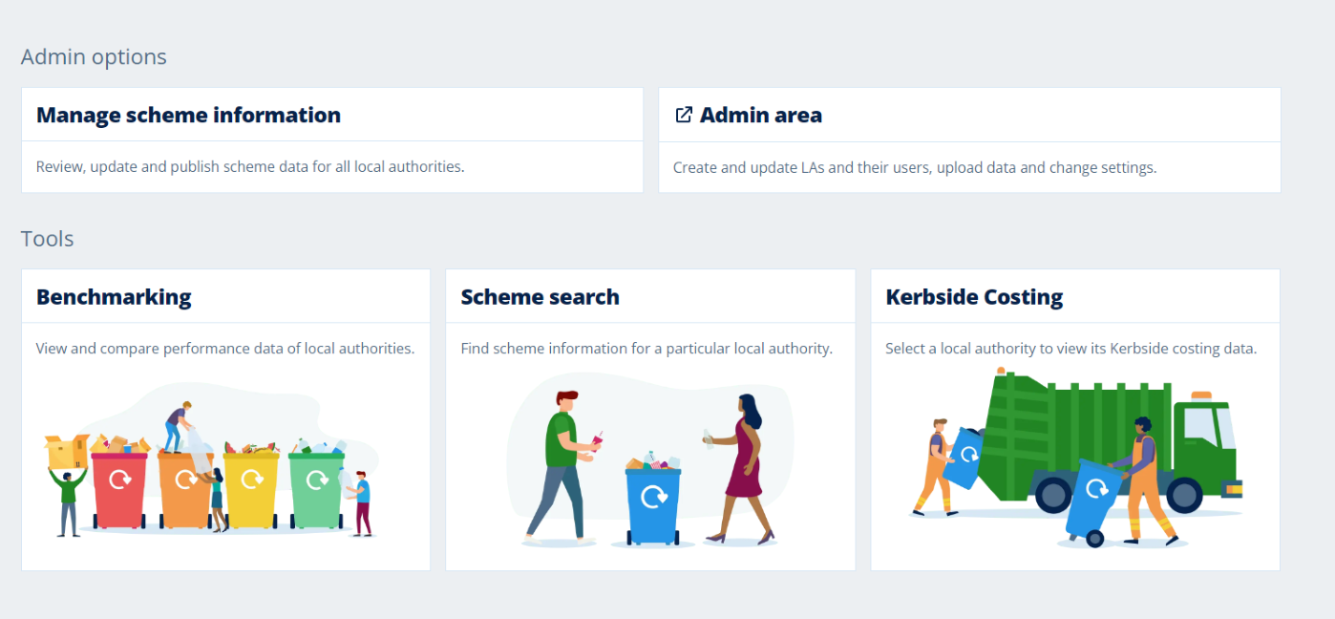
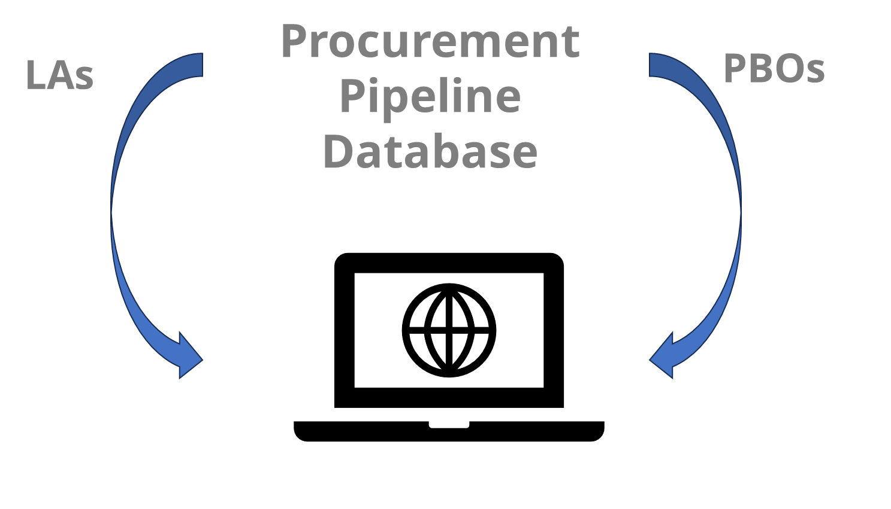
Procurement Pipeline Database (in development)
Hosted on WRAP LA Portal.
Available for all English LAs to use FoC.
Would contain data/information from WRAP, LAs and PBOs.
A Joint Procurement “Match-Making” Service that allows LAs to see who else might be coming to the market and when.
Potential for a range of filters/functions to enable potential matches to be found.​
Will improve LA transparency over committed orders.​
Notes:
Tested with LA groups (one to one) and LARAC workshop (October 2023).

Slide 19
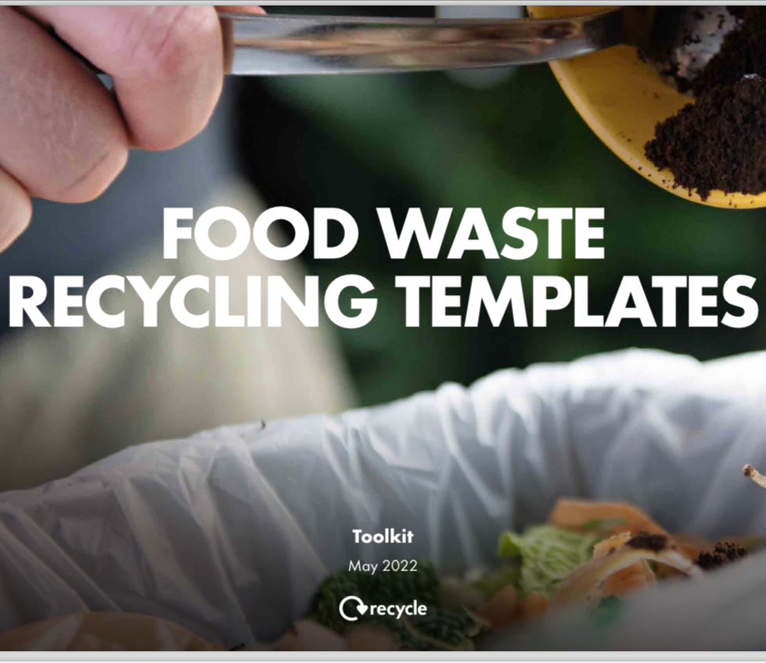
Food waste recycling toolkit
Customisable templates.
Normative and unity messaging.
Introducing or promoting a new food waste recycling service.
Localised for authority:
leaflets
kitchen caddy sticker
contamination tie
posters and livery
social media assets
https://wrap.org.uk/resources/campaign-assets/food-waste-recycling-toolkit

Slide 20
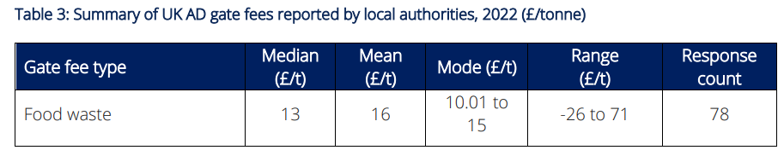
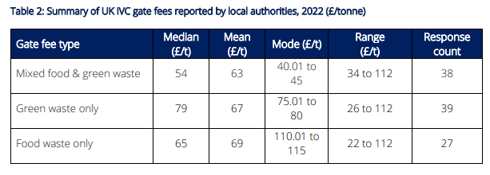
Cost of treatment/disposal
Median UK EfW gate fee (2022) = £103 per tonne
Median UK landfill gate fee (2022) = £126.60 per tonne (inc landfill tax)
https://wrap.org.uk/resources/report/gate-fees-report-2022-23
Notes:
OWC gate fee range = £24.50 to £29.50 in 2023 (LetsRecycle).
5 LAs commenced new AD contracts (food waste only) since 1st April 2022, with median gate fee of -£15 per tonne (i.e. income received). Likely a result of high energy prices at time of procurement (validated through operator surveys and interviews) coupled with dearth of material local to plants.
Standard rate of landfill tax in 2022/23 = £98.60 per tonne (£102.10 in 2023/24, £103.70 in 2024/25). Increasing to £126.15 in 2025/26.

Slide 21
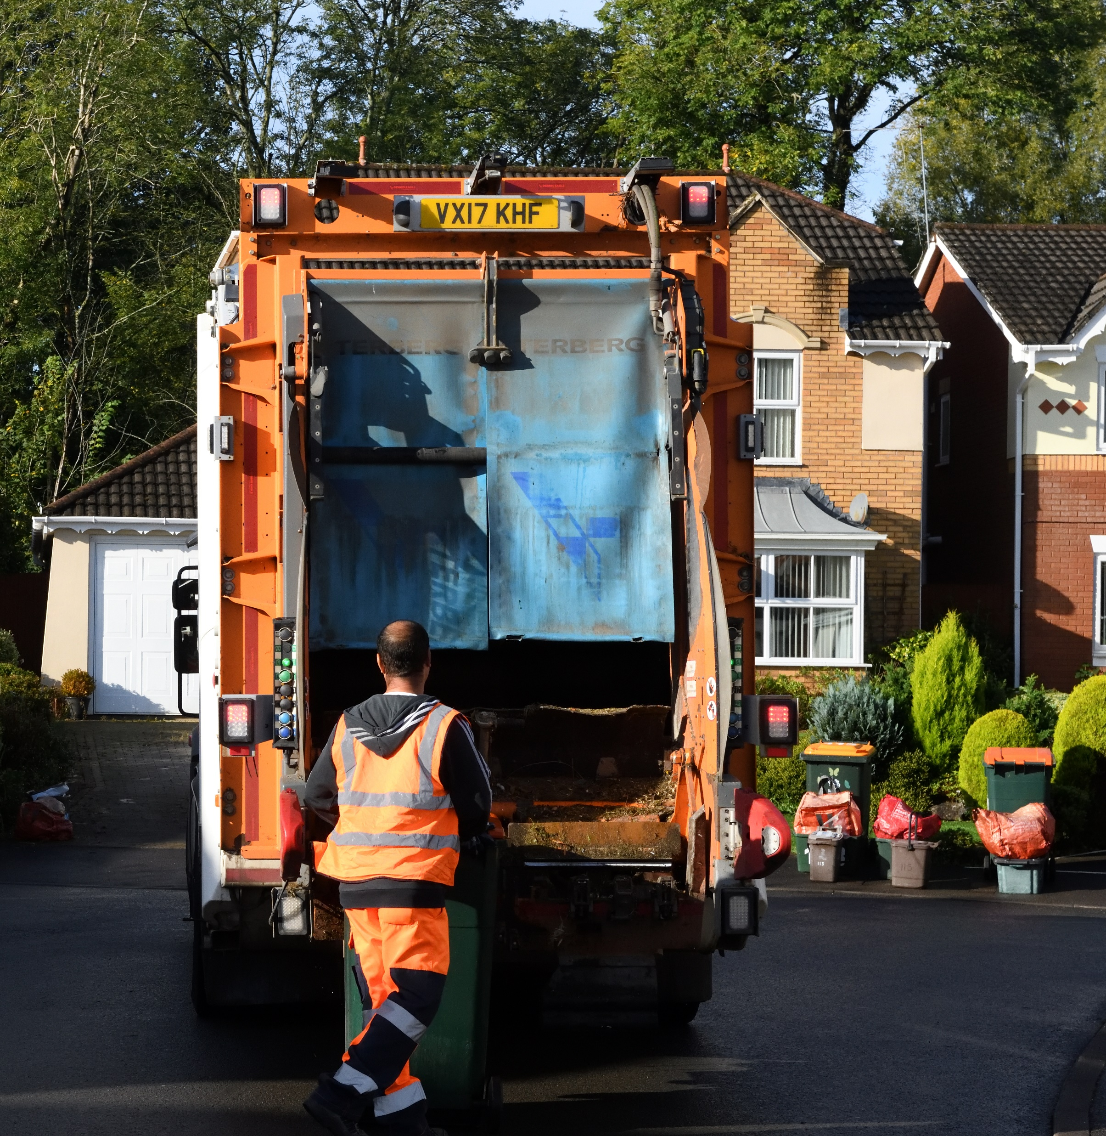
Non-statutory guidance
We will work with WRAP to develop non-statutory guidance on best practice around collection of a range of different materials and engage further with the sector on the content of this guidance.
Government response to Simpler Recycling consultation (23/11/23)
What is WRAP doing?
Engaging with Waste Network Chairs.
Fact gathering and data analysis to develop:
Principles on good practice waste and recycling collection and management.
Evidence to help with business cases for change.
Detail to ensure operational learning is shared.
Notes:
NSG = not further legal requirement but to influence behaviour.
NSG for GW to support LA decision making. January 2024 webinar on CGW: 38% of LAs set charge based on neighbouring LA.

Slide 22
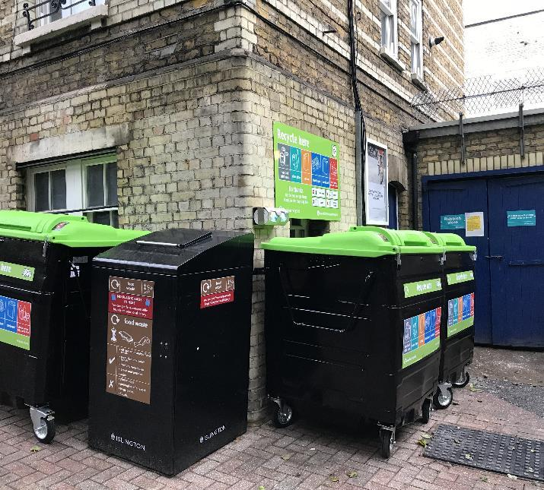
Further WRAP interventions
Continue to co-ordinate Organics Roadmap.
Map LA transition timelines.
Review LA bulking and hauling requirements.
Continuing one to one and one to many LA support through LA team.
LA guidance for mobilising service changes (including container distribution).
LA guidance on communal food waste collections.

Slide 23
Future considerations
Send no more than 10% of municipal waste to landfill by 2035 (CEP, RAWS).
Halve residual waste by 2042. Total mass of residual waste should not exceed 287kg per capita (Environmental Improvement Plan 2023).
Near elimination of biodegradable waste disposal in landfill from 2028 (Defra call for evidence, 2023).
65% municipal waste recycling rate by 2035.
Material quality: reduced input/output contamination thresholds for operators (EA permits).
Impact on other options for organic waste disposal (HWRCs, residual waste collection).
Notes:
Residual waste targets underpinned by The Environmental Targets (Residual Waste)(England) Regulations 2023.
Interim residual waste targets in 2028.
Quality: impact on SR permits (contamination<1%). PAS100 contamination limit<0.25% (0.12% sub limit for plastics). Thresholds may be lowered as part of Quality Protocol revision. Financial impact on operators and LA inputters.

Slide 24
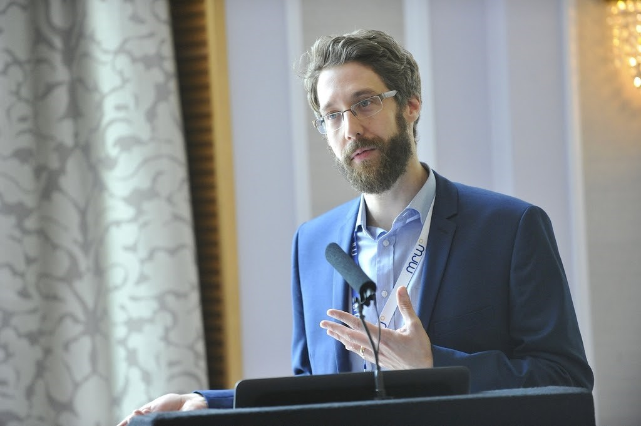

Thank you
wrap.org.uk
Daniel Roberts FCIWM
Waste and Recycling Specialist
@WRAP_UK

