Slide 1
Environment Agency
Regulatory Update
Sean McKay
Sludge Strategy Implementation Manager
Date: 21 March 2024
Audience: REA Organics 2024

Slide 2
Contents:
Management of sludges from non-mains domestic sewage treatment systems
Waste codes for sewage sludge materials: RPS 231
Permit consultation SR2010 No 4, 5, 6 and 17
EA Methane Action Plan
Additional Items to note

Slide 3
Management of sludges from non-mains domestic sewage treatment systems

Slide 4
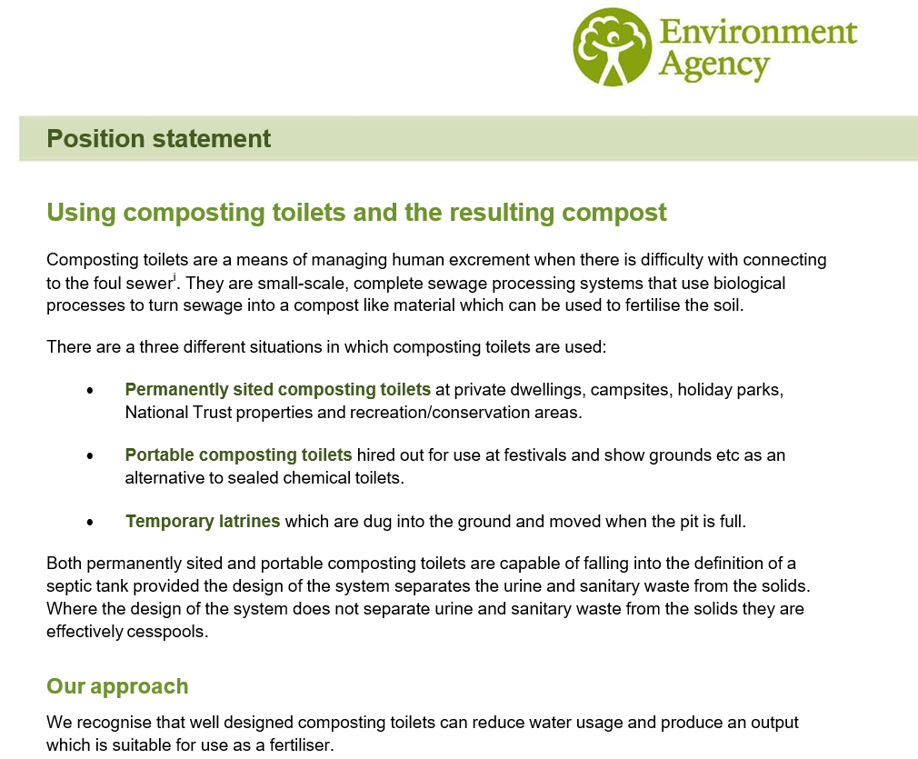
Position Statement 036 August 2011

Slide 5
What the external guidance is likely to cover
Septic tanks and other similar installations
Portable sanitary conveniences
Toilets using thermal processes
Cesspools
Chemical Toilets
Treat the waste
Spread the waste to agricultural land
How to apply for a permit

Slide 6
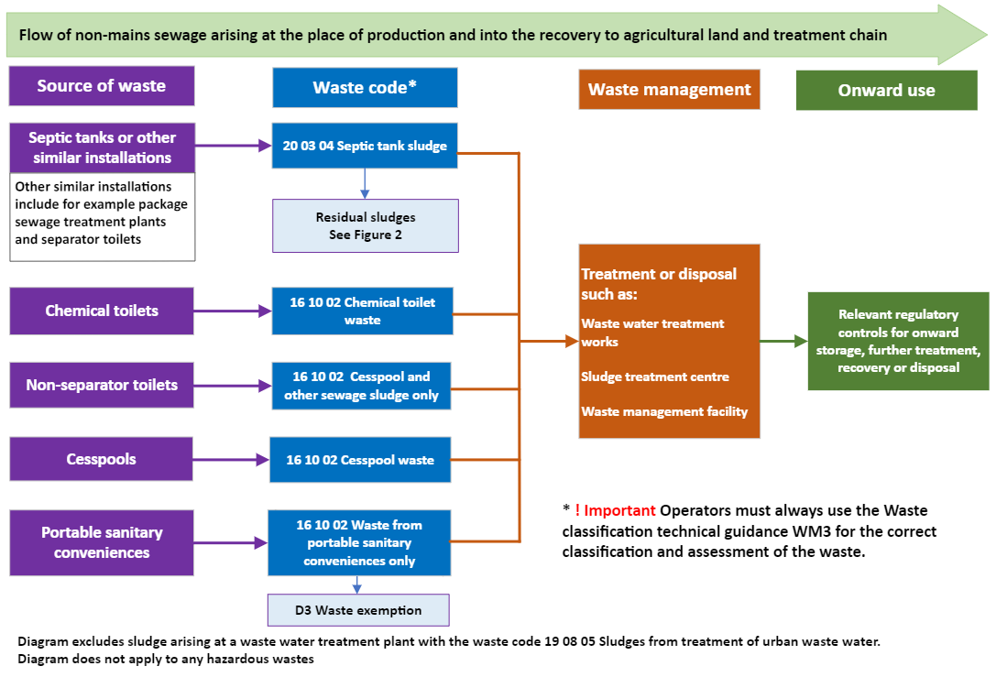
Figure 1. Management of sludges from non-mains domestic sewage treatment systems
DRAFT
DO
NOT
COPY

Slide 7
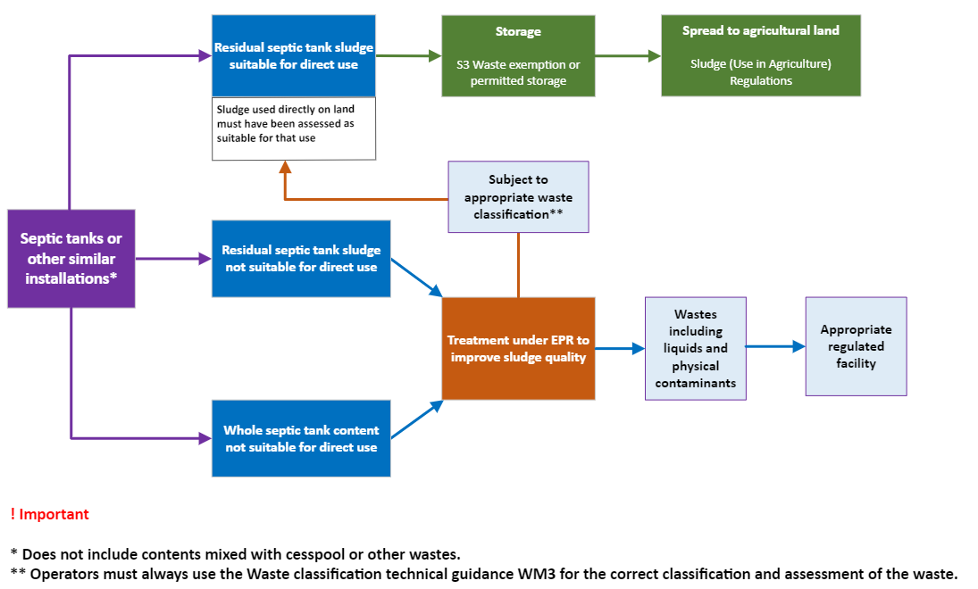
Figure 2. Septic tanks and other similar installations
DRAFT
DO
NOT
COPY

Slide 8

Waste codes for sewage sludge materials: RPS 231
RPS 231 allows you to use additional waste codes for sewage sludge materials:
Under an S3 or T21 waste exemption or standard rules permits SR2010 No 5, 6 and 17
For use in agriculture under the Sludge (Use in Agriculture) Regulations
Proposed updates to RPS 231 include:
Inclusion of additional waste codes for treated septic tank sludge materials
A new review date 2 years from publication
Reformat into new GOV.UK template

Slide 9
Permit consultation SR2010 No 4, 5, 6 and 17
SR2010 No 4 -
SR2010 No 5 -
SR2010 No 6 -
SR2010 No 17 -
mobile plant for spreading waste to land for agricultural or ecological benefit
mobile plant for reclamation, restoration or land improvement
mobile plant for land-spreading of sewage sludge
storage of wastes to be used in land treatment

Slide 10
EA Methane Action Plan
Spring 2024 publication
Improve the data of sectors we regulate
Maximise the effectiveness of our regulation to enable and encourage operators to reduce methane emissions and maximise utilisation efficiency
Work with external partners
Additional information
Call for Evidence - Committees - UK Parliament

Slide 11
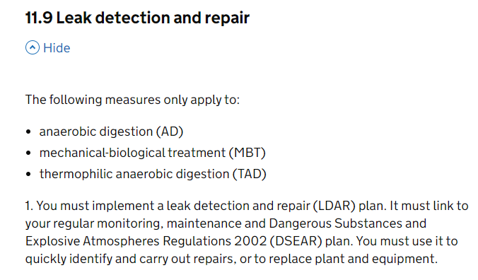
Leak detection and repair (LDAR)
Updated guidance on LDAR - Biological waste treatment: appropriate measures for permitted facilities
Permit review
Gathering data

Slide 12
Additional items to note
Environmental permitting progress – Biowaste treatment (AD, aerobic treatment and MBT)
Compost and digestate Resource Frameworks (Quality Protocol revisions)

Slide 13
What’s next?
Any comments or questions?
Email: sean.mckay@environment-agency.gov.uk

