Slide 1

Applying a behaviour change approach to encourage sustainable waste behaviours
Dr Nicola Buckland
Chartered Psychologist & Senior Lecturer
Organics 2024

Slide 2
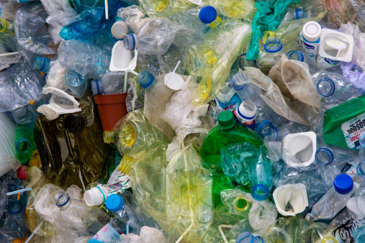
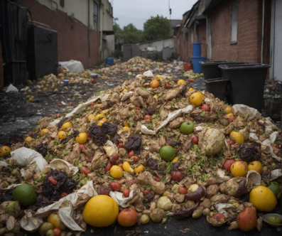
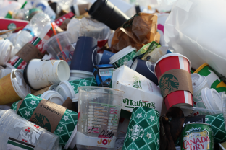
The need for sustainable waste behaviours
Notes:
Divert food waste from landfill
Reduce plastic waste in favour of more sustainable alternatives
Reduce contamination

Slide 3

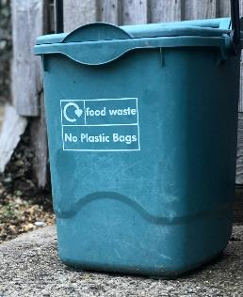
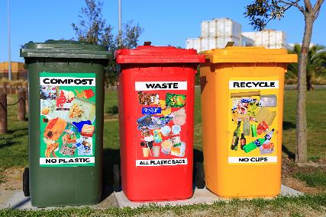
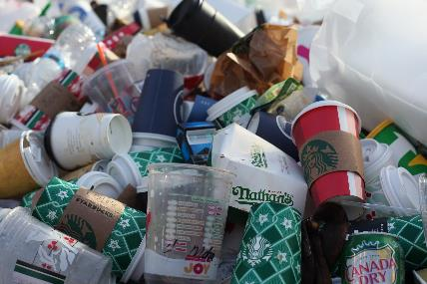
Example relevant behaviours
Compost food waste
Select the right bin
Avoid contamination
Behaviour change is needed for sustainable waste behaviours.
Notes:
There are two key actions or behaviours required to allow for compostable packaging to end up at composting sites to be composted.
Firstly, people need to place compostable packaging in the correct bin, second, people need to avoid placing non-compostable packaging in the compost bin. Contaminating materials are a challenge to the composting process.
There are issues with both of these actions and compostable packaging tends to be appropriately disposed of.
We know there are issues
Put compostable packaging in the correct bin (involves identifying compostable packaging and the right bin)
Avoid contaminating the compost bin.
BOTH OF THESE ARE BEHAVIOUR

Slide 4

Behaviour is complex!
Human behaviour is complex
We need a systematic approach to understand behaviours, and where needed change behaviours.
Notes:
Behaviour is complex, and using a systematic approach can help inform the process to understand behaviours, and where needed, how to change behaviours.
Human behaviour is one component amongst many factors and actors to target. And it’s an important one!

Slide 5

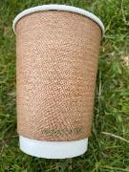





A systematic approach to understanding and changing behaviours
For behaviour to occur there must be:
Capability
Opportunity
Behaviour
Motivation
[Capability Opportunity and Motivation-Behaviour Model of Behaviour (COM-B), Michie et al. 2011]
Notes:
For behaviour to occur there must be capability, opportunity and motivation
Capability: The ability to enact behaviour
Physical – have the physical strength to put compostable packaging in the bin.
Psychological (e.g. aware how to identify compostable packaging)
Opportunity: Environment that enables behaviour
Physical environment
Social environment
Motivation: Processes that initiate or inhibit behaviour
Reflective – plans, evaluations – think composting is a good thing.
Automatic – emotions, habit

Slide 6




A systematic approach to understanding and changing behaviours
STEP 1: Understand existing waste behaviours.
Identify what components need to change.
Assess multiple sources of information:
(Michie et al. 2011)
Notes:
Identify what needs to change, and what to target. Through this form a behavioural diagnosis.
- Identify the behaviour to target, and then investigate it to understand what needs to change.
Observations, focus groups, interviews, existing reports and previous findings, s urveys.

Slide 7
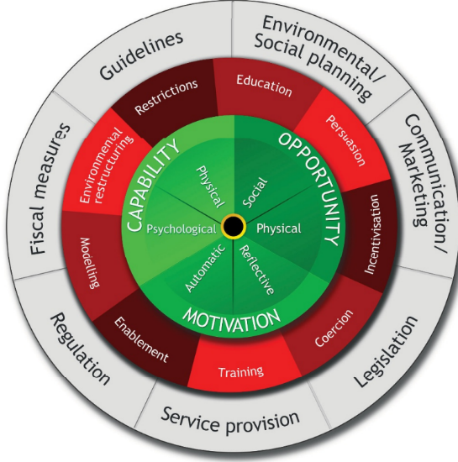
A systematic approach to changing behaviours
Step 2: Develop interventions to improve composting behaviours.
The Behaviour Change Wheel guides intervention development.
(Michie et al. 2011)
Notes:
Systematic approach allows us to know exactly what is being targeted

Slide 8
What works?
Most research has been in behaviours for reducing plastics generally (e.g. recycling). This shows that….
Providing information alone is not effective for changing behaviours.
Providing the opportunity and motivation to engage in desired behaviour is also important to change behaviours.
People need to be capable, motivated and have the opportunity to engage in sustainable waste behaviours.
Behaviour change interventions can effectively encourage sustainable waste behaviours.
(Allison et al., 2022)

Slide 9
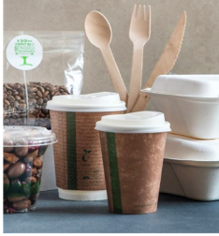

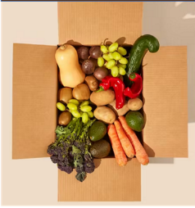

Interventions to increase the collection of compostable packaging
Develop and evaluate interventions to encourage the appropriate disposal of compostable packaging across three contexts:
Closed Loop Arena
Local Authority
Online Retailer
Notes:
NICOLA SLIDE

Slide 10





















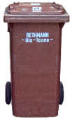
Local authority trial
Recruited 120 households to take part in a 6-week trial.
To provide households with a supply of compostable packaging, they received a food box every 2 weeks
Boxes contained snacks and fresh produce in compostable and non-compostable packaging, provided by:
We tested the effect of an intervention to encourage households to put compostable packaging into their co-mingled food and garden waste bins
(Matthews et al., in prep)
Notes:
Partnered with Medway Council to test the collection of compostable packaging in co-mingled food and garden waste bins.
We did not tell participants the trial was about compostable packaging during recruitment and pre-intervention phase to avoid bias.
All households had a brown food and garden waste bin, food caddies were provided where requested.
Products in compostable packaging consisted of:
Tea bags
Coffee pods
Twist-wrapped sweets
Chocolate bars
Crisps
Nuts
Fresh produce – bagged pears and carrots
Compostable carrier bags
Products in non-compostables packaging consisted of bagged apples, popcorn, crisps and chocolate raisins

Slide 11
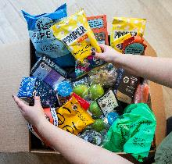








Trial structure
Pre- intervention
Intervention
Basic information
Week 1 | Week 2 | Week 3 | Week 4 | Week 5 | Week 6
Food boxes
Survey
Waste audits (total household waste)
(Matthews et al., in prep)
Notes:
Waste audits were done manually and results were on total waste from all households.

Slide 12

Intervention development
Five focus groups with 21 residents living in Medway, Kent identified barriers and enablers to putting compostable packaging in the food/garden waste bin.
Also integrated previous findings/reports.
Used the COM-B model⁴ to develop an intervention to deliver across workplaces.
4: Michie et al., (2011). Implementation science, 6, 1-12; 5: Allison, et al., (2022). Frontiers in Sustainability, 3, 92; 7: https://www.closedlooppartners.com/research/us-consumer-perception-of-compostable-packaging/
(Matthews et al., in prep)
Notes:
NICOLA SLIDE

Slide 13

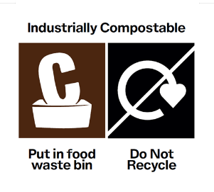
Intervention: Clear labelling
Main barrier: Confusion identifying compostable packaging and knowing which bin to use
Front of pack labelling:
Clear message that the packaging was compostable
Check for disposal instructions
Back of pack labelling:
Colour-matched to Medway’s brown food and garden waste bins
Developed with insights from online user testing and input from OPRL
Labels applied as stickers to compostable items
(Matthews et al., in prep)
Notes:
Labels were applied onto products as stickers in food boxes 2 and 3

Slide 14
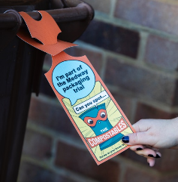
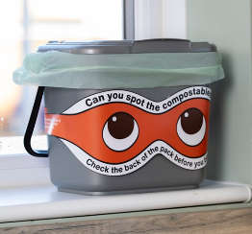
Intervention: Leaflet and bin prompts
Main barrier: Positioning of the food/garden waste bin and insufficient storage space for compostable packaging
Leaflet included:
Encouragement to use a kitchen food caddy for compostable packaging (food caddies provided where requested)
Tips on where to position food caddy and food/garden bin.
Bin prompts to provide visual reminders:
Mask to attach to bin caddy
Tag to attach to food/garden bin
Notes:
ERIC SLIDE
Use food caddy, tips for bins and bin prompts
BARRIERS
Confusion around which materials go in which bin
Positioning of the food/garden bins make the bins difficult to use
Insufficient storage space at home for compostable packaging

Slide 15
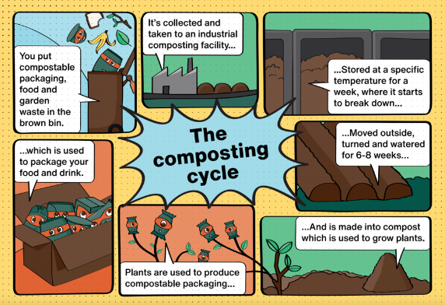
Motivation to compost
Main barrier: limited of awareness of the composting process
Bag of compost with an infographic to show the output of the composting process

Slide 16





Trial structure
Pre- intervention
Intervention
Basic information
Week 1 | Week 2 | Week 3 | Week 4 | Week 5 | Week 6
Food boxes
Waste audits (total household waste)
(Matthews et al., in prep)
Notes:
Waste audits were done manually and results were on total waste from all households.

Slide 17

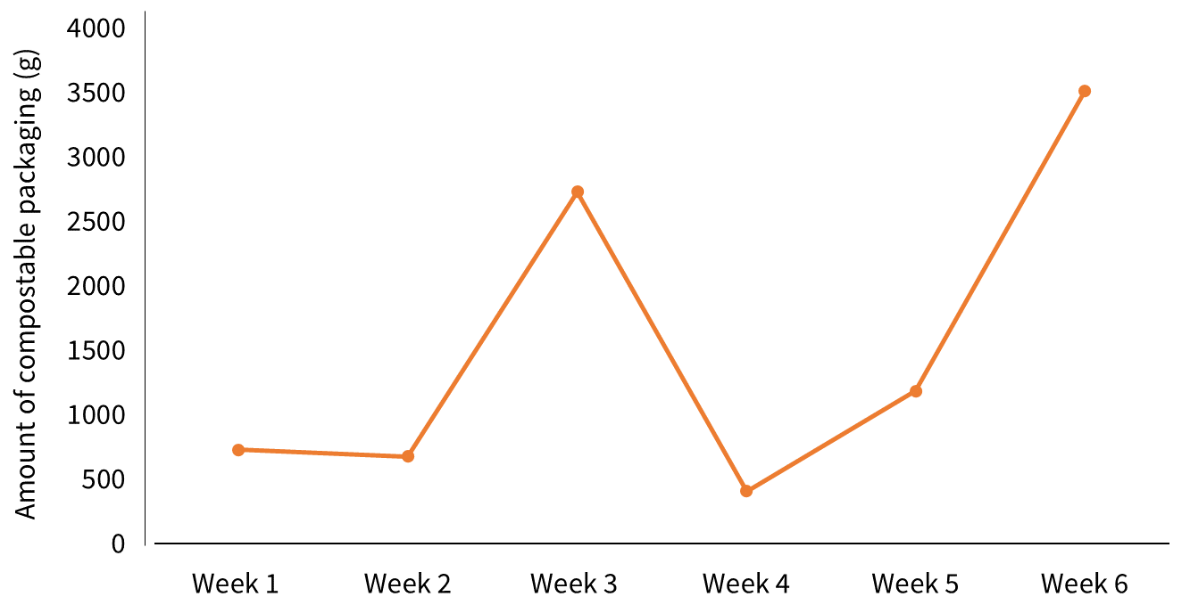

Results: Compostable packaging in the food/garden bin
Intervention started
Waste collected from 120 households
Intervention
Pre-intervention
Pre-intervention
(Matthews et al., in prep)
Notes:
Between week 1 and week 3, change of 2000 kg (274%);
Between week 1 and week 5 change of 458 kg = 63%
Between week 1 and week 6 change of 2786 kg; 382%

Slide 18
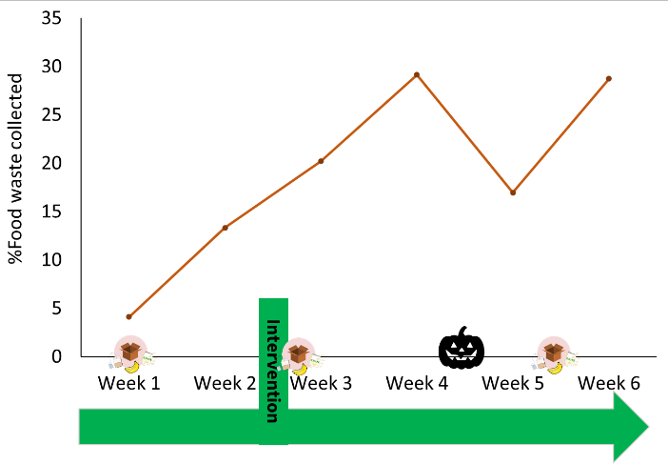
Results: The amount of food waste composted increased
Between week 3 and week 6, food waste increased by 23%.
(Matthews et al., in prep)

Slide 19
Summary and recommendations
Consumer behaviour is an important component of sustainable waste systems.
The COM-B model can be used to understand existing behaviours and identify what needs to change to support sustainable waste behaviours.
Through this understanding, relevant components can be targeted in behavioural interventions to increase sustainable waste behaviours.
Importantly, while awareness about waste behaviours is needed, opportunity and motivation also need to be targeted.
Our research showed that an intervention which targeted capability, opportunity and motivation increased the amount of compostable packaging and food waste collected. This approach can be applied to other waste behaviours and contexts.

Slide 20










Project Team Acknowledgements
The University of Sheffield
Dr Meghann Matthews
Dr Sara Bru Garcia
Sarah Greenwood
Prof. Thomas Webb
Hubbub
Rosie Sharp
Eric Saldanha
Carla
Roberts-Owen
TIPA
Julia Schifter
Tomos Davies
RECOUP
Tom McBeth
Futamura
Lucy Cowton
REA
Emily Nichols
Biome Technologies
Paul Mines
John Ryan
Envar
Martin Graves
Whitney O’Sullivan
Contact: n.buckland@sheffield.ac.uk;
www.linkedin.com/in/nicolabuckland

