Slide 1

Managing Nutrient neutrality requirements
Anna Becvar, Director Earthcare Technical Ltd
21st March 2024

Slide 2
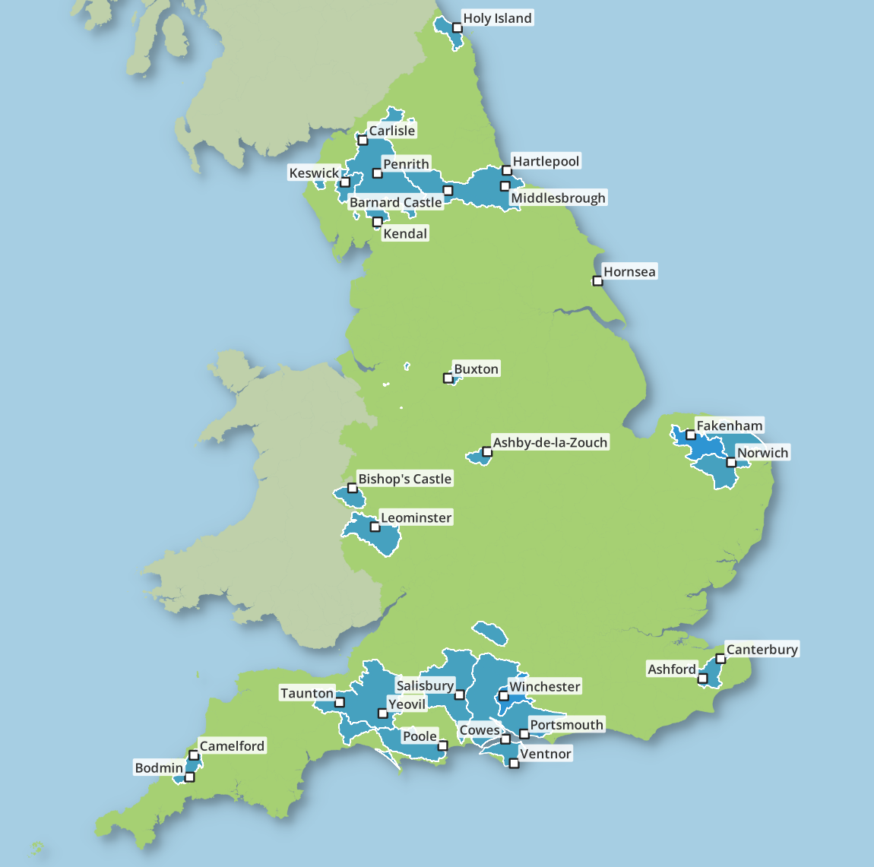

Timeline of change
2018 - Ruling by Court of Justice of the European Union (CJEU) on the interpretation of the Habitats Directive in the ‘Dutch Nitrogen Case’
2019 – Nutrient neutrality – To meet requirements of the Conservation of Habitats and Species Regulations 2017
2021 - The Environment Act, protection of: nature, water quality, clean air, biodiversity targets, waste reduction
2022 – Tighter ammonia air quality impact parameters
2023 - Levelling Up and Regeneration Bill requires the upgrade of water treatment works in the designated catchments by 1 April 2030.
2024 – Biodiversity net gain and offsetting
There will be more regulations and tighter enforcement.

Slide 3
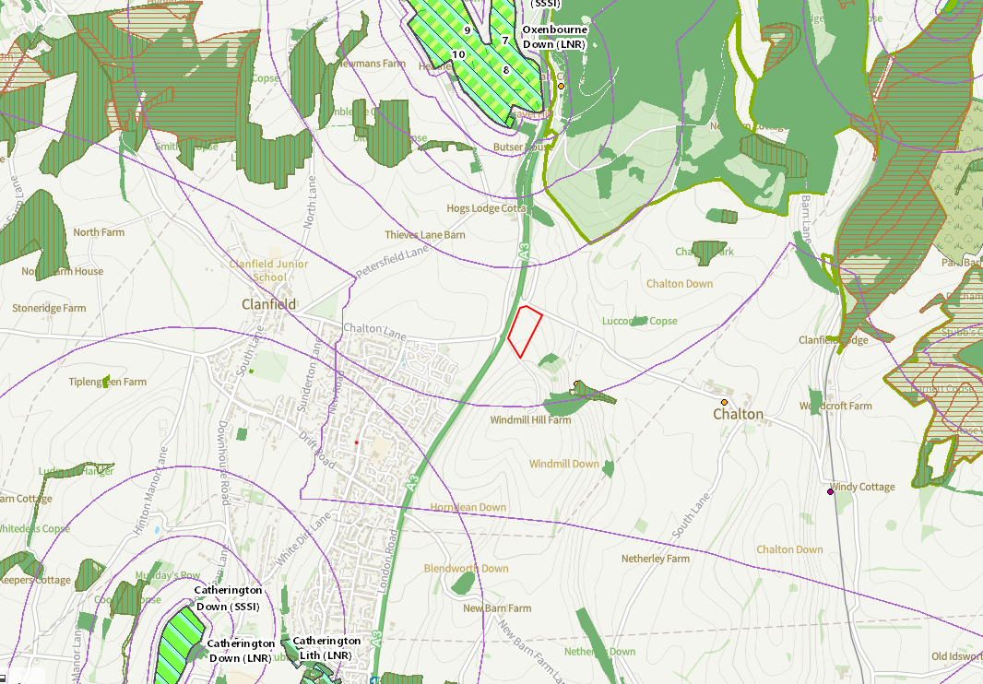
Project inception – nutrient planning considerations
Air quality impact assessment​
Ecological receptors​
NO_{x}, SO₂, NH₃, N Deposition, Acid deposition, ​
Ecological receptors ≤10km from site, LWS + AW ≤ 2km from site ​
Dust ​
Human Receptors, typically up to1km​
NO₂, SO₂, CO, Benzene, NH₃ , dust/ particulates (PM₁₀ and PM_{2.5})​
Odour​
Bioaerosols ​
Odour impact assessment
Nutrient Neutrality assessment

Slide 4
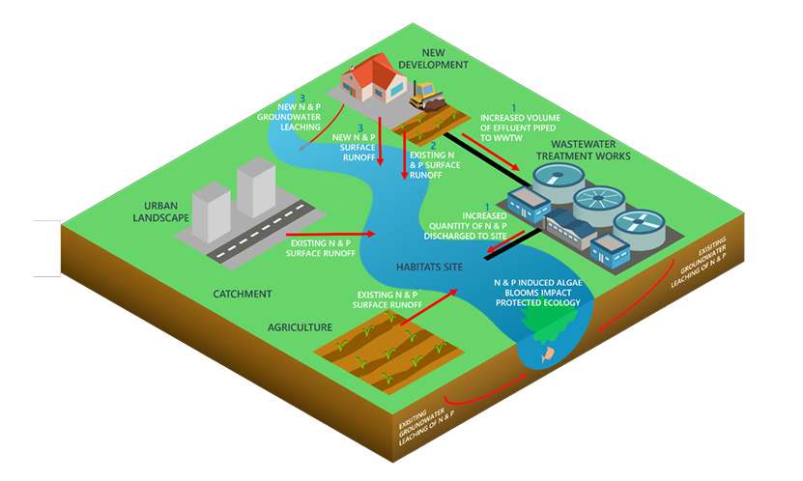
Catchment dynamics
Schematic of a water catchment system (Source: Nutrient neutrality generic methodology, Natural England 2022)

Slide 5
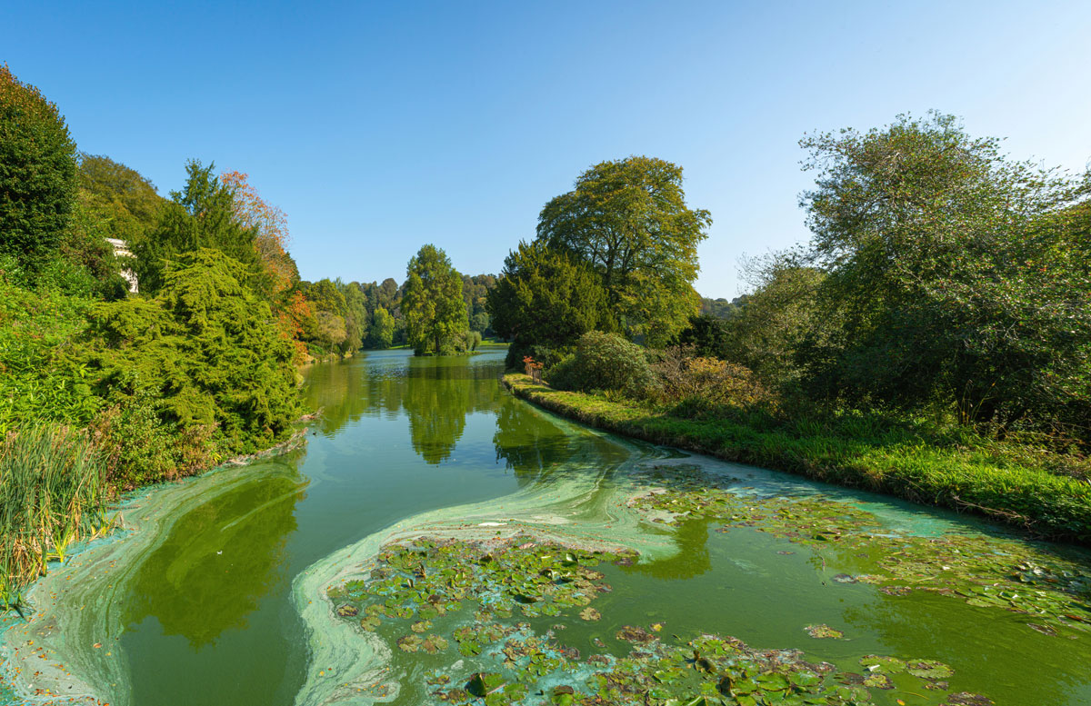
Nutrient neutrality remit
Types of development affected:
Housing, tourism, festivals, gypsy sites
Agricultural development
Anaerobic digesters/new sites
Lagoons?
‘Prior approval’ development
Total N greatest concern leaching:
Freely draining soil type
High rainfall levels
Land use - heavier N use
Total P greatest concern runoff:
Impermeable soil type
High rainfall levels
Land use – soil erosion and high P soils.

Slide 6
Mitigation…..
Site design and operation is covered by Regulations and Guidance:
Typically, Environmental Permitting (England and Wales) Regulations 2018 – Environment Agency competent authority
CIRIA736 – containment systems
Nitrate Vulnerable Zone Regulations
The Reduction and Prevention of Agricultural Diffuse Pollution (England) Regulations 2018, referred to as ‘the Farming Rules for Water’ (FRfW).
Codes of Good Agricultural Practice
Protecting our Water, Soil and Air: A Code of Good Agricultural Practice for farmers, growers, and land managers
Guidance: Nitrates and phosphates: plan organic fertiliser and manufactured fertiliser use
The Code of Good Agricultural Practice for reducing ammonia emissions
Incentive Schemes require a Sustainability Audit Report

Slide 7
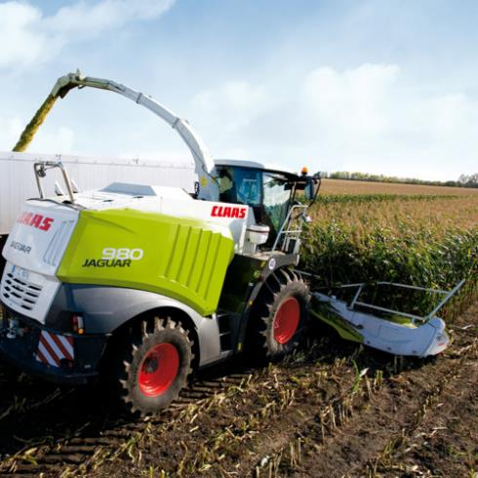
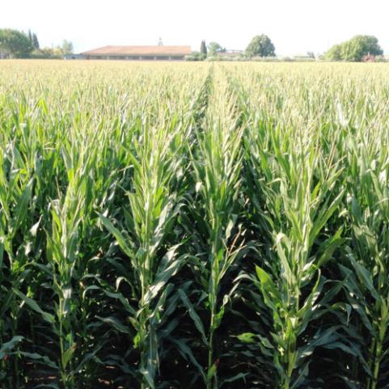
Growing maize
Is there any such thing as a good year for weather now?
Select appropriate fields.
Check angle and length of slope.
Avoid soils and slopes at risk of soil erosion.
Grass margins in risk areas - next to surface water, ditches, gateways.
Choose early maturing maize varieties with short growing season
Harvest before 1st October
If soils compacted – cultivate
Either under sow with grass or establish cover crop fast by 15 Oct
Keep roads clean and mark harvest trailers – magnetic signs

Slide 8
Effective use
Apply nutrients to meet crop need
Check land bank and storage needs
Check soil types
Soil analysis for P – check landbank capacity
Analysis of biofertiliser
Nutrient management plan in place before use
Avoid runoff ≤30m³/ha liquids not worked in
Avoid run through ≤50m³/ha liquids incorporated
Digestate/compost use should not result in an increased N & P load in the catchment. It should replace manufactured fertiliser use.

Slide 9
Office@earthcaretechnical.co.uk 02392 290 488
Thank you for listening!
Notes:
“ Environmental compliance is important for protecting the environment and human health, avoiding harm, meeting customer and consumer expectations, and enhancing our client’s reputation and brand value.”

