Slide 1








Slide 2



Our Policy Asks
1. Boost financial incentives for growers to compost
3. Promoting local circular systems
4. Reducing contamination levels
2. Create a level policy playing field to support sustainable composting
5. Support through the transition period

Slide 3
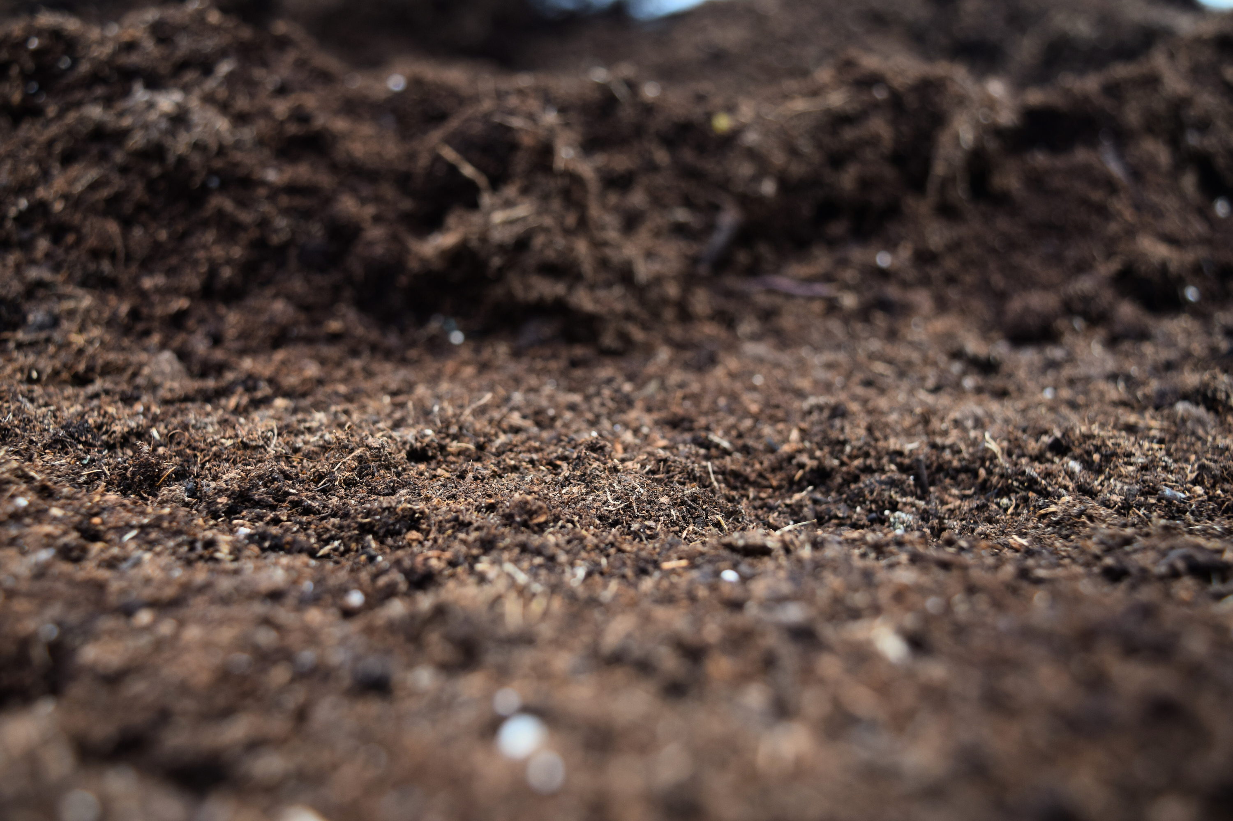

Notes:
Slide 6 A photo of broccoli
Slide 7 Thank you slide with Enrich the Earth web address and hello@sizzle email.
Thanks
Trewin

Slide 4
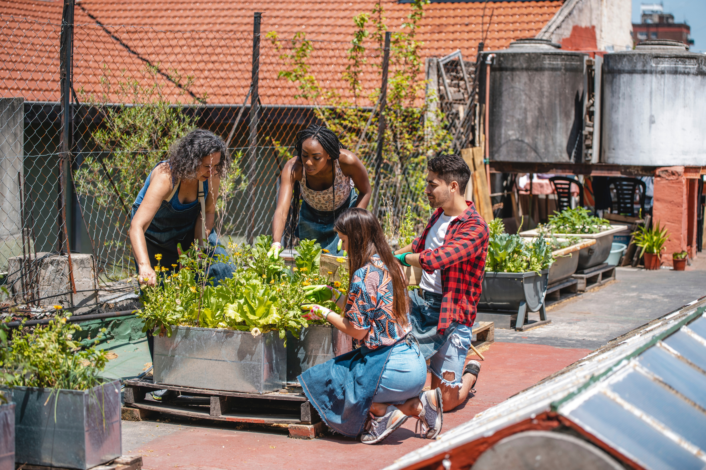

Slide 5
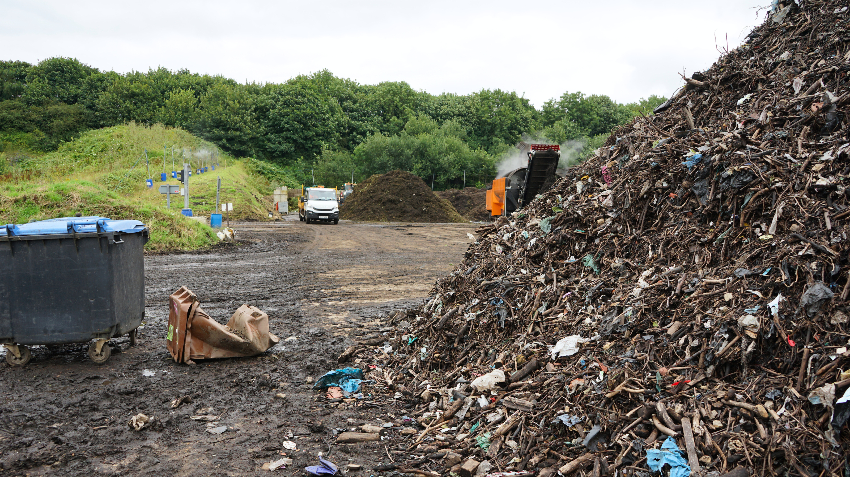


Slide 6
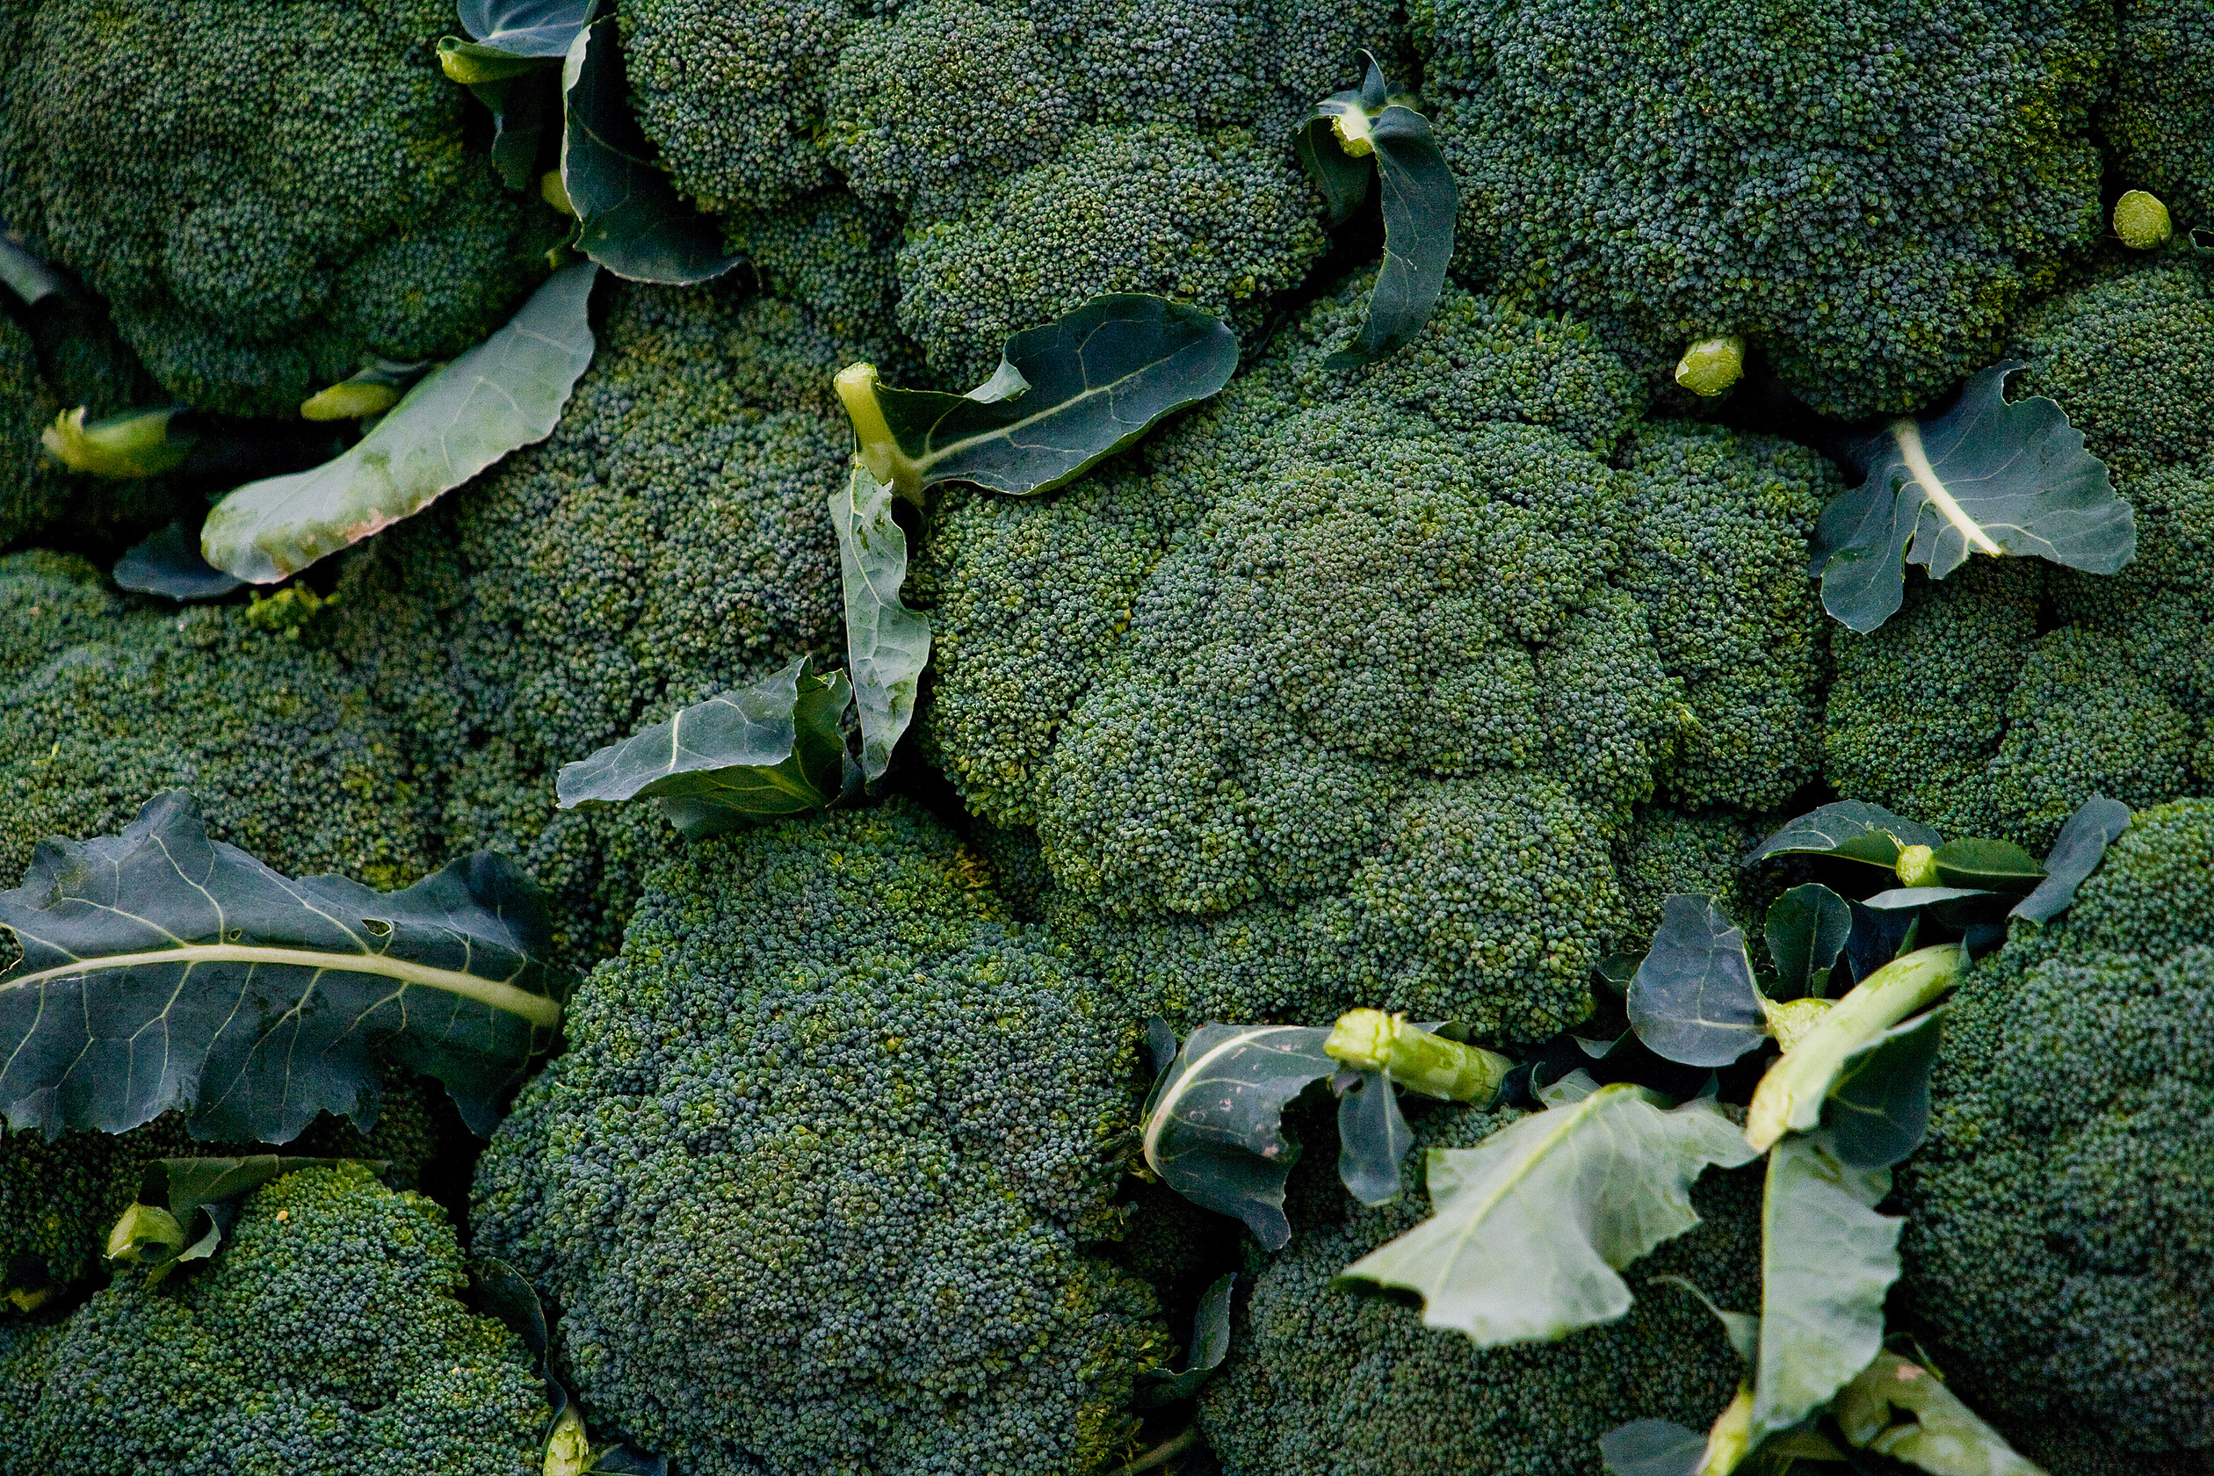

Slide 7
Thank you for your attention.
www.EnrichTheEarth.co.uk
Contact hello@sizzle.org.uk
for more information

