Slide 1

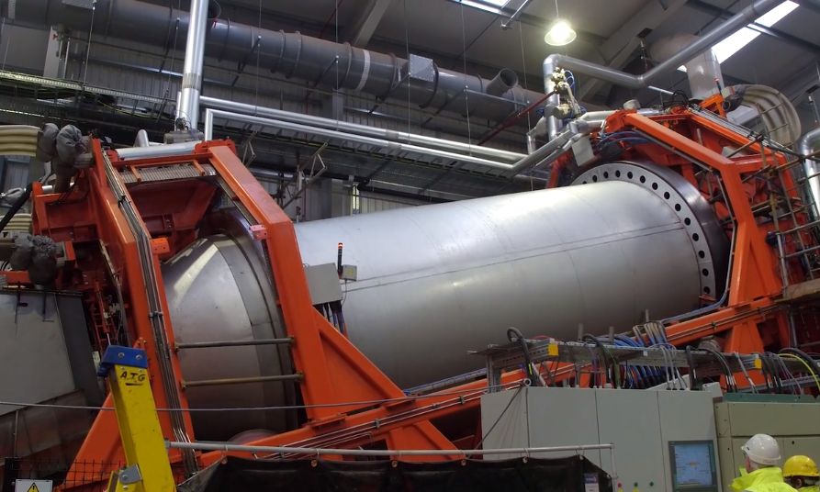

Biodegradable packaging as a potent source of biogas following thermal hydrolysis pre-treatment
Dr Andrew Walsh

Slide 2

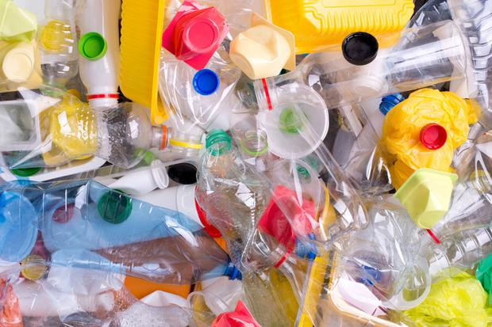
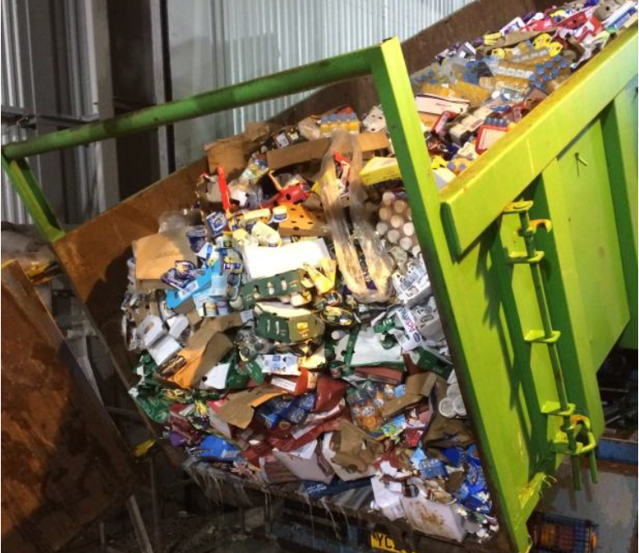
The Reality of Bio-waste

Slide 3
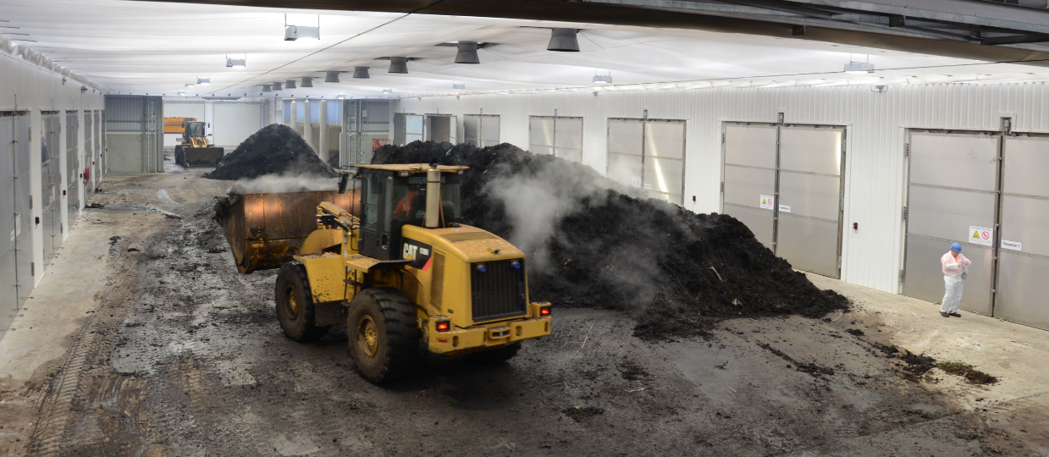
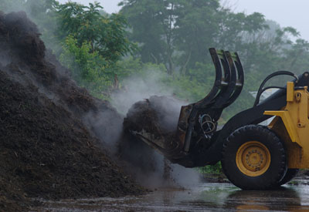
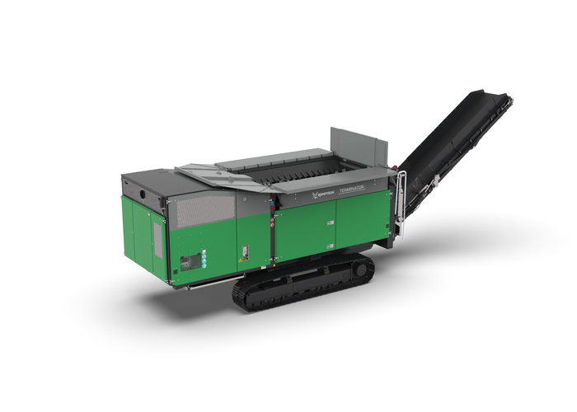
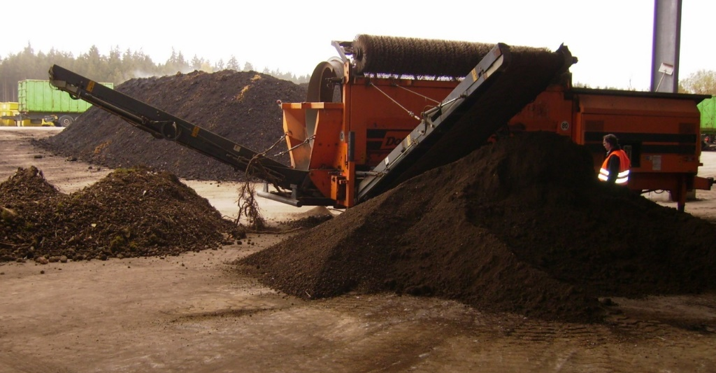
Aerobic Composting of Biodegradable Packaging

Slide 4
“Wet” AD of biodegradable packaging
?
In Europe “AD” current represents
between 30-70% of the bio-waste
recycling infrastructure.
The balance of the capacity is
composting.
This balance is shifting towards
AD due to the incentivized
production of a sustainable
biofuel in the form of biomethane.

Slide 5
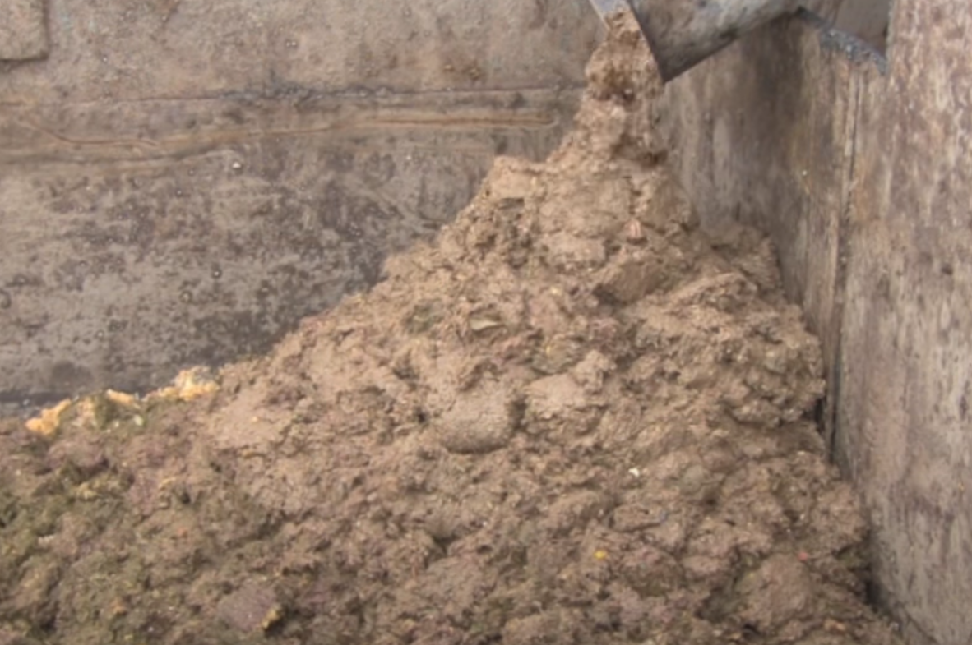
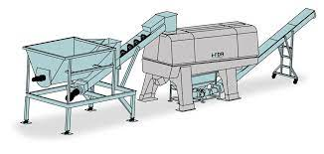
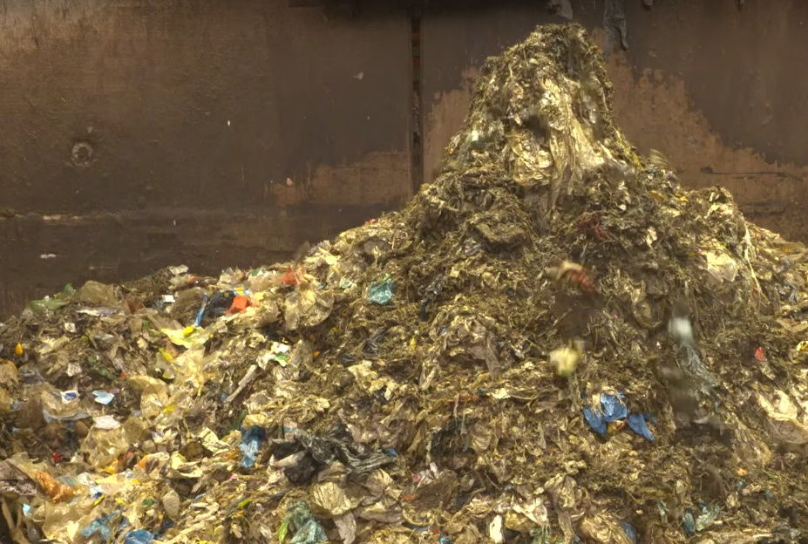
“Wet” AD of Biodegradable Packaging

Slide 6
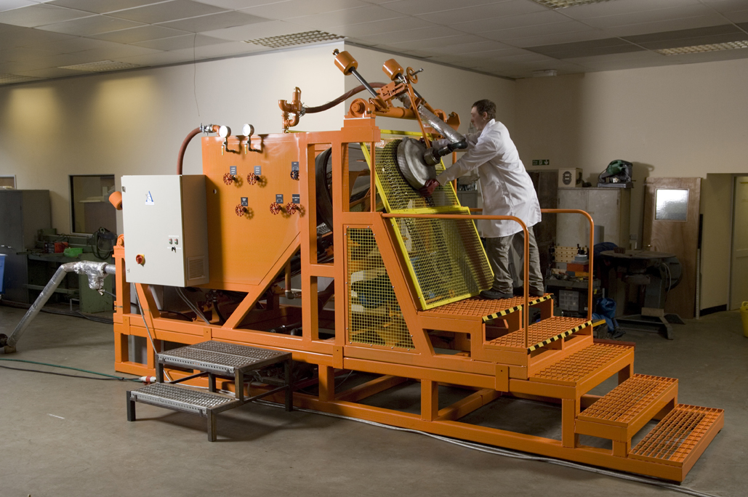
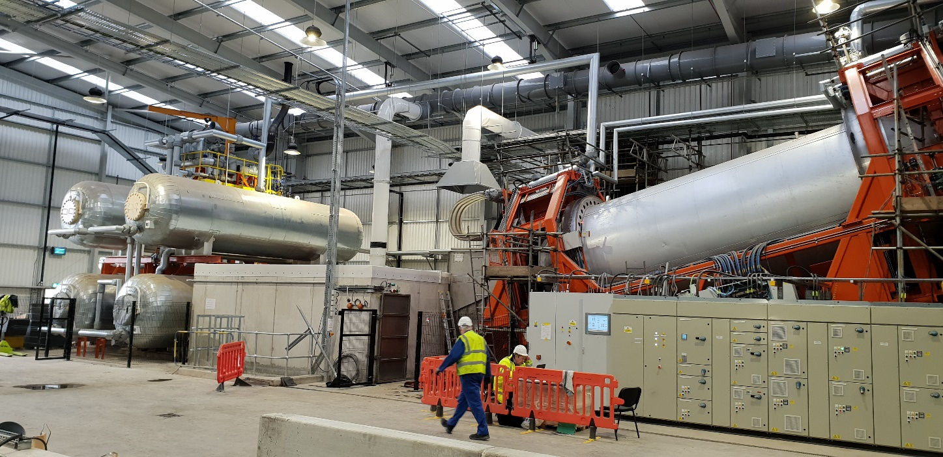
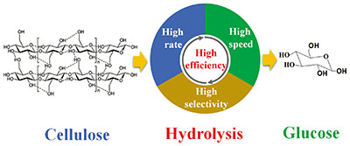
Thermo-pressure hydrolysis (TPH)
120 -185 ºC
2 – 6 bar steam pressure
20 – 40-minute treatment
Soluble sugars
&
Hemicellulose

Slide 7
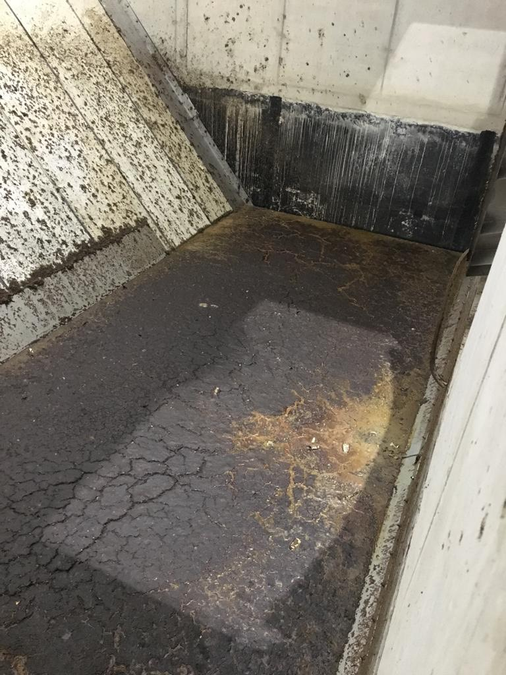
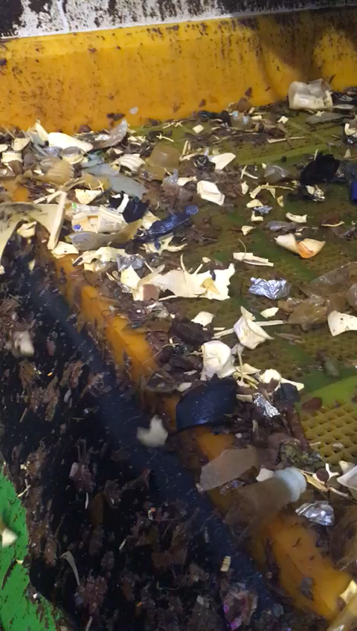
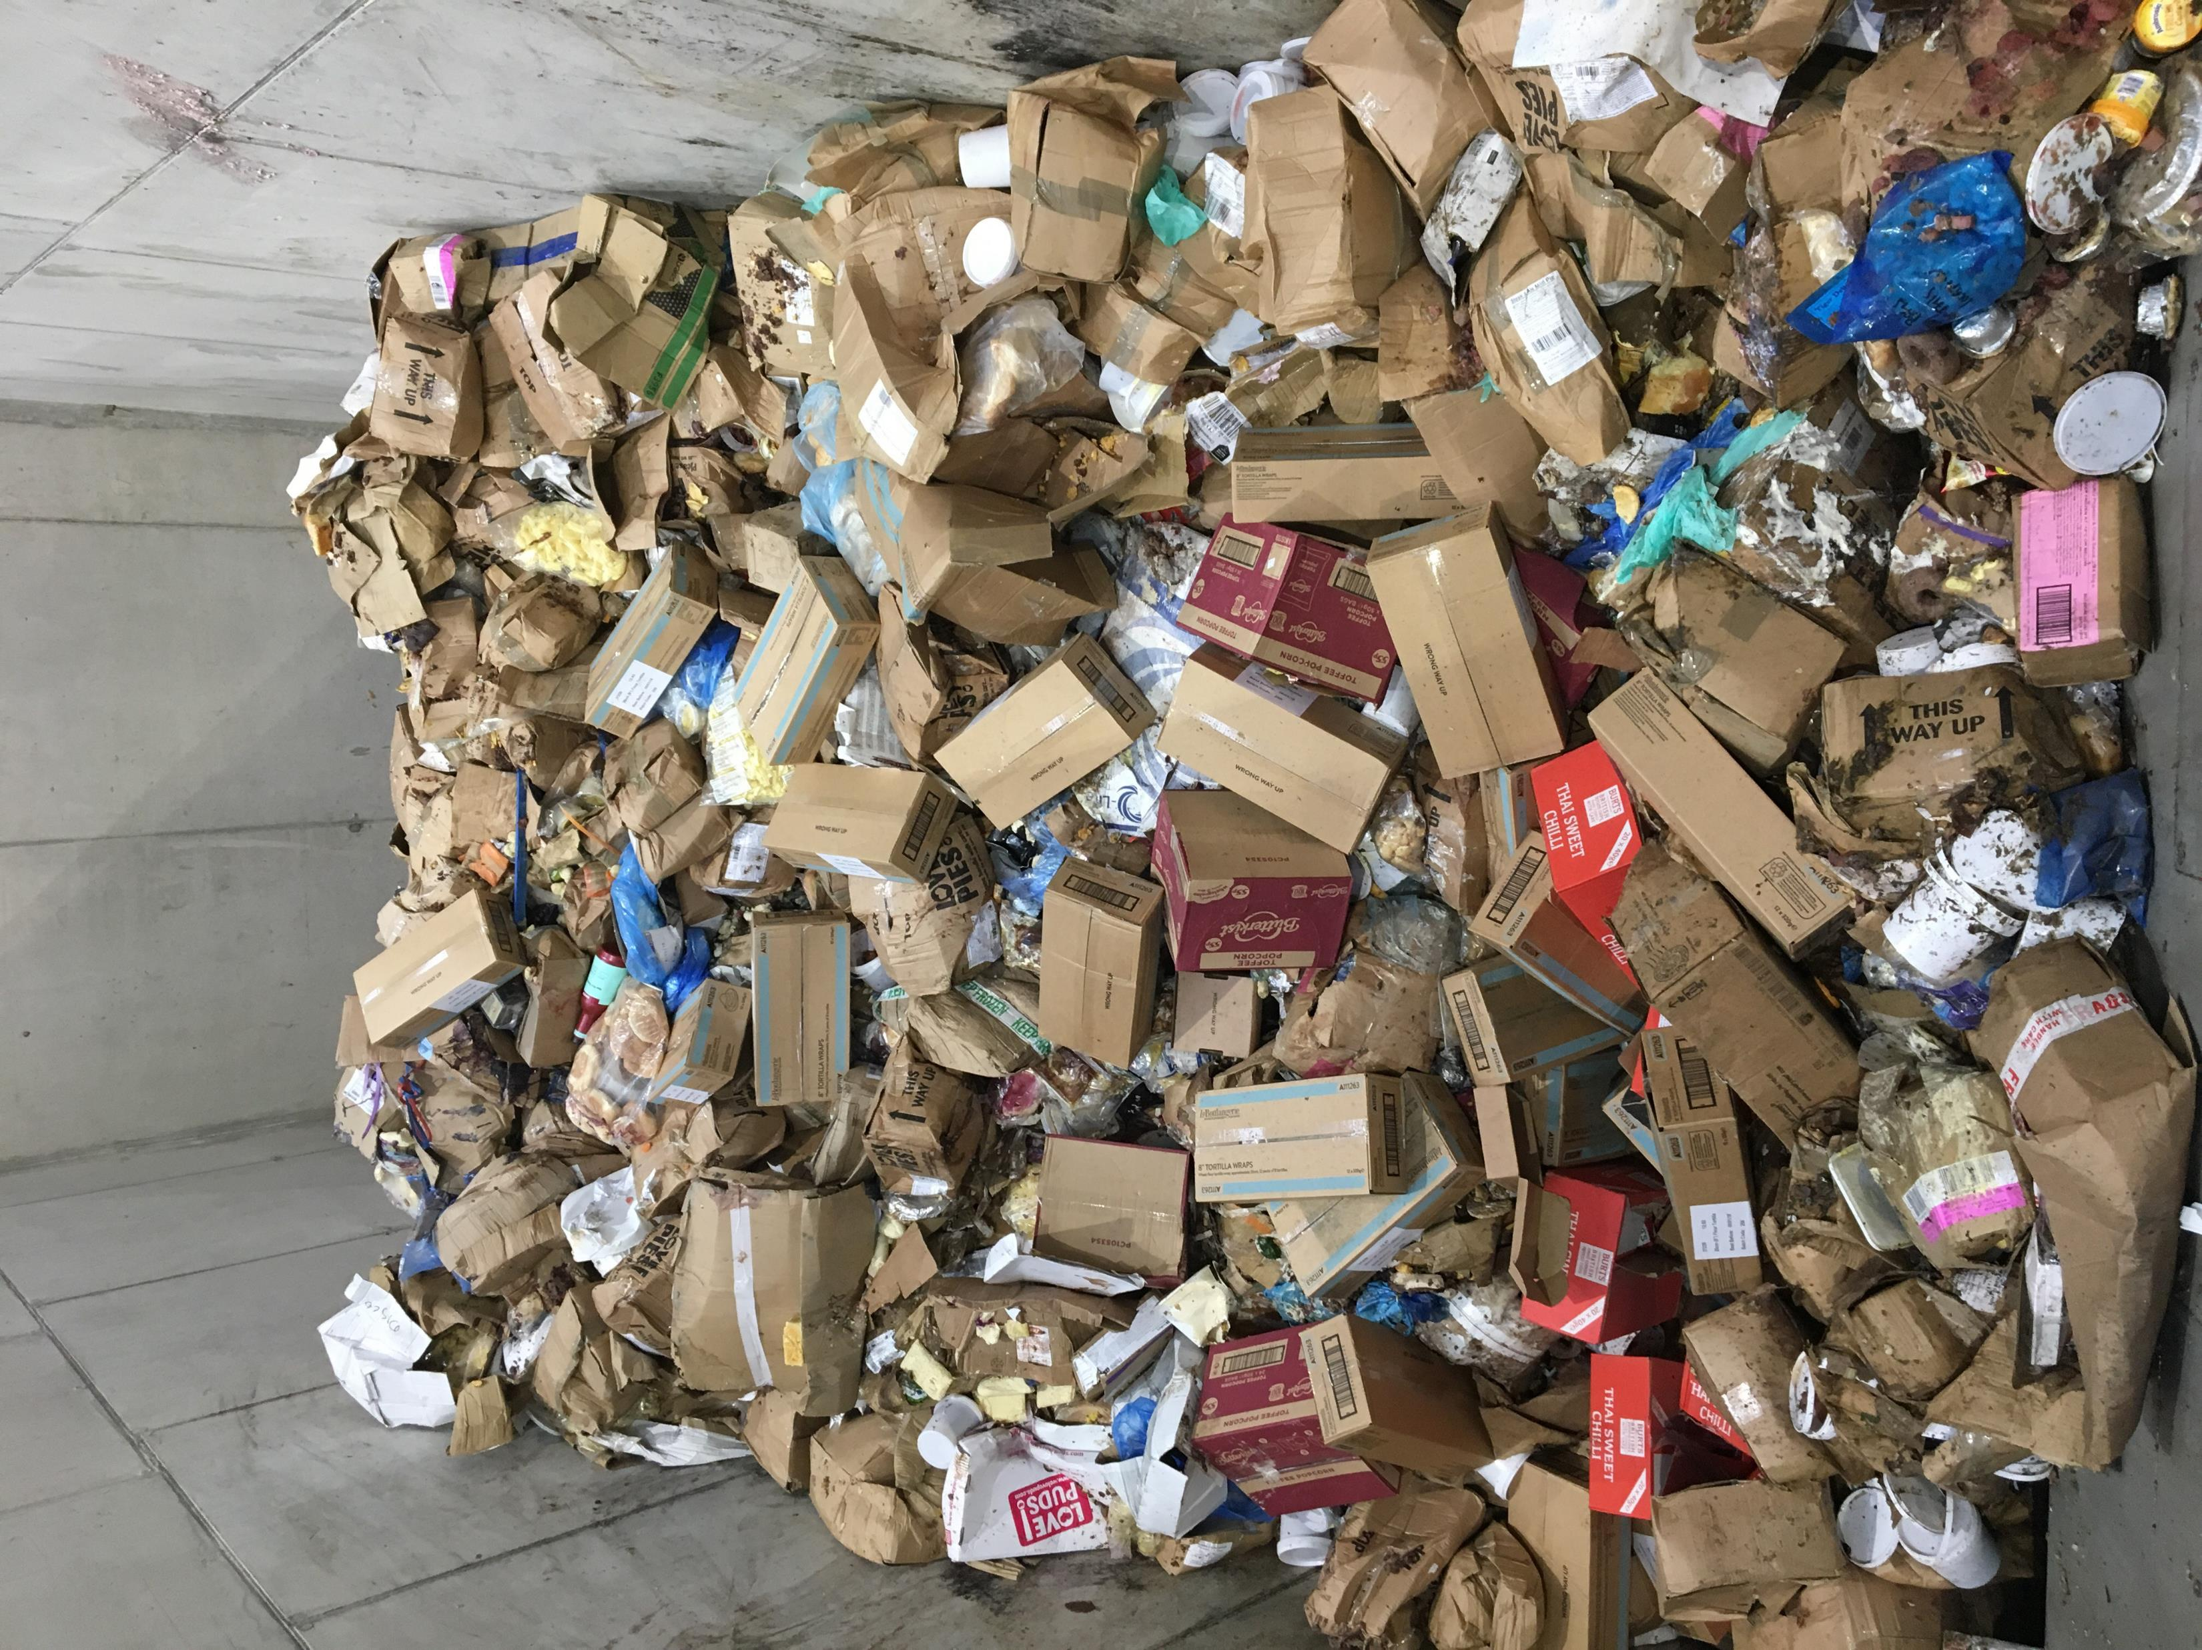
TPH of packaged bio-waste and removal of plastics
TPH
Screen
7

Slide 8
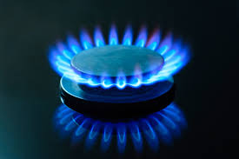
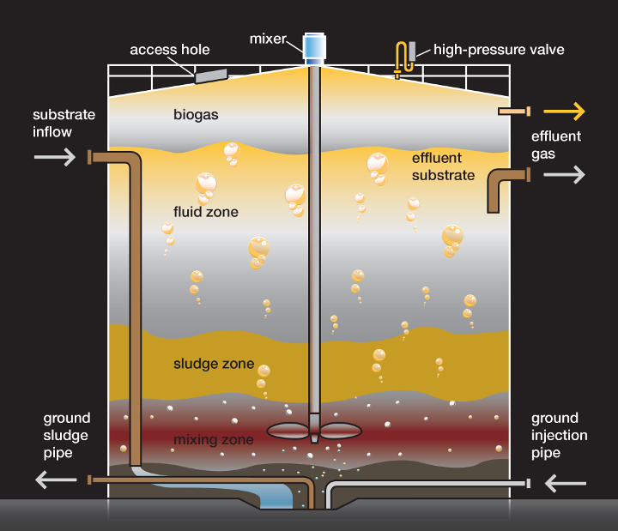
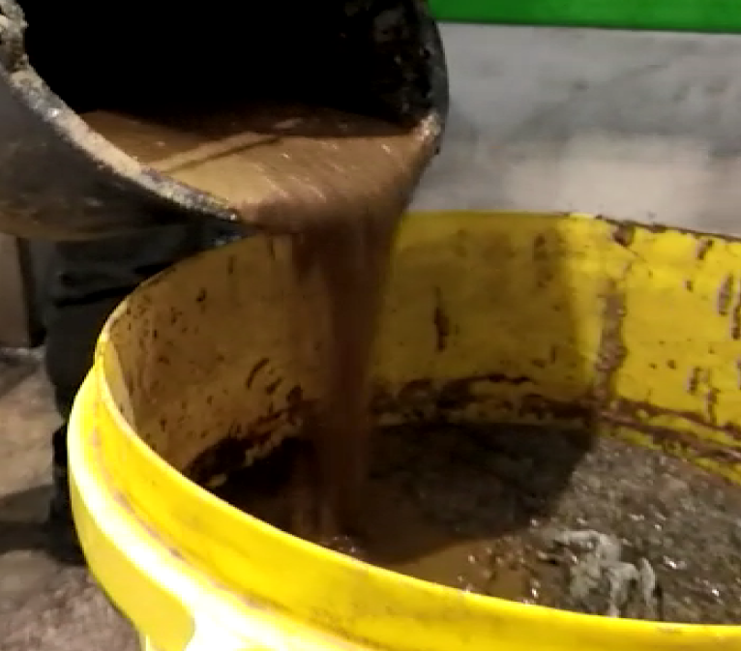
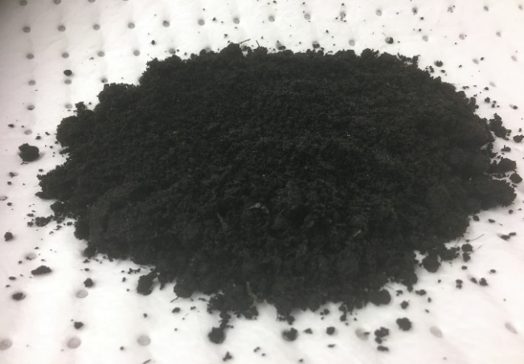
Thermo-pressure hydrolysis (TPH)

Slide 9
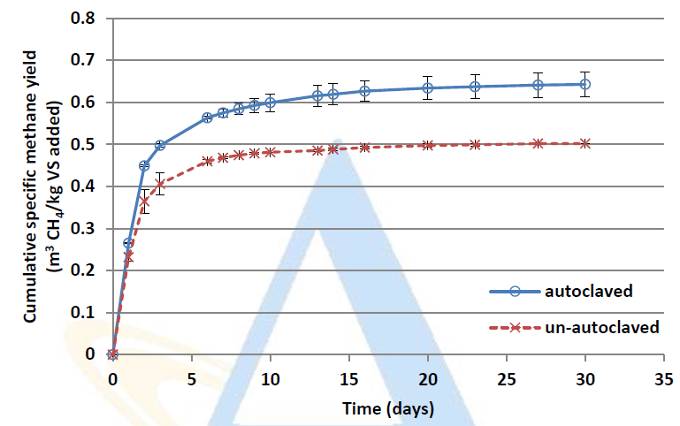
Biomethane from Food waste (with and without TPH)

Slide 10
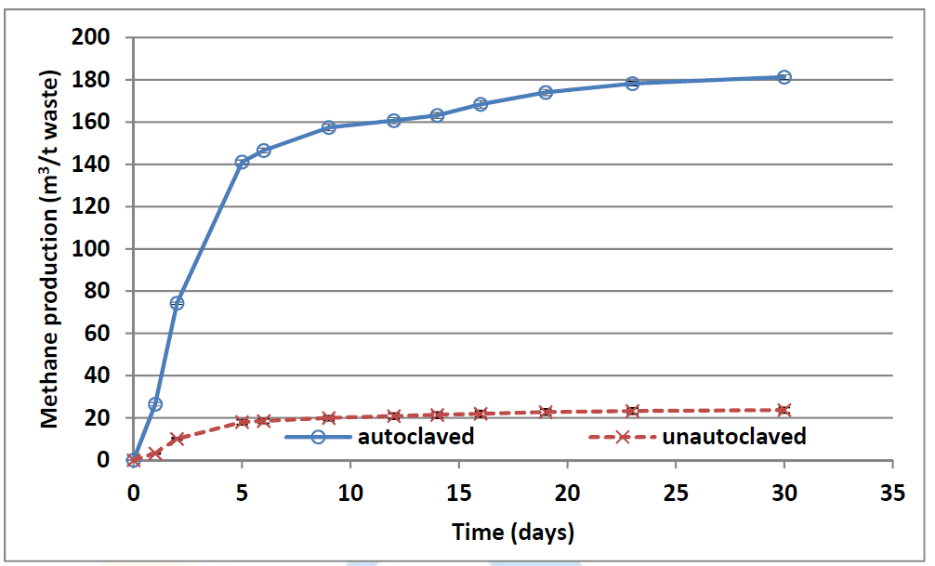
Trial 1 - Biodegradable AD Reject
392 m³/t VS
180 m³/t waste
79% Extraction

Slide 11
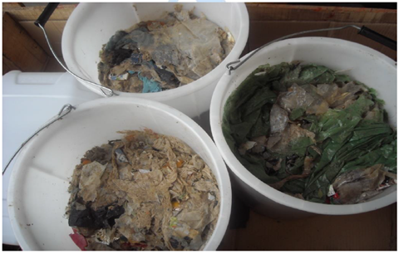
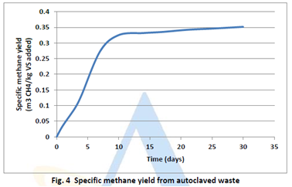
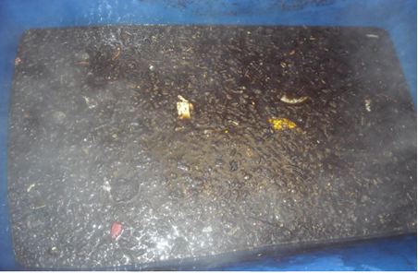
Trial 2 - Biodegradable AD Reject
350 m³/t VS
100 m³/t waste
45% Extraction

Slide 12
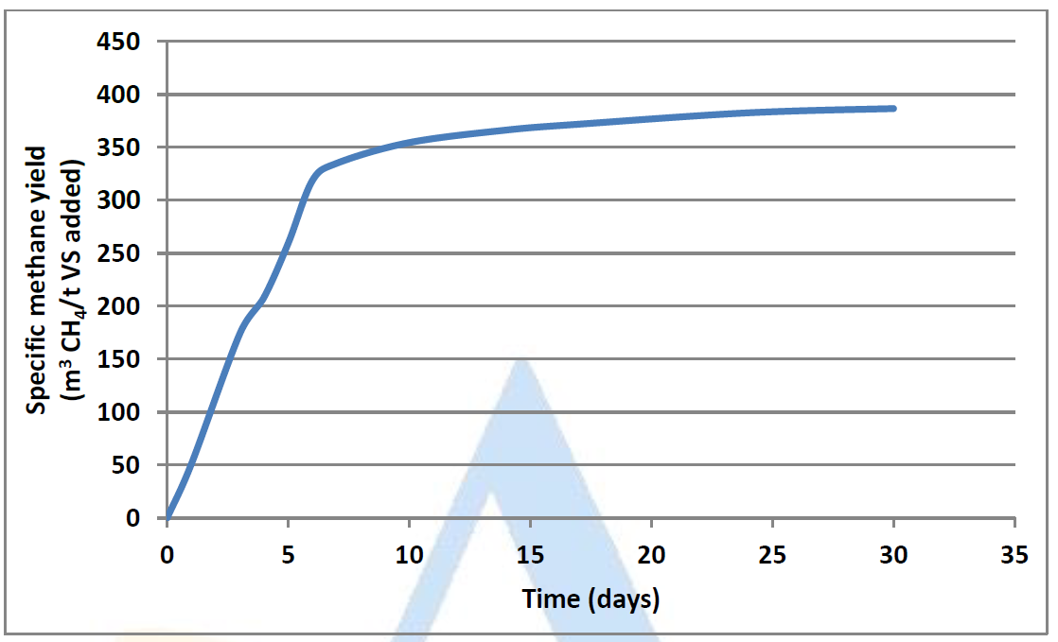
Trial 3 - Mixed biodegradables
387 m³/t VS
317 m³/t waste
100% Extraction

Slide 13
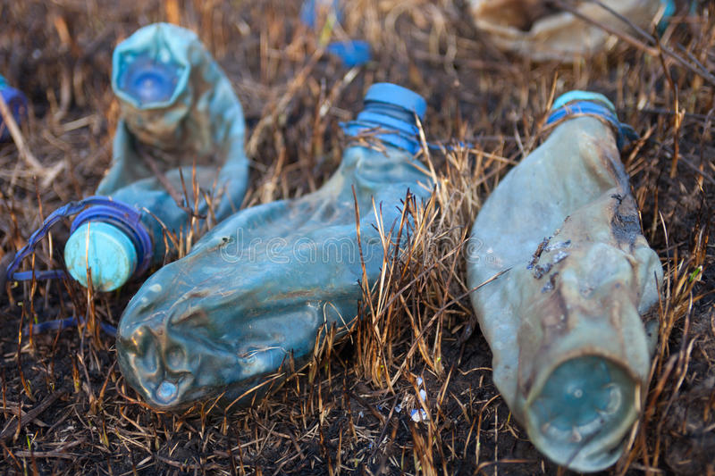
Trial 4 - Impact of TPH on Hydrocarbon Plastics

Slide 14
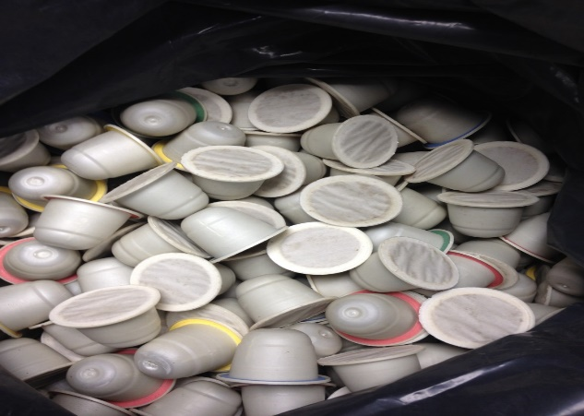
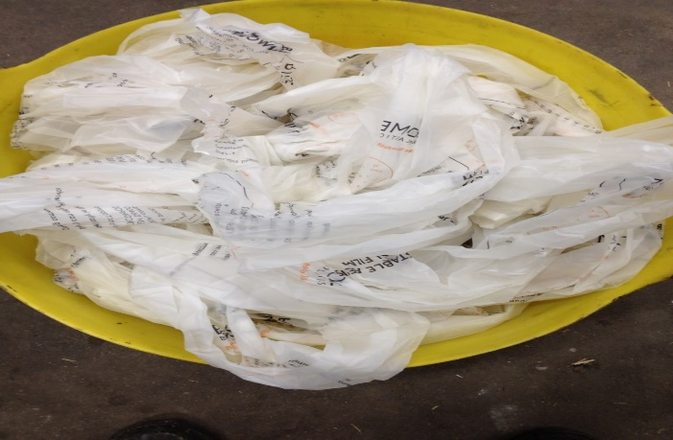
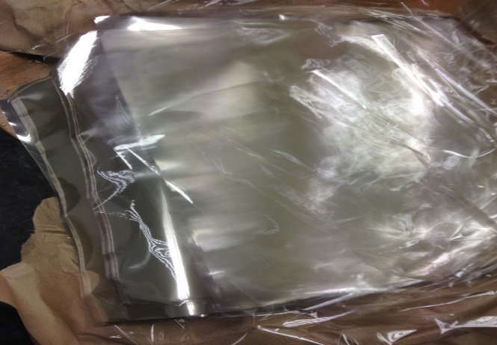
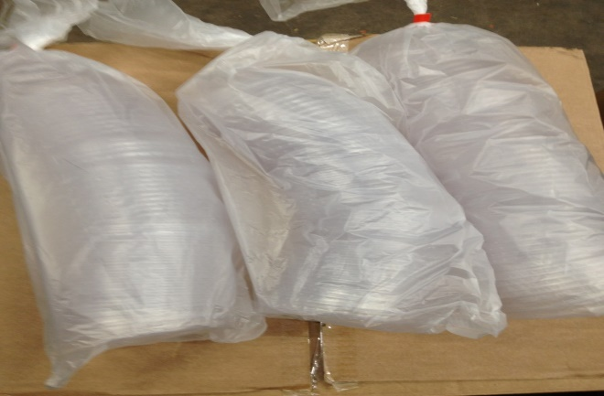
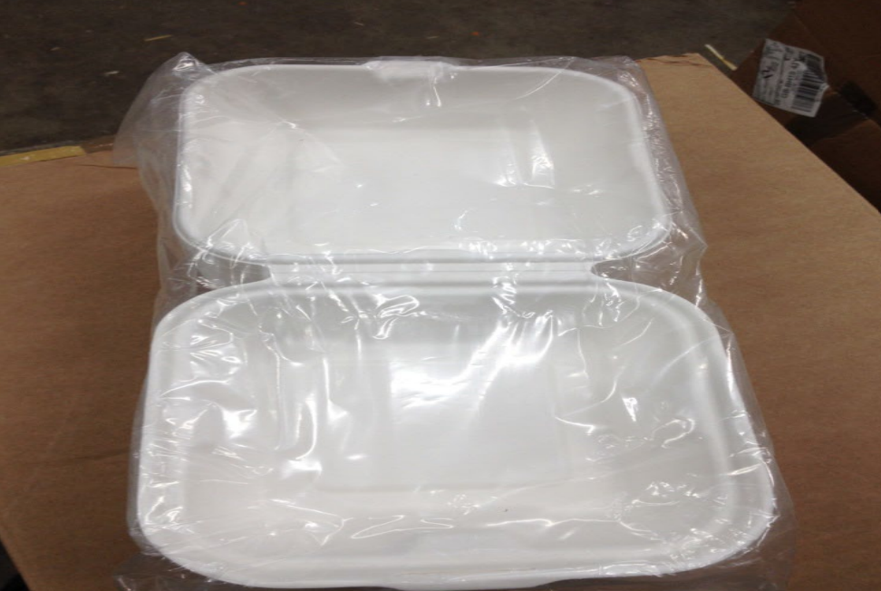
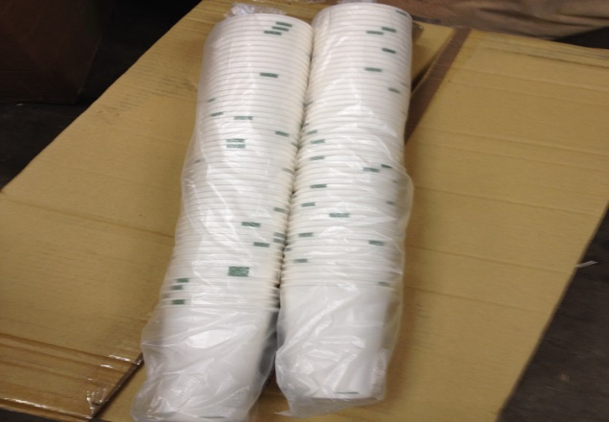

Trial 5 – Bio-packaging components

Slide 15
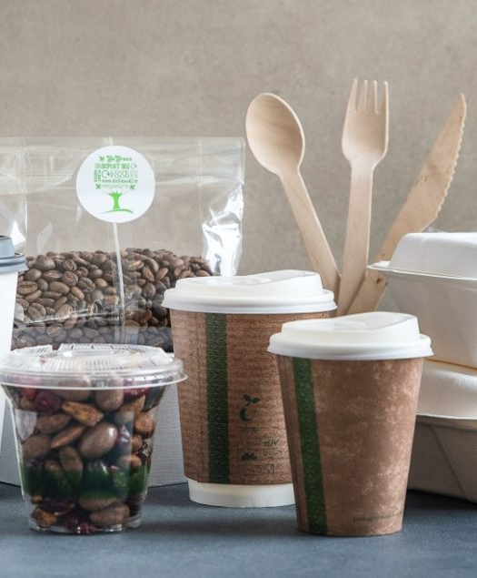
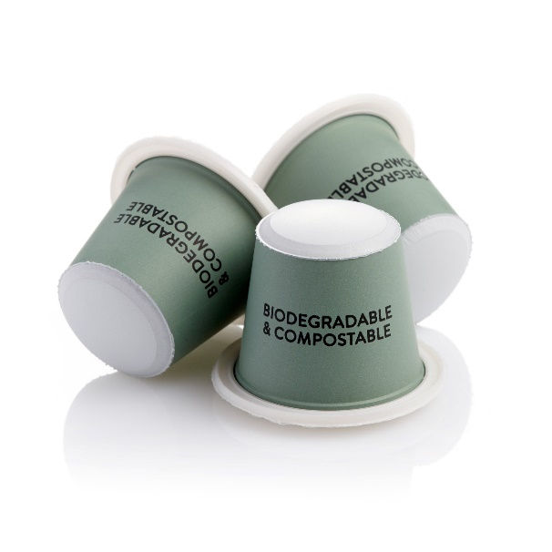
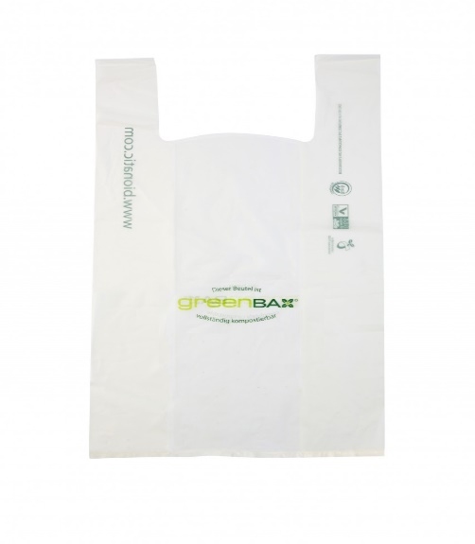
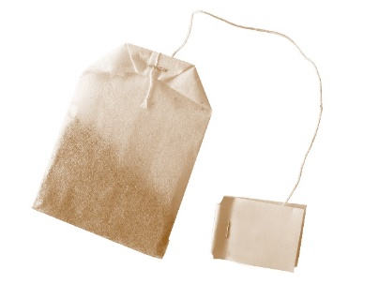
Bio-packaging liquefied by thermal hydrolysis
90.4% pass
General packaging composed of “biomass” - bagasse, wood and cardboard
85.6% pass
PLA Coffee pods with coffee
Lids did no pass
96.7% pass
Cellulosic carrier bags
(Corn starch)
100% Pass
PLA material

Slide 16
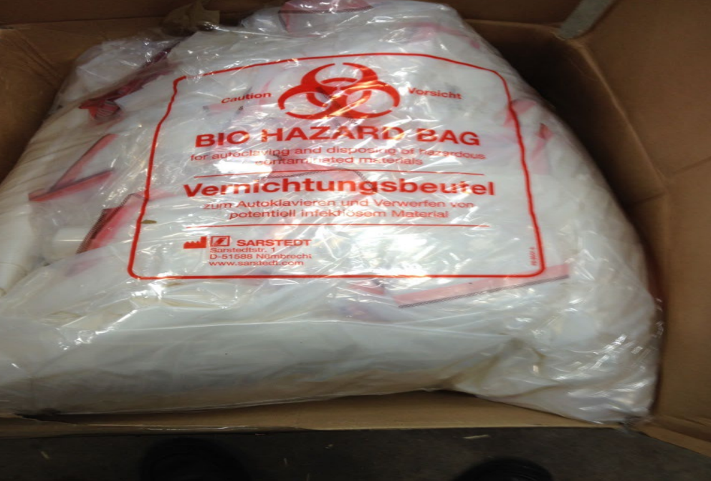
Bio-packaging not liquefied by thermal hydrolysis
Bioplastics other than PLA that are designed for high temperature applications (cooking) did not liquefy or fragment significantly.
Therefore, this class of bioplastics can be expected to rejected at conventional and TPH AD facilities prior to digestion.
However, this grade of bio-plastic appears to represent a relatively small proportion of biodegradable packaging on the market.

Slide 17
Biomethane potential of the various bio-materials

Slide 18
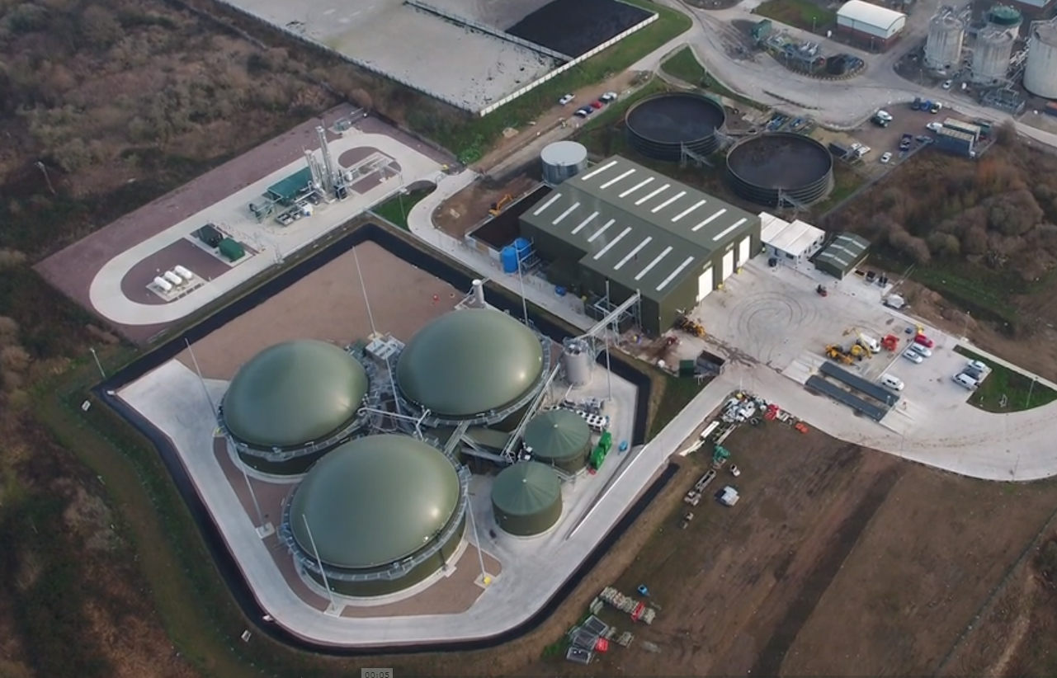
The Full-scale experience

Slide 19
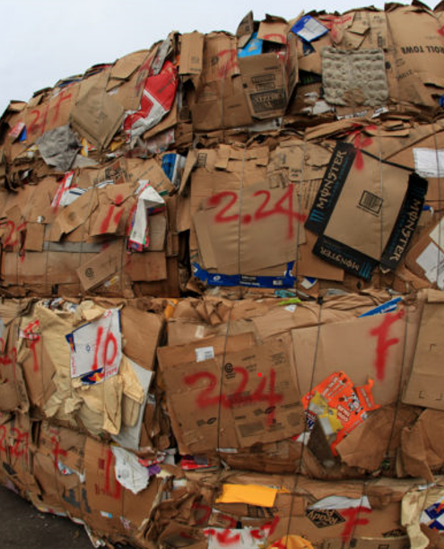
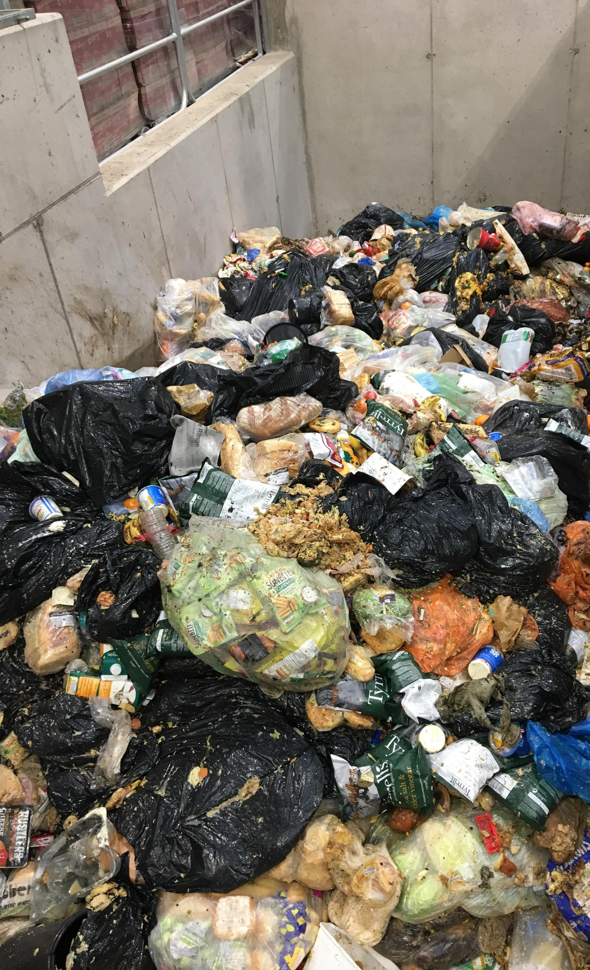
Derby “Food waste”

Slide 20
Performance
Methane
m³/t

Slide 21
TPH versus conventional digestion modelling
111 m³ CH₄/ fresh tonne
4,000 tpa of waste to landfill
155 m³ CH₄/ fresh tonne
1,400 tpa of waste to landfill

Slide 22
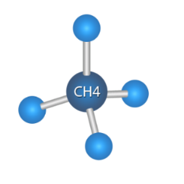
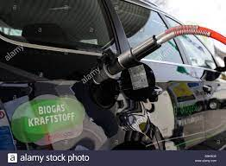
Renewable energy potential of bio-packaging
1 tonne of typical food waste (no TPH) = 130 m³ CH₄
= 1.3 MW_{th}
1 tonne of mixed biodegradable packaging = 310 m³ CH₄
(TPH) = 3.1 MW_{th}
3.1 MW_{th} = 100 household daily consumption
3.1 MW_{th} = 310 litres of diesel
= 5,000 km for an average car

Slide 23
Questions?

