Slide 1
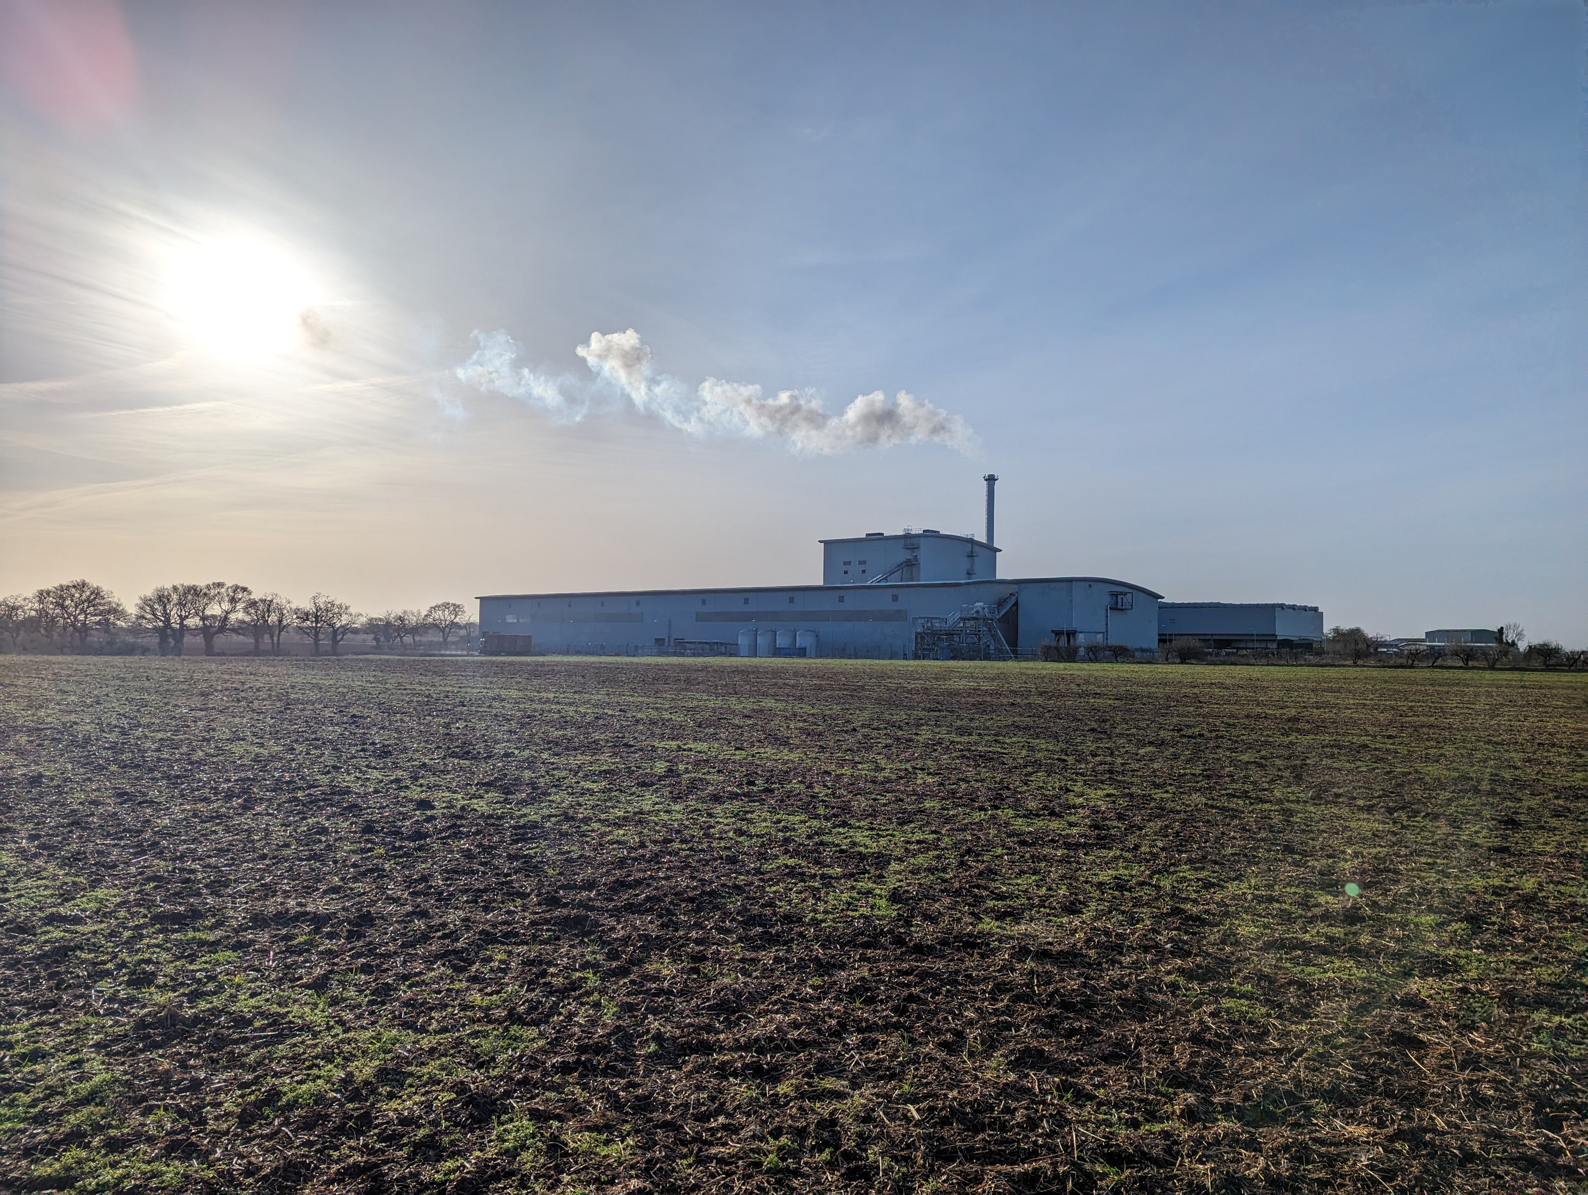

Melton Renewable Energy UK Ltd
Biomass Fuel Feedstocks
Bill Griffiths
Commercial Director
Email: Bill.Griffiths@mreuk.com Mobile: 07590 961009

Slide 2
Melton Renewable Energy Power Station Portfolio
Melton manages a fleet of 7 x operational renewable energy power stations
Installed generating capability of 195MW
Annual fuel requirements of 1.5m tonnes
Each of our 5 owned and operated power stations have been operational for over 20 years
MRE has a proven track record of sourcing biomass fuels & providing reliable material off-take
MRE is willing to enter long-term agreements for biomass fuel
Our fuel feed systems can handle a variety of material types – poultry litter, arb woodchip, horse-bedding, Meat & Bone Meal, cereal straw

Slide 3
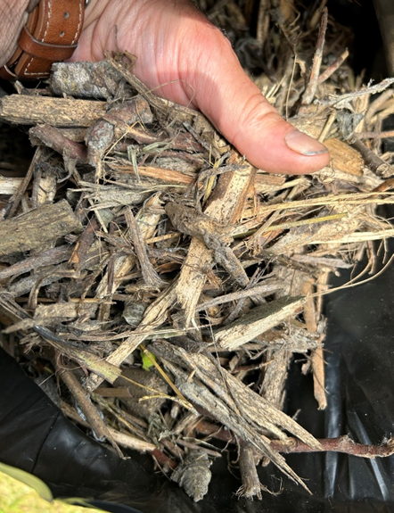
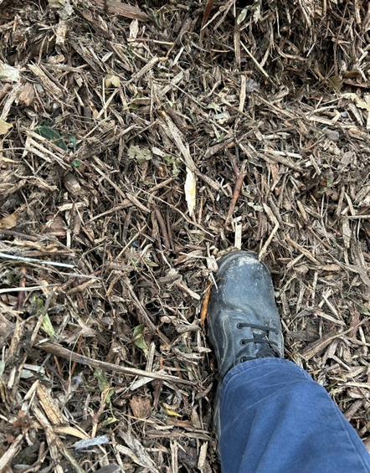
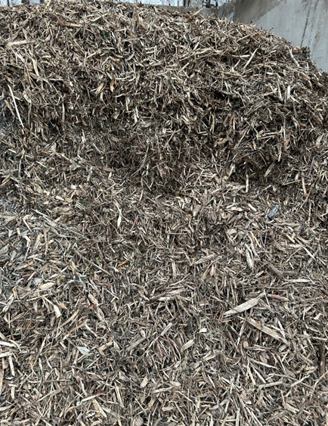
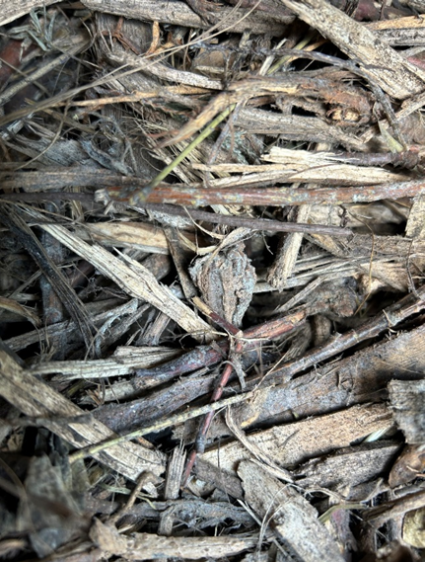
Pre-compost White Biomass – what is it?
EWC 19 05 01 – Non-composted fraction of municipal & similar wastes

Slide 4
Benefits of capturing White Biomass
Removal of woody fraction at the front-end within days rather than weeks will: release operational space, increase annual capacity & Gate Fee earning potential on the Permitted site
Enables more effective & efficient composting of the green waste material passed forward for open windrow composting
Initial screening out of the grass cutting and leaves will reduce the need of shredding this fraction of the inbound green waste thereby reducing the use & cost of diesel leading to a reduced carbon footprint of the composting operation
Further diesel and carbon savings will be made as the white biomass woody fraction will not be being turned weekly through the composting process
Less compost oversize will be recirculated round the compost site thereby further reducing diesel use and carbon footprint of the overall operation
Reduced amount of Off-spec “compost oversize” generated as a waste by-product at the back end of the current composting process.
Faster turn round of cashflow as white biomass is produced & sold-on in days rather than weeks or months

Slide 5
White Biomass Fuel Specification

Slide 6
Why talk to Melton?
We have been operating for over 20 years and form an important part of the UK’s regional energy mix
We provide baseload electricity and a key service managing agricultural wastes and residues
We have an in-depth understanding of the waste & agricultural industries and their requirements
We understand the operational challenges faced by organics sector
We identify new opportunities to spread business risk
  Potential for EWC 19 05 03 Off-spec compost oversize
Please give Bill Griffiths a call to explore more
Email: Bill.Griffiths@mreuk.com Mobile: 07590 961009

