Slide 1


Solar & Storage Forum
Thursday 3rd September 2026
www.r-e-a.net

Slide 2
REA Competition Law & AI notetakers policy
REA’s compliance with all aspects of UK Competition Law applies to all activities of REA including its subsidiaries, Member Forums, committees, working groups, technical groups, and sub-groups and any other such meeting:
  Members are not permitted to discuss competitively sensitive information, or to use REA as a conduit for such discussions.
  Competitively sensitive information covers any non-public strategic information about a business’s commercial policy. It includes, but is not limited to, future pricing and output plans.
  Please note this session is being recorded for note taking purposes and AI note takers will not be permitted. Such bots will be ejected to maintain confidentiality
Notes:
MS

Slide 3
Agenda
Item | Lead | Start | Time
Introductions, competition law | Matt | 13:00 | 5 mins
Policy developments, consultation & news | Stephanie | 13:05 | 20 mins
Overview from chair | Chair | 13:25 | 5 mins
Alice Etheridge, NESO | Speaker | 13:30 | 15 mins
Arbaaz Nayeem, EY | Speaker | 13:45 | 10 mins
Dan Skinner, DeterTech Carl Gurney, Gallagher | Speaker | 13:55 | 15 mins
Beth King, TLT | Speaker | 14:10 | 10 mins
Richard Gow, ENGIE | Speaker | 14:20 | 15 mins
Any other business | Chair | 14:35 | 10 mins
Notes:
We are looking for new members for Steering Group – meet up 4 times a year (roughly week before main forum) – please let me know, or email mparry@r-e-a.net to join or for more information.
Are there any battery solutions companies on this call that could help Rob Hughes (Cosmic Charging), he’s looking for provider of batteries for apartment buildings.

Slide 4
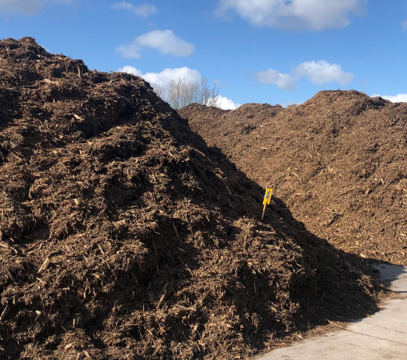

Recent consultations
Plug-in solar consultation (DESNZ)
REA response supportive of amendments to PSSR & IPS
Highlighted importance of appropriate consumer protections, impact on DNO’s ability to balance local grid and expansion of salary sacrifice
Will continue to engage with DESNZ in early stage of rollout
LDES Window 1 minded-to decisions (Ofgem)
REA welcomed the variety of long-duration storage tech, including PSH, CAES and VFB/ZN
Noted that ~50% capacity use Li-ion BESS, which can ‘queue jump’, so care should be taken to avert market distortion for shorter duration Li-ion BESS
Called for regular auctions and greater certainty and visibility of future LDES cap and floor application windows. Proposed rolling 3-year timeline to align with 3-year SSEP review cycle
Final awards decision Autumn 26
Window 2 targeted 2027
Community Batteries call for evidence (DESNZ)
REA response supported efforts to utilise local renewable energy resources in alignment with WHP
Highlighted key barriers and requested clear guidance regarding access to capital to fund high upfront costs
Updated H&S guidance and additional standards possibly required for larger battery schemes
Notes:
Encourage jump in if additional comments!
Plug in: Rapid turnaround from intention announcement (March) to legal approval (Aug). Major UK retailers preparing to stock.
Government incorporated this feedback into interim product spec, including strengthened requirements to support safe consumer use (clearer info on product scope, installation, circuit identification, mounting, Engineering Recommendation G98 notification requirements, prohibited uses, and circumstances where professional advice should be sought)
LDES window: 77 eligible projects shortlisted to 16 (published June 26). Consultation responded to this proposal (see slide). Ofgem intends to consult on design of future cap and floor Windows, with design to consider SSEP, alignment with overall energy system reforms & role of new tech

Slide 5
Estimated Policy Timeline 2026-27
Public consultation on draft SSEP
Final SSEP published
Market Reform Strategies
Balancing, Settlement & Dispatch reforms ongoing
CSNP in development
Q3 2026 Q4 2026 Q1 2027 Q2 2027 Q3 2027 Q4 2027
Clean Flexibility Roadmap update
Formal WCfD consultation
First WCfD Allocation Round?
LDES Window 1 Award
Consultation prior to LDES Window 2 opening
CfD Allocation Round 8
Results of AR8, contracts signed
Revenue Mechanism & Asset Deployment
Plug-in solar introduced to UK market
Notes:
RNP: SSEP: Pathway Options Report submitted to the UK Energy Secretary yesterday. report outlines 6 potential pathways to meet Britain’s future energy needs, providing a strategic view of the energy infrastructure required, where located, and when delivered. Draft consultation expected Spring 2027, final SSEP end 2027
Reforms to balancing and dispatch - first phase is the design phase and will run until late 2026 - transition to feed into the implementation phase.
Following transitional CSNP published summer 26, final CSNP expected end 28
Following REA-hosted pre-consultation engagement over summer for REA members to shape early thinking of WCfD design & eligibility, formal consultation expected later this year/early next, with first AR late 2027, scheme operational 2028
LDES already discussed Final awards decision Autumn 26. Window 2 targeted 2027
AR8 application window closed August, depending on appeals process, contracts signed around March 27

Slide 6
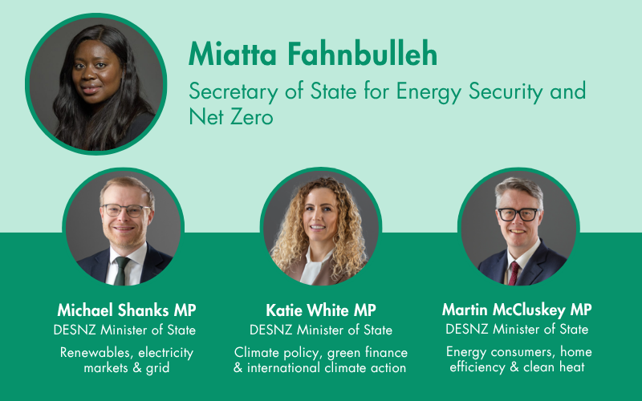
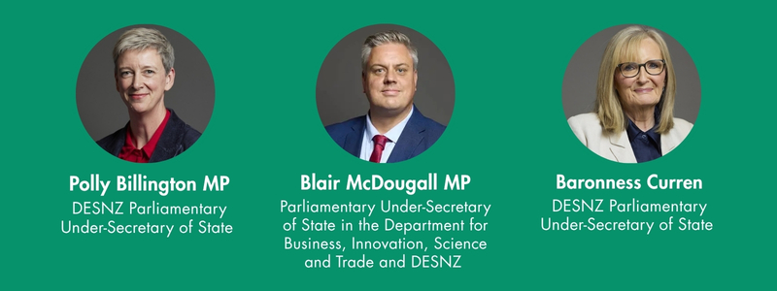
Burnham Government – New DESNZ Ministers
Consultations, meetings, media, others…member thoughts
Notes:
Ministerial appointments were completed by 23rd July
REA are working with communications agency Hawthorn to contact and build relationships with new Ministers, including Andrew Bowie new Shadow Minister for Energy (following reshuffling over last week)
degree of continuity within the department, with Michael Shanks remaining in post. Katie White also been promoted from climate-focused Parliamentary Under-Secretary role to Minister of State.
While there may be some adjustment in emphasis - particularly around affordability and energy security - the composition of the ministerial team suggests broad continuity with the department’s existing priorities.
Polly Billington’s promotion is particularly noteworthy, with Hawthorn having a close relationship with her. She is well versed in the brief, having served on the executive of SERA, Labour’s Environment Campaign, and the advisory group of the Labour Climate and Environment Forum.
Polly has also worked closely with Miatta previously. She served as a special adviser to Ed Miliband in the Cabinet Office before becoming his media director during his leadership campaign. We heard this morning that Miatta advocated particularly strongly for Polly’s appointment. This offers a useful indication of how the department may operate, with much of Ed’s previous agenda likely to remain influential.

Slide 7
Recent policy developments
Announcement | Specifics | REA role/next steps
Wholesale CfDs/Electricity Generators Levy The REA has long pushed for additional long-term supports for older projects | Former Energy Secretary Ed Miliband announced plans in April 2026 to offer voluntary ‘wholesale CfDs’ to older projects. In parallel to this, the Electricity Generators Levy (EGL) means that generators will have to pay a higher (55%, previously 45%) tax on excess revenues. Relatively welcome announcement, as prior to announcement there had been a lot of talk of breaking the link between gas and electricity prices, triggering fear of rash decisions. | Campaigning for fair deal on voluntary CfDs and decent timelines – thoughts from across the group? Thought pieces on benefits of continuing to support legacy renewable projects – does anyone want to contribute any pieces? The REA held a roundtable with DESNZ on 23rd July and will continue to engage with the WCfD team
Warm Homes Plan The REA continues to advocate for more financing and wider coverage | This year’s update announced £15 billion to accelerate home upgrades (solar, storage and heat pumps), with specific targeting for low-income homes. Finance barriers being reduced; plan includes low- or zero-interest loans and funding support. Future Homes Standard will require solar on all new homes. | Working closely with government to make sure scheme maximises results. Continuing to make the case for rooftop solar, batteries and heat pumps to be included in Salary Sacrifice Scheme, open up possibility of adoption to a much wider share of the market. Pushing to get batteries included in Future Homes Standard.

Slide 8
Other recent developments (1)
Announcement | Specifics | REA role/next steps
New Government in place after Andy Burnham replaces Kier Starmer as Labour Leader and UK Prime Minister | The Burnham ministry began on 20th July 2026 Ministerial appointments were completed by 23rd July Ed Miliband has moved from DESNZ to become the Foreign Secretary, and was replaced by Miatta Fahnbulleh Rachel Reeves was replaced by John Healey as Chancellor The Department for Science, Innovation and Technology (DSIT) was disbanded and merged into the Department for Business, forming the new Department for Business, Innovation, Science and Trade (DBIST). The Sec. of State is Jonathan Reynolds. Angela Eagle has become the Sec. of State for Defra, replacing Emma Reynolds | The REA has sent welcome letters to the new Secretaries of State We are working with our communications agency Hawthorn to contact and build relationships with new Ministers.
Gas and oil prices up sharply REA liaising with Ministers and media to emphasis how recent geopolitical events further case for renewables | Closure of Strait of Hormuz removes roughly 25% of the world’s seaborne oil and 20% of global LNG. Triggered sharp rises in oil and gas prices – likely leading to higher inflation and higher interest rates (at least higher than they would otherwise have been). Having initially surged, over 50% higher, European gas prices have since moderated a bit (now up around 20% vs pre-troubles) as markets have increasingly realized 20% of world’s LNG is only equivalent to around 3% of global gas supplies. | Keep communicating how recent event only further emphasize the reason why we should invest in more renewable generation – reduced exposure to volatility in imported fossil fuel prices.

Slide 9
Other recent developments (2)
Announcement | Specifics | REA role/next steps
DESNZ: Reformed National Pricing delivery plan REA been liaising closely with DESNZ on this | Outlines plans on how to be managed. SSEP will set zonal caps on how much generation of each tech can connect in each zone. Connections regime (already reformed via TM04+) will be tightened further so that connection offers align with these caps; location choice as important as quality. TNUoS charges face fundamental reform. Gov’s preferred options (2a, 2b and 3) all involve either abolishing or substantially redesigning locational transmission charges. Aims to constrain curtailment costs through network accelerations, Dynamic Line Rating, storage integration and demand flexibility. CfD and capacity market designs could change as a direct result of RNP. Balancing and settlement reforms add a further operational dimension. Mandatory balancing market participation threshold will be lowered, gate closure and market trading deadline will align, unit-bidding will be introduced, and settlement periods may shorten to 15 to 5 minutes. | The REA responded to the RNP consultation on 2nd June. You can read the full response on our website: https://www.r-e-a.net/resources/reformed-national-pricing-rnp-reforms-to-siting-and-investment-levers-rea-response/

Slide 10
Solar & Storage Forum | Policy priorities
Reformed National Pricing (RNP)
Grid Connection & Queue Governance
Long duration energy storage (LDES) – cap and floor mechanism
Planning & Safety
Reducing high electricity prices
Notes:
Following feedback and discussions with Steering Group, in process of developing slightly new format to these meetings. Proposing to shift focus more towards encourage forum-wide discussions on priority policy areas – overview of which are highlighted here. Moving forward, will try to limit external speakers and instead work to develop and create position papers which will aid our engagement with wider stakeholders most notably, ministers, NESO & Ofgem.
So this is a heads up of proposed change – love to hear any feedback on this, suggestions how we can best facilitate this, and hopefully by next forum I will have finetuned the key policy areas and strategy to start developing these positions! Let me know thoughts!
Leading on from planning and safety pillar, mark has short piece speak to re battery safety

Slide 11

Battery Safety and Consumer Confidence
As battery energy storage systems become increasingly common across homes and businesses, maintaining confidence in the technology remains important to the continued growth of the sector.
Battery safety is often discussed in terms of product testing and compliance, but safe outcomes depend on a range of factors working together, including product design, installation quality, commissioning, maintenance and ongoing support.
As battery deployment increases, several themes may be worthy of ongoing industry discussion:
Ensuring high standards of product safety and installation quality
Supporting installer competence and good system design
Managing the growing role of software, connectivity and remote monitoring
Maintaining long-term support arrangements throughout a product's operational life
Continuing to build consumer confidence in battery technologies and the wider sector
The renewable energy industry has a strong track record of collaboration and continuous improvement. Battery technologies continue to develop rapidly, creating opportunities for manufacturers, installers, industry bodies, certification organisations, insurers and policymakers to work together in support of safe and successful deployment.
Battery storage will play an important role in the UK's energy future. Continued focus on safety, quality and consumer confidence will help ensure that market growth is matched by long-term public trust.

Slide 12
Guest speakers

Slide 13

Strategic Energy Plans
Alice Etheridge, NESO

Slide 14

Power Purchase Agreements
Arbaaz Nayeem, EY

Slide 15
Prices keep climbing, volatility has not eased – the PPA case is stronger
Rising N2EX day-ahead prices, as well as across all season products for the forward 12 months
N2EX UK monthly average, Jan – Aug 2026 (£/MWh)
Annual price uncertainty, 2024 – 2026 YTD (£/MWh)
August 2026 (£128/MWh) was the highest month of the year to date and 59% above the February low.
Range of monthly averages
Annual average
£99/MWh
+37%
£44–51
14 -19%
N2EX UK average, Jan – Aug 2026 – up 23% on the 2025 full year
2026 YTD average against 2024 (£73/MWh) – two years of sustained increases
Spread between the cheapest and most expensive month, every year since 2024
Spread of monthly prices not eased
Why the PPA case holds: prices have risen for three consecutive years to £99/MWh, yet the annual spread holds at £44–51/MWh and dispersion at 14–19% – buyers are paying more for no more certainty. A PPA converts that volatility into a fixed, long-dated price and is the most direct tool to take the uncertainty off the table.
2026 | EYP | Global Renewables
EY Parthenon
1

Slide 16
Illustrative TB2 spread index – how the swap settles month by month
Left: how the 2-hour top-bottom spread is formed intraday. Right: the resulting swap settlement against a fixed price
SPOT TB2 index – intraday spread formation (illustrative)
Monthly swap settlement vs a fixed price (X = £88/MWh)
SPREAD
The 2-hour top-bottom spread (C) is the average discharge price less the average charge price – the value a battery captures, and the index the swap settles against.
Realised spread is higher than the fixed price, so the Seller pays the Buyer.
Realised spread is lower than the fixed price, so the Buyer pays the Seller.
Shape is illustrative. Charge in the midday solar trough, discharge into the evening peak.
Key message:- wider the intraday trough-to-peak gap on the left, the taller the bar on the right – e.g. 5 of the 10 months settled in the buyer’s favour, and the swap converts that volatility into a single monthly cash flow.
2026 | EYP | Global Renewables
EY Parthenon
4

Slide 17
BESS swap mechanism – monetising the spread
No physical energy transfer; settled alongside the existing vPPA under an ISDA
Unchanged
New ISDA-based swap
vPPA CfD settlement
Fixed swap price paid (X)
Generator
(solar / wind)
Corporate
off-taker
BESS provider
/ trader
Strike vs. market price
TBx spread index (C)
Financial flows only – the swap sits outside the PPA and does not disturb existing settlements with the generator.
How the mechanism works
Why it works for a PPA buyer
What to test before committing
1
Financial-only contract
Monetises the spread between low-price solar hours and peak demand – no physical delivery.
1
Natural hedge
The spread widens exactly when the solar capture price collapses.
1
Liquidity & tenor
BESS spread contract availability; liquidity reduces beyond CAL+3.
2
Index-linked arbitrage
BESS provider trades charge / discharge against a published TBx spread index.
2
Bolt-on, not a rewrite
Existing vPPA and additionality / REGO claims are untouched.
2
Index & basis
TBx duration, area and settlement granularity.
3
Two-way settlement
Buyer pays the fixed swap price and receives the realised index, or vice versa.
3
Upside restored
Regains exposure to high-price hours where the vPPA is capped.
3
Credit & accounting
Counterparty credit, collateral and hedge designation.
2026 | EYP | Global Renewables
EY Parthenon
2

Slide 18



Proxima Nova
Proxima Nova
Secured and Insured.
Dan Skinner, DeterTech
Carl Gurney, Gallagher

Slide 19


Giving greater peace of mind to people and communities, every day.
Notes:
So what did we provide?
Due to the challenge of volume of vulnerable areas, we needed a visible, overt solution to change the environment. This consisted of 8 x PID 360, 2 x DTSentinel and SmartWater for high-level deterrence
We added value by using our enhanced police relationship to create wider engagement in the area. South Yorkshire Police worked with us to provide a safe and stable environment by having more presence.
We gave greater peace of mind by providing ongoing support through Crime Intelligence, enabling a proactive approach.

Slide 20
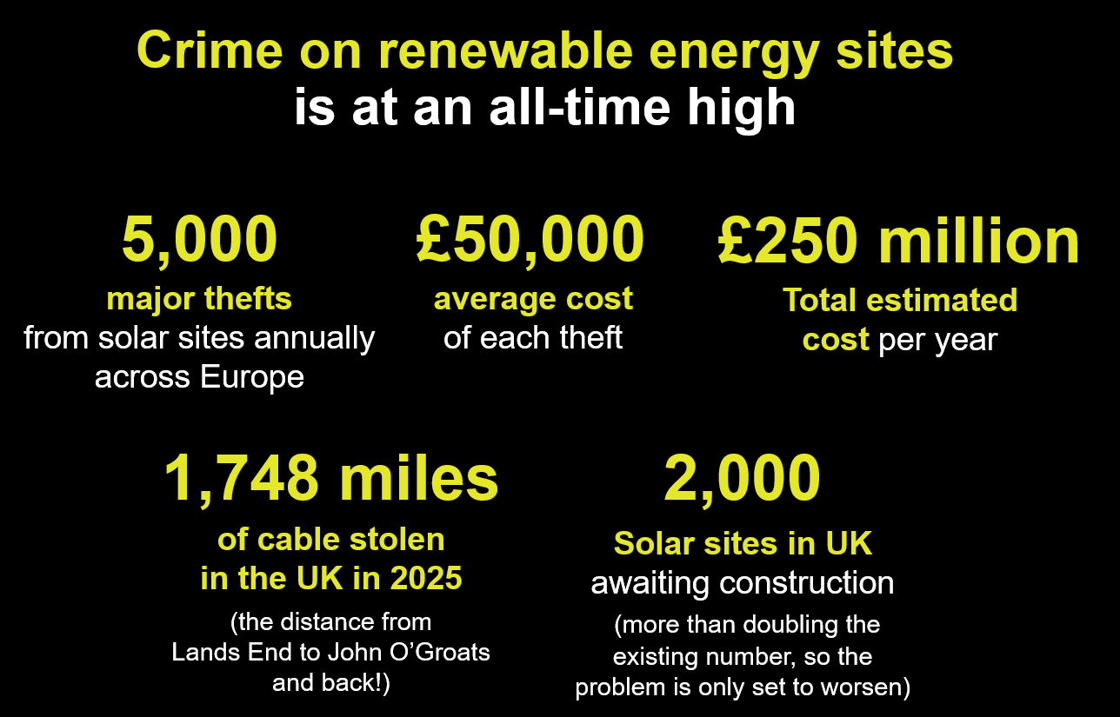
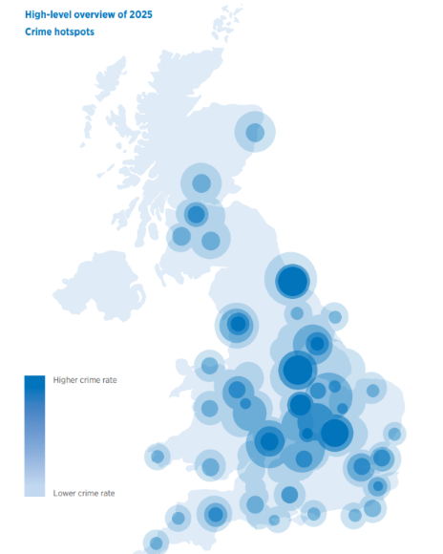
Notes:
So what did we provide?
Due to the challenge of volume of vulnerable areas, we needed a visible, overt solution to change the environment. This consisted of 8 x PID 360, 2 x DTSentinel and SmartWater for high-level deterrence
We added value by using our enhanced police relationship to create wider engagement in the area. South Yorkshire Police worked with us to provide a safe and stable environment by having more presence.
We gave greater peace of mind by providing ongoing support through Crime Intelligence, enabling a proactive approach.

Slide 21
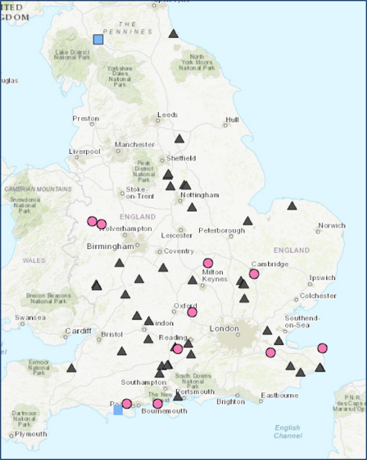
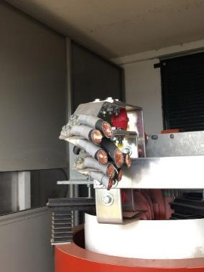
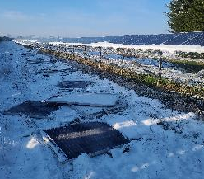
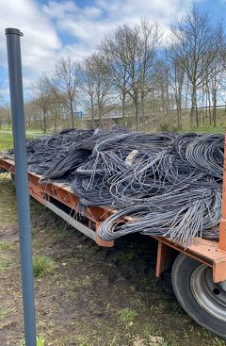
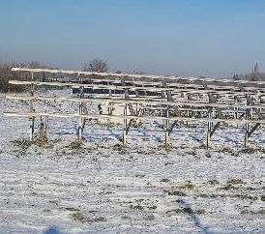
What’s being targeted?
What’s being targeted?
Notes:
So what did we provide?
Due to the challenge of volume of vulnerable areas, we needed a visible, overt solution to change the environment. This consisted of 8 x PID 360, 2 x DTSentinel and SmartWater for high-level deterrence
We added value by using our enhanced police relationship to create wider engagement in the area. South Yorkshire Police worked with us to provide a safe and stable environment by having more presence.
We gave greater peace of mind by providing ongoing support through Crime Intelligence, enabling a proactive approach.

Slide 22

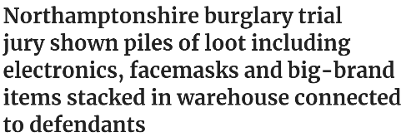
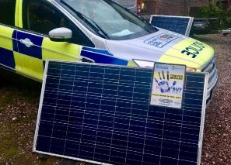
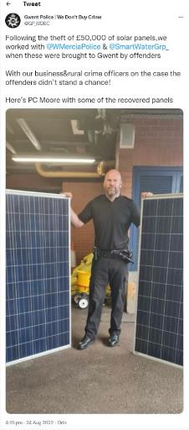
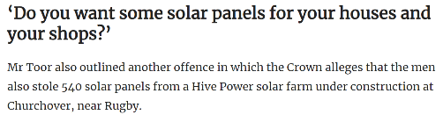
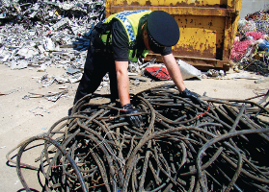
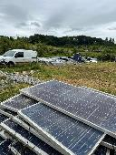
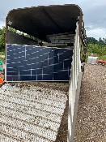
What are we doing about it?
Panel theft arrest –
Test purchase operation
£50k worth of panels recovered and arrest
Assisting in police investigation recovering 550 panels
Scrap Dealer Visits
Notes:
So what did we provide?
Due to the challenge of volume of vulnerable areas, we needed a visible, overt solution to change the environment. This consisted of 8 x PID 360, 2 x DTSentinel and SmartWater for high-level deterrence
We added value by using our enhanced police relationship to create wider engagement in the area. South Yorkshire Police worked with us to provide a safe and stable environment by having more presence.
We gave greater peace of mind by providing ongoing support through Crime Intelligence, enabling a proactive approach.

Slide 23

On average, the percentage of thefts on solar farms from 2024 to 2025 has risen 48%.
1 x DTSentinel (Solar Tower)
4 x PID 360
High Level Deterrent
Change in Enviroment
Negates repeat Crime
Asset continuity
This causes delays, inconvenience
and incurs cost.
We’ve used our industry expertise to adapt to this by providing a quick turnaround solution, preventing these thefts from reoccurring.
We believe changing the environment is key and we do this by providing
a successful deterrent.
Notes:
So what did we provide?
Due to the challenge of volume of vulnerable areas, we needed a visible, overt solution to change the environment. This consisted of 8 x PID 360, 2 x DTSentinel and SmartWater for high-level deterrence
We added value by using our enhanced police relationship to create wider engagement in the area. South Yorkshire Police worked with us to provide a safe and stable environment by having more presence.
We gave greater peace of mind by providing ongoing support through Crime Intelligence, enabling a proactive approach.

Slide 24
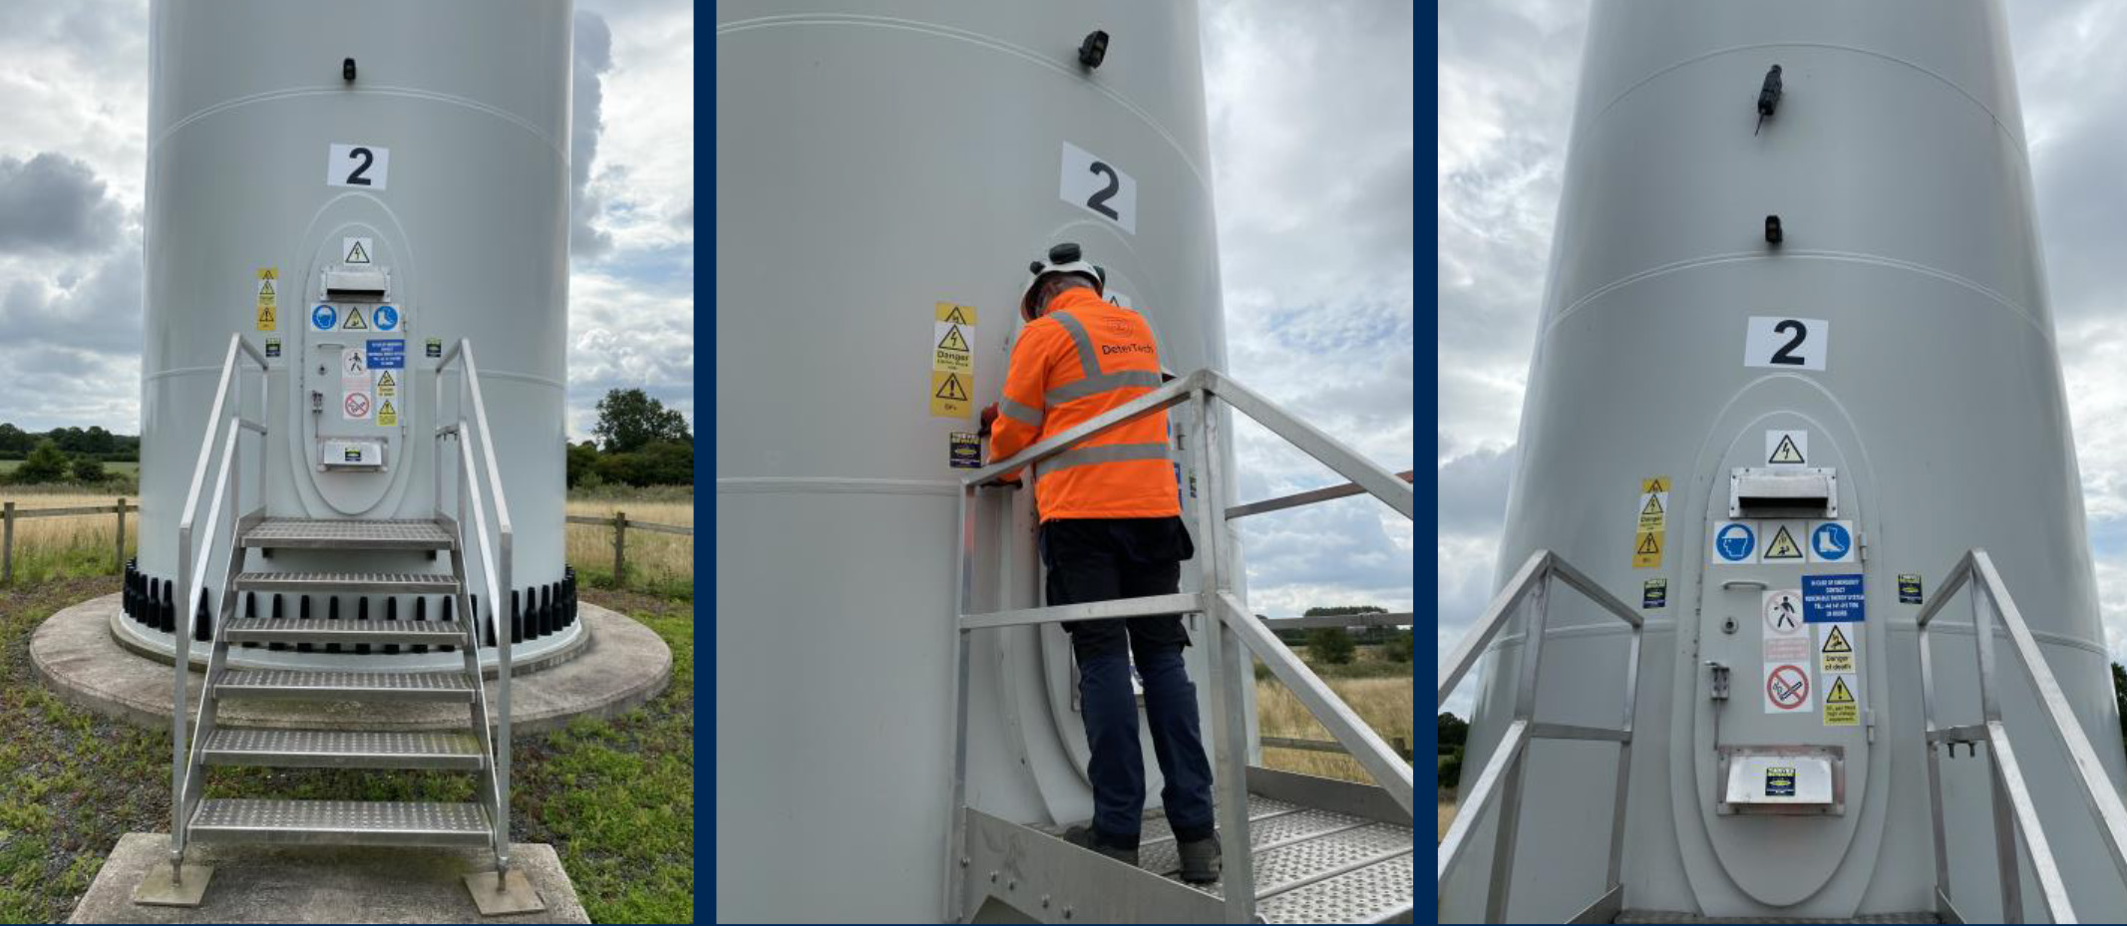
Wind Turbine Solution
This year, we’ve seen a huge spike in wind farm thefts. Using our CI database, a trend is emerging which is only getting worse.
Using our enhanced sector knowledge, customer base and expertise, we designed a package which is already successfully deterring crime on
wind farms.
1 x SmartRecon
1 x Bridge w/ Solar
Mobile Response
Long term Protection
Zero downtime
Asset Continuity
Notes:
So what did we provide?
Due to the challenge of volume of vulnerable areas, we needed a visible, overt solution to change the environment. This consisted of 8 x PID 360, 2 x DTSentinel and SmartWater for high-level deterrence
We added value by using our enhanced police relationship to create wider engagement in the area. South Yorkshire Police worked with us to provide a safe and stable environment by having more presence.
We gave greater peace of mind by providing ongoing support through Crime Intelligence, enabling a proactive approach.

Slide 25
Unfortunately, it’s clear crime on renewable energy sites is currently here to stay, but if we work together, with the industry and the police, we can make a difference by designing out crime in this sector, together.
Notes:
So what did we provide?
Due to the challenge of volume of vulnerable areas, we needed a visible, overt solution to change the environment. This consisted of 8 x PID 360, 2 x DTSentinel and SmartWater for high-level deterrence
We added value by using our enhanced police relationship to create wider engagement in the area. South Yorkshire Police worked with us to provide a safe and stable environment by having more presence.
We gave greater peace of mind by providing ongoing support through Crime Intelligence, enabling a proactive approach.

Slide 26
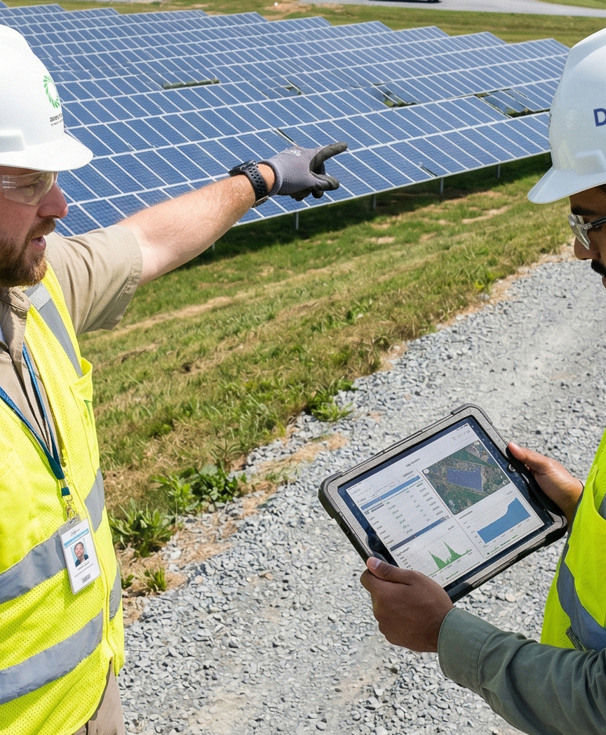
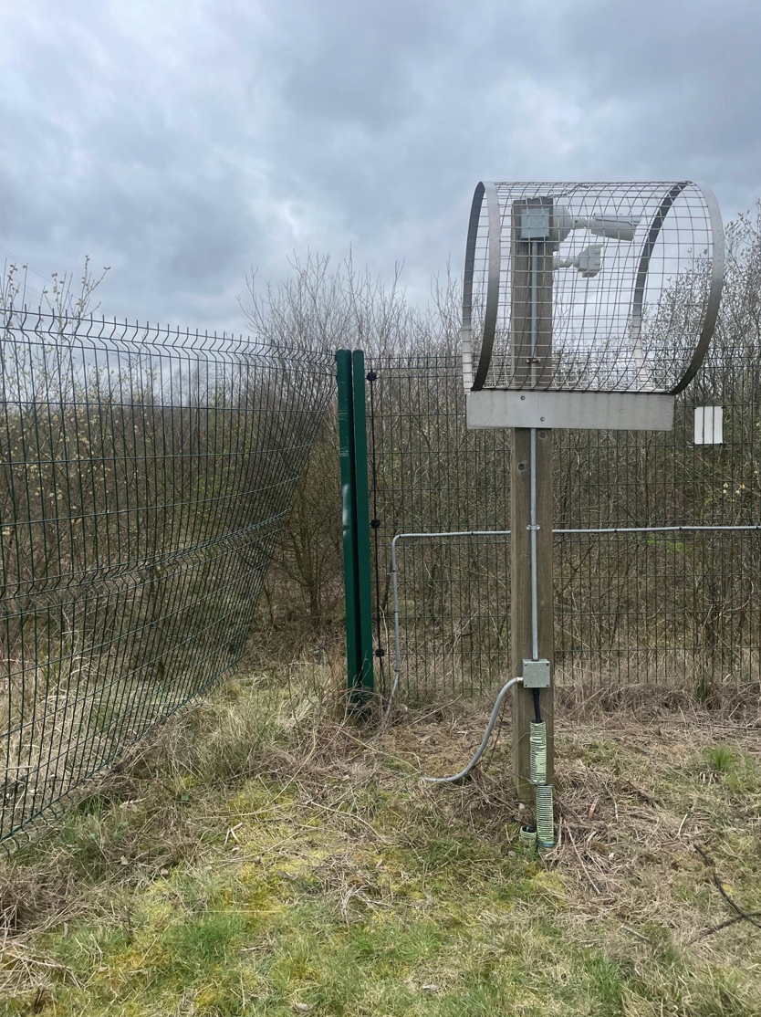
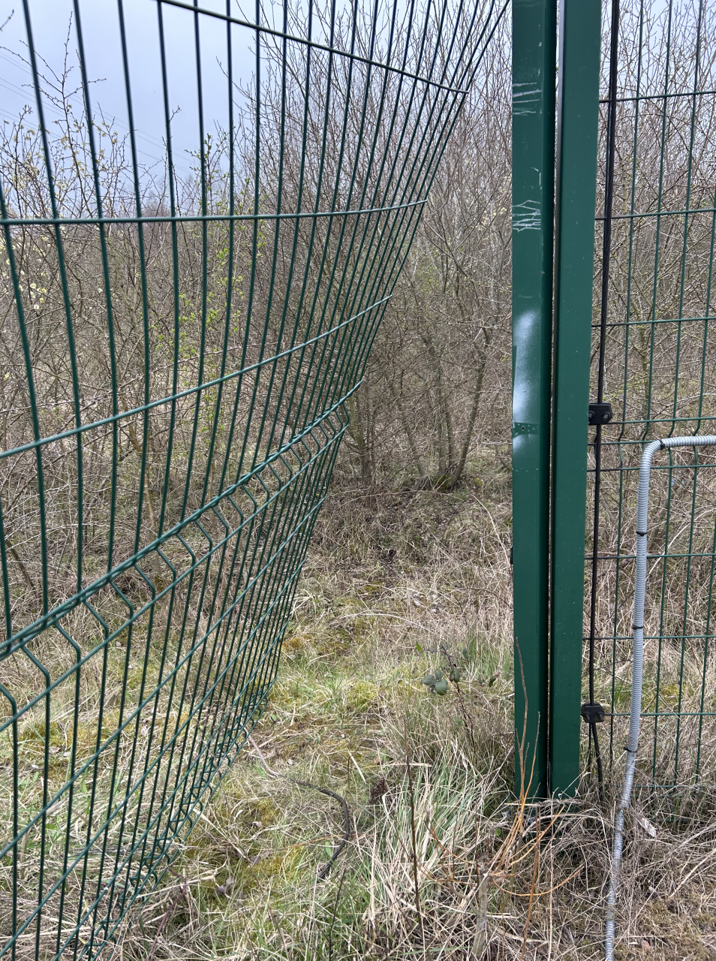
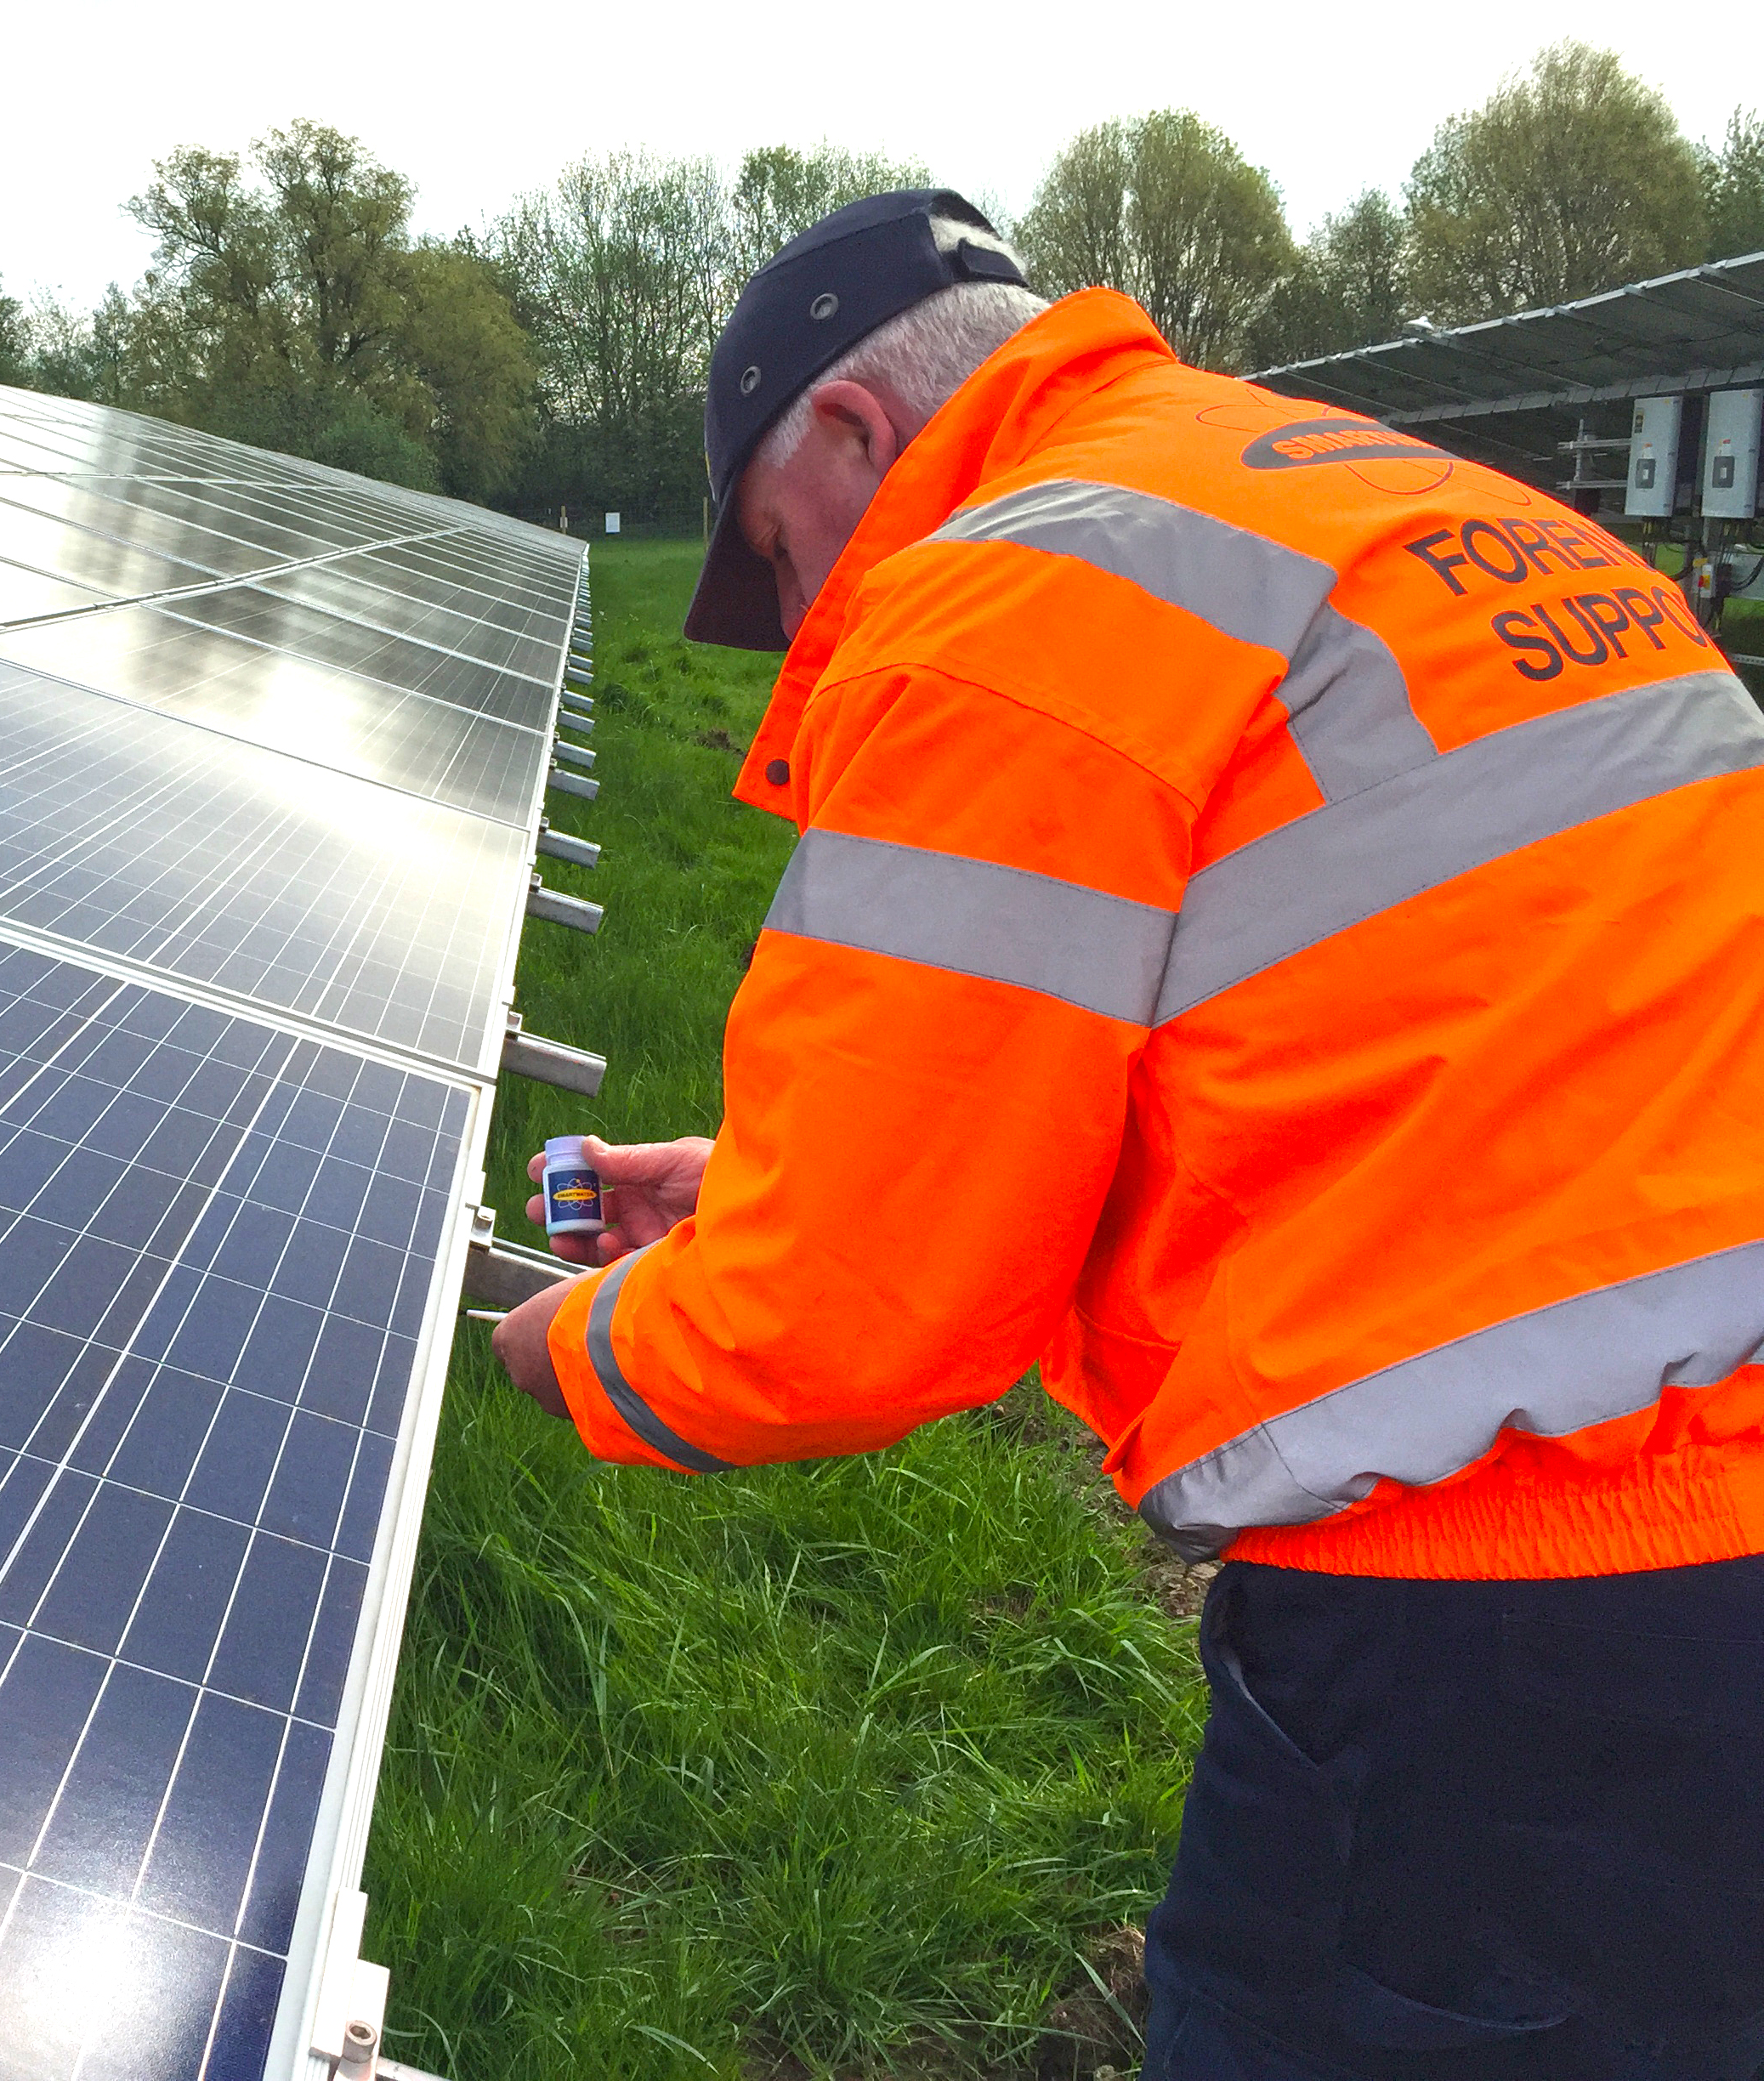
Doncaster Solar Farm:
The Story
Various incidents of criminal activity
Site at 0% capacity and due closure – insurer risk
Customer approached DeterTech as a last resort
DeterTech met with customer at site to survey and provide expert opinion
DeterTech solution deployed
Regular engagement with South Yorkshire Police
Notes:
One of our valued clients experienced serious concern over one of their solar assets, based in Doncaster. The site suffered various incidents of criminal activity, including theft, vandalism and unwarranted access
The site was at 0% capacity and due closure. This led to huge financial loss and insurers losing trust in our client and the asset.
Customer approached DeterTech as a last resort after trying patrols, cctv towers and another provider
Our team of Specialist Risk Advisors met with the customer at site to survey and provide expert opinion on the solution
DeterTech solution deployed to counteract criminal activity. Our recommendation was based on expertise and fact due to ex police experience and real-time crime data.
We had ongoing regular engagement with South Yorkshire Police and managed to orchestrate key holding for site

Slide 27
PROJECT LIFECYCLE
Deliver on time, on spec, on budget …..create value
DEVELOPMENT
Partnerships
Main Contracts negotiation
Financing
Design
BUILD
Start of works
Finalisation of contracts
Equipment supply & transportation
Financial Close
TESTING & COMMISSIONING
Phased handover
Open cycle
OPERATION
Warranty period
Maintenance
Risk prevention, allocation and contract drafting
Insurance programme design (construction and operational)
Assessment of uninsured areas - Cyber
Insurance / security budget estimate
Marketing of insurance programme
Insurance implementation
Kick-off meeting Risk engineering: Claims consultancy and technical support
Change in risk / Progress Reports
Risk survey
Wrap-up meeting technical support
Change in risk /
|Progress Reports
Handover to operations
Insurance renewals
Risk engineering
Claims
Change in risk / Progress

Slide 28

CONCERN TO PEACE OF MIND
Enhanced approach to risk mitigation may not meet the conditions of the policy
Don’t want to discover any gaps in the insurance policy after the event and disputing the claim
Shouldn’t be penalised for this enhanced approach but this approach needs to be disclosed and accepted
Translating Knowledge into Insurance Programme Design
This has enabled AJG with the support of DeterTech to provide an innovative solution that recognises the approach made to safeguarding your assets

Slide 29


For more information visit us at solar and storage
Dan Skinner:
M: 07974 274005
E: dan.skinner@detertech.com
Carl Gurney:
M: 07715626731
E: carl_gurney@ajg.com

Slide 30
Planning and consenting challenges for solar and storage projects
REA Solar and Storage Forum
Beth King – Associate Solicitor, TLT

Slide 31

Grid capacity and grid connection uncertainty
Key planning and consenting challenge for solar developers right now is grid capacity restraints and grid connection uncertainty.
Same issue facing all energy generation projects.
Consenting dilemma:
  Planning permission supports securing of grid connection.
  Grid connection is needed to get planning consent.
EIA issues:
Decision-makers need sufficient environmental information before consent.
Applicants cannot assess unknown infrastructure.

Slide 32

Raeshaw Farms Judgment
Raeshaw Farms, February 2026 = an EIA case.
Core issue was whether decision-maker had considered the relationship between wind farm and future grid connection in EIA terms.
Court of Session identified material errors in appeal decision:
  Failure to undertake a fact-specific assessment of EIA project.
  Failure to consider cumulative effects.
  Irrationality challenge by relying on benefits whilst disregarding disbenefits.
Raeshaw does not establish a fixed rule that generating stations and grid connections are always a single EIA project.
EIA is not an exercise in speculation (Finch, 2024 judgment).

Slide 33
The policy position in England
English national energy policy framework anticipates and permits separate consenting of generation and network infrastructure.
Solar TCPA projects are being consented separately.
Solar NSIPs are being held back – financial risks are a cause for concern.
Llanbrynmair wind farm provides example of pragmatic decision-making.

Slide 34

The position in Scotland
Ditcher Law wind farm planning permission quashed.
Scottish EIA Regulations facilitate multi-stage decision-making.
Multi-stage consenting does not remove the need for EIA or permit “salami-slicing”.
Recent Scottish appeal decision permitting consent of generation element without grid connection.

Slide 35
What should solar developers do?
Developers need a clear and legally defensible strategy for project definition and EIA if grid connection is uncertain.
If sufficient information is known about the grid connection then developers should assess.
If no information is available, developers will require robust EIA justification.

Slide 36
Thank you
Any questions?

Slide 37
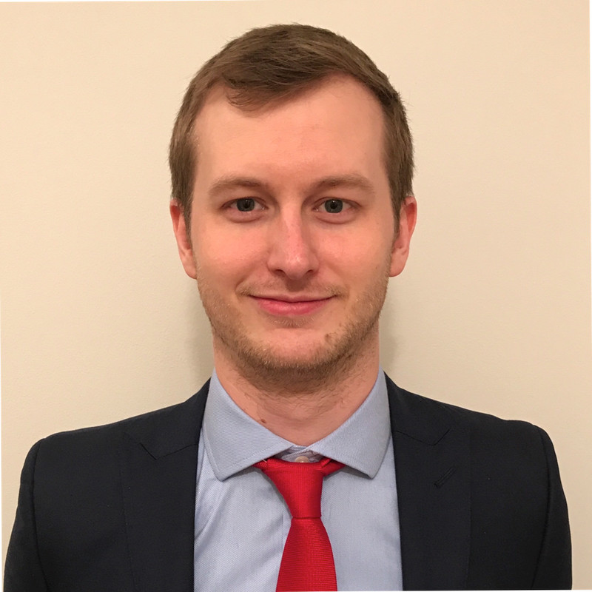
Repetitive Retrading
Richard Gow, ENGIE

Slide 38
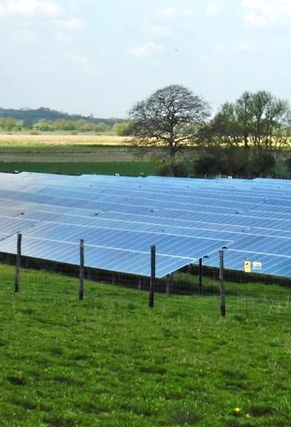
Any other business

Slide 39
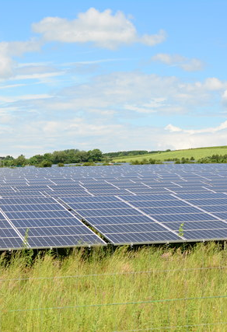
Thank you
Next forum: December 2026
Contact: Stephanie Greenslade sgreenslade@r-e-a.net
Any questions?
www.r-e-a.net

